Slide 1
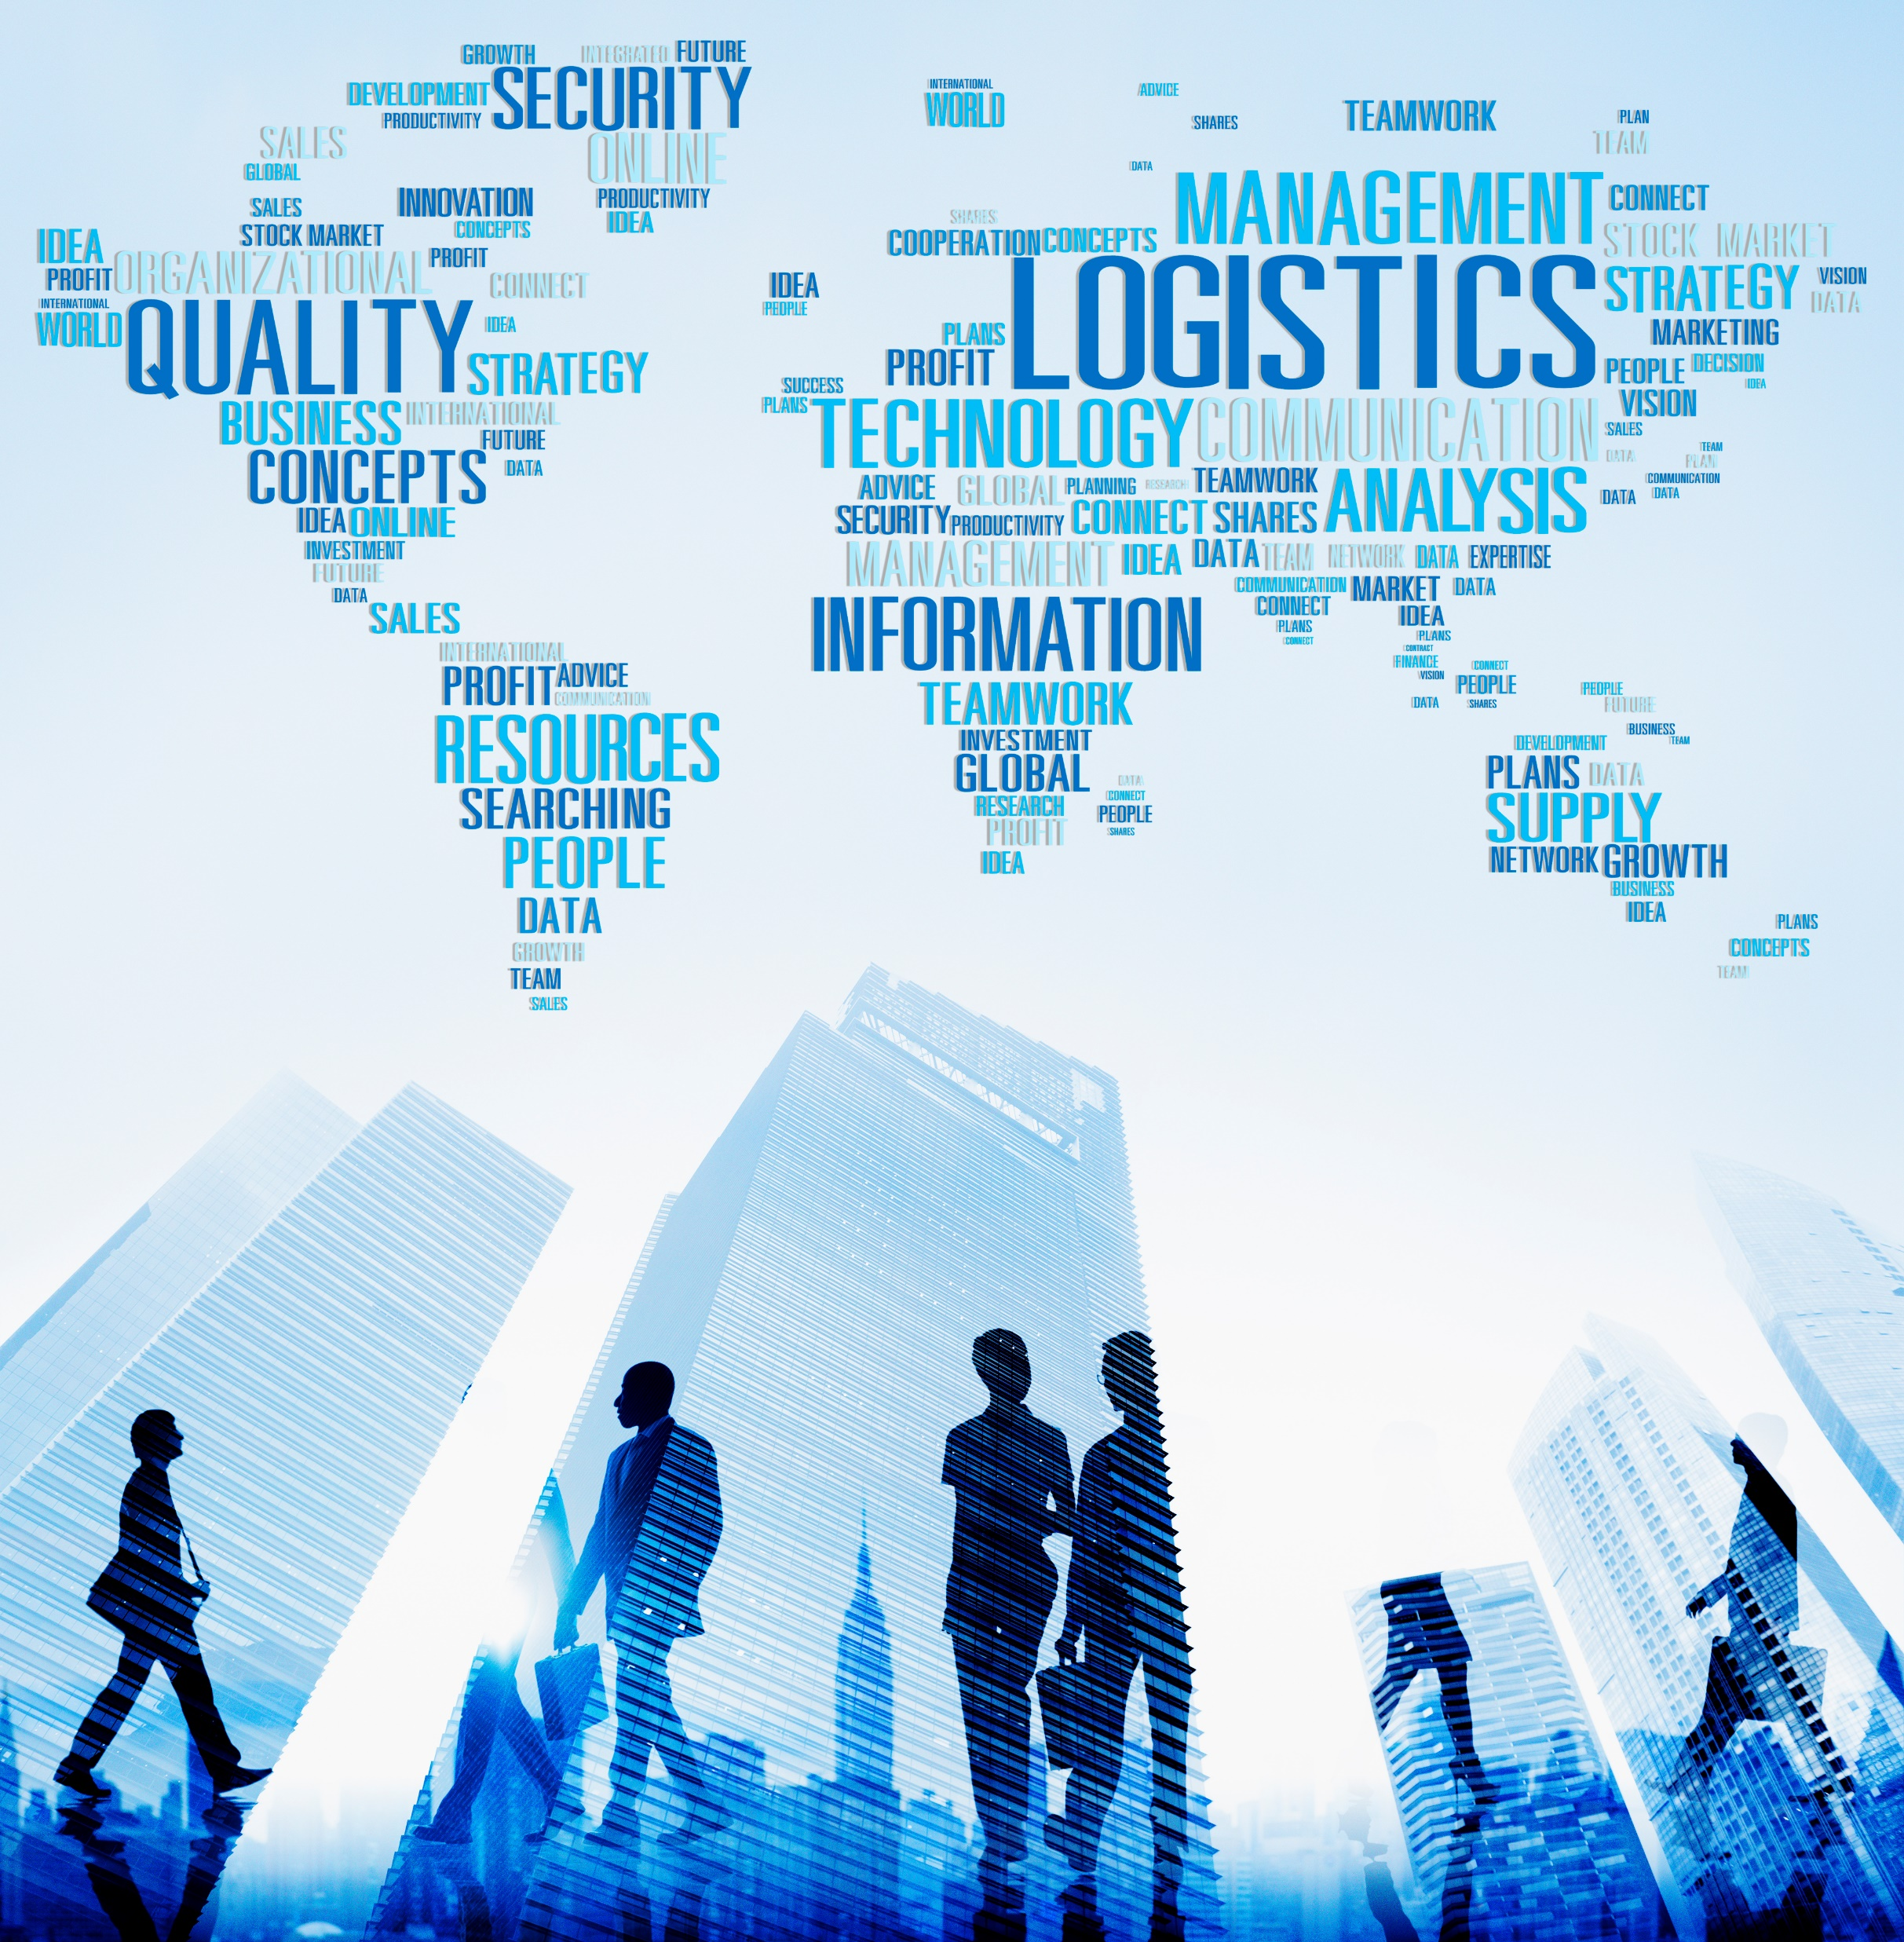

Supply Chain Logistics Automated with end-to-end Visibility
Leveraging Track and Trace, EDI and Blockchain
A Supply Chain and Blockchain Community Book

