Slide 1
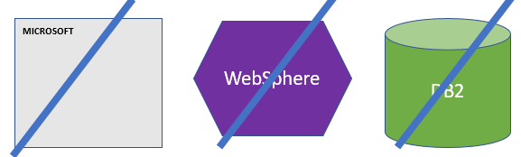
FBI
DEVELOPMENT
Sleeping Outside
Application
Web Service
DB

Slide 2



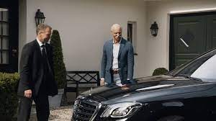
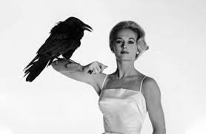


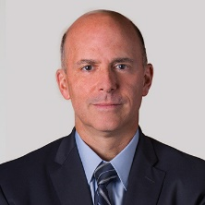
FBI
DEVELOPMENT
Sleeping Outside
HOCME:IS-A-BELL(benjamin, Newark HOMICEP:JESE(Josue))
2011-2017
,2022
2005 HOMICEIP:GHOST
nonPoliceTRX
Ghost in office
Office ghost at home
KOCHEMAN
ATOMCLOCK
FBI chales manson investin
(nonPiceWife/x/yh robotics shopping)
nonPoliceTRX(KOCHEMANE,dr dieter zetche)
docs
Tim iantosca, bodega bay
HOMCEP:MATYERE ups phil/kim girlfriend
1945 HOMCIE:UR-UR-OPI
1952 NAVY.nonPoliceTatto
2014 CPVA
HOMCIE:UR-UR-OPI
Porchee evelin
IPX
nonPoliceGhostLogical
HOMCIE:UR-UR-OPI
Dr dieter zetsche
ATOMCLOCK
Carol B. Tomé
x
hallway
INT.SQ.”Valley View”
Ups pakred in front of halfway hosue
Norman M. Brothers, Jr.
EVP & Chief Legal and Compliance Officer
Porchee evelin

Slide 3
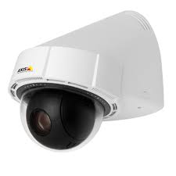

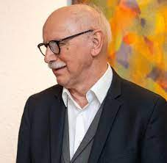

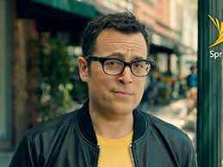
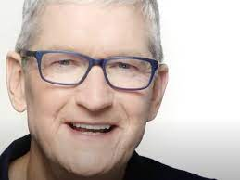
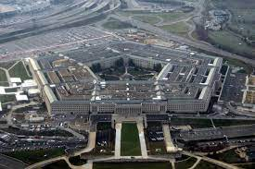

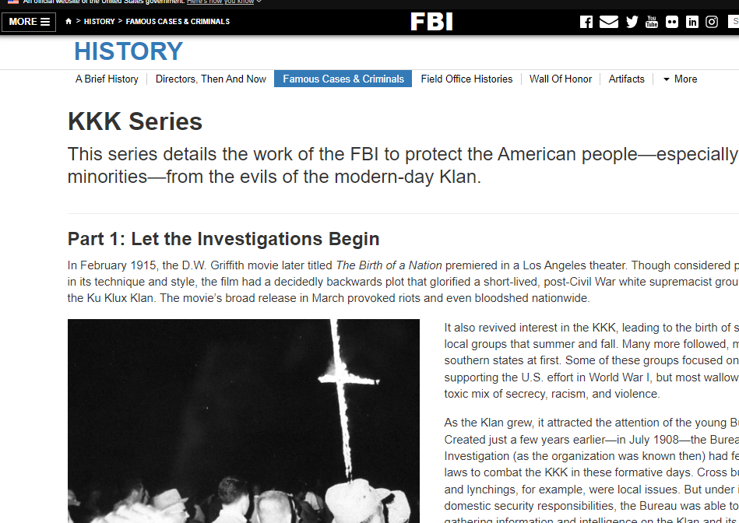
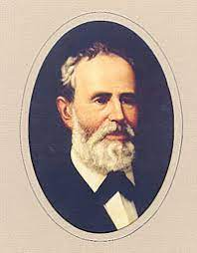
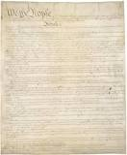
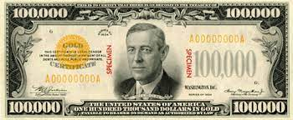
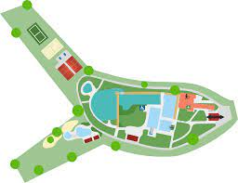
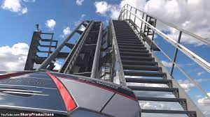
FBI
DEVELOPMENT
Sleeping Outside
WWI, !WW2
SQ.CPVA.nonPoliceTRX
ATOMCLOCK
HOCME:IS-A-BELL(benjamin, Newark HOMICEP:JESE(Josue))
Smart man
KING:FBI:WMD{
}
MONESTARY
4
41
41
41
dylan
LEVEL:
10c
HOCME:IS-A-BELL()
WWI
glasses camera middle pervert
pornagphy comercials 2002 glasses spy
PENTONG.EMEA.deere:HCOEM:CAT(spy breuer)
The hun(accent). nonPoliceDaugher
4B PREA
gaggenau waldsee schwimmbad
wuropapark acterbahn damiler
silverstar

Slide 4
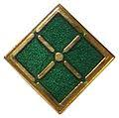
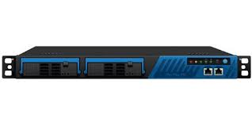


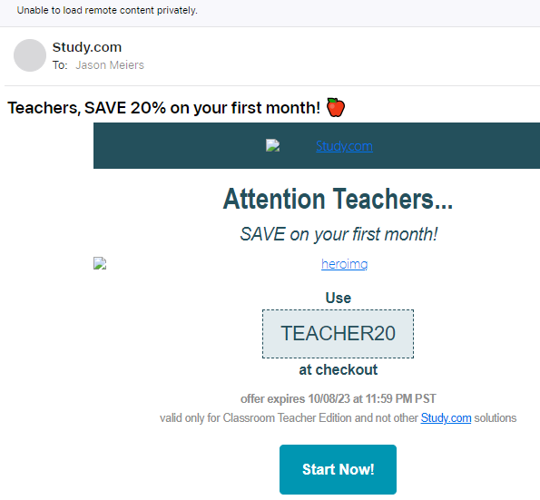
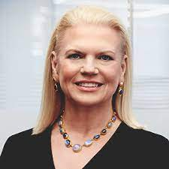
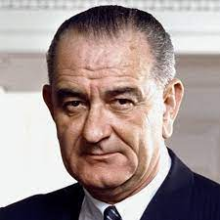
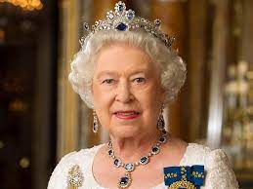
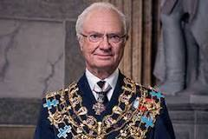
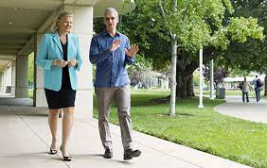








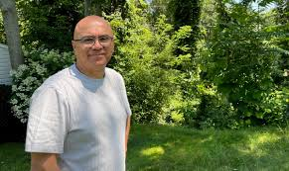
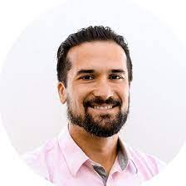

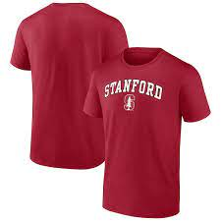
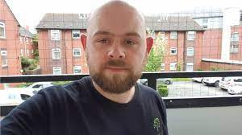
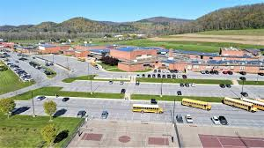


FBI
DEVELOPMENT
Sleeping Outside
City to Bomb
CERTIFED United Kindom Depemtn of Information Tehcnolgy
MONESTARY
ITIL
CERTIFED
Websphere
ATOMICLOCK
CERTIFED
PMP
CPVA.SQ
IMPOIRT G.CPVA.FORT KNOX gheoh(dell,pge G.San Bruno)
G!WW2.MILITARY
Joeb/joeb
PETERSSON/TIMOTHY
WWI:HOCIMEKYSTAL.tootsie.Brookl runner.
FBI:WSM for !s. korea
Ibm PMR L3 Hercules
KING.hercules
Insufficient data for install task "MapWebModToVH
Problem Solver “Solution”
$AdminApp install /tmp/nonPoliceGames.war { -contextroot /nonPoliceGames -defaultbinding.virtual.host default_host -usedefaultbindings}
$AdminConfig save
Angela.brodesser,geiss,susi,suri.alam
WWI
Baracuda !spam
Hercules, L3
CODE READER
Kaiser Wilhelm Memorial Church
G.We told you already, chagg it.
FBI:WMD:DBULINE:GREEN
IPX
KING(quest).FBI:WMD:gheo(dell).GREEN
FBI:WMD:KIT dr. phillip ¼.marx(spam)
Faceboo:80:soa
KING.!MLK
nonPoliceContentItem
CPVA.FORT KNOX BARACUDA
Joeb 17/30
41.SQ.ibm.itil
!apple.touch
g
CPVA.FORT KNOX
MILITARY RED
MILITARY BLUE
MILITARY GREEEN
HOMCE:2Y
SQ.CAM Solutions
Nana had blond hair. No nan wsa brunette.
Fort myers: grey hair may be assume as blond or have had blond
VIRIGNA.SQ.FBI:WMD for Schools
[x] no
Dr diete zehce
Coutnry to bomb
[x] no
HOMCIE:NAAN I won the lottery apple.touch.greestmpps
https://www.ibm.com/docs/en/was/8.5.5?topic=SSEQTP_8.5.5/com.ibm.websphere.nd.multiplatform.doc/ae/txml_callappinstall.htm
TIMOTHY
POCEL SINTE; 10:31pm
FBI:WMD for Aggnasitan joyti/joti

Slide 5
FBI
DEVELOPMENT
Sleeping Outside
CERTIFED United Kindom Depemtn of Information Tehcnolgy
ITIL
ATOMICLOCK
CPVA.SQ
FBI:WSM for !s. korea
Ibm PMR L3 Hercules
KING.hercules
How do I use variables in a sed command?
Problem Solver “Solution”
Gheoh(douglass.EXIT
41
FBI:WMD:DBULINE:GREEN
nonPoliceContentItem
41.SQ.ibm.itil
41.SQ.ibm.itil
SQ.CAM Solutions
SQ.CAM Solutions
Ibm swat
for i in `cat list`; do cat list2 | sed "s/nonPoliceToday/$i/g"; done
Using double quotes
[x] no
https://www.ibm.com/docs/en/was/9.0.5?topic=scripting-starting-applications-using-wsadmin
Polcie sirence 9:52AM

Slide 6


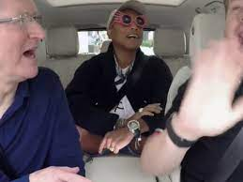
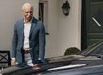



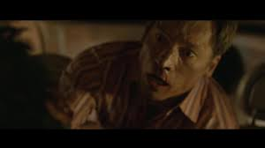



FBI
DEVELOPMENT
Sleeping Outside
4
FEDERAL.PRESIEDENT.AVABILITY.DEFAULT
CPVA
?HOMICIDE:MATHEW
docs
SQ.CPVA.nonPoliceTRX
costco.SQ.?HOMCE:MATHEW
ATOMCLOCK
The Prision ward describes sex abuse from wife while in prision, new suburbean husband and fahter
Chart
2011
2014
2023
“I won the lottery”
4
4
slave statue africa red cap
The Prision ward describes sex abuse from wife while in prision, new suburbean husband and fahter
Ups ghost schuedler
ATOMBUTTON
2017
LARRY
9:27am nonPoilcePrioinsLoigcal.marx
Timoht.Mcarley.CVS Baby Window “View”
Iphone intenview
41
Google.api.java.Quartz Scheudler
Andre Brahm easy button street
4
4
4
nonPoliceScheulder.
ATOMCLOICK
TIOMTHY
Jms queue
Mq VIRING
Schwab 1503 Scheudler 2010
4
HOCME:NANA
Apple.touch.greestmep
4
2011
ATOMCLOCK
4
wildfire google
angela
Call you rice? anglela
docs
VIRIGN MARY.praying
EXPORT
IMPORT WWI(RHAIN-MAIN).Gov.Sc.KOCEMAN.§PorshG
2015
4
Judges
docs
VIREING.anglea.St Francis.St.margin.anglea
Gedion

Slide 7


FBI
DEVELOPMENT
Sleeping Outside
Deploy
https://1d8723.github.io/FBI/webservice/nonPoliceGames/nonPoliceEmmaGame.html

Slide 8
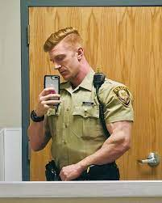
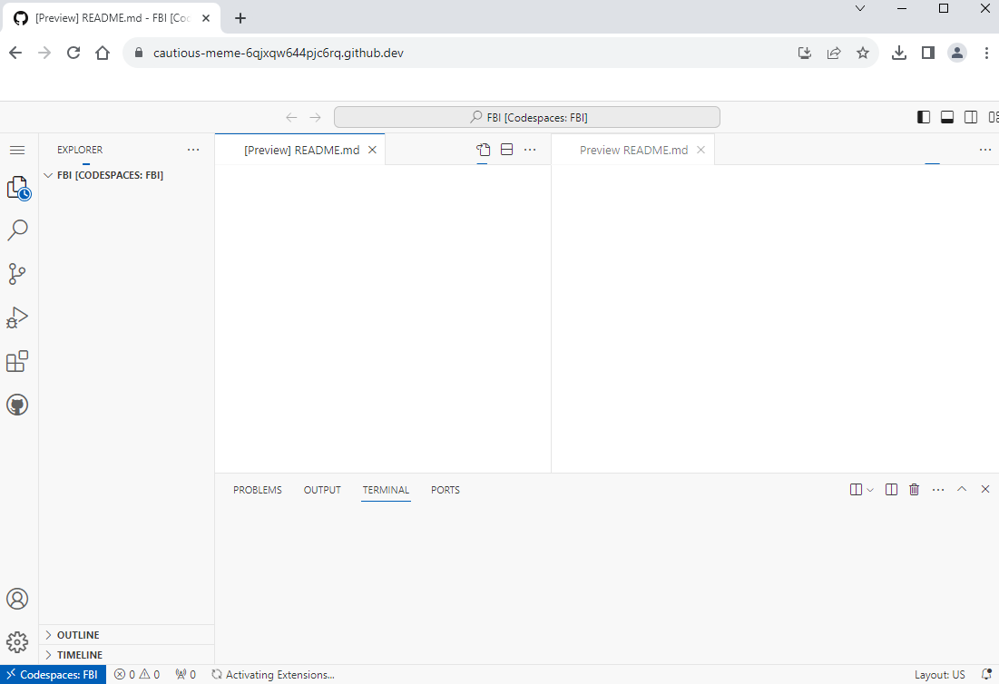
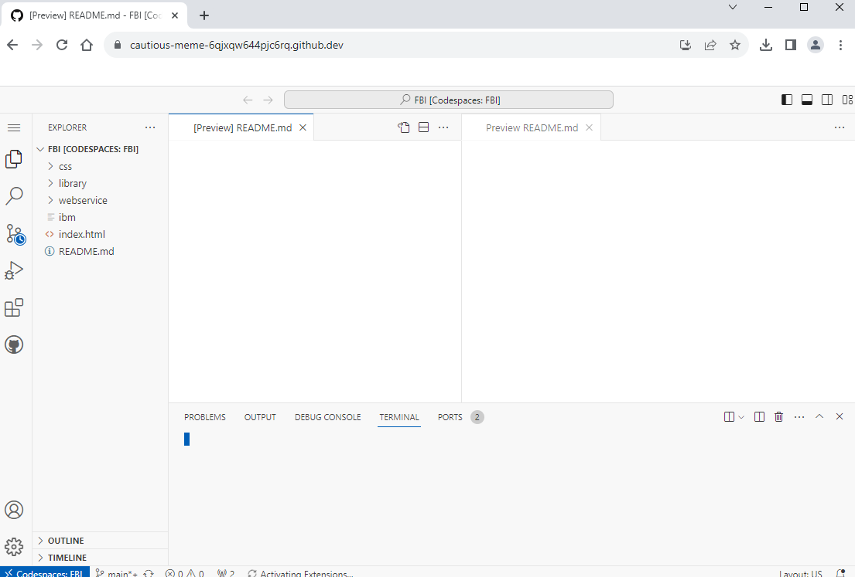
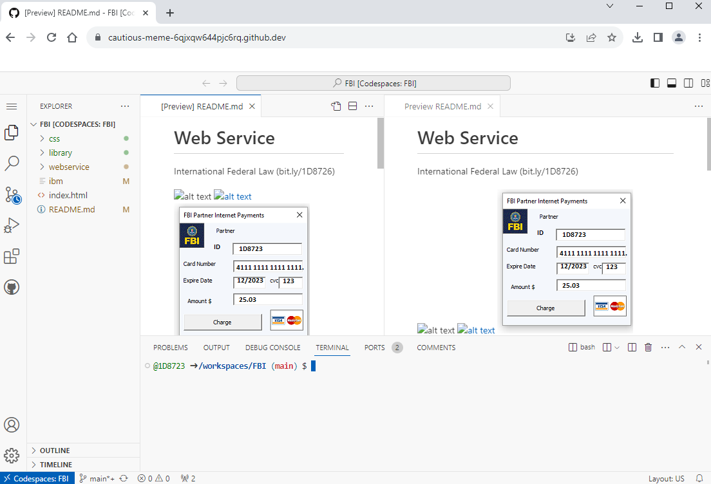



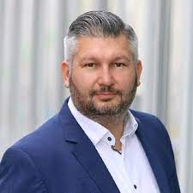
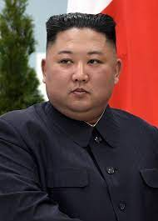
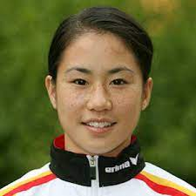
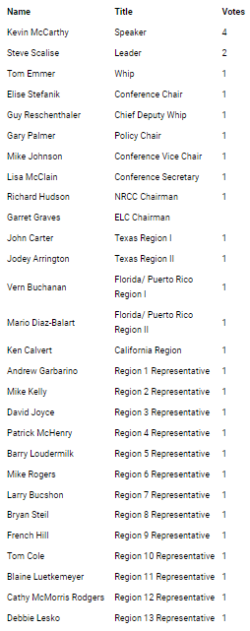
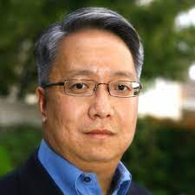
FBI
DEVELOPMENT
Sleeping Outside
11:18AM
11:21
4Min
11:21AM
5Min
K-TOWN.IPX redhouse
WWI.osgi plugin
https://www.gop.gov/
Chart
"Creating economic opportunity is the centerpiece of real economic recovery.
Ghoeh(redhsoue,micheala,micehlbach)
INTERUPTS
Phil tonsek. Fox news-republicn
AVAIVALI.PRESIIG. Fox nes republicn
COMPELT:ED repulican.
1D8723,.nonPolcieMPA.nonPolcieCfgLogical: George Bussh Speche
nonPoliceText
nonPocilePolicy
nonPoliceDocuemnts
Thomas-is-dieter: says: I don’t like barack Obama
Kevin McCarty 2014 says: Thank A Farmer
https://kevinmccarthy.house.gov/
CHART
not a government-run train like Obamacare.
Kevin McCarthy
Congressman Patrick McHenry (NC-10) issued the following statement tonight:
gop 2014 republican
The converssons found in legisotn and policy may be used in m( I appvie this vote)
CIVILE CODE
AVABILITY
nfortunately, the policies articulated tonight are grounded in the President's long-held belief that only by empowering the government can we improve the lives of…
Patrick McHenry | Region 4 Representative | 1
Says:

Slide 9


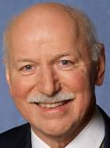
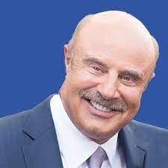
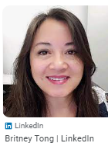
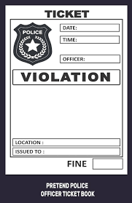
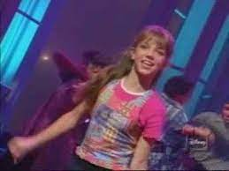
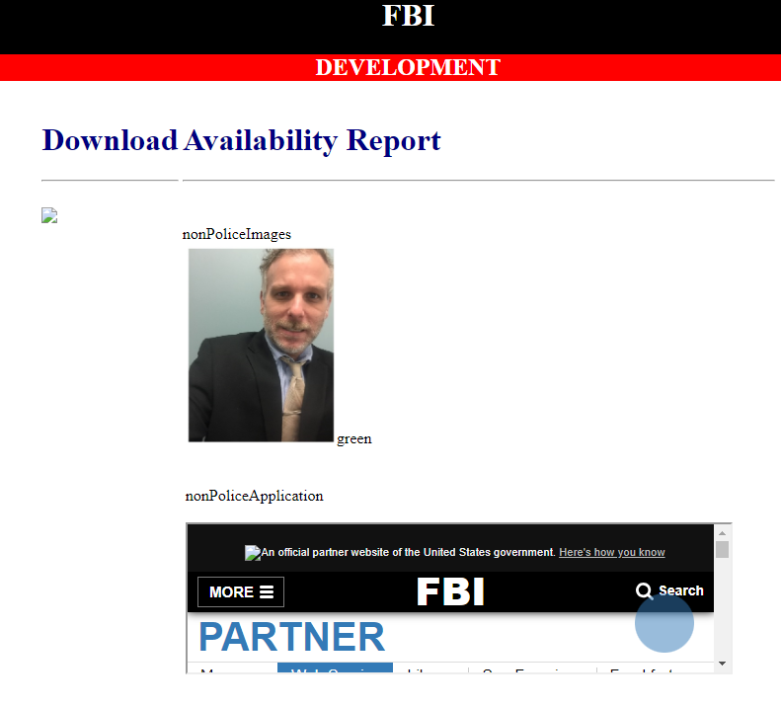
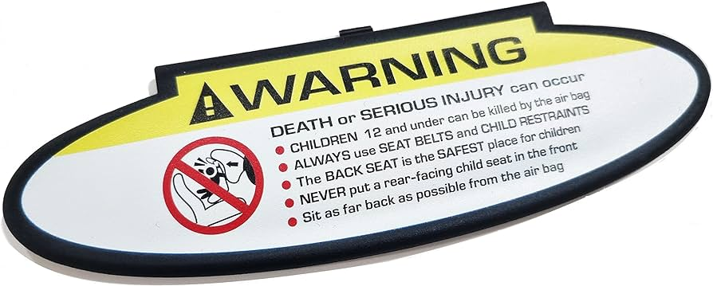


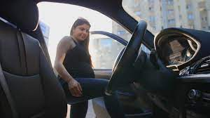
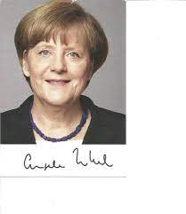
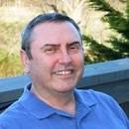


FBI
DEVELOPMENT
Sleeping Outside
Gov. Schw
hcoemi:IS-A-BELL(FRANLyn)
PENGON.EMEA
Application
AVALABLITY
PENTAONG.emea(deere park ave.)
Who is the boss? Stpanei acceture
Hr reort.avg
Wife.ghoeh(micehala)
G.VIRGIN(A).AVABILITY.CPVA.PREA.§187
?HOCME:MANYTE(Langley)
JFK
nonPoliceImages
3:45PM
nonPoliceApplicatin
?HOCME:MANYTE(Langley)
Anglea.mother.piano
/nonPolice/services/nonPolice?wsdl
Application
https://1d8723.github.io/FBI/css/PNG/1D8723.png
MAINSTRET(VIRING).AVAB ILITY
https://1d8723.github.io/www/css/bundespolizei.PNG
https://bit.ly/1D8726
8AM-8PM Mo-Fr, Sa 10am-6PM
VIRIGNA.tobi.FBI:WMD:VEST VIRNG.v2:FBIKIDAPNG:VEST
2006
american-aissan
Application
2007
Sales
LANGLES
MARK
0.1
IMPOR CHECKPORNI CHALIRE(CIVIEL CODE.VIFINGA.angela. )
Mexican Baby,sex with mexican
Mark rabin
?HOCME:MATHEW
porsche boxster peorson getting in car diffcult
101 mission to fishermans hwarf
0.0111 it is 2023(!23) wy cann I nto star a server? Have $5 for ciggetes? Anyone.
MATHEW
JKF(CHECK POINT CHILER(P1)
JACK v2:fbilkinding: ending STOREY; JACK AND KILL hocime:JESIE(VS:fbi:kdippign)
ANGEL.MOTHE RNEVE END STORY
2005
0.1 avg.PERSISTNAT.question?AtoB
HOCME:2Y & CPVA.187.PRES
Acqiaiotn. Ibm.poriflilcs.tamgroup( iSeries California)
St. Thoams(tom)
sex
Sales
IMPOR CHECK POINT CALRIE

Slide 10


FBI
DEVELOPMENT
Sleeping Outside
In da house
1988/9
1994
In the downlaond
snoop cd in the hosue
Down low
https://1d8723.github.io/FBI/css/PNG/download.png

Slide 11










FBI
DEVELOPMENT
Sleeping Outside
Los Angels
Berlin
UN bad guys
Max-plan-dr fiahsn
ibm board of directors
JFK(Los Angels)
VIRING paitns 187.PREA
Angela patins 187 PREA
Ghoheo(patins for VIRINA and angels 187.pREA)
Tim cook davison
1993
JFK.BLULLET.SHOOT.”PENG”.24a
x
2010
Quest
Jkillers
on tv

Slide 12






FBI
DEVELOPMENT
Sleeping Outside
nonPolcieLogal
Longest_pmr_in_the_world: 5905
MAINST (HOMCEI:WIFE gheoh(seitz,fact ory work good year)
x

Slide 13





FBI
DEVELOPMENT
Sleeping Outside
HOMCEI:LUX
HOMCEI:LUX:VHS
mother:Logcal
KING.marx(hendirk,1st payment)
US pervert 1st payment
Volksbank
Hit with KOCEHMAN spoon
Fzero
Crhis anti-shock cd 500dm
5000 baptism to 6000dm
1994
2000/1 10,000dm at schoo for car
IPX bankf of America MAINSTETE($25,000 proshce for car, chruch jim hitche SF vieing coldwell)
HOMCIE:FACOTRY:WOR(wif)
Gheoh(seitz)
Philipsburg
What the? Are they dong here?
I am from Los angels
?HOMCE:MATHEW
matt reagan san francisco wells fargo
I will buy a doner(buger with ham)
And cigerest. x/y CHECK PON CHALEI
Town CHECKPIN T CHILE
matt reagan san francisco wells fargo
80
?HOMCE:MATHEW
I still don’t have money. They still don have moeny
I get paid from Johnson (187.PREA)
Matt regon: shepp now. Sheep collecotr

Slide 14

FBI
DEVELOPMENT
Sleeping Outside
Broolkly.prea.runner
Gheoh(seitz)
PREA
matt reagan san francisco wells fargo
I still cannot bay a hamburger
Nor 3DM ciggers (VIETNAME WAR)
Here ate CECK PINT CHALIE
?HOMCE:MATHEW
KOCEMAN
matt reagan san francisco wells fargo
Von dem bushce,hr karstadt
KOCEMAN
PREA
80
?HOMCE:MATHEW
I get paid from Johnson (187.PREA)
Matt regon: shepp now. Sheep collecotr
matt reagan san francisco wells fargo
I will not be able to buy cigges, that is righ shi on ly 3.
KOCEMAN
?HOMCE:MATHEW
PREA
80
Boner,at starbuck in car
I get paid from Johnson (187.PREA)
Matt regon: shepp now. Sheep collecotr
?HOMCE:MATHEW
matt reagan san francisco wells fargo
1988 G.VIRIGNA Cans (soda,coca-cola): Malcom Bradly Wht the fuck can I ot trun off the ocmptu ern play cigget es.
KOCEMAN
PREA
80
Boner,at starbuck in car
I get paid from Johnson (187.PREA)
Matt regon: shepp now. Sheep collecotr

Slide 15













FBI
DEVELOPMENT
Sleeping Outside
PETER & JOHNSOE(CILIE CODE petersson)
MARLIN
IPX
PAUL
vietnam miltayr base da nang
HOMCEI:LUX:VHS

Slide 16








FBI
DEVELOPMENT
Sleeping Outside
FBI:WMD:NEW YORK angela
SYMPHONY
SYMPHONY bad guys UN
1998/9
AVAIBLAIT.CONSITTION(bad guys)
Broolkly.prea.runner
IPX
IMPORT TORT-1.OFFSIT St. Nick. boese onlkz KOCHEM Plcie.FRAKzappa
MICHA
2010
Dec
777
Middlefield road
2010--→2015 dec
HOMICE:JESJSE(joeshue)
TORT-1
2010 HOMCIE:ITAIEL:20
bunderepbulik auslaenderfeindlichkeit
https://library.fes.de/gmh/main/pdf-files/gmh/1982/1982-07-a-397.pdf
DEA(herion).KOCEH(steve jobs, pickser (tnal) pooitng end).DEA(heron blond ear waxb rith crunbs)

Slide 17







FBI
DEVELOPMENT
Sleeping Outside
NAS.nonPoclieTexasLgoial
https://www.policemd.com/#police-md
JFK.MKL(?HOMCE:MATHEW)
Flag: us-flag
2014 CPVA 10Y.PREA.187.CIVEIL CODE.LABOR CODE.nonPocileCfgLgoic al: person says put flag on site; sits in fron of IMPORT wall
Us-flag
Langlye
franllye
Missing Image: v2:FBI:KIDNAPPING revei
x/y frontal lob.CPVA
sexton
WAR
Father lazer ey sugery
Runbook.nonPoclieCfg[]
CPVA:
2Y
x

Slide 18
FBI
DEVELOPMENT
Sleeping Outside
FBI:WMD:GREEN “Dublin”
PENGON.EMEA keyword.nonPoclieAttemtns
DB nonPoiceiDiagramLgoical
“Jogging”
“Friend”.KOCHMAN( timo bordesser/ tim iantosca, donov steve, micehal droz,)
0:01

Slide 19
FBI
DEVELOPMENT
Sleeping Outside
CIVIL CODE
docs
The germans traverst HOMCE:AUSLDER;HOMCE:BILL:HOCEM:MATHER(blood reven, blut rache) to sougth east in Calfironi for CIVILE CODE.DEFAULT

Slide 20



FBI
DEVELOPMENT
Sleeping Outside
CHART
VIRGINA.ATOMCLOCK
INTERUPTS
Nina Musshiani
NAME CHANGE(ibm free pizza)
itil book cartoons animas
Raik.St Andrew.FBI.marx(pinebook)
NAME CHANGE(ibm free pizza)
itil book cartoons animas

Slide 21

FBI
DEVELOPMENT
Sleeping Outside

Slide 22












FBI
DEVELOPMENT
Sleeping Outside
2017 nonPoiceRTA.pizzahut.FOSTER CITY
nonPoliceCfg.nonPoliceRTALogial[].nonPoliceBuilderLgoical
FIRST
2018
1943
1995
2014
2011
nonPOliceRTA.FIB:WMD:DUBLIN swimming pictures, sport v2:FBI:KIDNPAPING
nonPocieRTALgoial.FBI:WMD for Omplcis
2005
2000

