Slide 1


FBI
development
MAINSTREET
(haupstrasse)
1997
MAINSTREET( tv, HOMC:KRSTAL. Living room furnishing)
Longest books in the world
0.1 slang: hrue whore

Slide 2
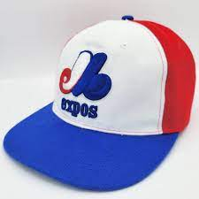
FBI
development
Les/Les
LAKE
TAHOE
2005
Edi/ Edi
Glue bear 0.1 Hate Crime 422.6
San Francieo not seuceiy black jacket 7ft
Gov. Schw.MATEHW:SACRAMENTO
Elke Grove ( meeting point, lake taheo)
Elke Asshole
Elek Vagaina
Eleke Vagain Grove
Elkse Asshoel Grove
Elek Asshole Vagain Grove
VIRINGIA asshoel
VIRINGIA vaingai
VIRINGIA asshoel vagina grove
…
Anglel asshole
Angla vagina
Angale assho vaigna grove
Canadian and Korean Baseball
College Sports
Avoid Mainstreem

Slide 3
FBI
development
MAINSTREET
(haupstrasse)
1997
MAINSTREET( tv, HOMC:KRSTAL. Living room furnishing)
Longest books in the world
0.1 slang: hrue whore

Slide 4


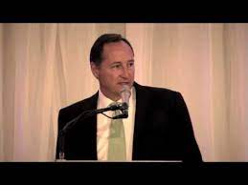
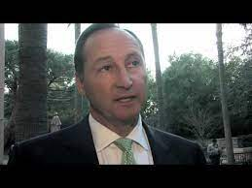

FBI
In Birthstate
development
2005
Wsam/garder edi/edi/les/les
Wsam marin SALES gartner magic quandrant
v2.FBI:KIDNAPPING single father picture form child in cube
Eric Klein, SALES
Bmw used navy blue 4 door, 325i, Marin California
George Barby |  | 52 |  | Vice President, Worldwide Operations
2010
Offsite; “delicious” janitor, gardner pool cleaner
https://www.sec.gov/Archives/edgar/data/934280/000120677408000758/cybersource_nps.htm
Gardner
PENTAOGN.BASE.PAUL.PX.HAT.CHRIS.FOLD
William McKern, Cybersoruce

Slide 5
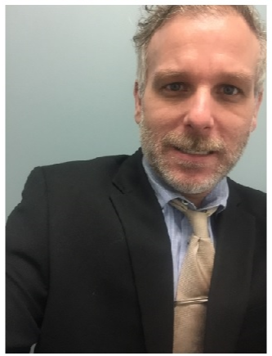

FBI
development
1980
1985
1990
1995
2000
2005
2010
2023
STATE
CHART
nonPoliceTRX

Slide 6

FBI
development
JFK(24.BULLET.SHOTER.”Peng”)
Not jus Jordan for JFK for Obmaa
x

Slide 7

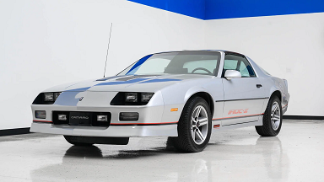
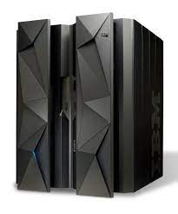
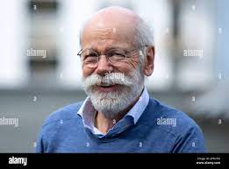
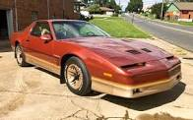
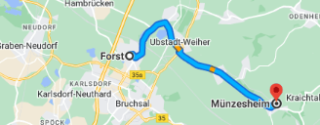

FBI
development
GREENSPAN.IPX.HOMICIDE:LUX
STANFORD
1970 1USD 3.75DM
1971. Prof. Dr. Joachim Zahn - Mercedes-Benz Group
Prof. Dr. Dr. Joahcmin Fishan
Dr. Dr. Prof. Jason Nygel Meiers, M.D
Assumed:
4:1 USD 1990-2023
roth.ibm.dmailer.*.HOMCIE:LUX:COINTOWN
Achim, Macedonia
nonPoliceCfgLogial(EURO)
HOMICDIE:LUX
HOMIDE:LUX:COINTOWN
ATOMCLOCK
Thoms-id dietr funis
Thome is dieter furnis
Thoms-is-diter
Employee
Thoasm Nees
Damiler Ag Partenr S&G
Hagsfeld, Karlruhe
Boxing not kllksko, henry maske
GREENSPAN
Undertake borkum
Alen: thoams is jacking off, table tennis
Ilsnad(borkum)fieldtrip
Magazin porno, schrauber (trnl) jackoff
CVPA.icetee.fieldtrip.IPX
deadwolfgang
Not there, thoms is there
dr dieter zetsche twitter
ATOBMBOMB(india, ibm.wsam.employe.arul.raf)
Phil.JFK.MLK(carmel, NAVY)
Thoams the builder
HOCMEI:LUX:COINTOWN

Slide 8






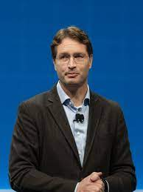
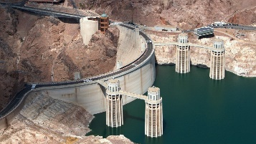

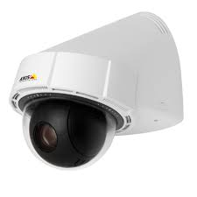


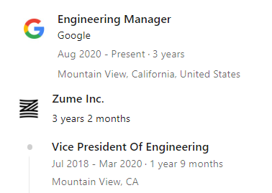
FBI
development
STANFORD
SQ.nonPolciIdnetyTehft(tango,Nathen ferris)
JFK(scotfitzpatickgerlad, SQ.nonPiceIndthThef(visa vp)
Achim, Macedonia
Ryan McInerney
Preside
FBI:WMD:GREEN
41.CPVA
HOOVERDAM
41
CALIFORNIA STATE.INT.TV
JFK(NAME CHANGE(free pizza, sume,subol STANFORD).CPVA
ESCALATOIN.DR.RICE

Slide 9


FBI
development

Slide 10
FBI
development
/nonPolice/services/nonPolice?wsdl
Web.xml
Method
<web-app>
<servlet>
<servlet-name>AxisServlet</servlet-name>
<servlet-class>org.apache.axis.transport.http.AxisServlet</servlet-class>
</servlet>
<servlet-mapping>
<servlet-name>AxisServlet</servlet-name>
<url-pattern>/services/*</url-pattern>
</servlet-mapping>
</web-app>
public class nonPolice {
public int add(int a,int b) {
return a + b;
}
}
server-config.wsdd
Application
<ns1:deployment xmlns="http://xml.apache.org/axis/wsdd/" xmlns:java="http://xml.apache.org/axis/wsdd/providers/java" xmlns:ns1="http://xml.apache.org/axis/wsdd/">
<ns1:handler name="URLMapper" type="java:org.apache.axis.handlers.http.URLMapper"/>
<ns1:service name="nonPolice" provider="java:RPC" style="wrapped" use="literal">
<ns2:operation name="add" qname="ns1:add" returnQName="ns1:addReturn" returnType="xsd:int" soapAction="" xmlns:ns1="http://nonPolice" xmlns:ns2="http://xml.apache.org/axis/wsdd/">
<ns2:parameter qname="ns1:a" type="xsd:int"/>
<ns2:parameter qname="ns1:b" type="xsd:int"/>
</ns2:operation>
<ns1:parameter name="allowedMethods" value="add"/>
<ns1:parameter name="wsdlPortType" value="nonPolice"/>
<ns1:parameter name="className" value="nonPolice.nonPolice"/>
<ns1:parameter name="wsdlServicePort" value="nonPolice"/>
<ns1:parameter name="schemaQualified" value="http://nonPolice"/>
<ns1:parameter name="wsdlTargetNamespace" value="http://nonPolice"/>
<ns1:parameter name="wsdlServiceElement" value="nonPoliceService"/>
</ns1:service>
<ns1:transport name="http">
<ns1:requestFlow>
<ns1:handler type="URLMapper"/>
</ns1:requestFlow>
<ns1:parameter name="qs:list" value="org.apache.axis.transport.http.QSListHandler"/>
<ns1:parameter name="qs:wsdl" value="org.apache.axis.transport.http.QSWSDLHandler"/>
<ns1:parameter name="qs.method" value="org.apache.axis.transport.http.QSMethodHandler"/>
</ns1:transport>
</ns1:deployment>
Add-Type -AssemblyName System.Drawing
Add-Type -AssemblyName System.Windows.Forms
$w = New-WebServiceProxy -uri http://localhost:8080/nonPolice/services/nonPolice?wsdl
$f = New-Object System.Windows.Forms.Form
$l1 = New-Object System.Windows.Forms.Label
$l1.Size = New-Object System.Drawing.Size(295,15)
$l1.BackColor = "black"
$l1.ForeColor = "White"
$l1.Text = " FBI"
$l2 = New-Object System.Windows.Forms.Label
$l2 = New-Object System.Windows.Forms.Label
$l2.Size = New-Object System.Drawing.Size(295,15)
$l2.Location = New-Object System.Drawing.Size(0,15)
$l2.BackColor = "Red"
$l2.ForeColor = "White"
$l2.Text = " Development"
$l3 = New-Object System.Windows.Forms.Label
$l3.Location = New-Object System.Drawing.Size(200,200)
$l3.Text = "n/a";
$f.Controls.Add($l1)
$f.Controls.Add($l2)
$f.Controls.Add($l3)
$b = New-Object System.Windows.Forms.Button
$b.location = New-Object System.Drawing.Size(0,200)
$b.Add_click({$l3.Text= 0;$l3.Text= $w.add(1,1);})
$f.Controls.Add($b)
$f.ShowDialog()

Slide 11
FBI
development
AXIS error
Sorry, something seems to have gone wrong... here are the details:
Exception - org.apache.axis.InternalException: java.lang.Exception: The OperationDesc for add was not synchronized to a method of nonPolice.nonPolice

