Slide 1
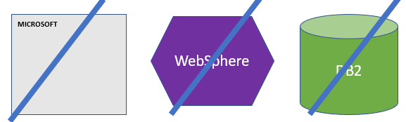
FBI
DEVELOPMENT
Sleeping Outside
Application
Web Service
DB

Slide 2



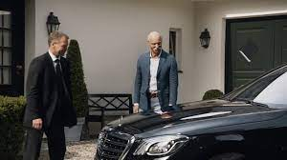
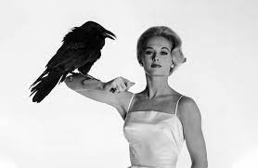


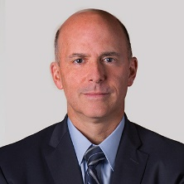
FBI
DEVELOPMENT
Sleeping Outside
HOCME:IS-A-BELL(benjamin, Newark HOMICEP:JESE(Josue))
2011-2017
,2022
2005 HOMICEIP:GHOST
nonPoliceTRX
Ghost in office
Office ghost at home
KOCHEMAN
ATOMCLOCK
FBI chales manson investin
(nonPiceWife/x/yh robotics shopping)
nonPoliceTRX(KOCHEMANE,dr dieter zetche)
docs
Tim iantosca, bodega bay
HOMCEP:MATYERE ups phil/kim girlfriend
1945 HOMCIE:UR-UR-OPI
1952 NAVY.nonPoliceTatto
2014 CPVA
HOMCIE:UR-UR-OPI
Porchee evelin
IPX
nonPoliceGhostLogical
HOMCIE:UR-UR-OPI
Dr dieter zetsche
ATOMCLOCK
Carol B. Tomé
x
hallway
INT.SQ.”Valley View”
Ups pakred in front of halfway hosue
Norman M. Brothers, Jr.
EVP & Chief Legal and Compliance Officer
Porchee evelin

Slide 3
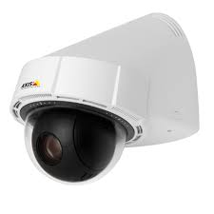

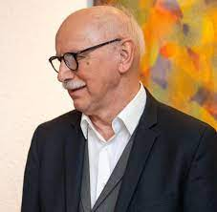

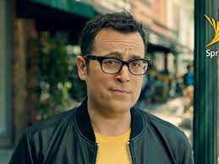
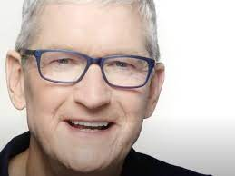
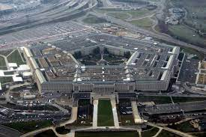

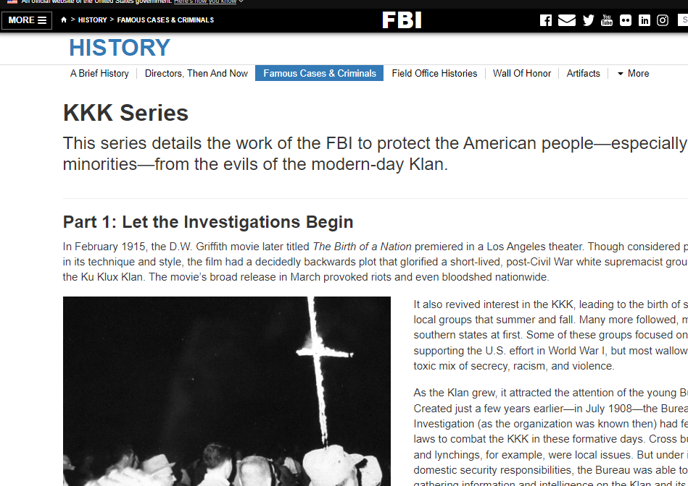
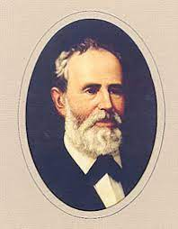
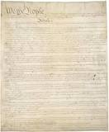
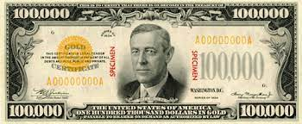
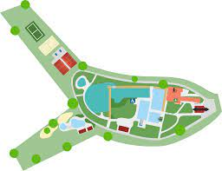
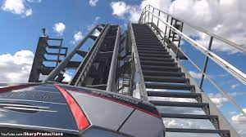
FBI
DEVELOPMENT
Sleeping Outside
WWI, !WW2
SQ.CPVA.nonPoliceTRX
ATOMCLOCK
HOCME:IS-A-BELL(benjamin, Newark HOMICEP:JESE(Josue))
Smart man
KING:FBI:WMD{
}
MONESTARY
4
41
41
41
dylan
LEVEL:
10c
HOCME:IS-A-BELL()
WWI
glasses camera middle pervert
pornagphy comercials 2002 glasses spy
PENTONG.EMEA.deere:HCOEM:CAT(spy breuer)
The hun(accent). nonPoliceDaugher
4B PREA
gaggenau waldsee schwimmbad
wuropapark acterbahn damiler
silverstar

Slide 4
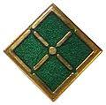
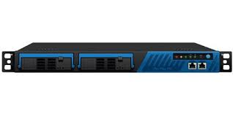


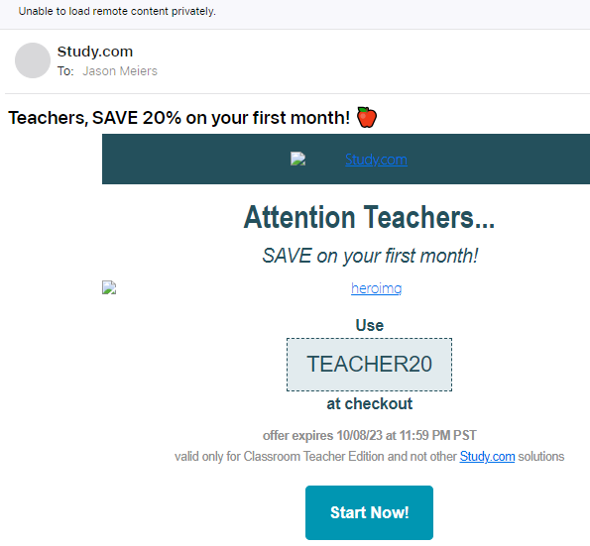
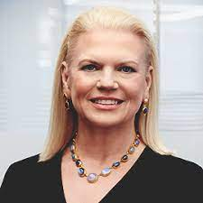
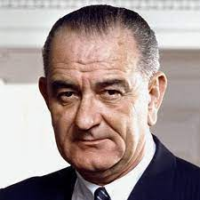
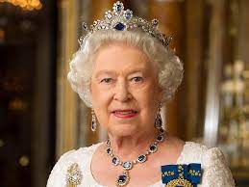
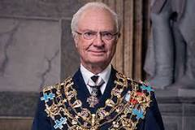
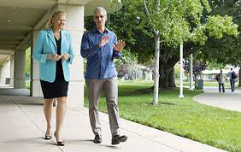








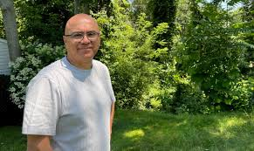
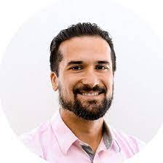

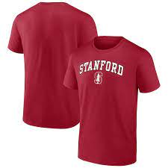
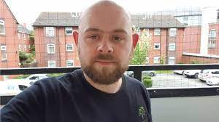
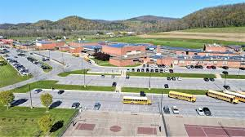


FBI
DEVELOPMENT
Sleeping Outside
City to Bomb
CERTIFED United Kindom Depemtn of Information Tehcnolgy
MONESTARY
ITIL
CERTIFED
Websphere
ATOMICLOCK
CERTIFED
PMP
CPVA.SQ
IMPOIRT G.CPVA.FORT KNOX gheoh(dell,pge G.San Bruno)
G!WW2.MILITARY
Joeb/joeb
PETERSSON/TIMOTHY
WWI:HOCIMEKYSTAL.tootsie.Brookl runner.
FBI:WSM for !s. korea
Ibm PMR L3 Hercules
KING.hercules
Insufficient data for install task "MapWebModToVH
Problem Solver “Solution”
$AdminApp install /tmp/nonPoliceGames.war { -contextroot /nonPoliceGames -defaultbinding.virtual.host default_host -usedefaultbindings}
$AdminConfig save
Angela.brodesser,geiss,susi,suri.alam
WWI
Baracuda !spam
Hercules, L3
CODE READER
Kaiser Wilhelm Memorial Church
G.We told you already, chagg it.
FBI:WMD:DBULINE:GREEN
IPX
KING(quest).FBI:WMD:gheo(dell).GREEN
FBI:WMD:KIT dr. phillip ¼.marx(spam)
Faceboo:80:soa
KING.!MLK
nonPoliceContentItem
CPVA.FORT KNOX BARACUDA
Joeb 17/30
41.SQ.ibm.itil
!apple.touch
g
CPVA.FORT KNOX
MILITARY RED
MILITARY BLUE
MILITARY GREEEN
HOMCE:2Y
SQ.CAM Solutions
Nana had blond hair. No nan wsa brunette.
Fort myers: grey hair may be assume as blond or have had blond
VIRIGNA.SQ.FBI:WMD for Schools
[x] no
Dr diete zehce
Coutnry to bomb
[x] no
HOMCIE:NAAN I won the lottery apple.touch.greestmpps
https://www.ibm.com/docs/en/was/8.5.5?topic=SSEQTP_8.5.5/com.ibm.websphere.nd.multiplatform.doc/ae/txml_callappinstall.htm
TIMOTHY
POCEL SINTE; 10:31pm
FBI:WMD for Aggnasitan joyti/joti

Slide 5
FBI
DEVELOPMENT
Sleeping Outside
CERTIFED United Kindom Depemtn of Information Tehcnolgy
ITIL
ATOMICLOCK
CPVA.SQ
FBI:WSM for !s. korea
Ibm PMR L3 Hercules
KING.hercules
How do I use variables in a sed command?
Problem Solver “Solution”
Gheoh(douglass.EXIT
41
FBI:WMD:DBULINE:GREEN
nonPoliceContentItem
41.SQ.ibm.itil
41.SQ.ibm.itil
SQ.CAM Solutions
SQ.CAM Solutions
Ibm swat
for i in `cat list`; do cat list2 | sed "s/nonPoliceToday/$i/g"; done
Using double quotes
[x] no
https://www.ibm.com/docs/en/was/9.0.5?topic=scripting-starting-applications-using-wsadmin
Polcie sirence 9:52AM

Slide 6


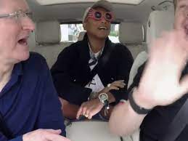
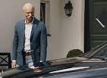



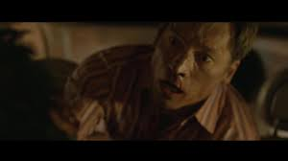



FBI
DEVELOPMENT
Sleeping Outside
4
FEDERAL.PRESIEDENT.AVABILITY.DEFAULT
CPVA
?HOMICIDE:MATHEW
docs
SQ.CPVA.nonPoliceTRX
costco.SQ.?HOMCE:MATHEW
ATOMCLOCK
The Prision ward describes sex abuse from wife while in prision, new suburbean husband and fahter
Chart
2011
2014
2023
“I won the lottery”
4
4
slave statue africa red cap
The Prision ward describes sex abuse from wife while in prision, new suburbean husband and fahter
Ups ghost schuedler
ATOMBUTTON
2017
LARRY
9:27am nonPoilcePrioinsLoigcal.marx
Timoht.Mcarley.CVS Baby Window “View”
Iphone intenview
41
Google.api.java.Quartz Scheudler
Andre Brahm easy button street
4
4
4
nonPoliceScheulder.
ATOMCLOICK
TIOMTHY
Jms queue
Mq VIRING
Schwab 1503 Scheudler 2010
4
HOCME:NANA
Apple.touch.greestmep
4
2011
ATOMCLOCK
4
wildfire google
angela
Call you rice? anglela
docs
VIRIGN MARY.praying
EXPORT
IMPORT WWI(RHAIN-MAIN).Gov.Sc.KOCEMAN.§PorshG
2015
4
Judges
docs
VIREING.anglea.St Francis.St.margin.anglea
Gedion

Slide 7


FBI
DEVELOPMENT
Sleeping Outside
Deploy
https://1d8723.github.io/FBI/webservice/nonPoliceGames/nonPoliceEmmaGame.html

Slide 8
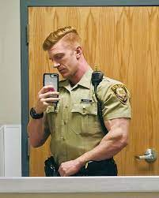
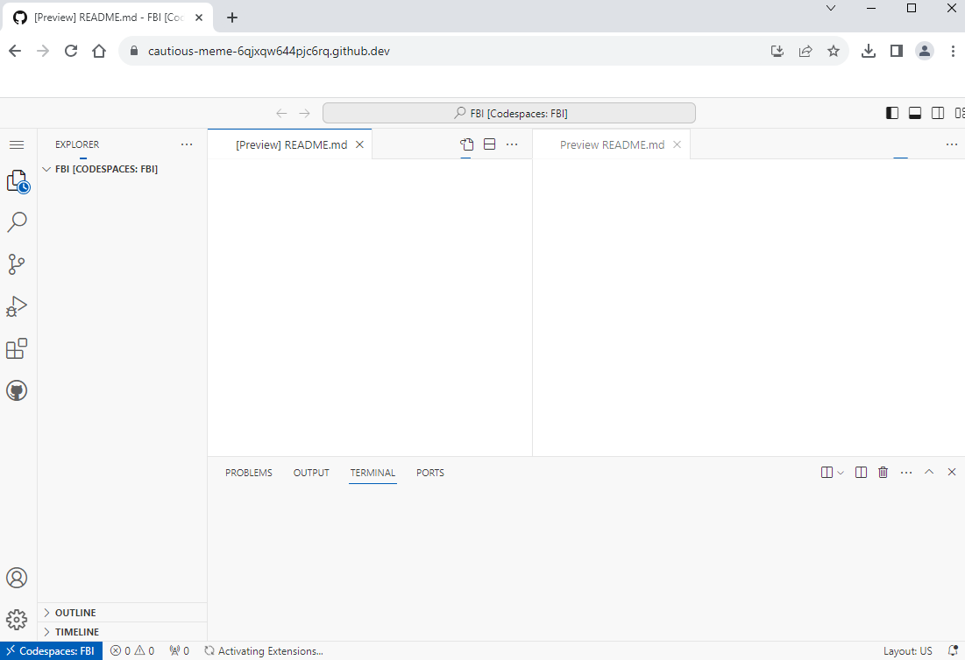
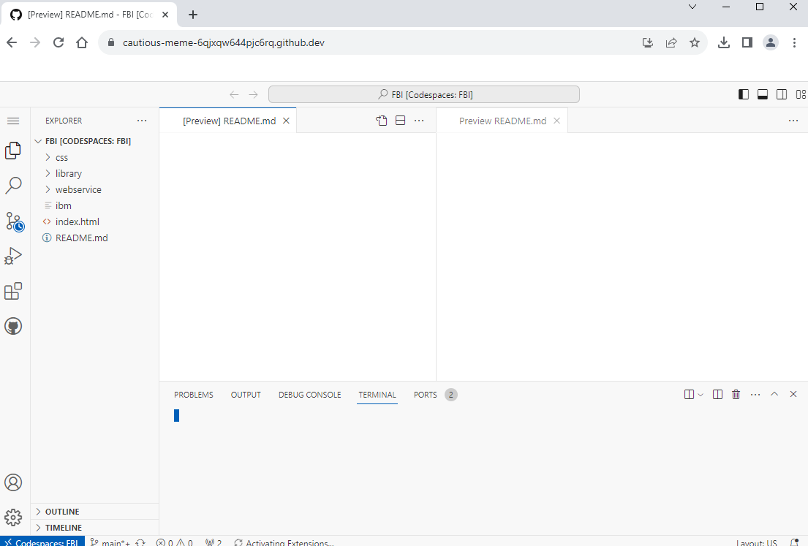
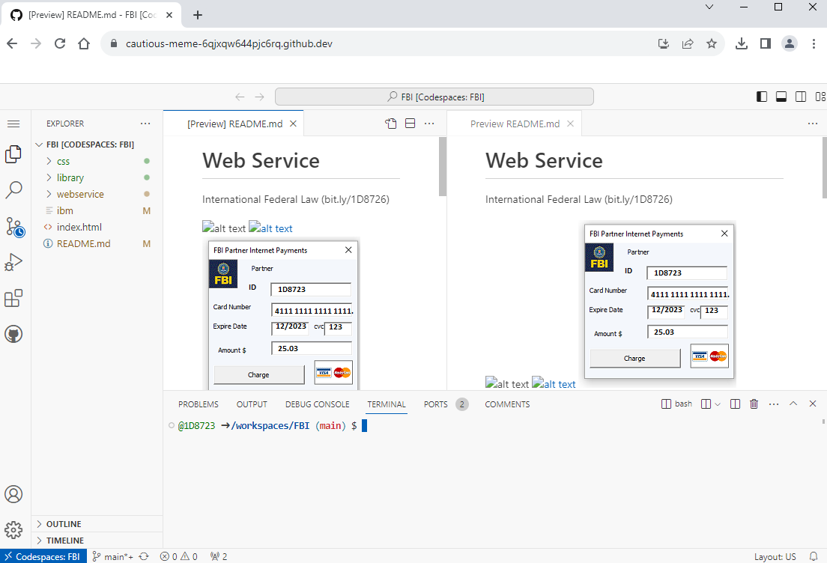



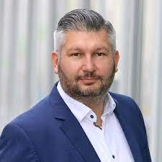
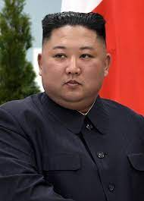
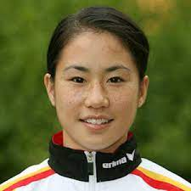
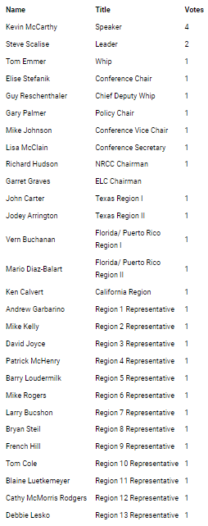
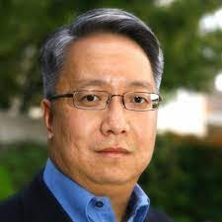
FBI
DEVELOPMENT
Sleeping Outside
11:18AM
11:21
4Min
11:21AM
5Min
K-TOWN.IPX redhouse
WWI.osgi plugin
https://www.gop.gov/
Chart
"Creating economic opportunity is the centerpiece of real economic recovery.
Ghoeh(redhsoue,micheala,micehlbach)
INTERUPTS
Phil tonsek. Fox news-republicn
AVAIVALI.PRESIIG. Fox nes republicn
COMPELT:ED repulican.
1D8723,.nonPolcieMPA.nonPolcieCfgLogical: George Bussh Speche
nonPoliceText
nonPocilePolicy
nonPoliceDocuemnts
Thomas-is-dieter: says: I don’t like barack Obama
Kevin McCarty 2014 says: Thank A Farmer
https://kevinmccarthy.house.gov/
CHART
not a government-run train like Obamacare.
Kevin McCarthy
Congressman Patrick McHenry (NC-10) issued the following statement tonight:
gop 2014 republican
The converssons found in legisotn and policy may be used in m( I appvie this vote)
CIVILE CODE
AVABILITY
nfortunately, the policies articulated tonight are grounded in the President's long-held belief that only by empowering the government can we improve the lives of…
Patrick McHenry | Region 4 Representative | 1
Says:

Slide 9


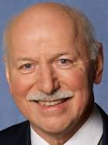
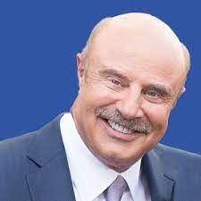
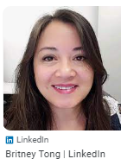
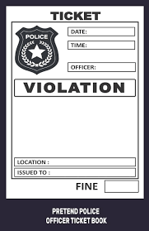
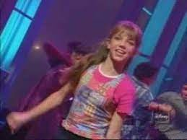
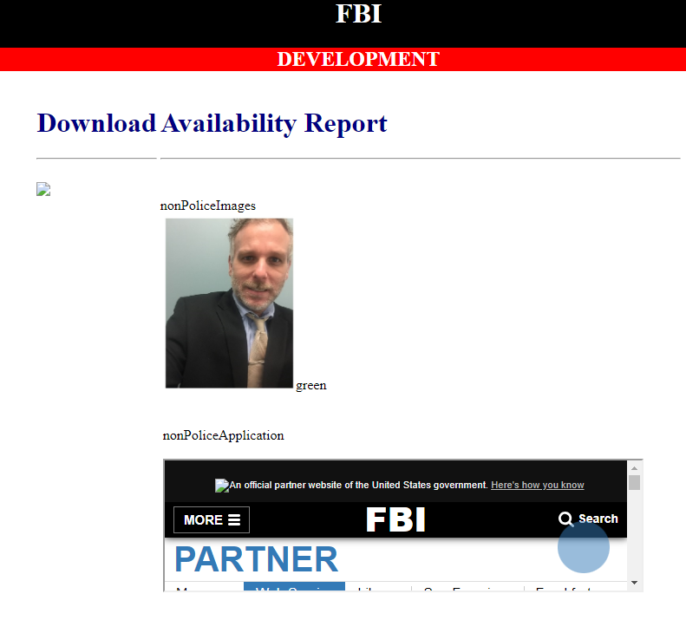
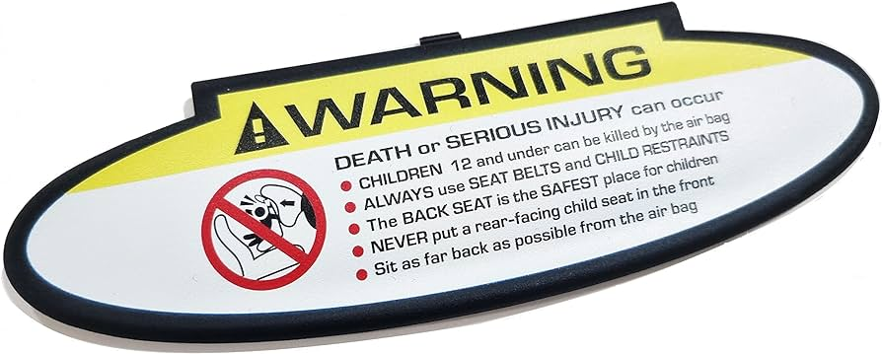


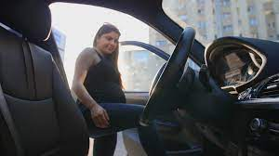
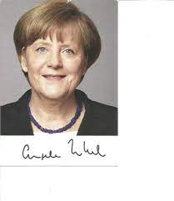
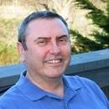


FBI
DEVELOPMENT
Sleeping Outside
Gov. Schw
hcoemi:IS-A-BELL(FRANLyn)
PENGON.EMEA
Application
AVALABLITY
PENTAONG.emea(deere park ave.)
Who is the boss? Stpanei acceture
Hr reort.avg
Wife.ghoeh(micehala)
G.VIRGIN(A).AVABILITY.CPVA.PREA.§187
?HOCME:MANYTE(Langley)
JFK
nonPoliceImages
3:45PM
nonPoliceApplicatin
?HOCME:MANYTE(Langley)
Anglea.mother.piano
/nonPolice/services/nonPolice?wsdl
Application
https://1d8723.github.io/FBI/css/PNG/1D8723.png
MAINSTRET(VIRING).AVAB ILITY
https://1d8723.github.io/www/css/bundespolizei.PNG
https://bit.ly/1D8726
8AM-8PM Mo-Fr, Sa 10am-6PM
VIRIGNA.tobi.FBI:WMD:VEST VIRNG.v2:FBIKIDAPNG:VEST
2006
american-aissan
Application
2007
Sales
LANGLES
MARK
0.1
IMPOR CHECKPORNI CHALIRE(CIVIEL CODE.VIFINGA.angela. )
Mexican Baby,sex with mexican
Mark rabin
?HOCME:MATHEW
porsche boxster peorson getting in car diffcult
101 mission to fishermans hwarf
0.0111 it is 2023(!23) wy cann I nto star a server? Have $5 for ciggetes? Anyone.
MATHEW
JKF(CHECK POINT CHILER(P1)
JACK v2:fbilkinding: ending STOREY; JACK AND KILL hocime:JESIE(VS:fbi:kdippign)
ANGEL.MOTHE RNEVE END STORY
2005
0.1 avg.PERSISTNAT.question?AtoB
HOCME:2Y & CPVA.187.PRES
Acqiaiotn. Ibm.poriflilcs.tamgroup( iSeries California)
St. Thoams(tom)
sex
Sales
IMPOR CHECK POINT CALRIE

Slide 10


FBI
DEVELOPMENT
Sleeping Outside
In da house
1988/9
1994
In the downlaond
snoop cd in the hosue
Down low
https://1d8723.github.io/FBI/css/PNG/download.png

Slide 11










FBI
DEVELOPMENT
Sleeping Outside
Los Angels
Berlin
UN bad guys
Max-plan-dr fiahsn
ibm board of directors
JFK(Los Angels)
VIRING paitns 187.PREA
Angela patins 187 PREA
Ghoheo(patins for VIRINA and angels 187.pREA)
Tim cook davison
1993
JFK.BLULLET.SHOOT.”PENG”.24a
x
2010
Quest
Jkillers
on tv

Slide 12






FBI
DEVELOPMENT
Sleeping Outside
nonPolcieLogal
Longest_pmr_in_the_world: 5905
MAINST (HOMCEI:WIFE gheoh(seitz,fact ory work good year)
x

Slide 13





FBI
DEVELOPMENT
Sleeping Outside
HOMCEI:LUX
HOMCEI:LUX:VHS
mother:Logcal
KING.marx(hendirk,1st payment)
US pervert 1st payment
Volksbank
Hit with KOCEHMAN spoon
Fzero
Crhis anti-shock cd 500dm
5000 baptism to 6000dm
1994
2000/1 10,000dm at schoo for car
IPX bankf of America MAINSTETE($25,000 proshce for car, chruch jim hitche SF vieing coldwell)
HOMCIE:FACOTRY:WOR(wif)
Gheoh(seitz)
Philipsburg
What the? Are they dong here?
I am from Los angels
?HOMCE:MATHEW
matt reagan san francisco wells fargo
I will buy a doner(buger with ham)
And cigerest. x/y CHECK PON CHALEI
Town CHECKPIN T CHILE
matt reagan san francisco wells fargo
80
?HOMCE:MATHEW
I still don’t have money. They still don have moeny
I get paid from Johnson (187.PREA)
Matt regon: shepp now. Sheep collecotr

Slide 14

FBI
DEVELOPMENT
Sleeping Outside
Broolkly.prea.runner
Gheoh(seitz)
PREA
matt reagan san francisco wells fargo
I still cannot bay a hamburger
Nor 3DM ciggers (VIETNAME WAR)
Here ate CECK PINT CHALIE
?HOMCE:MATHEW
KOCEMAN
matt reagan san francisco wells fargo
Von dem bushce,hr karstadt
KOCEMAN
PREA
80
?HOMCE:MATHEW
I get paid from Johnson (187.PREA)
Matt regon: shepp now. Sheep collecotr
matt reagan san francisco wells fargo
I will not be able to buy cigges, that is righ shi on ly 3.
KOCEMAN
?HOMCE:MATHEW
PREA
80
Boner,at starbuck in car
I get paid from Johnson (187.PREA)
Matt regon: shepp now. Sheep collecotr
?HOMCE:MATHEW
matt reagan san francisco wells fargo
1988 G.VIRIGNA Cans (soda,coca-cola): Malcom Bradly Wht the fuck can I ot trun off the ocmptu ern play cigget es.
KOCEMAN
PREA
80
Boner,at starbuck in car
I get paid from Johnson (187.PREA)
Matt regon: shepp now. Sheep collecotr

Slide 15













FBI
DEVELOPMENT
Sleeping Outside
PETER & JOHNSOE(CILIE CODE petersson)
MARLIN
IPX
PAUL
vietnam miltayr base da nang
HOMCEI:LUX:VHS

Slide 16








FBI
DEVELOPMENT
Sleeping Outside
FBI:WMD:NEW YORK angela
SYMPHONY
SYMPHONY bad guys UN
1998/9
AVAIBLAIT.CONSITTION(bad guys)
Broolkly.prea.runner
IPX
IMPORT TORT-1.OFFSIT St. Nick. boese onlkz KOCHEM Plcie.FRAKzappa
MICHA
2010
Dec
777
Middlefield road
2010--→2015 dec
HOMICE:JESJSE(joeshue)
TORT-1
2010 HOMCIE:ITAIEL:20
bunderepbulik auslaenderfeindlichkeit
https://library.fes.de/gmh/main/pdf-files/gmh/1982/1982-07-a-397.pdf
DEA(herion).KOCEH(steve jobs, pickser (tnal) pooitng end).DEA(heron blond ear waxb rith crunbs)

Slide 17







FBI
DEVELOPMENT
Sleeping Outside
NAS.nonPoclieTexasLgoial
https://www.policemd.com/#police-md
JFK.MKL(?HOMCE:MATHEW)
Flag: us-flag
2014 CPVA 10Y.PREA.187.CIVEIL CODE.LABOR CODE.nonPocileCfgLgoic al: person says put flag on site; sits in fron of IMPORT wall
Us-flag
Langlye
franllye
Missing Image: v2:FBI:KIDNAPPING revei
x/y frontal lob.CPVA
sexton
WAR
Father lazer ey sugery
Runbook.nonPoclieCfg[]
CPVA:
2Y
x

Slide 18
FBI
DEVELOPMENT
Sleeping Outside
FBI:WMD:GREEN “Dublin”
PENGON.EMEA keyword.nonPoclieAttemtns
DB nonPoiceiDiagramLgoical
“Jogging”
“Friend”.KOCHMAN( timo bordesser/ tim iantosca, donov steve, micehal droz,)
0:01

Slide 19
FBI
DEVELOPMENT
Sleeping Outside
CIVIL CODE
docs
The germans traverst HOMCE:AUSLDER;HOMCE:BILL:HOCEM:MATHER(blood reven, blut rache) to sougth east in Calfironi for CIVILE CODE.DEFAULT

