Slide 1
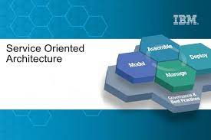
Shell, Java, J2EE, Web Service, T/PF, Assembly

Slide 2
Shell
opt="db2"
if [ "$1" = "$opt" ]; then
#docker cp w-db2-1:/database/config/db2inst1/sqllib/java/db2jcc4.jar /tmp
#docker cp w-db2-1:/database/config/db2inst1/sqllib/java/db2jcc_license_cu.jar /tmp
docker cp /tmp/db2jcc4.jar w-websphere-1:/tmp/
docker cp /tmp/db2jcc_license_cu.jar w-websphere-1:/tmp/
fi

Slide 3
Java
nonPoliceFile.java
nonPoilceFile{
File file = new File(“nonPoliceFile.txt”)
Runtme.runtime(). docker cp w-db2-1:/database/config/db2inst1/sqllib/java/db2jcc4.jar /tmp
Runtme.runtime(). docker cp /tmp/db2jcc4.jar w-websphere-1:/tmp/
);
}

Slide 4
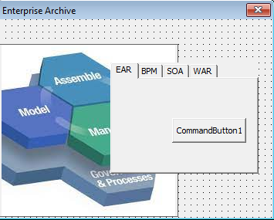
J2EE
/opt/IBM/WebSphere/AppServer/profiles/AppSrv01/bin/earExpander.sh –build nonPoliceWeb.war ./*

Slide 5
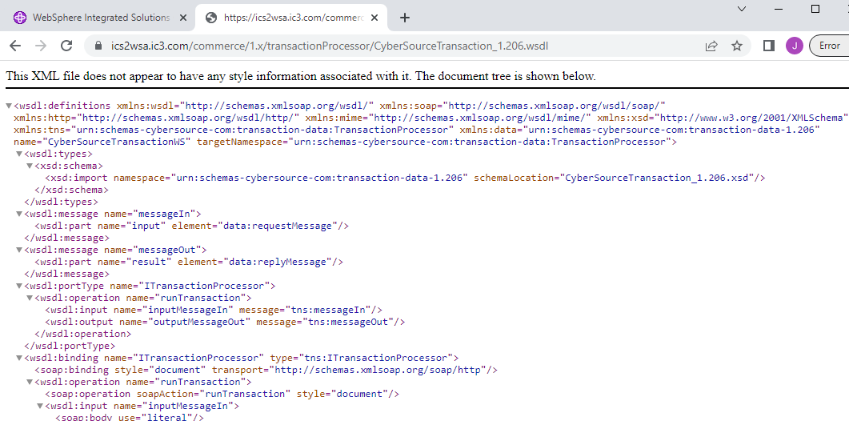
Web Service
https://ics2wsa.ic3.com/commerce/1.x/transactionProcessor/CyberSourceTransaction_1.206.wsdl

Slide 6
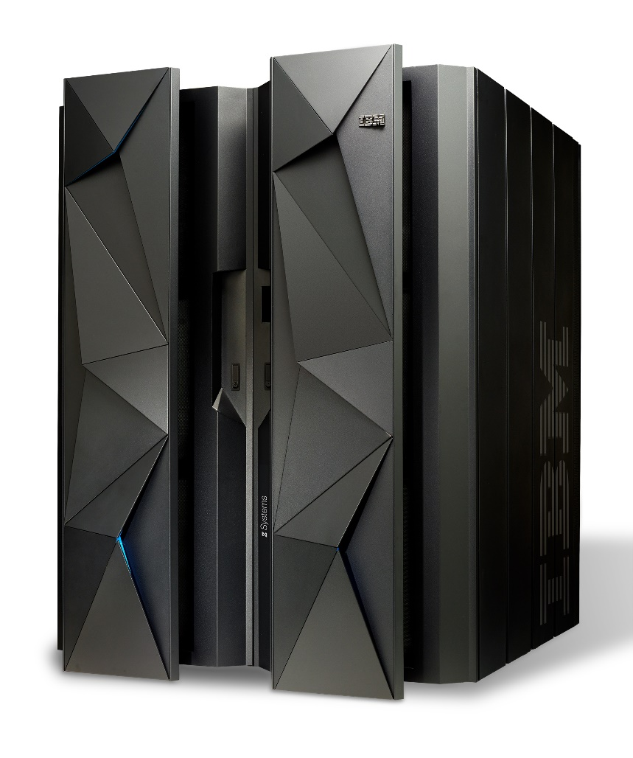
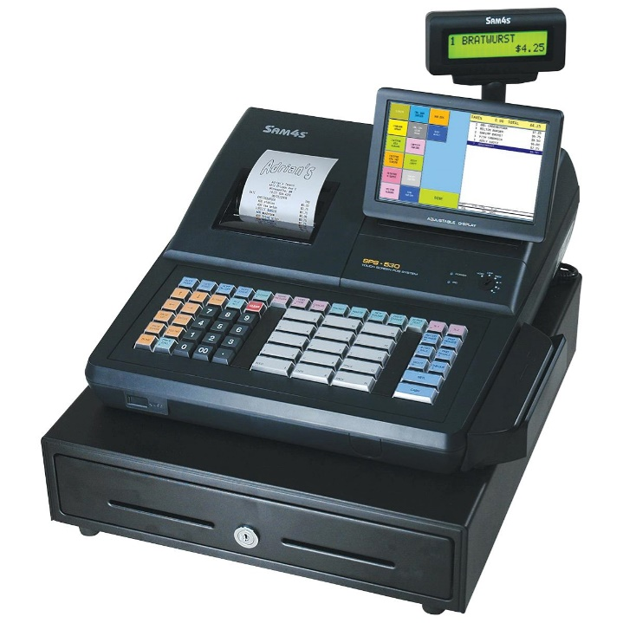
T/PF, Assembly
https://www.nist.gov/itl/publications-0/federal-information-processing-standards-fips
https://nvlpubs.nist.gov/nistpubs/fips/nist.fips.199.pdf

Slide 7
Report
Shell:
100 scipts per server
Management syetsm shell scripts
95% missied conversion (shell to java) – Reusable Code, Consulting Hours
Java:
Files, Servers(tomcat), proects
J2EE:
100 scipts per server
WebService:
100 scipts per server
TP/F, Assembly:
Assmbley, C++ i.e. ATM, FIPS(federal bank processing), ACH (automated check clearing house)
Code that is completed (1970 ACH Visa Retail), IBM Disgugued Engineer (Cyberoruce, Burned in Chip), IBM Mainframe Security( Burned in Memory)

Slide 8
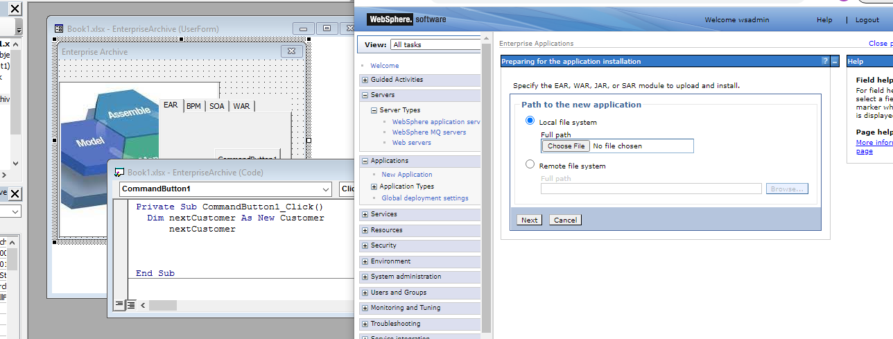

Slide 9
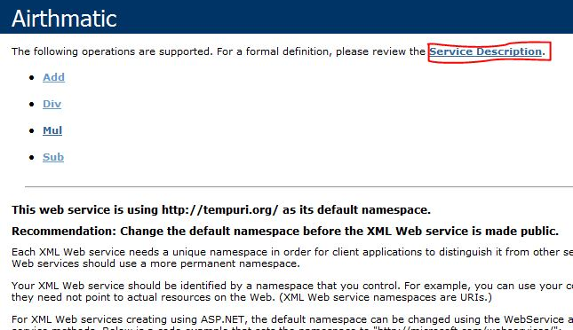
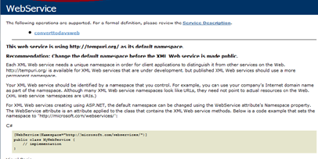
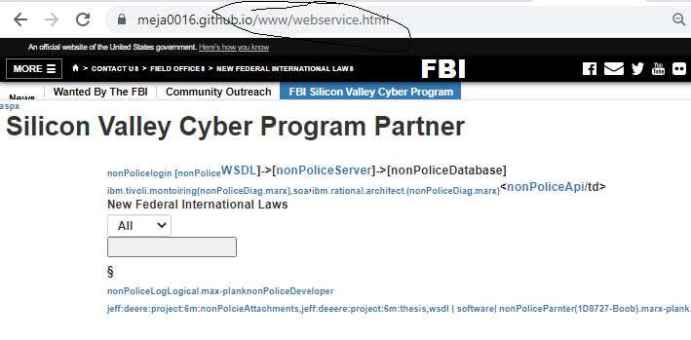
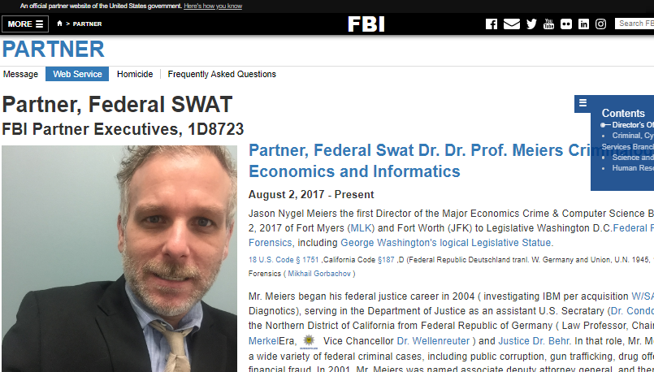



BPM
Service catleog/Employe/Conultant/Business
Uddi,wssr
Service catleog/Employe/Conultant/Business
Service catleog/Employe/Conultant/Business
Service catleog/Employe/Conultant/Business
Shell, java, j2ee, WebSerivce,, TP/F, Assembly

Slide 10
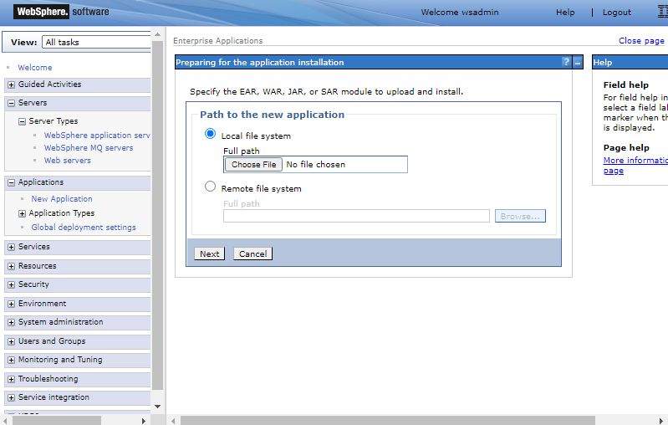


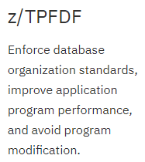

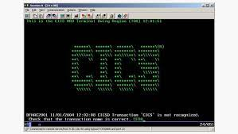

T/PF, Assembly
Sequoia: kubernetes (new vitualization 2027)
- AGANI: shell, java, j2EE
https://www.ibm.com/products/z-transaction-processing-facility
Federal Bank: Mr. Mann (Library)
Retail: Visa
https://www.ibm.com/docs/en/cics-tx/10.1.0?topic=cloud-install-cics-tx-docker-image

