Slide 1


FBI
partner
development
Yes
This your ass

Slide 2


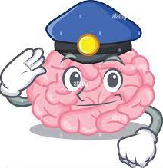
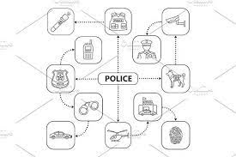
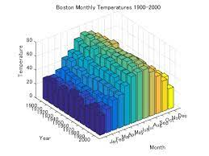
FBI
partner
PILKII: My ass --larry
development
Daimler AG
Micheala
Visa, Oreagaon Ducks
~int32
SAP
Dr. Roos (Mind Map) Algebra 4
ww1.g.cherrytree.gorbachev(nonPoliceWife("Michealea").nonPoliceDaughter)
Dr. Roos (Mind Map) Algebra 4
Qbit – Oprah - >
WWI, WWII
Dr. Dr. prof. h.c. Joseph - Quantum Physics
Quantum Computing
Quantum Mathematics
Dr. Einstein

Slide 3


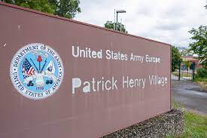

FBI
partner
development
Carl-Benz
PILKII: My ass
Pool, This your ass

Slide 4

FBI
partner
1987
Marlin
development
!Ms. Price

Slide 5



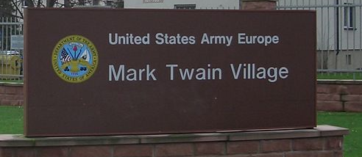

FBI
partner
Mrs. Price
development
PILIKI
§PREA
Benjamin Franklin Village – MANNHEEIM
SON-OF-MANN
VILLAGE
Monday
Tuesday
Wednesday
Thrusday
Friday
Satruday
sudnay

Slide 6

FBI
partner
development

Slide 7
FBI
partner
development
Degenfeld
!PILIKI

Slide 8
FBI
partner
development
FBI

Slide 9
FBI
Daimler AG
ibm
WWI.Son of Joseph
Mona Lisa
Otto-Hahn
Penis and
Scheide
Kirsche(transl.)cherry
Kirsche(transl.)Church
41.Dual meaning
SCH, S-C-H (PRONC.)SS, CEE, HAH

Slide 10

FBI
WWI.Son of Joesph
Mona Lisa
ibm
Wiener, Jeff
Muschiani, Nina
Hermossa
Penis and
Scheide
Church
Creed
.hidden

Slide 11
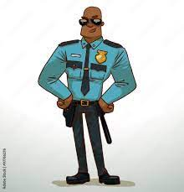

FBI
FBI
partner
ibm
Muschiani
development
Wiener, Jeff
Kirsche S-C-H
LABOR CODE

Slide 12
FBI
partner
development
Joseph's Son ( Francisco, dustin)
Kirsh-i
1st Grade Daughter
1st Grade Sister
1st Grade Half-Brother
1st Grade Kirsch-i, ?
1st Grade Daniel Kirschbaum
Franceso, Daniel and Daniel
Franceo has new friend Jason
kirsch-I since 1st grade
The Pope Francesco is Josphere Son
The Pope Dustin is Joeseph’s Son

Slide 13




Year 41
1994 Daimler Ag
Layers of §422.6 !Hate Crime
2000 KIT Warstreet
LVA
2013
WWI retirement ATB United States (ROTH)
2016
Kirsch-i
Kirsche(transl.)Church
Kirsche(transl.)Cherry
Kirsch-i(Meaning)
Daniel Kirschbaum,
Fiat, Daimer AG

Slide 14
HELLO this Jeff Winer I am important Meeting Please away
FBI
partner
development

Slide 15
FBI
partner
Muschiani
development
FBI
ibm
Wiener, Jeff
Kirsche S-C-H -I
LABOR CODE AND 24x7
MLK(BLACK ) and Wife Accenture
IN YOUR FACE,
MUSSHCI means Vagaina

Slide 16
HELLO this Jeff Winer I am important Meeting Please away OUT OF MY MEETING
FBI
partner
development

Slide 17
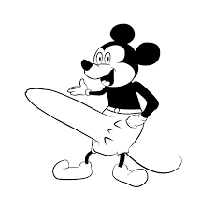

FBI
partner
development
Carl-Benz

Slide 18
FBI
partner
development
FBI

Slide 19
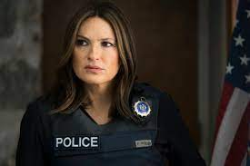
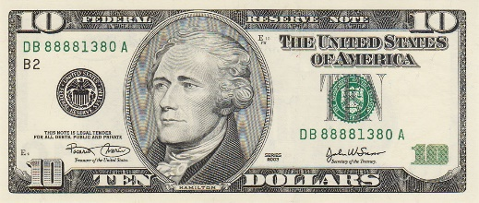
FBI
partner
development
FBI
KRYSTAL
Social Security Administration “Kisch-i” Father
10pm Bar
Pope Paul
Peter
Mary
Joseph
Ron!
1990

Slide 20
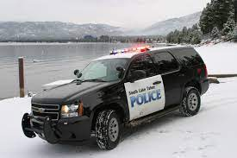
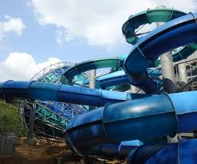

FBI
partner
development
FBI
Polizei Coin Town
LUX
1990 Vice President, Merkel, Vice Vice President Wellereuter
Maria, Son of Joseph
“The Lake”
Denise 11
Coin Town
Lux(ury)
Benjamin Franklin, younger, coin town
Schneller Propeller
(fatster Plan Roter
, faster)
white:medium
41..Aida,API,shipping.nonPolcieRT phil
Sends Cherrytre data fast Bilderberg in Brain

Slide 21
FBI
partner
development
FBI
LUX
Swimming Pool Cabin, KA/BAD-FRA
Gorbachev(Kito,Lips) Chaped
2 Years Younger ( Son of Joseph)
2013 Dr. Rice, Biographie and Lips Chap
2004
1991
Brown

Slide 22
FBI
partner
development
FBI
I am Benjamin
My father is Mr. Lux, from Coin Town

Slide 23
FBI
partner
development
FBI
I am Jesus
My father is God

Slide 24
FBI
partner
development
FBI
I am Goethe
My father is Herr Gott

Slide 25


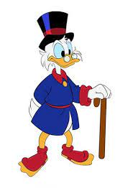
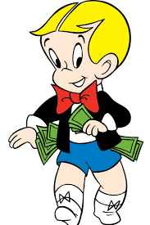

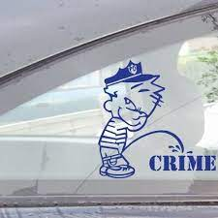
FBI
partner
development
You did not go to coin town, scrooge in Monopoly?
Dr. Dieter Zetsche in the game Monopoly?
Damier AG
Yes
Yes
Vs.
Class-Action TORT

Slide 26
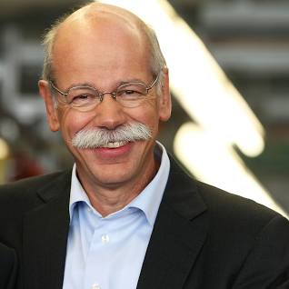

FBI
partner
development
Are you Scrooge in Coin Town
with the Monopoly?
Dr. Dieter Zetchse
Dieter-is-Thomas
Yes
Yes, I killed Wolfgang Lux For the Kaiser Karl Wilhem Emplire And Adophy Hitler Empire, or Nazi Empire I am serial killer

Slide 27
FBI Partner
INTERNATIONAL JUSTICE
Mathew
Scrooge vs. Richie Rich
The Judge found
Scrooge guity of going
To Coin Town from
his monpoloy
Vol. 1, February 17th 2023 for Children
Scrooge vs. Richie Rich
The Judge found
Scrooge guity of going
To Coin Town from
his monpoloy
Scrooge vs. Richie Rich
The Judge found
Scrooge guity of going
To Coin Town from
his monpoloy
Scrooge vs. Richie Rich
The Judge found
Scrooge guity of going
To Coin Town from
his monpoloy
Scrooge vs. Richie Rich
The Judge found
Scrooge guity of going
To Coin Town from
his monpoloy
Scrooge vs. Richie Rich
The Judge found
Scrooge guity of going
To Coin Town from
his monpoloy
Bit.ly/1D8726
Scrooge vs. Richie Rich
Are you Scrooge in Coin Town
with the Monopoly
Scrooge vs. Richie Rich
The Judge found
Scrooge guity of going
To Coin Town from
his monpoloy
Scrooge vs. Richie Rich
The Judge found
Scrooge guity of going
To Coin Town from
his monpoloy
Piliki
Scrooge vs. Richie Rich
The Judge found
Scrooge guity of going
To Coin Town from
his monpoloy
Scrooge vs. Richie Rich
The Judge found
Scrooge guity of going
To Coin Town from
his monpoloy
Scrooge vs. Richie Rich
The Judge found
Scrooge guity of going
To Coin Town from
his monpoloy
Scrooge vs. Richie Rich
The Judge found
Scrooge guity of going
To Coin Town from
his monpoloy
Scrooge vs. Richie Rich
The Judge found
Scrooge guity of going
To Coin Town from
his monpoloy
Scrooge vs. Richie Rich
The Judge found
Scrooge guity of going
To Coin Town from
his monpoloy
Bit.ly/1D8727
Mark
Scrooge vs. Richie Rich
The Judge found
Scrooge guity of going
To Coin Town from
his monpoloy
Scrooge vs. Richie Rich
The Judge found
Scrooge guity of going
To Coin Town from
his monpoloy
Scrooge vs. Richie Rich
The Judge found
Scrooge guity of going
To Coin Town from
his monpoloy
Bit.ly/1D8728

Slide 28
FBI Partner
INTERNATIONAL JUSTICE
Mathew
Scrooge vs. Mr. Rich
The Judge found
Scrooge guity of going
To Coin Town from
his monpoloy
Vol. 1, February 17th 2023
Scrooge vs. Richie Rich
The Judge found
Scrooge guity of going
To Coin Town from
his monpoloy
Scrooge vs. Richie Rich
The Judge found
Scrooge guity of going
To Coin Town from
his monpoloy
Scrooge vs. Mr. Rich
The Judge found
Scrooge guity of going
To Coin Town from
his monpoloy
Scrooge vs. Richie Rich
The Judge found
Scrooge guity of going
To Coin Town from
his monpoloy
Scrooge vs. Richie Rich
The Judge found
Scrooge guity of going
To Coin Town from
his monpoloy
Scrooge vs. Richie Rich
The Judge found
Scrooge guity of going
To Coin Town from
his monpoloy
Scrooge vs. Richie Rich
The Judge found
Scrooge guity of going
To Coin Town from
his monpoloy
Scrooge vs. Richie Rich
The Judge found
Scrooge guity of going
To Coin Town from
his monpoloy
Bit.ly/1D8726
Piliki
Scrooge vs. Richie Rich
The Judge found
Scrooge guity of going
To Coin Town from
his monpoloy
Scrooge vs. Richie Rich
The Judge found
Scrooge guity of going
To Coin Town from
his monpoloy
Scrooge vs. Richie Rich
The Judge found
Scrooge guity of going
To Coin Town from
his monpoloy
Scrooge vs. Richie Rich
The Judge found
Scrooge guity of going
To Coin Town from
his monpoloy
Scrooge vs. Richie Rich
The Judge found
Scrooge guity of going
To Coin Town from
his monpoloy
Scrooge vs. Richie Rich
The Judge found
Scrooge guity of going
To Coin Town from
his monpoloy
Bit.ly/1D8727
Mark
Scrooge vs. Richie Rich
The Judge found
Scrooge guity of going
To Coin Town from
his monpoloy
Scrooge vs. Richie Rich
The Judge found
Scrooge guity of going
To Coin Town from
his monpoloy
Scrooge vs. Richie Rich
The Judge found
Scrooge guity of going
To Coin Town from
his monpoloy
Bit.ly/1D8728

Slide 29
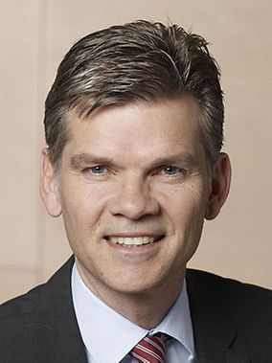
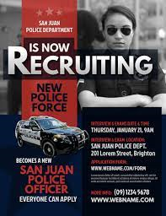






FBI Partner
INTERNATIONALE JUSTIZ
Vol. 1, February 17th 2023
FBI Partner vs. IBM
The Judge found
Scrooge guity of going
To Coin Town from
his monpoloy
FBI Partner vs. Sam Sawres
The Judge found
Scrooge guity of going
To Coin Town from
his monpoloy
FBI Parter vs Joseph Sexton
The Judge found
Scrooge guity of going
To Coin Town from
his monpoloy
FBI Partner vs. Jotyi
The Judge found
Scrooge guity of going
To Coin Town from
his monpoloy
FBI Partner vs. Damiler AG
The Judge found
Scrooge guity of going
To Coin Town from
his monpoloy
FBI Partner vs Visa
The Judge found
Scrooge guity of going
To Coin Town from
his monpoloy
FBI Partner vs. Cisco Montoring
The Judge found
Scrooge guity of going
To Coin Town from
his monpoloy
FBI Partner vs. Dylan ?
The Judge found
Scrooge guity of going
To Coin Town from
his monpoloy
FBI Partner vs. ? Backer
The Judge found
Scrooge guity of going
To Coin Town from
his monpoloy
Vice President
Germany
FBI Partner vs. Yang
The Judge found
Scrooge guity of going
To Coin Town from
his monpoloy
Petersson vs. Yang
The Judge found
Scrooge guity of going
To Coin Town from
his monpoloy
FBI Partner vs. Yahoo!
The Judge found
Scrooge guity of going
To Coin Town from
his monpoloy
Prof. Dr.
Susanne Baer,
LL.M. (Michigan)
FBI Parnter v. Jeff Weiner
The Judge found
Scrooge guity of going
To Coin Town from
his monpoloy
FBI Partner v. LinkedIn
The Judge found
Scrooge guity of going
To Coin Town from
his monpoloy
FBI Parnter v. Nina Mussiani
The Judge found
Scrooge guity of going
To Coin Town from
his monpoloy
FBI Partner
Dr. Dr. Prof. h.c. Jason Petersson
FBIT Partner v. Apple
The Judge found
Scrooge guity of going
To Coin Town from
his monpoloy
FBI Partner v. Tim Cook
The Judge found
Scrooge guity of going
To Coin Town from
his monpoloy
FBI Parnterv. Bertelsmann
The Judge found
Scrooge guity of going
To Coin Town from
his monpoloy

Slide 30
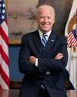
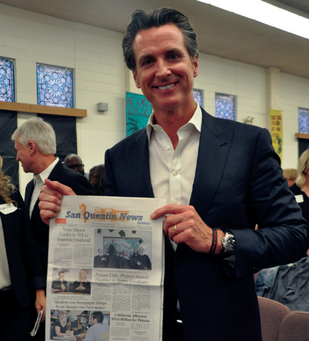


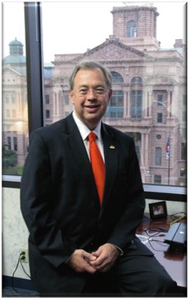
FBI Partner
INTERNATIONAL JUSTICE
2008
Vol. 1, February 17th 2023
Scrooge vs. Mr. Rich
The Judge found
Scrooge guity of going
To Coin Town from
his monpoloy
FBI Partner vs. Sam Sawres
The Judge found
Scrooge guity of going
To Coin Town from
his monpoloy
FBI Parter vs Joseph Sexton
The Judge found
Scrooge guity of going
To Coin Town from
his monpoloy
FBI Partner vs. Jotyi
The Judge found
Scrooge guity of going
To Coin Town from
his monpoloy
Scrooge vs. Richie Rich
The Judge found
Scrooge guity of going
To Coin Town from
his monpoloy
Scrooge vs. Richie Rich
The Judge found
Scrooge guity of going
To Coin Town from
his monpoloy
Governor,
California
FBI Partner vs. Cisco Montoring
The Judge found
Scrooge guity of going
To Coin Town from
his monpoloy
FBI Partner vs. Dylan ?
The Judge found
Scrooge guity of going
To Coin Town from
his monpoloy
FBI Partner vs. ? Backer
The Judge found
Scrooge guity of going
To Coin Town from
his monpoloy
FBI Partner vs. Yang
The Judge found
Scrooge guity of going
To Coin Town from
his monpoloy
Petersson vs. Yang
The Judge found
Scrooge guity of going
To Coin Town from
his monpoloy
FBI Partner vs. Yahoo!
The Judge found
Scrooge guity of going
To Coin Town from
his monpoloy
FBI Parnter v. Jeff Weiner
The Judge found
Scrooge guity of going
To Coin Town from
his monpoloy
FBI Partner v. LinkedIn
The Judge found
Scrooge guity of going
To Coin Town from
his monpoloy
FBI Partner v. LinkedIn
The Judge found
Scrooge guity of going
To Coin Town from
his monpoloy
FBI Partner
Dr. Dr. Prof. h.c. Jason Petersson
FBIT Partner v. Apple
The Judge found
Scrooge guity of going
To Coin Town from
his monpoloy
FBI Partner v. Tim Cook
The Judge found
Scrooge guity of going
To Coin Town from
his monpoloy
FBI Parnterv. Bertelsmann
The Judge found
Scrooge guity of going
To Coin Town from
his monpoloy
Judge
Tarrant County)

Slide 31
FBI
partner
development
FBI
I am Goethe
§vggg
My father is Mr. Gott

Slide 32
FBI
partner
development
FBI
I am Benjamin
I am Harris
I am Wolfgang
I am Özoğuz
My father is Otto
My father is Olaf
My father is George
My father is Joe

Slide 33

FBI
FBI
partner
development
1992
School

Slide 34

FBI
partner
development
1992
School

Slide 35

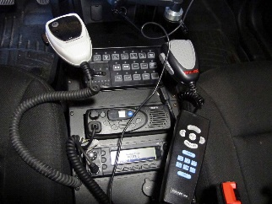
FBI
partner
development
1992
School

Slide 36
FBI
partner
development
1987
Marlin

Slide 37

FBI
partner
development
1984
Red House

Slide 38

FBI
partner
development
1981
Water

