Slide 1





Hate Speech Detection Using
Machine Learning
Akshay Gunjal – 171007
Shaun Dsilva – 171104
Davon Carvalho - 171027

Slide 2

🤬
Introduction
🤬
Review of Literature
🤬
Problem Definition & Proposed Solution
🤬
Scope of Project
🤬
System Description
🤬
Hardware and Software Requirements
🤬
User Interface Design (GUI Snapshots)
🤬
Results
🤬
Conclusion
🤬
Literature Cited
🤬
Acknowledgement

Slide 3








Introduction
What is Hate Speech?
Hate speech is defined as "public speech that expresses hate or encourages violence towards a person or group based on something
such as race, religion, sex, or sexual orientation“.
Promoting enmity between different groups on grounds of religion, race, place of birth, residence, language, etc., and doing by a.)words or b.)acts are held prejudicial to maintenance of harmony.
Whoever, with deliberate and malicious intention of outraging the religious feelings of any class of [citizens of India], [by words, either spoken or written, or by signs or by visible representations or otherwise], insults or attempts to insult the religion or the religious beliefs of that class, shall be punished with imprisonment of either description for a term which may extend to [three years], or with fine, or with both.

Slide 4
Daily Event
Review of Literature
Title Of Paper
Review
Issues
Hate Speech Detection in Code-switched Text Messages
Uses CRISP-DM methodology (Cross-Industry Standard Process for data mining.) for tweets.
Could not identify ASCII’s in words. E.g “F#uck you all!”. Could not identify acronyms such as “WTF”, Smh.nkt!
Hate Speech Detection Using Latent Semantic Analysis (LSA) Method Based on Image.
Hate Speech Detection using Latent Semantic Analysis. A new methodology has been developed to identify emotions using text on Image.
Similarity value 0.6225636956 is considered as hate word And if below not a hate word.

Slide 5
Review of Literature
Title Of Paper
Review
Issues
Threat and Abusive Language Detection on Social Media in Bengali Language
Different types of algorithms like Multinomial Naïve Bayes, Support Vector Machine, CNN-LSTM are used and the data set used is of Facebook.
From results it was observed that both CNN-LSTM and SVM provide the same accuracy , however on larger dataset CNN-LSTM works well.
To distinguish text-containing offensive or hate speech, artificial Neural Network (ANN) techniques are used. Synthetic minority oversampling technique(SMOT) is used for text classification processes.
Application of Machine Learning Techniques for Hate Speech Detection in Mobile Applications.
Algorithms get degraded if there is a variety of data.

Slide 6
Daily Event
Review of Literature
Title Of Paper
Review
Issues
Hate Speech on Twitter: A Pragmatic Approach to Collect Hateful and Offensive Expressions and Perform Hate Speech Detection.
Texts are classified in three classes: clean, offensive, hateful. Binary classification and ternary classification is performed for the test set and validation set.
Offensive text accuracy of 84% and hateful text accuracy of 74%.

Slide 7
Problem Definition & Proposed Solution
🤬 To develop a hate speech detection model using various classifiers like Random Forest, Naïve Bayes, Support Vector Machine (SVM), and Logistic Regression.
Proposed Solution :
Analyzing various classifiers based on dataset and choosing the model with best output.
Deploying the model in custom Android Chat Application.
Censor the hate / abusive words from the chat between users.
Deploying the model on web page created using StreamLit.

Slide 8

Scope Of Project
Our project is designed for analyzing various algorithms based on the given dataset and finding the optimum algorithm.
The model can predict 91% of non hate speech and 62% offensive and hate speech.
Two major issues that we faced in this project were :
Imbalanced dataset
Difficulty of the model to understand hate speech

Slide 9
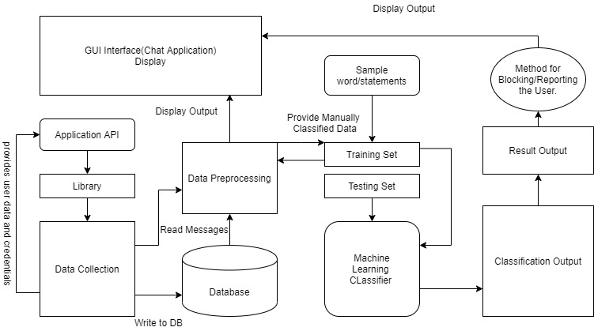
System Block Diagram
Fig 1. System Block Diagram

Slide 10
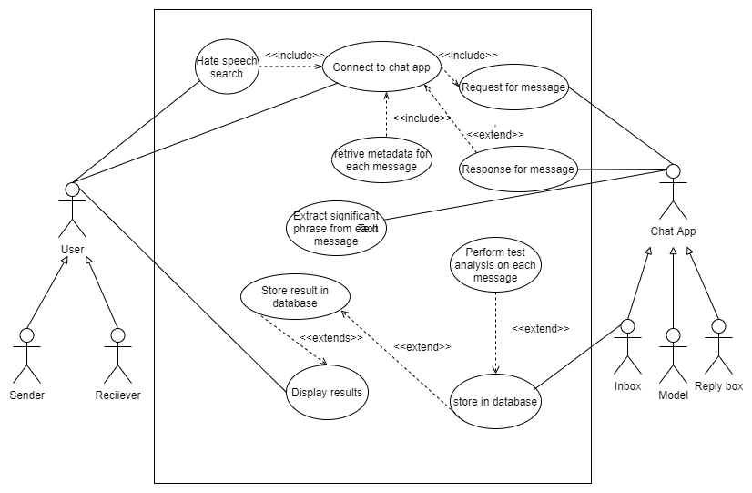
Use Case Diagram
Fig 2. Use Case Diagram

Slide 11
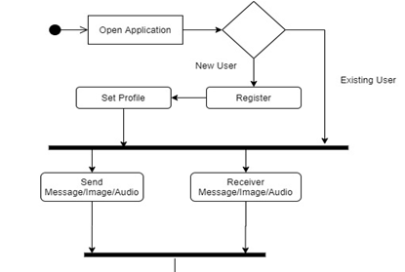
Activity Diagram
A
Fig 3.1 Activity Diagram

Slide 12
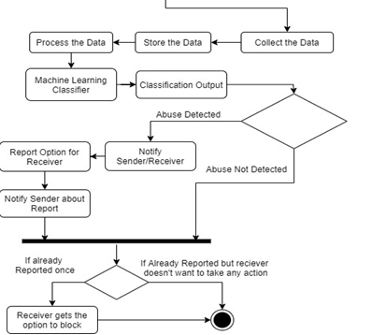
Activity Diagram
A
Fig 3.2 Activity Diagram

Slide 13
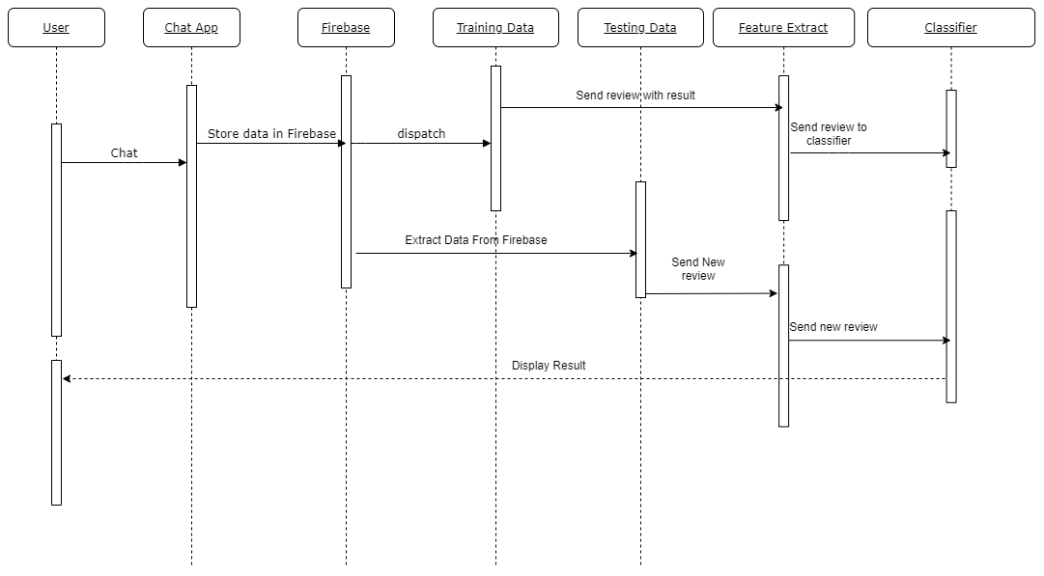
Sequence Diagram
Fig 4. Sequence Diagram

Slide 14
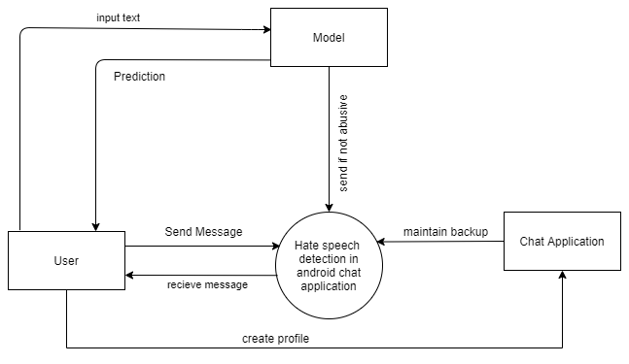
Data flow Diagram
Level 0
Fig 5.1 Data flow Diagram

Slide 15
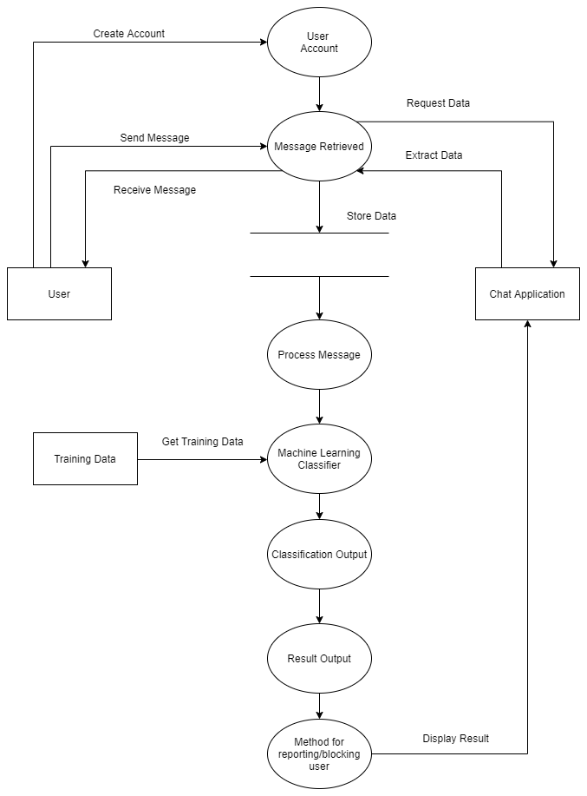
Data flow Diagram
Level 1
Fig 5.2 Data flow Diagram

Slide 16
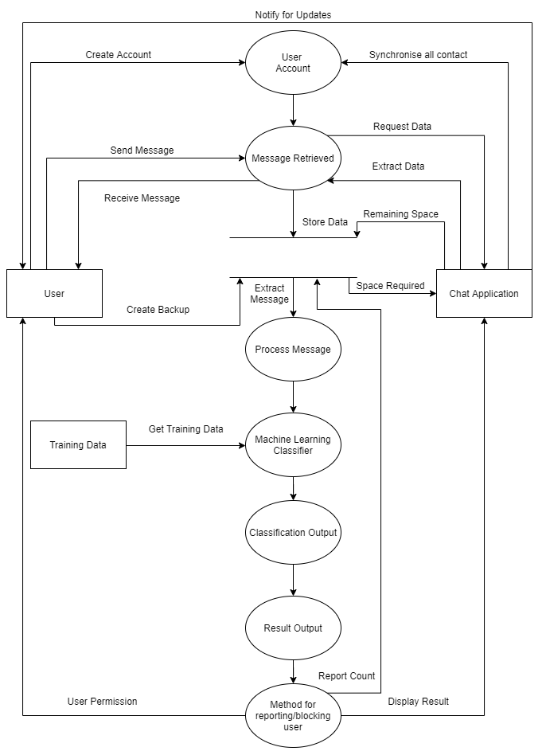
Data flow Diagram
Level 2
Fig 5.3 Data flow Diagram

Slide 17
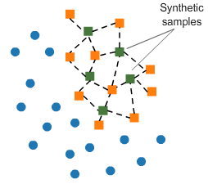












Modeling Process
CountVectorizer Logistic Regression
1
2
3

Slide 18






Hardware & Software Requirements
Software's
Languages
Android Studio
Flutter
StreamLit
Python IDE
Python
Jupyter
Hardware
Requirements
Processor :
2.3GHz and above
Hard Drive :
8GB free space or above
Memory :
4 GB RAM and above
Internet :
Stable Internet Connectivity

Slide 19

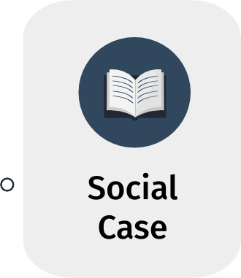












Additional Libraries
VADER

Slide 20


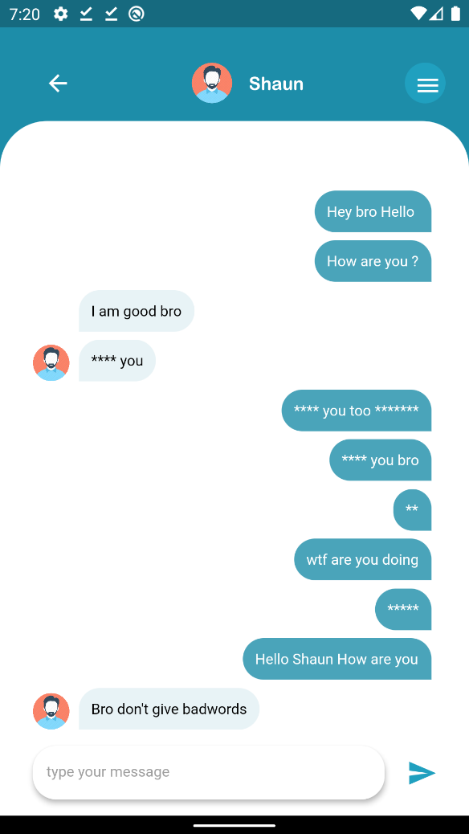


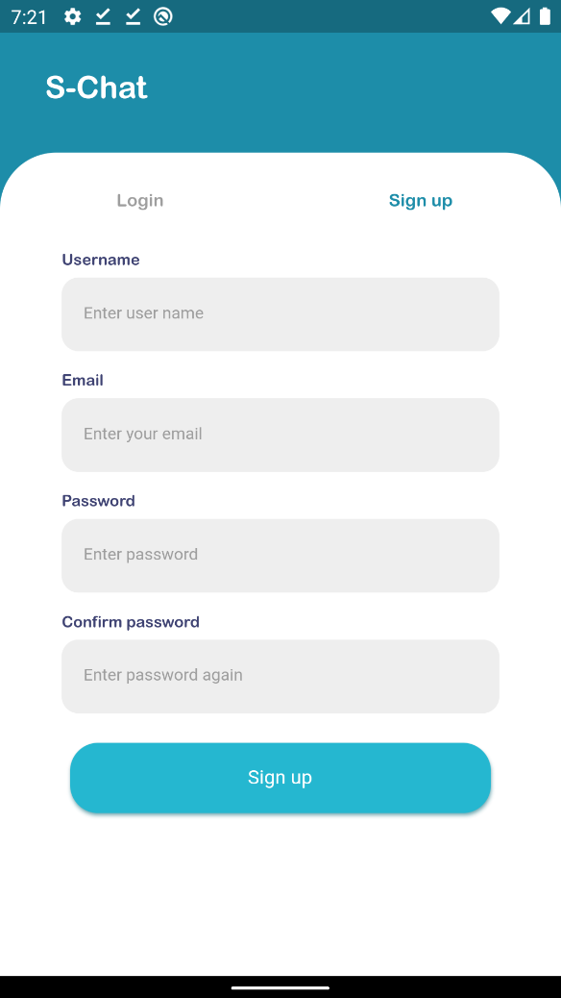
User Interface Design
Fig. 7 Sign Up Screen
Fig. 9 Chats
Fig. 11 Chat Screen
Fig. 10 User Profile
Fig. 8 Sign In Screen
Fig. 6 Splash Screen

Slide 21
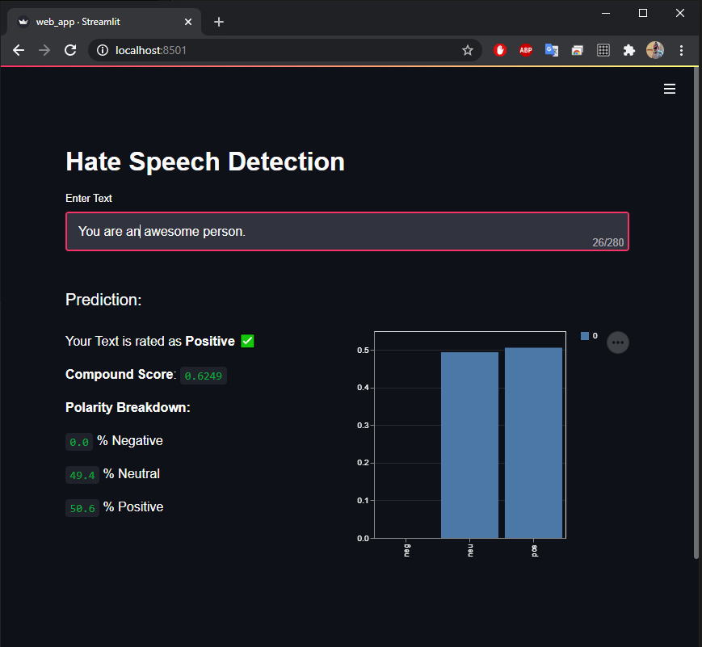
User Interface Design
Model Deployment
Fig. 12 Model deployment on StreamLit

Slide 22
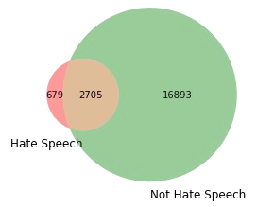


Results
Unique Words per Label
24,802 Tweets
20,277 Word Vocabulary
Fig 13. Hate to Non hate proportion

Slide 23
Baseline Model
Final Model
Naive Bayes
with TF-IDF Vectorization
Logistic Regression
with Count Vectorization
F1 Score
0.1923
F1 Score
0.3958
Recall
0.1254
Recall
0.624

Slide 24
Comparison Table
 | Pression | Recall | F1-Score | Weighted- F1 | Fit
Random Forest - TFIDF | 0.412844 | 0.161290 | 0.231959 | 0.927249 | Underfit
Log Reg - TFIDF | 0.293900 | 0.569892 | 0.387805 | 0.913449 | Overfit
Naive Bayes - TFIDF | 0.411765 | 0.125448 | 0.192308 | 0.925487 | Underfit
SVM - TFIDF | 0.360947 | 0.437276 | 0.395462 | 0.928112 | Underfit
SVM - Doc2Vec | 0.205148 | 0.634660 | 0.310069 | 0.873748 | Overfit
SVM - CountVectorizer | 0.271218 | 0.536496 | 0.360294 | 0.910436786 | Overfit
Log Reg - CountVectorizer | 0.289831 | 0.624088 | 0.395833 | 0.912113 | Underfit
Log Reg Oversampled – CountVectorizer | 0.232558 | 0.474453 | 0.312125 | 0.902366 | Overfit
Log Reg Undersampled – CountVectorizer | 0.570175 | 0.237226 | 0.335052 | 0.937658 | Underfit

Slide 25
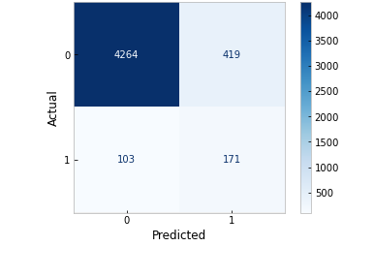
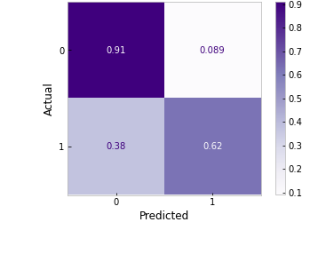
Fig. 14 Confusion Matrix for Logistic Regression with CountVectorizer
Fig. 15 Normalized Confusion Matrix for Logistic Regression with CountVectorizer

Slide 26

Conclusion
As hate speech continues to be a social problem, the need for automatic hate speech detection systems becomes more apparent.
We presented the current approaches for this task as well as a new system that achieves reasonable accuracy.
The final model had an F1 of .3958 and Recall of .624. Although this project had extensive preprocessing and modeling iterations, there is still room for improvement.
Ultimately, automating hate speech detection is an extremely difficult task because of the nuances in English slang and slurs. This project was able to get that process started, but there is much more work to be done to keep this content off of the public-facing forums.

Slide 27
Literature Cited
[1] Ombui, E., Muchemi, L., & Wagacha, P. (2019). Hate Speech Detection in Code-switched Text Messages. 2019 3rd International Symposium on Multidisciplinary Studies and Innovative Technologies (ISMSIT). doi:10.1109/ismsit.2019.8932845
[2] Niam, Ilham Maulana Ahmad, Budhi Irawan, Casi Setianingsih, and Bagas Prakoso Putra. “Hate Speech Detection Using Latent Semantic Analysis (LSA) Method Based on Image.” In 2018 International Conference on Control, Electronics, Renewable Energy and Communications (ICCEREC), pp. 166-171. IEEE, 2018.
[3] Chakraborty, Puja, and Md Hanif Seddiqui. "Threat and Abusive Language Detection on Social Media in Bengali Language." In 2019 1st International Conference on Advances in Science, Engineering and Robotics Technology (ICASERT), pp. 1-6. IEEE, 2019.
[4] Raufi, B., & Xhaferri, I. (2018). ​Application of Machine Learning Techniques for Hate Speech Detection in Mobile Applications. 2018 International Conference on Information Technologies (InfoTech).​ doi:10.1109/infotech.2018.8510738
[5] Watanabe, H., Bouazizi, M., & Ohtsuki, T. (2018). Hate Speech on Twitter: A Pragmatic Approach to Collect Hateful and Offensive Expressions and Perform Hate Speech Detection. IEEE Access, 6, 13825–13835. doi:10.1109/access.2018.2806394.

Slide 28
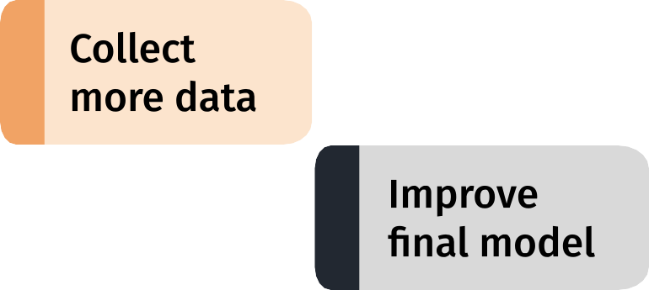
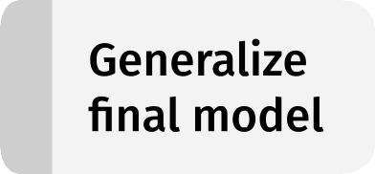

Next Steps
Future Scope
Hate Speech in images

Slide 29
Questions ?
Thank you !

