Slide 1
Randomization
Text book: Chris Spear

Slide 2
Randomization Overview
Why Randomize?
As designs grow it becomes more difficult to test their features through directed test cases
Directed test cases checks specific features of a design and can only detect anticipated bugs
Directed test case approach is a time consuming exercise
Directed tests detect only anticipated bugs in the design
Solution is Constrained Random Testcases (CRT) which randomize the input stimulus
Random testing detects the bugs you did not expect in your design

Slide 3
Randomization
Randomization is the process of making something random.
SystemVerilog randomization is the process of generating random values to a variable.
Verilog has a $random method for generating the random integer values-this is good for randomizing the variables alone, but it is hard to use in case of class object randomization.
For easy randomization of class properties, SystemVerilog provides rand keyword and randomize() method.

Slide 4
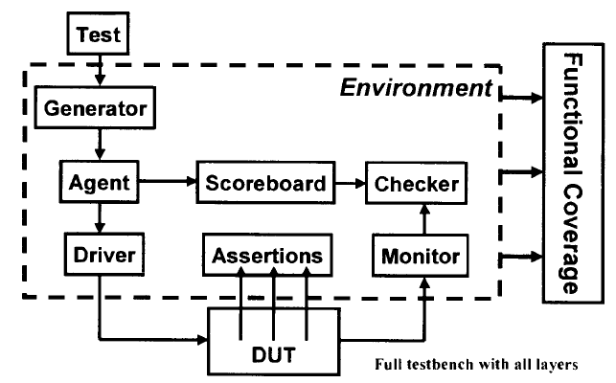
Test Bench

Slide 5
What to randomize
Device configurations
Environment configurations
Primary Input Data
Encapsulated input data
Protocol exceptions, errors and violations
Delays

Slide 6
1. Device Configurations
Randomize different operational settings of the DUT, such as:
Clock configurations(e.g., frequency, duty cycle variations)
Power modes(e.g., normal, low-power, idle, sleep)
Operating voltages(if applicable in modeling)
Memory configurations(e.g., different address spaces, word sizes)
Peripheral enable/disable states

Slide 7
Device Configurations
Example:
class DeviceConfig;
rand bit [2:0] power_mode; // 3-bit power mode
configuration
rand bit [1:0] clock_divider; // Clock divider settings
constraint valid_config{
power_modeinside {0, 1, 2, 3}; // Only valid power modes
clock_dividerinside {1, 2, 4}; // Only allowed dividers
}
endclass

Slide 8
2. Environment Configurations
Randomize aspects of the verification environment:
Testbench parameters(e.g., simulation time, reset duration)
Clock skews, jitter, and glitches
Interrupt latencies
Multi-master/multi-slave configurations (for protocols like AXI, I2C, SPI)

Slide 9
Environment Configurations
Example:
class EnvConfig;
rand bit [3:0] num_masters;
rand bit [3:0] num_slaves;
rand bit [7:0] irq_latency; // Interrupt latency in cycles
constraint valid_env{
num_masters<= 4;
num_slaves<= 8;
irq_latencyinside {[1:10]}; // Latency range
}
endclass
// Note: The inside keyword in SystemVerilog allows to check if a given value lies within the range specified using the inside phrase.

Slide 10
3. Primary Input Data
Randomize fundamental input signals to the DUT:
Address and Data values
Control signals (read/write/enable/select)
Command sequences
Example:
class PrimaryInput;
rand bit [31:0] addr;
rand bit [31:0] data;
rand bit rw; // Read (0) or Write (1)
constraint aligned_addr{
addr% 4 == 0; // Ensure 4-byte alignment
}
endclass

Slide 11
4. Encapsulated Input Data
Randomize structured data types, such as packets or frames:
Protocol headers and payloads
Packet length variations
CRC values for integrity checks
Example:
class APBTransaction;
rand bit [31:0] paddr;
rand bit [31:0] pwdata;
rand bit penable;
rand bit pwrite;
constraint valid_apb{
paddrinside {[32'h0000_0000:32'h0000_FFFF]}; // Valid address range
}
endclass

Slide 12
5. Protocol Exceptions, Errors, and Violations
Randomly inject errors to verify DUT robustness:
Parity, CRC, or checksum errors
Out-of-order transactions
Dropped or duplicated transactions
Timing violations (setup/hold)

Slide 13
Protocol Exceptions, Errors, and Violations
Example:
class ErrorInjection;
rand bit parity_error;
rand bit crc_error;
rand bit [3:0] protocol_violation;
constraint single_error{
parity_error+ crc_error+ protocol_violation<= 1; // Only one error at a time
}
endclass
Note: In SystemVerilog, constraints are typically considered dynamic because they are evaluated and applied during runtime, specifically during the randomization process.
The purpose of constraints is to guide the randomization to produce values that satisfy specified conditions.

Slide 14
6. Delays
Randomize delays for better coverage of corner cases:
Bus delays (e.g., wait states, arbitration delays)
Reset assertion time
Interrupt response delay
Example:
class Delays;
rand int unsigned bus_delay;
rand int unsigned reset_time;
constraint delay_constraints{
bus_delayinside {[0:20]}; // Bus delay between 0 and 20 cycles
reset_timeinside {[5:50]}; // Reset time between 5 and 50 cycles
}
endclass

Slide 15
Summary
Using constrained randomization, you ensure valid and meaningful test cases.
Functional coverage metrics should be used to verify that all corner cases are tested.
Directed tests + Randomized tests = Best verification strategy.

Slide 16
Random variables
random variables: The class variables which get random values on randomization are called random variables.
In order to make variables as random variables, Class variables need to be declared using the rand and randc type-modifier keywords.
Following types can be declared as rand and randc,
--singular variables of any integral type
--arrays
--arrays size
--object handle’s

Slide 17
Ex: rand bit [3:0] addr;
addr is a 4-bit unsigned integer with a range of 0 to 15. on randomization this variable shall be assigned any value in the range 0 to 15 with equal probability
randc keyword
randc is random-cyclic. For the variables declared with the randc keyword, on randomization variable values don’t repeat a random value until every possible value has been assigned.

Slide 18
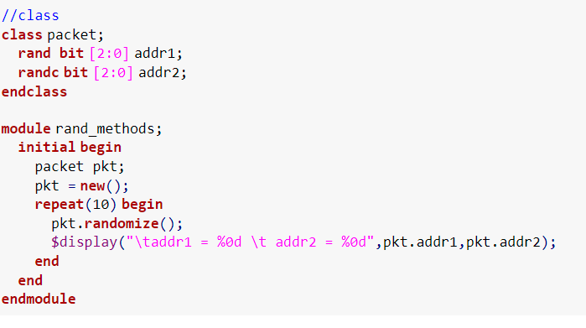
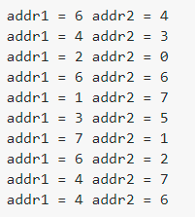

Slide 19
randomization example
In the previous example, Two variables addr1 and addr2 of same bit type are declared as rand and randc respectively, observe the randomized values of addr1 and addr2.
addr1 – takes the random value on every randomization addr2 – takes the random value on every randomization, but takes random value until every possible value has been assigned

Slide 20
In order to randomize the object variables, the user needs to call randomize() method.
example: object.randomize()

Slide 21
Randomization in SystemVerilog
Overview
Randomization enables users to automatically generate random input stimulus for functional verification
SystemVerilog enables user to specify random constrained (legal) values
Random constraints should be specified using OOP

Slide 22
Randomization in SystemVerilog
rand keyword
Random variables are declared with the rand keyword
Their values are uniformly distributed over the specified range
If unconstrained the variable shall assign any value in the specified range with equal probability
rand bit [7:0] y;
8-bit unsigned integer with the range 0 to 255
The probability of the same value repeating on successive calls to randomize is 1/256
If unconstrained y is assigned any value in the range 0 to 255 with equal probability
The probability of a value occurring on simultaneous calls to randomize is 1/256

Slide 23
Randomization in SystemVerilog
randc keyword
Random cyclic variables are declared with the randc keyword
They cycle through all the values in a random permutation of their declared range
Can only be of the type bit or enum(Typedef enum {READ, WRITE,CONTROL})
randc randomly iterates over all the values in the range and no value is repeated within an iteration
When the iteration finishes, a new iteration automatically starts
randc bit [1:0] y;
2-bit unsigned integer with the range 0 to 3
y can take values 0,1,2,3
initial permutation 0 -> 3 -> 2 -> 1
next permutation 2 -> 1 -> 3 -> 0
next permutation 2 -> 0 -> 1 -> 3

Slide 24
Randomization in SystemVerilog
Simple class with random variables
The Bus class models a simplified bus with two random variables: addr and data
The range1 constraint specifies the limits for the values of addr
Ensure non conflicting and legal constraints
class Bus
rand bit[15:0] addr;
randc bit[31:0] data;
constraint range1 {addr>1024; addr<16384;}
endclass
random variable
random cyclic: the random solver
will not repeat a permutation of values
Example: Simple class with random variables
constraining the random variables to values between 1024 and 16384

Slide 25
Randomization in SystemVerilog
randomize()function
Calling randomize() causes new values to be selected for all of the random variables in an object
The random values obey the constraints
randomize function returns a 1 on success and 0 on failure
Unconstrained variables are assigned any values in their declared range
a bus object is created and
randomized 50 times
result of each randomization
is checked
Bus bus=new;
repeat (50) begin
if(bus.randomize()==1)
$display(bus.addr, bus.data);
else
$display (“Randomization failed”);
end
Example: randomize() function example

Slide 26
Randomization in SystemVerilog
The constraint solver
The process of solving constraint expressions is handled by the System-Verilog constraint solver. The solver chooses values that satisfy the constraints.
Solves constraint expressions
The same seed results in the same random values
Use a different seed to generate different set of random values
The solver is specific to the simulation vendor
Constraint blocks are not procedural codes (begin and end not required)
Use { } to group multiple expressions.

Slide 27
Constraint Details
Constraint Blocks
Values of random variables are determined using constraint expressions that are declared using constraint blocks
Smart stimulus tests relationships between variables
They are class members like tasks, functions and variables
Constraint declaration
Constraint identifier: is the name of the constraint block.
Constraint block: is a list of expression statements that restrict the range of variable or define relations between variables
In the example below randomize() fails sometimes and succeeds sometimes, why?
constraint_identifier
constraint_block
Error!!!
rand bit[15:0] addr;
class Bus
bit[15:0] addr;
randc bit[31:0] data;
constraint range1 {addr>1024; addr<16384;}
endclass
Example: Simple constraint example

Slide 28
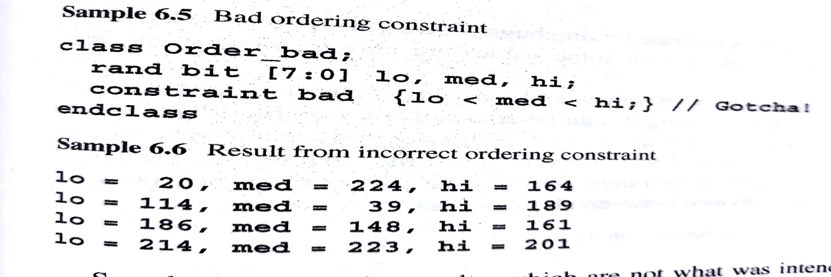
Constraint Details
Simple expressions
Constraint variables have to be in a fixed order
There can be only one relational operator (<, <=, ==, >= or >)
For multiple variables use multiple expressions
Declare a constraint to solve: 0 < a < b < c
Error!!! wrong way
right way
class Bus
rand bit[15:0] a,b,c;
constraint c1 { 0 < a < b < c; }
endclass
class Bus
rand bit[15:0] a,b,c;
constraint c1 { 0 < a;
a < b;
b < c;}
endclass

Slide 29
Constraint Details: Example
Set membership Operator: inside
If other constraints are absent, all values have an equal probability of being chosen by the inside operator
The negated (!) form of inside operator denotes that expression lies outside the set
addr is between 0 to 100
or between 1024 to 16384
multiple mutually exclusive
constraints can be defined
within one constraint
class Bus
rand bit[15:0] addr;
randc bit[31:0] data;
constraint range1
{
addr inside {[0:100],[1024:16384]};
data > 1000;
data < 10000;
}
endclass
Example: Constraint example with inside operator

Slide 30
Constraint Details: Quiz
Declare constraint blocks c1,c2,c3 and c4 so that variable x, a and v get the values shown:
x takes any values described in the constraint_block :
x is: 3,5,9,10,11,12,13,14,15,24,25,26,27,28,29,30,31,32
x is: 3,5,9,10,11,12,13,14,15,24,25,26,27,28,29,30,31,32, between y and 2y, z
rand integer x,y,z;
constraint c1 {x inside {3,5,[9:15],[24:32];}
constraint c1 {x inside {3,5,[9:15],[24:32],[y:2*y],z};}
b<=a and a<=c or b<=a<=c
rand integer a,b,c;
constraint c2 {a inside {b,c};}
c3: v is either 5,10,15,20
c4: v is never 5,10,15,20
integer fives[0:3] = {5,10,15,20};
rand integer v;
constraint c3 {v inside fives;}
constraint c4 !{v inside fives;}

Slide 31
Weighted Distribution
In constraint blocks, we can control the occurrence or repetition of the same value on randomization using dist operator.
Some values can be allocated more often to a random variable. This is called as weighted distribution. Weights will be specified to the values inside the constraint block.
Dist operator takes a list of values and weights, separated by := or :/

Slide 32
Weighted Distribution
Distributions: dist operator
Used to weigh some values more than the others
Property 1: They are a relational test for set membership
Property 2: They specify a statistical distribution function for the result
Can use := or :/ operator
:= specifies that the weight has to be the same for every specified value in the range
:/ operator specifies that the weight is to be equally divided between all values. If there are n values in a range the weight is range_weight/n
Values can be a single value or range such as [lo:hi]
The weights are not percentage and do not have to add up to a 100
Cannot be used with a randc
c1 should be 0 once and 1 five times
Error!!! wrong way
right way
rand integer a;
constraint c1 {a inside {0,1,1,1,1,1});
rand integer a;
constraint c1 {a dist {0:=1, 1:=5}};

Slide 33
Weighted Distribution
Another example
rand int src, dst;
costraint c1 {
src dist {0:=40, [1:3]:=60};
dst dist {0:=40, [1:3]:/60};
}
Example: Weighted random distribution with dist
src | weight
0 | 40/220
1 | 60/220
2 | 60/220
3 | 60/220
dst | weight
0 | 40/100
1 | 20/100
2 | 20/100
3 | 20/100

Slide 34
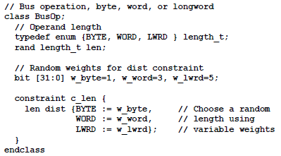
Weighted Distribution
Dynamically changing distribution weights
Example :
Here, the len enumerated variable has three values. The constraint defaults to choosing longword lengths, as w_lwrd has the largest value.

Slide 35
Weighted Distribution: Quiz
Distributions: dist operator := and :/
x is 100, 200 and 300 with a weight of 1,2 and 5 respectively
x dist {100:=1, 200:=2, 300:=5}
x is 100 and 300 with a weight of 1 and 5 respectively
x is never 200
x!=200;
x dist {100:=1, 300:=5}
x is 100, 101 , 102 with a weight of 1 each
x is 200 and 300 with a weight of 2 and 5 respectively
x dist {[100:102]:=1, 200:=2, 300:=5}
x is 100, 101 , 102 with a weight of 1/3 each
x is 200 and 300 with a weight of 2 and 5 respectively
x dist {[100:102]:/1, 200:=2, 300:=5}

Slide 36
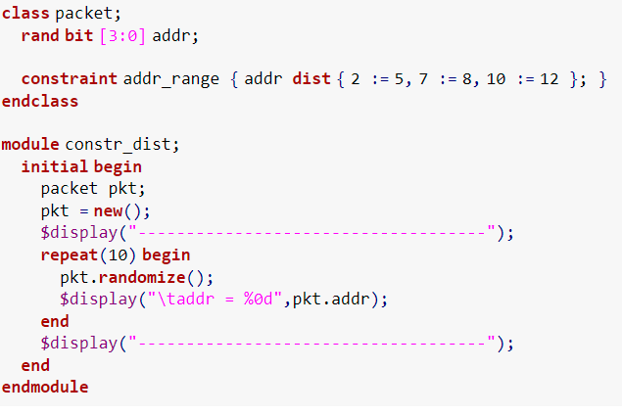
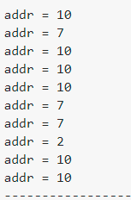

Slide 37
Bidirectional Constraints
Bidirectional Constraints
Constraint blocks are not procedural but declarative - All active at the same time
SystemVerilog constraints are bidirectional, which means that the solver looks at the constraints on both side of an expression.
Solve the constraint
30>d>b==c>=25
Solution
A
B
C
D
E
F
b | c | d
26 | 26 | 27
26 | 26 | 28
26 | 26 | 29
27 | 27 | 28
27 | 27 | 29
28 | 28 | 29
rand logic [15:0] b,c,d;
costraint c1 {
b<d;
c==b;
d<30;
c>=25;
}
Example: Bidirectional constraints
Solution :
b (and c) must be in the range 26 to 28.
d must be in the range (b + 1) to 29.
Solutions for Bidirectional Constraints

Slide 38
Conditional Constraints
Conditional constraint operators
Constraint provide two constructs for declaring conditional relations
Implication operator ->
if…else
if(mode==small)
len<10;
else if (mode==large)
len>100;
mode == small -> len<10;
mode == large -> len>100
Example: if…else example
Example: Equivalent implication example
bit [3:0] a,b;
if(a==0)
b==1;
bit [3:0] a,b;
constraint c {(a==0)->(b==1);}
Example: if…else example
Example: Equivalent implication example
In constraint blocks, we use curly braces, { }, to group multiple expressions.
The begin...end keywords are for procedural code.

Slide 39
Solution Probabilities
Whenever you deal with random values, you need to understand the probability of the outcome.
SystemVerilog does not guarantee the exact solution found by the random constraint solver, but you can influence the distribution.
Any time you work with random numbers, you have to look at thousands or millions of values to average out the noise. Changing the tool version or random seed can cause different results.
Some simulators, such as Synopsys VCS, have multiple solvers to allow you to trade memory usage vs. performance.
Unconstrained
Probability of distribution
Solution | x | y | Probability
A | 0 | 0 | 1/8
B | 0 | 1 | 1/8
C | 0 | 2 | 1/8
D | 0 | 3 | 1/8
E | 1 | 0 | 1/8
F | 1 | 1 | 1/8
G | 1 | 2 | 1/8
H | 1 | 3 | 1/8
class Unconstrained;
rand bit x; // 0 or 1
rand bit [1:0] y; //0,1,2,or 3
endclass
Example: Class with unconstrained random variables
There are 8 possible solutions and because there are no constraints each has the same probability
Solutions for Unconstrained class

Slide 40
Solution Probabilities
Implication
Probability of distribution changes due to the implication operator
Implication is bidirectional
class Imp1;
rand bit x; // 0 or 1
rand bit [1:0] y; //0,1,2,or 3
constraint c_xy {
(x==0)->y==0;
}
endclass
Solution | x | y | Probability
A | 0 | 0 | 1/2
B | 0 | 1 | 0
C | 0 | 2 | 0
D | 0 | 3 | 0
E | 1 | 0 | 1/8
F | 1 | 1 | 1/8
G | 1 | 2 | 1/8
H | 1 | 3 | 1/8
Example: Class with implication
Value of y depends on x. When x is 0, y is 0. Hence for x=0, y cannot have any other value and hence the probability of x=0 and y!=0 is 0
Solutions for Imp1 class
Random solver recognizes that there are eight combinations of x and y, but all the
solutions where x==0 (A–D) have been merged together.

Slide 41
Solution Probabilities
Implication and bidirectional constraints
Probability of distribution changes due to an addition constraint
class Imp_Bid;
rand bit x;
rand bit [1:0] y;
constraint c_xy {
y>0;
(x==0)->y==0;
}
endclass
Solution | x | y | Probability
A | 0 | 0 | 0
B | 0 | 1 | 0
C | 0 | 2 | 0
D | 0 | 3 | 0
E | 1 | 0 | 0
F | 1 | 1 | 1/3
G | 1 | 2 | 1/3
H | 1 | 3 | 1/3
Example: Class with implication and constraint
When x is 0, y is 0 but when y is 0 there is no constraint on x. Since implication is bidirectional, if y was forced to a non zero value, x would have to be 1. Hence x can never be 0.
Solutions for Imp_Bid class

Slide 42
Solution Probabilities
Guiding distribution with Solve…before
Solve…before does not change the solution space but changes the probability of the results.
class SolveBefore;
rand bit x;
rand bit [1:0] y;
constraint c_xy {
(x==0)->y==0;
solve x before y;
}
endclass
Solution | x | y | Probability
A | 0 | 0 | 1/2
B | 0 | 1 | 0
C | 0 | 2 | 0
D | 0 | 3 | 0
E | 1 | 0 | 1/8
F | 1 | 1 | 1/8
G | 1 | 2 | 1/8
H | 1 | 3 | 1/8
Example: Class with implication and solve…before
Here The solver chooses values of x (0, 1) with equal probability.
In 1000 calls to randomize, x is 0 about 500 times, and 1 about 500 times.
When x is 0, y must be 0. When x is 1, y can be 0, 1, 2, or 3 with equal probability.
Solutions for solve x before y constraint

Slide 43
Solution Probabilities
class SolveBefore;
rand bit x;
rand bit [1:0] y;
constraint c_xy {
(x==0)->y==0;
solve y before x;
}
endclass
Example: Class with implication and solve…before
Solution | y | x | Unconstrained Probability | Solution Possibility | Probability
A | 0 | 0 | 1/8 |  | 1/8
B | 0 | 1 | 1/8 |  | 1/8
C | 1 | 0 | 1/8 |  | 0
D | 1 | 1 | 1/8 |  | 1/4
E | 2 | 0 | 1/8 |  | 0
F | 2 | 1 | 1/8 |  | 1/4
G | 3 | 0 | 1/8 |  | 0
H | 3 | 1 | 1/8 |  | 1/4
Solutions for solve y before x constraint

Slide 44
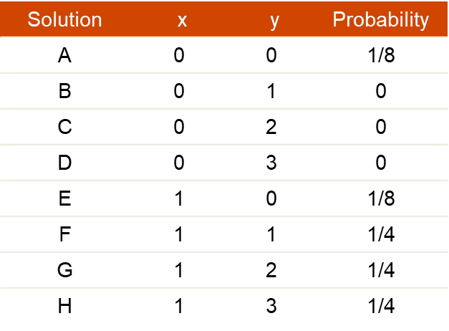
Solution Probabilities
Solve y before x
Since y is solved before x:
if y≠0 (y = 1, 2, or 3) , X cannot be 0 because x == 0 requires y==0, hence x must be 1
If y=0, x can be 0 or 1.
Probability:
Y has 4 possible values(0,1,2,3), Each y value has an equal probability of 1/4 since y is solved first
Case1: y=0 (1/4 probability)
x can be 0 or 1 with equal probability (1/2).
Probability of (x = 0, y = 0) = 1/4 × 1/2 = 1/8 (12.5%)
Probability of (x = 1, y = 0) = 1/4 × 1/2 = 1/8 (12.5%)
Case2: y≠0 (y = 1, 2, or 3, each with 1/4 probability)
x must be 1 due to constraint.
Probability of (x = 1, y = 1) = 1/4
Probability of (x = 1, y = 2) = 1/4
Probability of (x = 1, y = 3) = 1/4
Differences:
The probability of x = 0, y = 0 decreased. The probability of x = 1, y ≠ 0 increased because y is chosen first and directly affects x.

Slide 45
Solution Probabilities
Solve…before
if you use the constraint solve y before x, you get a very different distribution.
class SolveBefore;
rand bit x;
rand bit [1:0] y;
constraint c_xy {
(x==0)->y==0;
solve y before x;
}
endclass
Solution | y | x | Probability
A | 0 | 0 | 1/8
B | 0 | 1 | 1/8
C | 1 | 0 | 0
D | 1 | 1 | 1/4
E | 2 | 0 | 0
F | 2 | 1 | 1/4
G | 3 | 0 | 0
H | 3 | 1 | 1/4
Example: Class with implication and solve…before
Solution | x | y | Probability
A | 0 | 0 | 1/8
B | 0 | 1 | 0
C | 0 | 2 | 0
D | 0 | 3 | 0
E | 1 | 0 | 1/8
F | 1 | 1 | 1/4
G | 1 | 2 | 1/4
H | 1 | 3 | 1/4
Solutions for solve y before x constraint

Slide 46
Constraints
Iterative constraints
Allows arrayed variables to be constrained in a parameterized manner using loop variables
C1 constraints each element of an array to be in the set [2,4,8,16]
C2 constraints each element of an array to be greater than twice its index
class C;
rand byte A[4];
constraint C1{ foreach (A[i]) A[i]inside {2,4,8,16};}
constraint C2{ foreach (A[j]) A[j]> 2*j;}
endclass

Slide 47
Constraints
Iterative constraints
bit [3:0][2:1] B [5:1][4]
int A [2][3][4];
2
1
3
3
2
1
0
2
4
5:1
foreach (A[i,j,k])…
4
i iterates from 0 to 1
j iterates from 0 to 2
k iterates from 0 to 3
foreach (B[q,r,,s])…
q iterates from 5 to 1
r iterates from 0 to 3
s iterates from 2 to 1

Slide 48
Constraints
Functions in constraints
Some properties are unwieldy or impossible to express in a single expression
For instance computing the sum of one’s in a packed array uses a loop
Without the loop the loop will have to be unrolled
SystemVerilog allows constraint expressions to include function calls
Functions cannot contain output or ref arguments
Functions should be automatic
Functions that appear in constraints cannot modify the constraints
Functions shall be called before constraints are solved, and their return values shall be treated as state variables
Random variables used as function arguments shall establish an implicit variable ordering or priority
class B;
rand int x,y;
constraint C{x<=F(y);}
constraint D{ y inside {2,4,8};}
endclass
Forces y to be solved before x

Slide 49
Constraints
Constraint guards
Constraint guards are predicate expressions that function as guards against creation of constraints
They are not logical relations that have to be satisfied by the constraint solver
Prevents the solver from generating evaluation errors
Constraint guards are solved before the constraints and involve
Constants
State variables
Object handle comparisons
The constraint will fail on the last element due to a non existent handle in the linked list
class SList;
rand int n;
constraint sort{n<next.n;}
endclass
if statement acts as a constraint guard
class SList;
rand int n;
constraint sort{if(next!=null)n<next.n;}
endclass

Slide 50
Constraints
Constraint guards
Guard expressions can themselves include sub-expressions that result in evaluation errors
A 4-state representation is used where
0 : false -> Subexpression evaluates to FALSE
1 : true -> subexpression evaluates to TRUE
E: Error -> Subexpression causes an evaluation error
R: Random -> Expression includes random variables and cannot be evaluated
class D
int x;
endclass
class C;
rand int x,y;
D a,b;
constraint C1{(x<y || a.x > b.x || a.x==5) -> x+y==10;}
endclass
Case | a | b | a.x | b.x | Constraint
1 | !0 | 0 | 5 | error | x+y=10
2 | 0 | - | error | - | always error
3 | !0 | !0 | 10 | 20 | ( x<y) -> (x+y==10)

Slide 51
Constraints
Constraint guards
class D
int x;
endclass
class C;
rand int x,y;
D a,b;
constraint C1{(x<y && a.x > b.x && a.x==5) -> x+y==10;}
endclass
Case | a | b | a.x | b.x | Constraint
1 | !0 | 0 | 5 | error | error
2 | 0 | - | error | - | always error
3 | !0 | !0 | 5 | 2 | ( x<y) -> (x+y==10)

Slide 52
Disabling Random Variables
Disabling random variables with rand_mode()
Can be used to control whether a random variable is active or inactive
When a random variable is inactive it implies that the variable was never declared rand or randc
rand_mode() method is inbuilt and cannot be overridden
Value | Meaning | Description
0 | OFF | Sets the specified variable to inactive so that they are not randomized on subsequent calls to randomize() method
1 | ON | Sets the specified variable to active so that they are randomized on subsequent calls to randomize() method
class Packet;
rand integer src, dst;
endclass
int r;
Packet packet_a=new;
packet_a.rand_mode(0);
packet_a.src.rand_mode(1);
r=packet_a.dst.rand_mode();

Slide 53
Controlling Constraints
Controlling constraints with constraint_mode()
Can be used to control whether a constraint is active or inactive
When a constraint is inactive is not considered by randomize()
All constraints are initially active
constraint_mode method is built in and cannot be overridden
Value | Meaning | Description
0 | OFF | Sets the specified constraint block to inactive so that it is not enforced by subsequent calls to randomize() method
1 | ON | Sets the specified constraint block to active so that it is considered by subsequent calls to randomize() method
class Packet;
rand integer src, dst;
constraint filter{src>2*dst;}
endclass
function integer toggle_rand (Packet p);
if (p.filter.constraint_mode()==1)
p.filter.constraint_mode(0);
else
p.filter.constraint_mode(1);
toggle_rand=p.randomize();
endfunction

Slide 54
rand_mode method
The rand_mode() method is used to disable the randomization of a variable declared with the rand/randc keyword.
rand_mode(1) means randomization enabled
rand_mode(0) means randomization disabled
The default value of rand_mode is 1, i.e enabled
Once the randomization is disabled, it is required to make rand_mode(1) enable back the randomization
rand_mode can be called as SystemVerilog method, the randomization enable/disable .
Status of a variable can be obtained by calling variable.rand_mode().

Slide 55
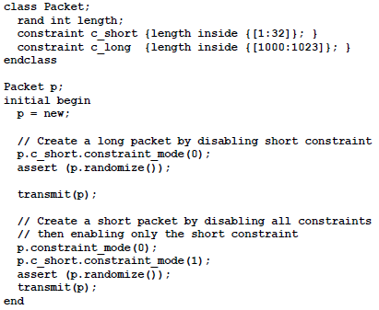
Controlling Multiple Constraint Blocks
A class can contain multiple constraint blocks. Your class might naturally divide into two sets of variables, such as data vs. control, so you may want to constrain them separately. Or you might want to have a separate constraint for each test.
Perhaps one constraint would restrict the data length to create small
transactions (great for testing congestion), while another would make long transactions.
At run-time, you can use the constraint_mode() routine to turn constraints on and off.
When used with handle.constraint, this method controls a single constraint.
When used with just handle, it controls all constraints for an object.

