Slide 1
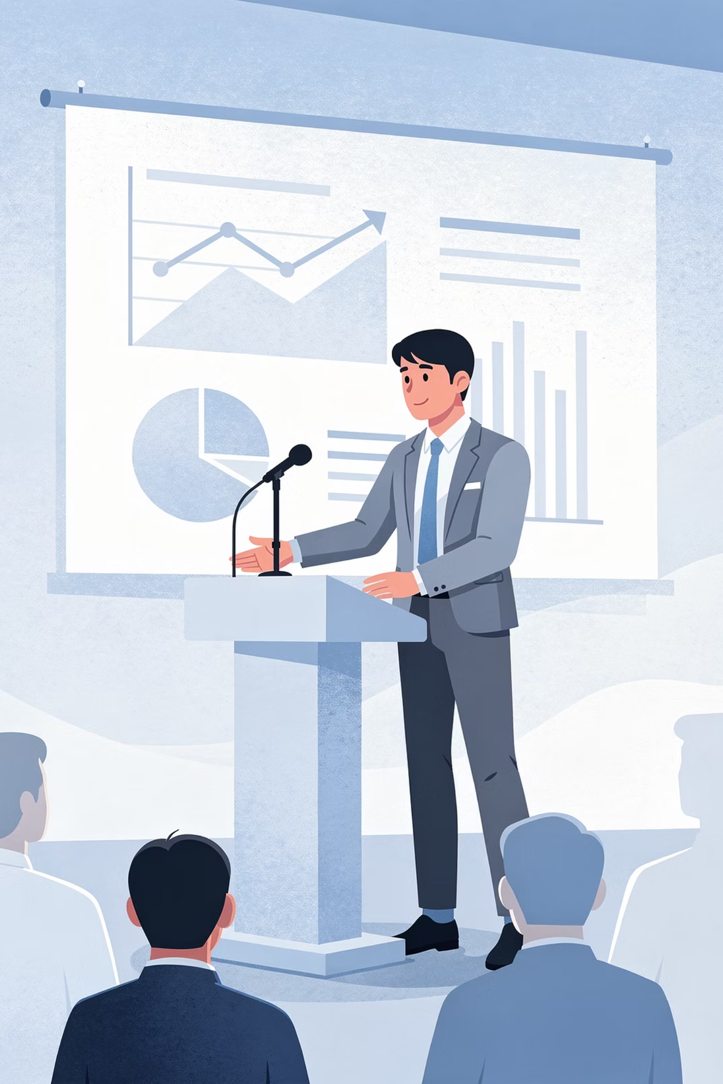
Session 25 :
Deliver & Reflect

Slide 2





Objectives
By the end of this hour, you will have accomplished the following:
Delivered
Defended
Received Feedback
Reflected
Mapped Pathways

Slide 3
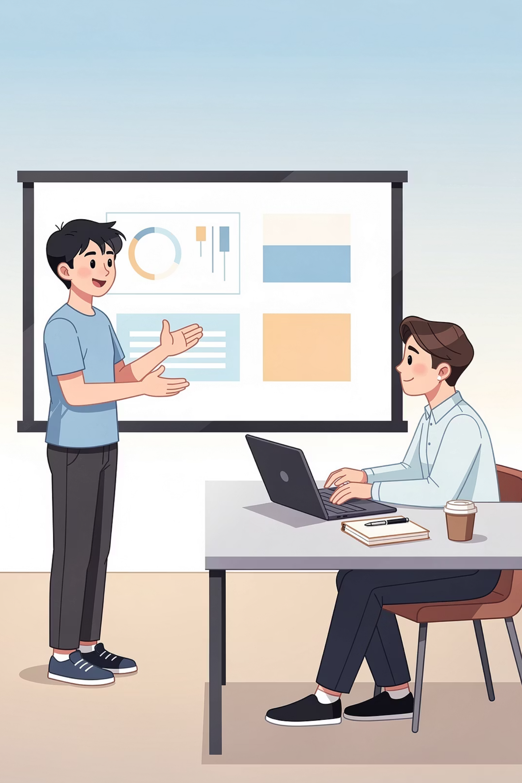
Your Presentation
You'll present your investigation now, using the Gamma slides you built and practiced.

Slide 4


Your Reflection
Before & After
Biggest Surprise
Turning Point
Proudest Moment
Do-Over
Meaning
There's no right answer to any of them. The goal is to articulate, in your own words, what changed in you.

Slide 5
Sharing Your Work
Your paper has been written to a structure used in research. Several journals accept submissions from student researchers like you.
The International Journal of Engineering and Science
International Journal of Research in Engineering, Science and Management
theijes.com
ijresm.com
American International Journal of Social Science
National Association for Interdisciplinary Research
aijsh.com
nairjc.com
RSIS International
International Journal of Novel Trends in Research
rsisinternational.org
ijntr.org

Slide 6
Your Prompt Library
Your prompt library is the collection of tested prompts you built starting in Session 11 - for ChatGPT, Gemini, NotebookLM, image generation, audio generation, and more.
What It Is
Why It Works
How to Use It
Compiled into a single document - all the prompts you tested and refined across Sessions 11-21.
The prompts are specific to use cases you encountered. They work because you tested them - not because someone else wrote them.
Use these prompts when you continue investigating, when you write papers in school, when you experiment with new AI tools.

Slide 7
What This Capstone Was Designed to Do
The capstone was designed to teach you four things you can do for the rest of your life. These skills compound - they apply to history papers, science investigations, professional reports, anything you'll need to investigate seriously.
Frame a Research Question
Find Credible Sources
Investigate with Depth
Communicate Findings
Distinguish real, useful sources from low-quality information
Combine reading with hands-on understanding
Move from raw work to a polished paper and a clear presentation
Take a topic and sharpen it into something investigable

Slide 8
What's Different About You Now
A useful question: what can you do now that you couldn't do before Session 1?
Real Work with AI Tools
Detecting Hallucination
Bias & Safety Awareness
Serious Investigation
Research Writing
Presenting Under Pressure

Slide 9
How Your View of AI Evolved
Where You Started
Where You're Ending
You started this program with whatever you thought AI was - perhaps a magic tool, perhaps a threat, perhaps something in between.
You're ending with a more accurate picture:
A useful tool that can also be wrong, biased, and unsafe
A technology that needs human oversight
A field that's changing fast
A domain being shaped by who builds it and how

Slide 10




The Research Framework
You started this capstone investigating one domain. You're ending it knowing how to investigate any domain.
Discover
Research
Find a domain and sharpen a question worth investigating
Gather credible sources and build your literature foundation
Deliver
Analyze
Communicate findings in writing and presentation
Combine reading with hands-on exploration and draw findings
This four-stage arc works for any topic you want to take seriously - AI in finance, climate solutions, mental health, local policy. Anything. The structure is portable. Take it with you.

Slide 11
Your Achievements
You Learned
You Investigated
You Wrote
You Spent 25 Sessions
How to think more carefully about a technology reshaping the world
Something that mattered to you, with rigor and honesty
A paper that didn't exist before - in your voice, about your findings
Doing real work.

Slide 12

Stay curious.
Stay honest.
Keep building.
The capstone ends. What you do next doesn't have to.

