Slide 1
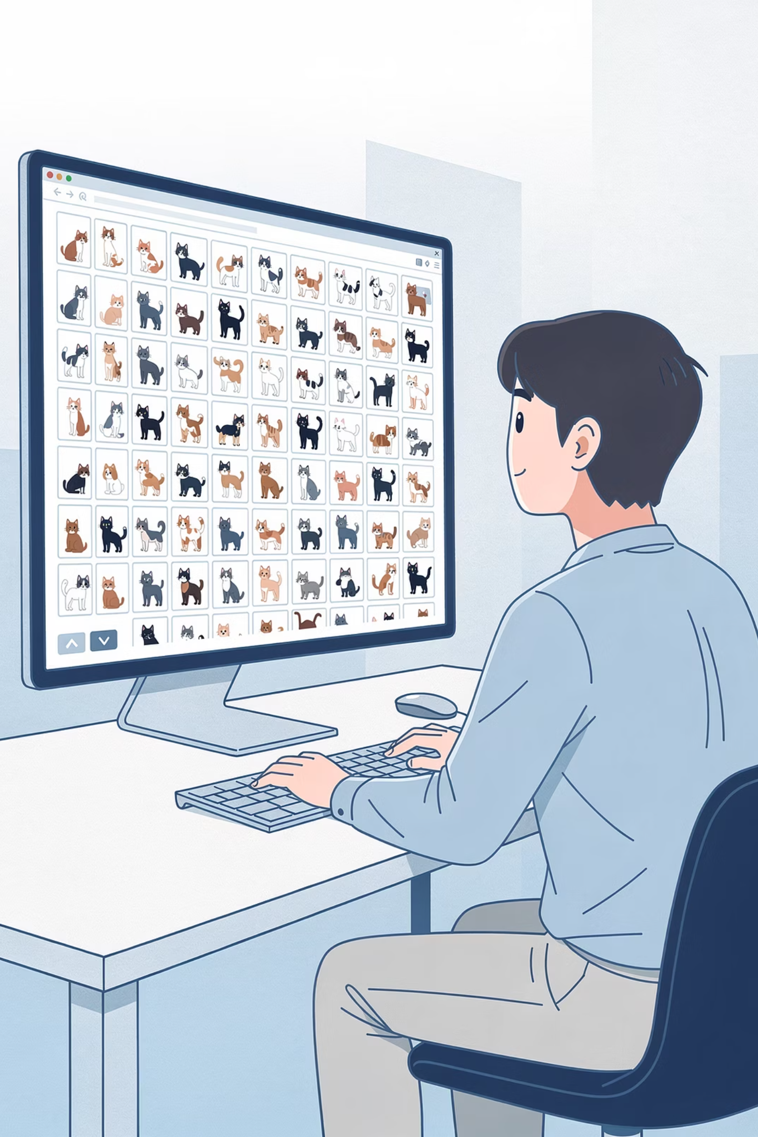
Session 6 :
Training Your Own AI Model

Slide 2
Objectives:
01
02
03
Understand Kaggle
Train a Model
Test Your Model
04
05
Compare Data Amounts
Observe Epochs

Slide 3
Recap : What We Learned in Session 5
Concept
What It Means
Dataset
A collection of examples used to teach AI
Features
The clues AI pays attention to (ears, face shape, fur)
Training Data
Practice examples AI learns from
Testing Data
New examples that check if AI really learned
Generalization
Being able to handle NEW situations – the goal
Overfitting
When AI memorizes instead of truly learning
Bias
When data is unfair or leaves groups out
Garbage In = Garbage Out
Bad data = bad AI, no matter what

Slide 4





What is Kaggle?
Kaggle is an online platform used by AI enthusiasts, data scientists, machine learning engineers and anyone looking for real-world datasets.
Datasets
Competitions
Tools
Community
Our dataset comes from:
kaggle.com - Cat and Dog Dataset

Slide 5
Our Dataset Structure
cat-and-dog-dataset/
├── training_set/ ← Images for TRAINING
│ ├── cats/ ← Many cat photos
│ └── dogs/ ← Many dog photos
└── test_set/ ← Images for TESTING
├── cats/ ← NEW cat photos (AI has never seen these!)
└── dogs/ ← NEW dog photos (AI has never seen these!)

Slide 6

Folder
What's Inside
Purpose
training_set/cats/
Hundreds of cat photos
Teaching the AI what cats look like
training_set/dogs/
Hundreds of dog photos
Teaching the AI what dogs look like
test_set/cats/
Many NEW cat photos
Testing - AI has never seen these!
test_set/dogs/
Many NEW dog photos
Testing - AI has never seen these!
Important: The images in test_set are brand new - the AI has never seen them during training. This helps us check if it really learned or just memorized.

Slide 7

🎮 Mini Activity : Build the Dataset
If we want to train an AI to recognize cats and dogs, what kinds of images should our dataset contain?
🐱 Cat Breeds
🐶 Dog Breeds
Persian, Siamese, tabby
Golden Retriever, Poodle, Labrador
📐 Angles
🌳 Backgrounds
Front, side, looking away, from above
Homes, parks, streets, grass
💡 Lighting
🐾 Ages
Bright sun, dim rooms, shadows
Kittens, puppies, adults, seniors
Question: What would happen if our dataset only had white cats and brown dogs? Discuss with your mentor.

Slide 8




Using Datasets to Train AI Models
Get a Dataset
Train the Model
Test the Model
Improve the Model

Slide 9

Training an Image Classification Model
An image classification model is a type of machine learning model that identifies objects in pictures.
Examples:
Models Learn By Analyzing:
Recognizing animals
Shapes
Detecting handwritten numbers
Colors
Identifying plants from photos
Textures
Recognizing faces to unlock phones
Edges

Slide 10
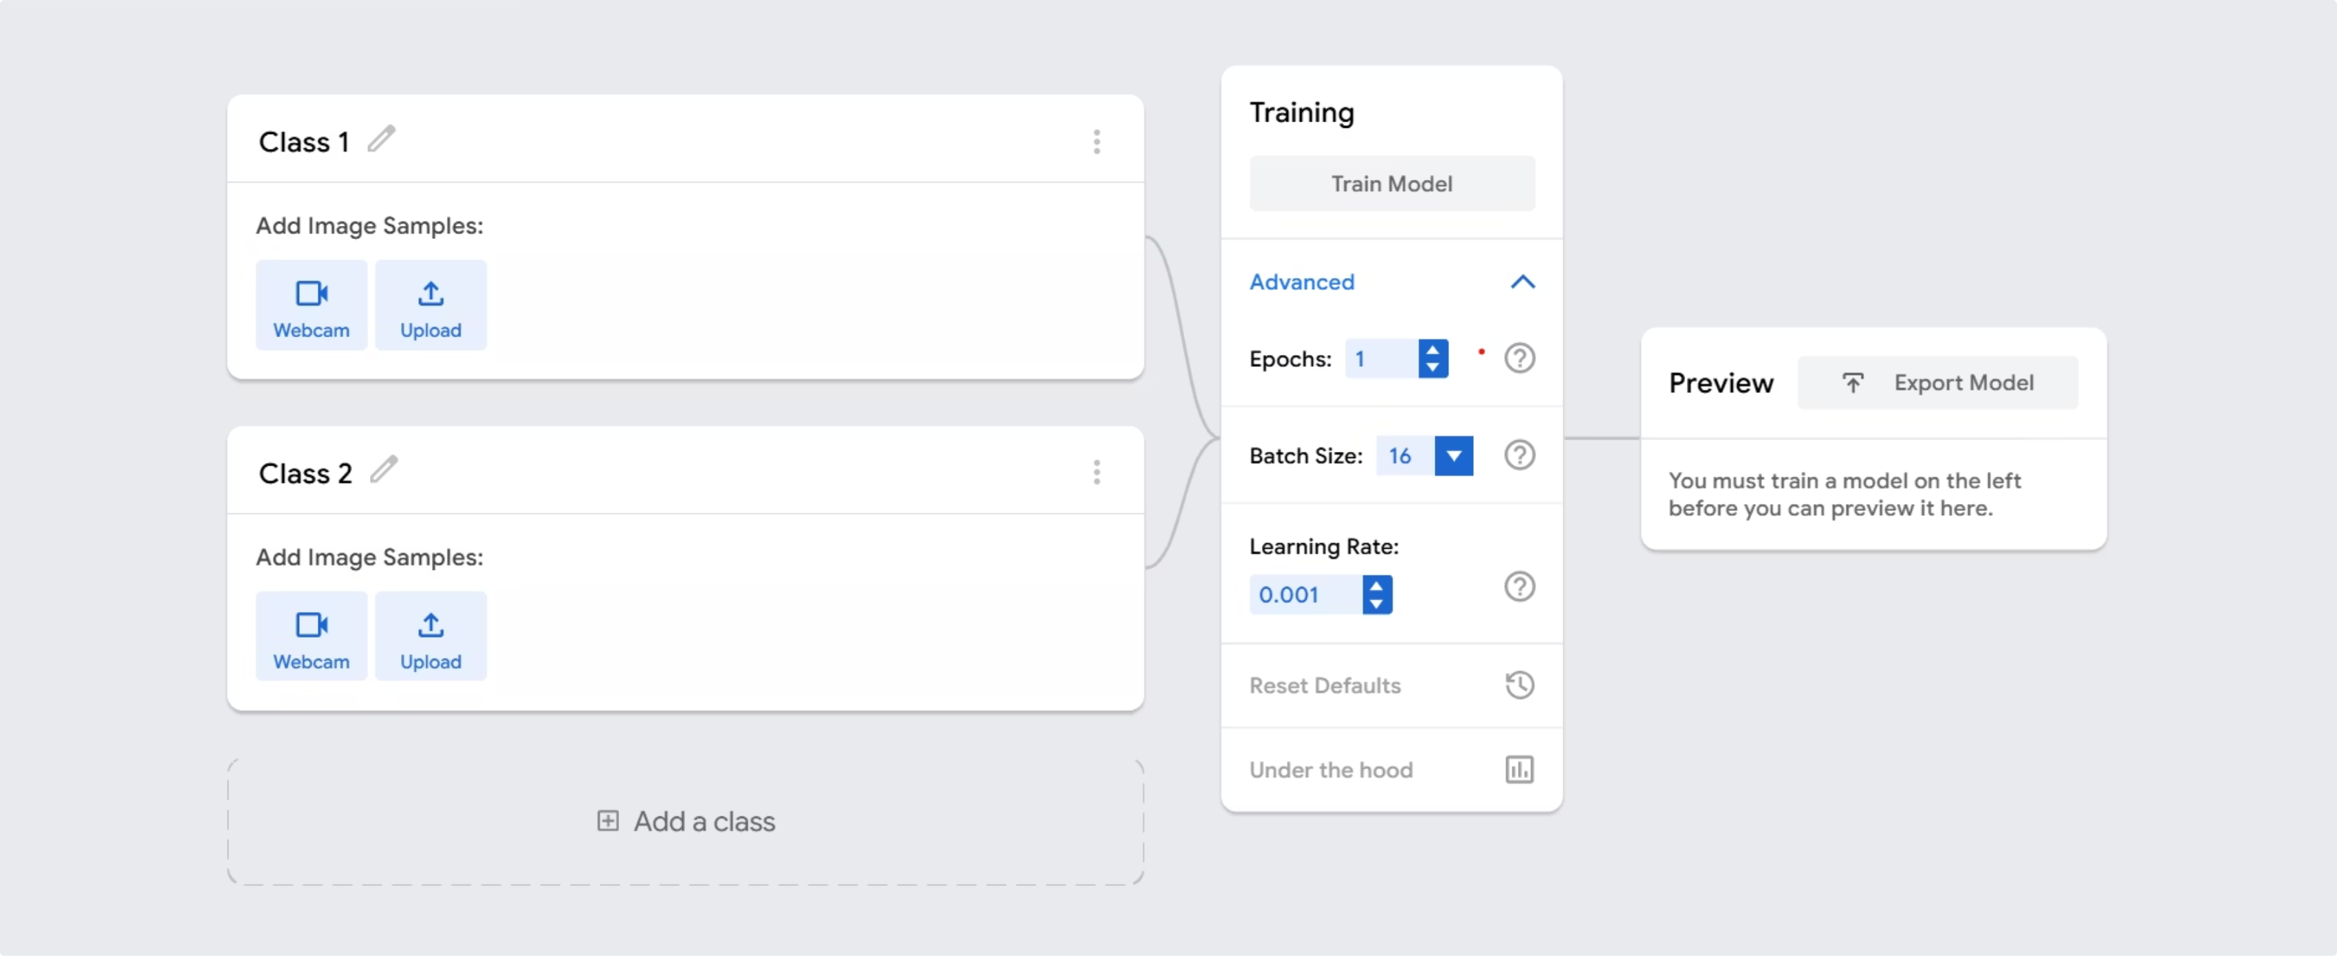
Google Teachable Machine

Slide 11
Understanding the Interface
Term
What It Does
Image Samples
Shows how many photos you've uploaded
Upload
Button to add images from your computer
Preview
Area to test your model with new images
Train Model
Button that starts the learning process
Advanced
Hidden settings for training
Epochs
How many times the AI sees all images
Output
Results showing confidence scores

Slide 12
🖐️ Hands-On Activity : Cat vs Dog AI Model
We will run 4 simple experiments using our Kaggle dataset. For testing, we'll use the same 4 images every time:
2 Cat Images
2 Dog Images
From test_set/cats/
From test_set/dogs/
Your mentor will tell you exactly which files to use (for example, "the first two cat images and first two dog images").

Slide 13

Experiment 1
1 image per class, 1 epoch
Experiment 2
10 images per class, 1 epoch
Experiment 3
~100 images per class, 1 epoch
Experiment 4
~100 images per class, 50 epochs

Slide 14



Experiment 1 : Very Little Data
1 image per class · 1 epoch
Prediction: What do you think will happen with only 1 cat photo and 1 dog photo?
Upload Training Images
Set Epochs to 1
Train the Model

Slide 15
Test Experiment 1
Now test your model on the 4 test images (provided by your mentor).
Image
Cat %
Dog %
Correct?
Test cat 1
___%
___%
Test cat 2
___%
___%
Test dog 1
___%
___%
Test dog 2
___%
___%
Total correct: ___ out of 4

Slide 16
Observations
Question
Your Answer
Did it recognize the training images? (Try them!)
Did it recognize new test images?
Was confidence higher on training images or test images?

Slide 17




Experiment 2 : A Bit More Data
10 images per class · 1 epoch
Prediction: What do you think will happen with 10 images per class?
Clear Old Data
Upload 10 Images Each
Keep Epochs = 1
Train the Model

Slide 18
Test Experiment 2
Test on the same 4 test images again.
Image
Cat %
Dog %
Correct?
Better than Exp 1?
Test cat 1
___%
___%
Test cat 2
___%
___%
Test dog 1
___%
___%
Test dog 2
___%
___%
Total correct: ___ out of 4

Slide 19
Compare Results
Experiment 1 (1 image)
Experiment 2 (10 images)
Correct out of 4
/4
/4
What do you notice? Did more data help?

Slide 20
Experiment 3: More Data
~100 images per class · 1 epoch
Prediction: What do you think will happen with around 100 images per class?
Clear Old Data
Upload Around 100 Images Each
Keep Epochs = 1
Train the Model

Slide 21
Test Experiment 3
Test on the same 4 test images.
Image
Cat %
Dog %
Correct?
Compare to Exp 2
Test cat 1
___%
___%
Test cat 2
___%
___%
Test dog 1
___%
___%
Test dog 2
___%
___%
Total correct: ___ out of 4

Slide 22
Compare Results
Exp 1 (1)
Exp 2 (10)
Exp 3 (~100)
Correct out of 4
/4
/4
/4
What do you notice? Did more data help? Why do you think that happened?

Slide 23
Experiment 4: More Training
~100 images per class · 50 epochs
Prediction: What do you think will happen if we train for much longer on the same images?
Keep Same Data
Increase Epochs to 50
Train the Model

Slide 24
Test Experiment 4
Test on the same 4 test images one last time.
Image
Cat %
Dog %
Correct?
Compare to Exp 3
Test cat 1
___%
___%
Better? Worse?
Test cat 2
___%
___%
Better? Worse?
Test dog 1
___%
___%
Better? Worse?
Test dog 2
___%
___%
Better? Worse?
Total correct: ___ out of 4

Slide 25
What Happened? Check One:
Got BETTER than Experiment 3
Got WORSE than Experiment 3
Stayed about the SAME
More training helped the model generalize even further.
The model may have started to overfit.
The model may have already learned all it could from the data.
What do you think caused this?
If it got worse, this could be overfitting - when AI memorizes instead of learning. If it stayed the same, maybe it learned all it could from the data.

Slide 26
Compare All 4 Experiments
Experiment
Images per Class
Epochs
Correct out of 4
1
1
1
/4
2
10
1
/4
3
around 100
1
/4
4
around 100
50
/4
Which experiment worked best? Experiment ___

Slide 27
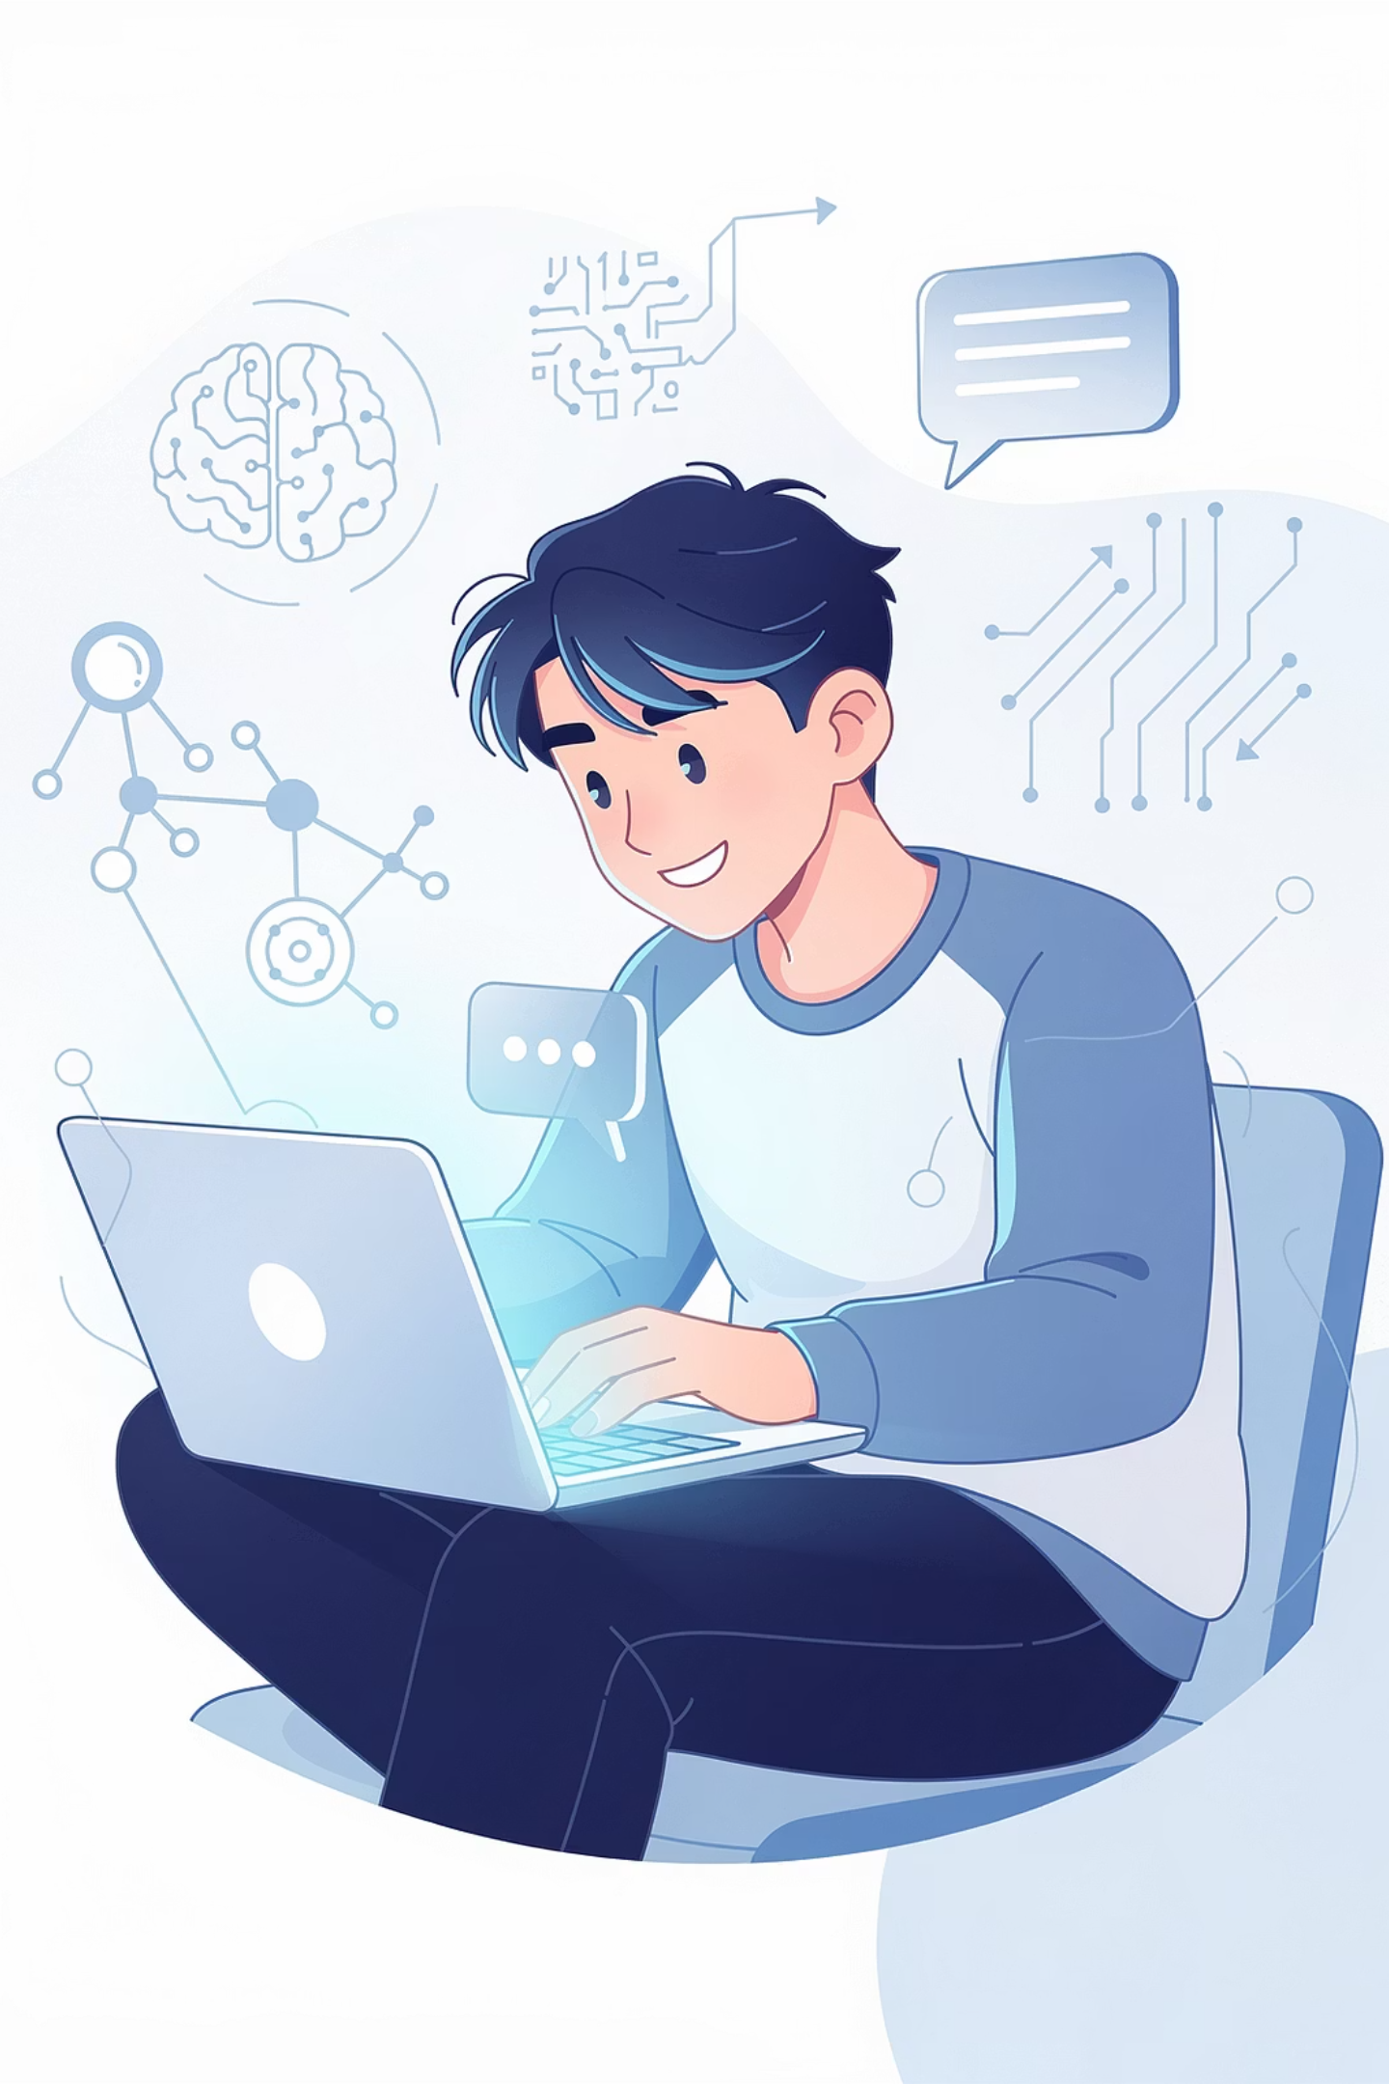
Key Takeaways
With very few images (1) - The AI could only memorize, not learn real patterns
With more images (10) - Performance improved a bit
With many images (around 100) - Performance improved a lot
With too much training (50 epochs) - Sometimes helps, sometimes causes overfitting

Slide 28
Real-World AI Uses the Same Process
1M+
100+
95%+
Images
Epochs
Accuracy
ImageNet, a famous dataset, has over 1 million labeled images used to train real AI models
Professional models are often trained for hundreds of epochs with careful monitoring
State-of-the-art image classifiers can achieve over 95% accuracy on test data

Slide 29
Summary : What We Learned Today
Kaggle
training_set
test_set
A website where data scientists share datasets
Folder with dataset used to teach the AI
Folder with brand new dataset to test real learning
Image Classification
Epochs
Confidence Score
AI that looks at pictures and decides what they show
How many times the AI studies all the training images
A percentage showing how sure the AI is about its prediction
Limited Data
Generalization
Overfitting
Not enough examples to learn properly
Being able to handle new situations
When AI memorizes instead of truly learning

Slide 30




Homework
Find a dataset online (any topic - images, text, sports, music, weather, anything interesting!)
Some Places to Look:
Answer These Questions:
Kaggle (explore their datasets section)
What type of data does the dataset contain? (Images? Numbers? Text? Audio?)
Government data websites
What problem could this dataset help solve? (Example: "This dataset of house prices could help predict what a house is worth.")
Sports statistics websites
Any public dataset you can find
What challenges might appear when training a model using this dataset?

Slide 31
Next Session Preview
Session 7: What is Generative AI?
You've trained AI to recognise things — next session, you'll discover AI that can create them. Text, images, audio, and more. Welcome to Generative AI.

