Slide 1

Session 14:
AI That Reads - Natural Language Processing (NLP)

Slide 2
Objectives
01
02
03
04
Define NLP
The Three‑Stage Pipeline
Breaking Down NLP Steps
Common NLP Tasks
05
06
07
Challenges in NLP
Hands‑On Tools
Prompt Library

Slide 3

Recap: What We Learned in Session 13
Key Idea
What It Means
Domain‑specific prompting
Adapt your prompt to creative, everyday, research, learning, or writing tasks.
Verification
Always check AI facts against trusted sources.
Transparency
Be honest about using AI - you are the author.
QuillBot
A tool for paraphrasing and polishing your own writing.
Responsible AI use
AI is a thinking partner, not a shortcut.
You can use AI for real tasks, from planning a picnic to writing a story but you stay in control, verify facts, and never submit AI work as your own.

Slide 4
The Language Puzzle
Sentence 1
Sentence 2
Sentence 3
"I saw a man on a hill with a telescope."
"Time flies like an arrow"
"Great weather we're having!"
Big Question: How does AI turn messy human language into something it can "understand" and then use that to help us?

Slide 5

What is Natural Language Processing (NLP)?
Natural Language Processing is the branch of AI that gives computers the ability to read, interpret, and generate human language.
Think of NLP as a translator between human and machine.

Slide 6
Where you see NLP every day
Spell checkers
Translation apps
Chatbots
Voice assistants
NLP doesn't "understand" like you do.
It finds patterns in billions of sentences and uses those patterns to predict what makes sense.

Slide 7




How NLP works:
The Three‑Stage Pipeline
Understand
Break
Generate
These stages happen in milliseconds. The AI doesn't "think", it follows mathematical steps.

Slide 8
Stage 1: BREAK - Chopping Text into Edible Pieces
The main "chopping" techniques:
Tokenization
Stemming
Lemmatization
Splitting text into tokens - words, punctuation, or sub‑words.
Chopping off word endings to get a root form.
Reducing a word to its dictionary form (more accurate than stemming).
"I love AI!" → ["I", "love", "AI", "!"]
"playing", "played", "plays" → all become "play"
"better" → "good" | "ran" → "run"
The AI can only work with tokens, not raw strings.
Helps group similar words without needing a dictionary.
Preserves real meaning. Useful for search engines and chatbots.

Slide 9
Stage 2: UNDERSTAND (NLU - Natural Language Understanding)
Part‑of‑Speech (POS) Tagging
Named Entity Recognition (NER)
Labeling each token as noun, verb, adjective, etc.
Finding and classifying named things - people, places, organisations, dates, quantities.
Why it matters: Knowing a word's role helps understand sentence structure.
Why it matters: Search engines, calendars, and news summarisers rely on NER.
All these "break" steps happen before the AI even tries to understand the meaning. They turn raw text into structured data.

Slide 10
Once the text is broken down, the AI needs to understand what it means.
Intent
Sentiment
Relationships
What does the user want?
Positive, negative, or neutral?
Who did what to whom?
(e.g., "What's the weather?" → intent = get forecast)
(e.g., "John gave Mary a book." → giver = John, receiver = Mary, object = book)
Example of NLU in action:
User types: "Can you turn off the living room lights?"
Intent = control device
Device = lights
Location = living room
Action = turn off
NLU is pattern matching, not true understanding. The AI doesn't "know" what a light is - it has learned that the words "turn off" + "lights" often appear together in commands.

Slide 11
Stage 3: GENERATE (NLG - Natural Language Generation)
A chatbot reply
A summary of a long article
A translated sentence
A story or poem
NLG uses the same next‑word prediction you learned in Session 8. It predicts the most likely sequence of tokens based on the input and its training.

Slide 12
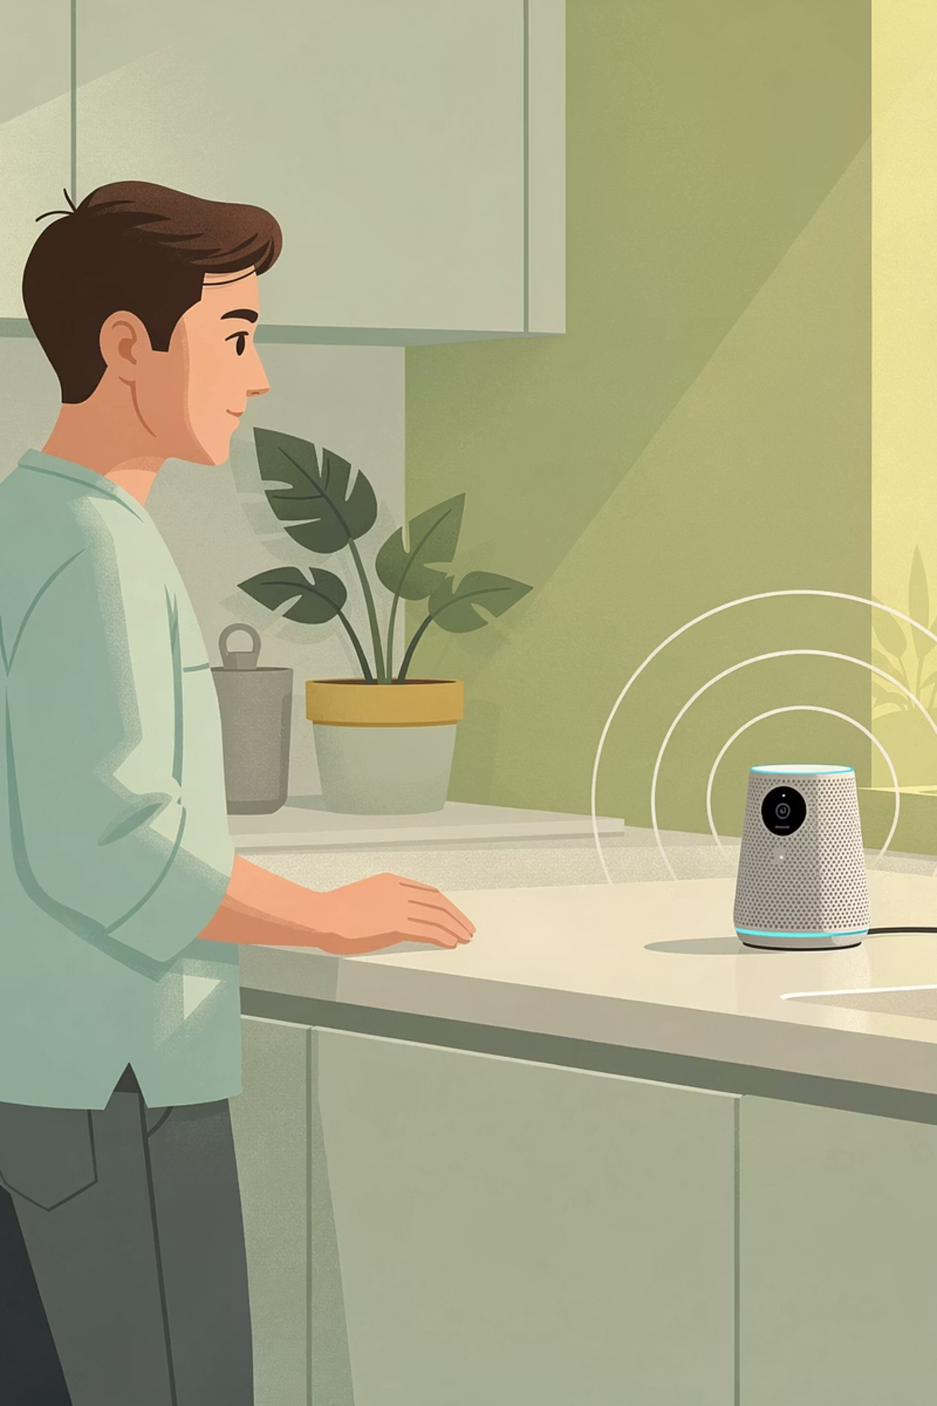

Putting It All Together: A Complete Example
Sentence: "Siri, what's the weather in Tokyo tomorrow?"
Stage
What happens
BREAK
Tokenize: ["Siri", ",", "what", "'s", "the", "weather", "in", "Tokyo", "tomorrow", "?"]
POS tagging: "Siri" (proper noun), "what" (pronoun), "weather" (noun), "Tokyo" (proper noun), "tomorrow" (adverb)
NER: "Siri" (product), "Tokyo" (location), "tomorrow" (date)
UNDERSTAND (NLU)
Intent = get weather forecast | Location = Tokyo | Time = tomorrow
GENERATE (NLG)
"Tomorrow in Tokyo, it will be partly cloudy with a high of 18°C."
All of this happens in less than a second!

Slide 13
Mini Activity 1: Match the NLP Break Step
Instructions: For each description, write which Break step it matches: Tokenization, Stemming, Lemmatization, POS Tagging, NER.
Description
Break Step
Splitting "I'm learning!" into ["I", "'m", "learning", "!"]
Tokenization
Reducing "running" to "run" (even if "run" is not the dictionary form)
Stemming
Reducing "better" to "good" (using a dictionary)
Lemmatization
Labeling "cat" as a noun and "sleeps" as a verb
POS Tagging
Finding "Amazon" as a company and "Jeff Bezos" as a person
Named Entity Recognition (NER)

Slide 14
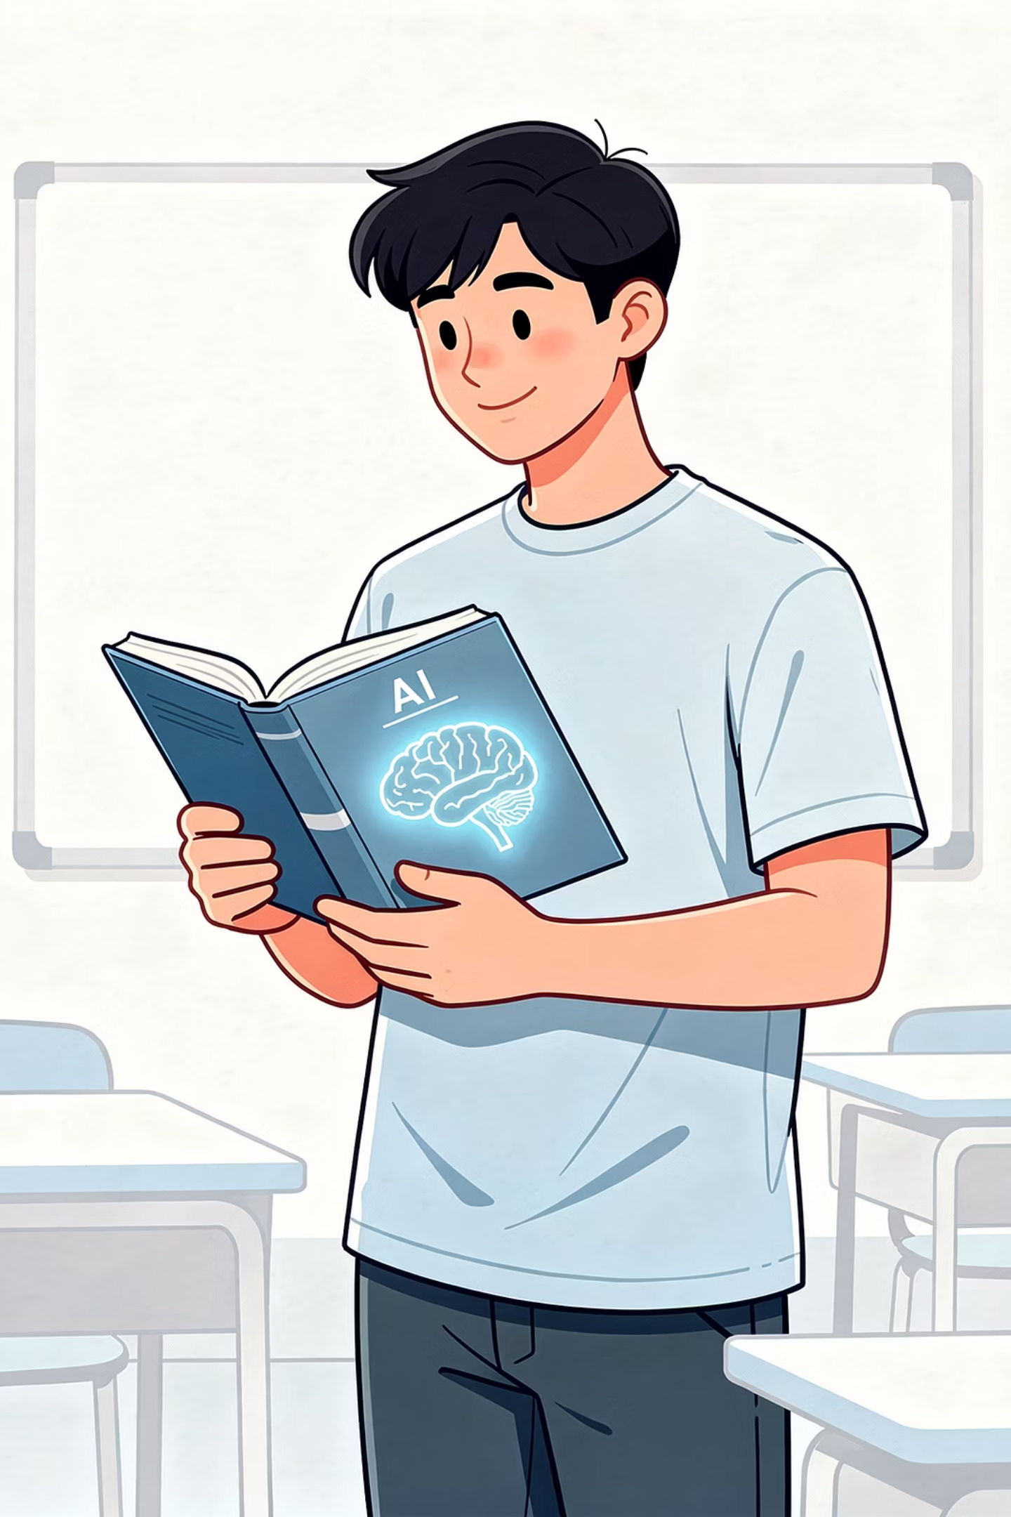
How ChatGPT Uses
"Break → Understand → Generate"
Stage
What ChatGPT does
Break
Converts your sentence into tokens (small pieces of words)
Understand
Uses a transformer to analyse the context and relationships between those tokens
Generate
Predicts the most likely next word in the sequence, one token at a time, to build a reply

Slide 15

How ChatGPT Uses "Break → Understand → Generate"
How ChatGPT works under the hood
What is a "transformer" in simple words?
ChatGPT uses Natural Language Processing (NLP) by leveraging a transformer‑based model to convert text into tokens, analyzing context and relationships between words, and predicting the most likely next word in a sequence.
A transformer is a type of AI model that is very good at paying attention to the right words, even if they are far apart in a sentence. It looks at all the words at once, decides which ones matter most for understanding the meaning, and uses that to predict the next word
So every time you chat with ChatGPT, you are seeing the "Break → Understand → Generate" Framework in action. You are no longer just using the car - you are looking inside the engine.

Slide 16

Common NLP Tasks
Sentiment Analysis
Machine Translation
Summarisation
Paraphrasing
Question Answering
Named Entity Recognition (NER)

Slide 17
Challenges in NLP
Ambiguity
Sarcasm & Irony
Idioms
Cultural Context
Bias
Low‑Resource Languages
Long‑Range Dependencies
NLP is powerful, but it's not perfect.
Always verify important information, especially when sarcasm or ambiguity might be involved.

Slide 18
Mini Activity 2: Spot the NLP Challenge
Instructions: For each sentence, identify which NLP challenge is present.
Choose from: Ambiguity, Sarcasm/irony, Idiom, Cultural context, Bias.
Sentence
NLP Challenge
"The bank was steep, so we had to climb carefully." (bank = river side, not money)
Ambiguity
"Break a leg!" (said to a performer before a show)
Idiom
"That's just what I needed – another pop quiz." (said after a pop quiz is announced)
Sarcasm/irony
A chatbot trained on American English tells a British user to "put your sweater in the trunk" (instead of "boot").
Cultural context
An image captioning AI always labels people with darker skin as "cook" and lighter skin as "chef".
Bias

Slide 19
NLP in the Real World
Grammar Checkers
Customer Support Chatbots
Smart Reply in Email
Voice Search on Smart Speakers

Slide 20
NLP in the Real World
Plagiarism Detection
Medical Record Analysis
e.g., Turnitin - Text matching, tokenization
NER, classification
Compares student essays against billions of web pages
Extracts "patient name", "diagnosis", "medication" from doctor's notes
Social Media Moderation
Personalised News Feed
Sentiment analysis, classification
Text classification, summarisation
Flags a comment containing hate speech or bullying
Groups articles by topic (sports, politics, tech) and shows you a summary

Slide 21

Hands‑On Activity:
Perform Common NLP Tasks
Goal: Perform five common NLP tasks using the tools we've focused on: QuillBot, Google Translate, ChatGPT/Gemini, and NotebookLM.
You'll experience sentiment analysis, translation, summarisation, paraphrasing, and named entity recognition.

Slide 22




Hands‑On Activity: Perform Common NLP Tasks
QuillBot
Google Translate
ChatGPT / Gemini
NotebookLM
quillbot.com
translate.google.com
chat.openai.com or gemini.google.com
notebooklm.google.com
Sample text (use for multiple tasks): "Starfish, also known as sea stars, are marine invertebrates found in oceans all over the world. They have five or more arms and can regenerate lost limbs. Starfish use tiny tube feet to move and to open shellfish like clams and mussels. They do not have a brain or blood; instead, they use seawater to pump nutrients through their bodies."

Slide 23
Task 1: Sentiment Analysis (ChatGPT/Gemini)
Goal: Determine if a piece of text is positive, negative, or neutral.
1
In ChatGPT or Gemini, type: "Perform sentiment analysis on the following text. Tell me if it is positive, negative, or neutral, and explain why in one sentence."
2
Paste this sentence: "I tried the new blueberry muffin from the school cafeteria, and it was absolutely delicious – best one yet!"
3
Write down the AI's answer.
4
Now try a negative sentence: "The math homework took me two hours and I still don't understand half of it."
5
Compare the two responses.
Reflection: Did the AI correctly identify the sentiment? Was it ever unsure?

Slide 24
Task 2: Machine Translation (Google Translate)
Goal: Translate text from English to another language and back.
1
Open Google Translate.
2
Set source language to "English" and target language to "Spanish".
3
Type or paste: "Where can I find a good book about space exploration?"
4
Write down the Spanish translation.
5
Now copy the Spanish translation and paste it back into Google Translate, changing the source to "Spanish" and target to "English".
6
Compare the back‑translated English with the original sentence.
Reflection: Did the meaning change? Try the same with an idiom: "It's raining cats and dogs." What happens?

Slide 25
Task 3: Summarisation (NotebookLM)
Goal: Create a short summary of a longer text using a source‑grounded tool.
1
In NotebookLM, create a new notebook called "NLP Tasks".
2
Add the sample text about starfish as a source (copy‑paste as text source).
3
In the chat box, ask: "Summarise this text in two sentences for a 5th grader."
5
4
Write down the summary.
Now ask a more specific question: "What are tube feet and what do starfish use them for? Answer in one sentence."
Reflection: How is NotebookLM's summary different from what ChatGPT might produce without the source?

Slide 26
Task 4: Paraphrasing (QuillBot)
Goal: Rewrite a sentence while keeping the same meaning.
1
Open QuillBot.
2
Copy the first sentence of the sample text: "Starfish, also known as sea stars, are marine invertebrates found in oceans all over the world."
3
Paste it into QuillBot and click "Paraphrase".
4
Try at least two different modes: "Standard", "Fluency", "Creative".
5
Write down your favourite paraphrased version.
6
Compare it with the original. Did the meaning change?
Reflection: When would paraphrasing be useful? (e.g., avoiding repetition, simplifying language, improving clarity.)

Slide 27
Task 5: Named Entity Recognition (ChatGPT/Gemini)
Goal: Extract people, places, organisations, and dates from a sentence.
1
In ChatGPT or Gemini, type: "Perform named entity recognition (NER) on the following sentence. List each entity and its type (person, location, organisation, date, etc.)."
2
Paste this sentence: "Marie Curie was born in Warsaw, Poland in 1867. She later moved to Paris, France, where she discovered radium and polonium."
3
Write down the entities the AI finds.
4
Try your own sentence: "My family is planning a trip to Tokyo, Japan next summer to visit the Ghibli Museum."
Reflection: Did the AI correctly identify all entities? What about "Ghibli Museum" - is that an organisation or a location?

Slide 28
Step 6: Add to Your Prompt Library
Choose one of the prompts you used today (from sentiment analysis, NER, summarisation, etc.) and add it to your Prompt Library. Use the flexible format:
Field
Your Entry
Date
Today's date
Goal
(e.g., "Perform named entity recognition on a historical sentence")
AI Tools Used
(e.g., ChatGPT)
Final Prompt
(copy the exact prompt you used)
Elements Used
(e.g., role‑based, zero‑shot)
What Worked
(your observation)

Slide 29
Summary:
Key Term
What It Means
Natural Language Processing (NLP)
AI that works with human language – reading, understanding, generating.
Break → Understand → Generate
The three‑stage pipeline of NLP (tokenization, stemming, lemmatization, POS tagging, NER → NLU → NLG).
Tokenization
Splitting text into small pieces (tokens).
Stemming
Crudely chopping word endings to get a root.
Lemmatization
Reducing a word to its dictionary form.

Slide 30
Summary:
Key Term
What It Means
POS Tagging
Labelling words as noun, verb, adjective, etc.
Named Entity Recognition (NER)
Finding and classifying names, places, dates, etc.
NLU (Natural Language Understanding)
Figuring out intent, sentiment, and meaning.
NLG (Natural Language Generation)
Producing new text.
Challenges in NLP
Ambiguity, sarcasm, idioms, cultural context, bias.
The most important idea from Session 14: NLP is a pipeline that breaks language into pieces, understands patterns, and generates responses but it's all pattern matching, not true understanding. That's why you must always verify, especially for sarcasm, idioms, and important facts.

Slide 31

Homework
Part 1: Quick Matching
Match each term to its correct description.
#
Term
Letter
Description
1
Tokenization
A
Labelling words as noun, verb, etc.
2
NER
B
Splitting text into small pieces
3
POS Tagging
C
Finding people, places, and dates
4
Lemmatization
D
Reducing "better" to "good"
5
Stemming
E
Reducing "running" to "run" (crude)

Slide 32
Homework
Part 2: Identify the NLP Stage
For each scenario, write whether it belongs to Break, Understand (NLU), or Generate (NLG).
Scenario
Stage
A chatbot splits "What's the weather?" into ["What", "'s", "the", "weather", "?"]
___________
A voice assistant figures out that "Set a timer for 5 minutes" means intent = set_timer, duration = 5
___________
A translation app writes "¿Dónde está la biblioteca?" after reading "Where is the library?"
___________

Slide 33
Homework
Part 3: NLP Challenge Spotting
Read the sentence and write which NLP challenge it shows: Ambiguity, Sarcasm, Idiom, Cultural context, Bias.
"The proposal was dead on arrival." (meaning: it had no chance of being accepted)
Part 4: Add to Your Prompt Library
Choose one of the tasks you completed in the hands‑on activity (sentiment analysis, translation, summarisation, paraphrasing, or NER). Write a prompt that you could use to perform that task again in the future. Run it in the appropriate tool (ChatGPT/Gemini, Google Translate, QuillBot, or NotebookLM). Write down the AI's response.
Add the prompt and the response to your Prompt Library (Date, Goal, Final Prompt, What Worked).

Slide 34

Next Session Preview -
Session 15 :
AI That Sees - Computer Vision
In next session, we will explore how AI "sees" the world - recognising objects, faces, and even emotions in images and videos. You'll also learn about computer vision in self‑driving cars, medical scans, social media filters, etc.

