Slide 1
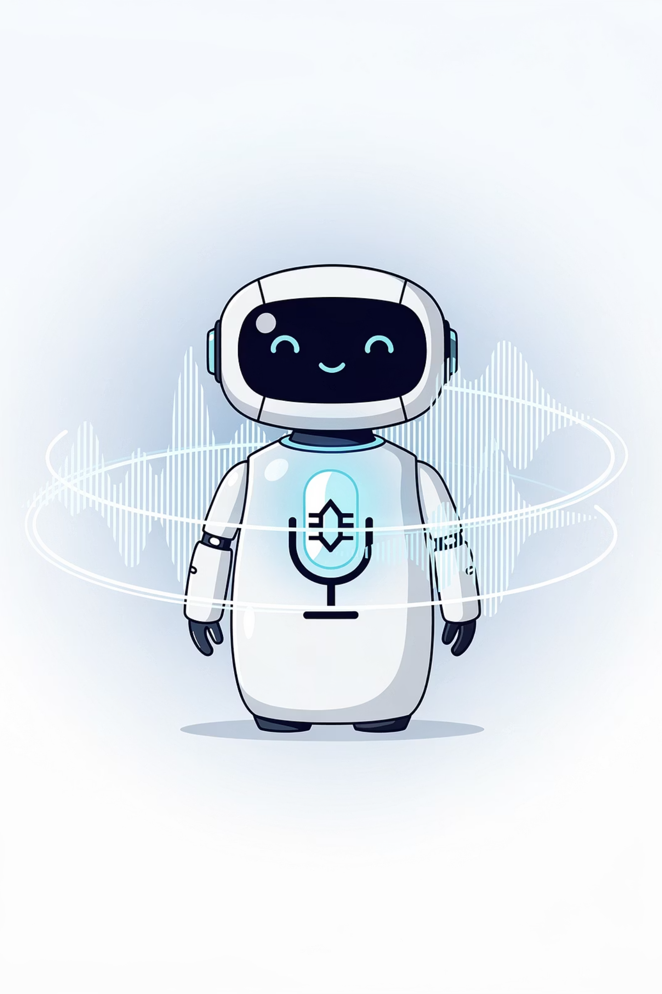
Session 16:
AI That Hears & Speaks -
Voice AI

Slide 2
Objectives
01
02
03
04
Define Voice AI and explain its core challenges.
Describe
Explain what happens inside each stage of the Voice AI pipeline.
Identify common Voice AI tasks.
The Voice AI framework: Hear → Process → Speak.
05
06
07
08
Recognize the key challenges in Voice AI.
List real-world Voice AI applications.
Use ElevenLabs to generate and experiment with synthetic speech.
Add a Voice AI prompt to your Prompt Library.

Slide 3

Recap: What We Learned in Session 15
Before we dive in, let's quickly revisit what we covered last time.
Key Idea
What It Means
Computer Vision (CV)
AI that interprets images and videos.
See → Process → Act
The three‑stage framework for visual AI.
Pixels, Features, Patterns, Prediction
How AI turns images into understanding.
Key insight
CV is pattern matching, not true seeing.
Today we move from seeing to hearing and speaking - Voice AI.

Slide 4
The Big Question:
How does AI turn Voice into meaningful words and then back into spoken language?

Slide 5
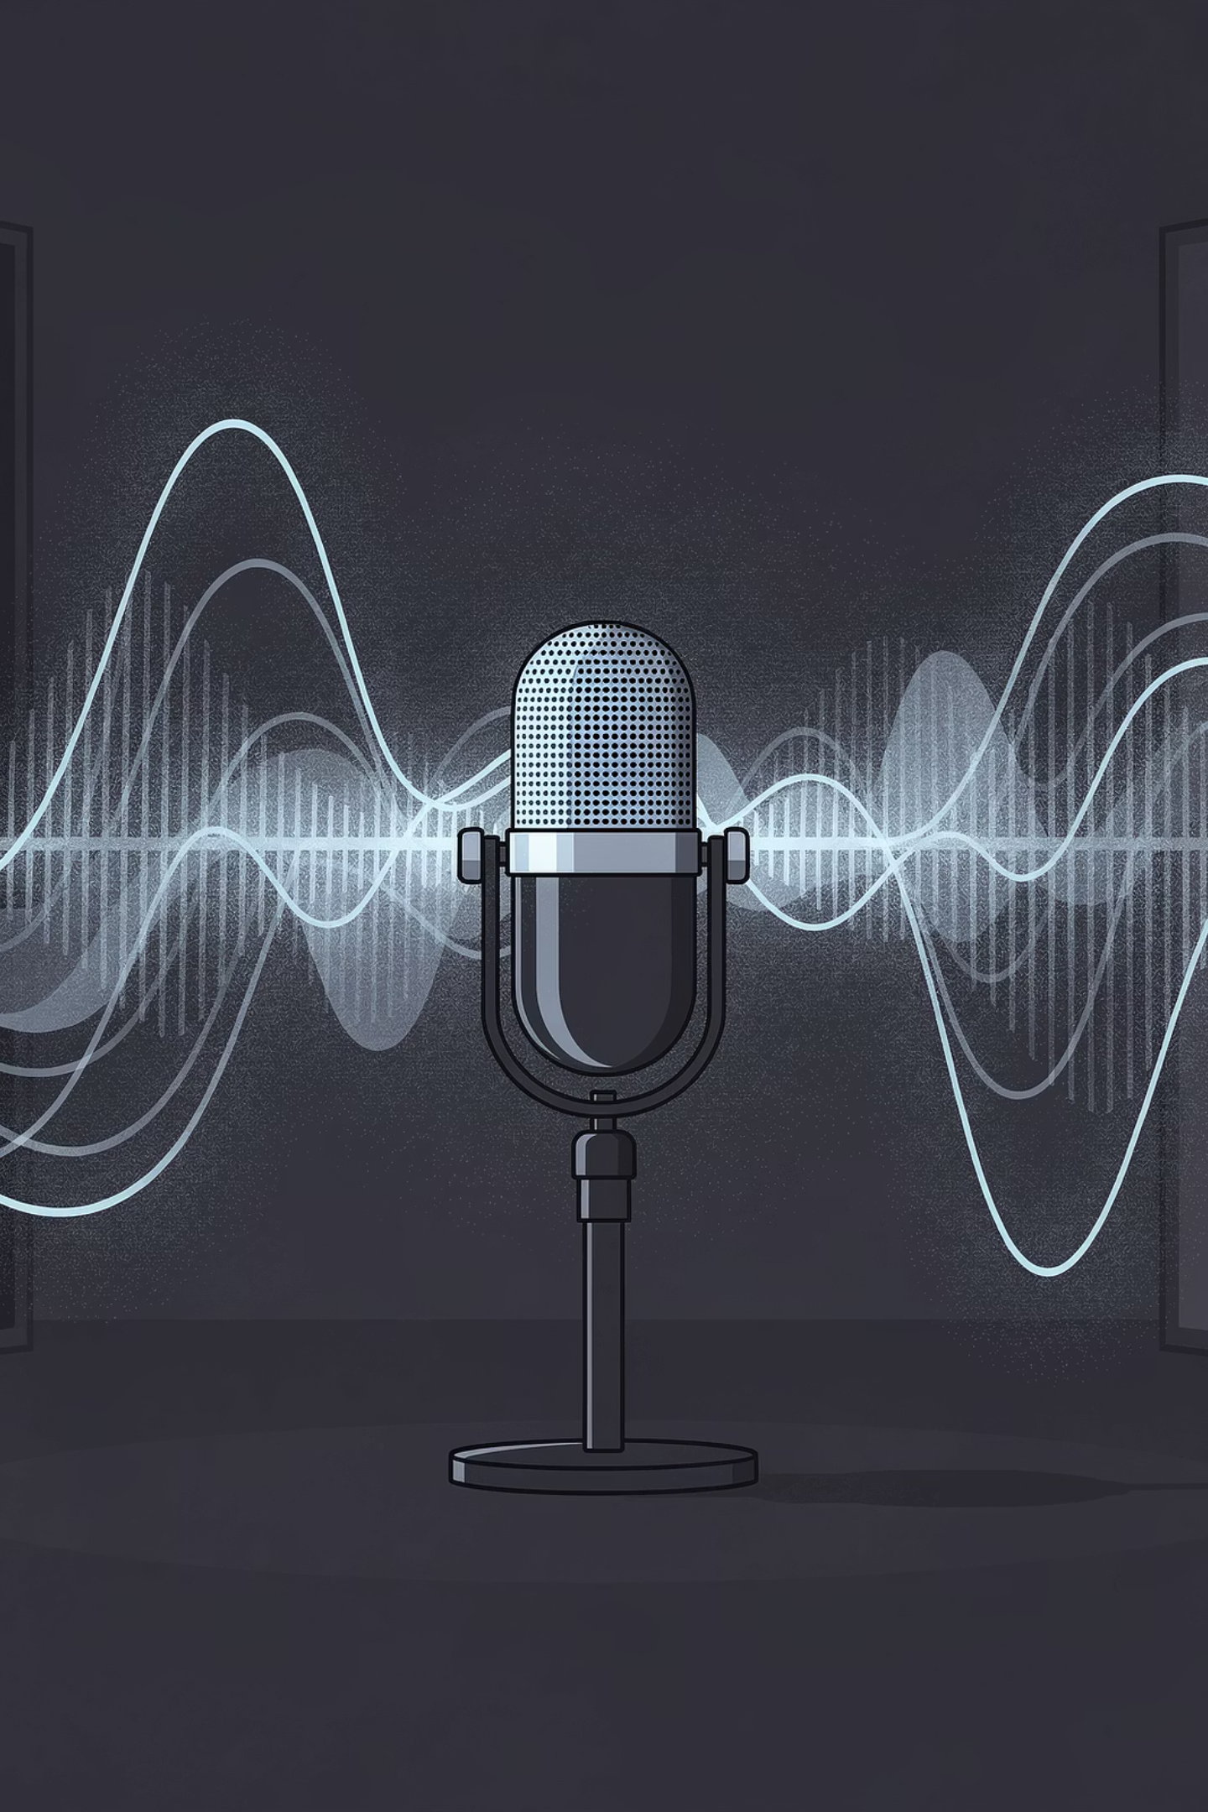
What is Voice AI?
Voice AI is the branch of AI that gives computers the ability to hear, interpret, and generate spoken language. It combines two major technologies:
ASR / STT
TTS
Automatic Speech Recognition / Speech-to-Text
Text‑to‑Speech - turning text into spoken audio.
Voice AI translates between sound and text — converting speech into words, understanding intent, and responding in a synthetic voice.

Slide 6
Where You See Voice AI Every Day
Voice Assistants
Voice Typing
Audiobooks
Live Captions
Translation Apps
Voice AI does not "hear" or "understand" like you do. It finds mathematical patterns in sound waves and matches them to words it has seen millions of times. It's pattern matching, not true comprehension.

Slide 7



How Voice AI Works: Hear → Process → Speak
Voice AI follows a three‑stage framework that matches what you learned in Session 1 (Sense → Think → Act).
Hear
Process
Speak
Capture sound waves and convert to digital data.
Convert speech to text, understand meaning, plan response.
Convert response text into spoken audio.
Sound Waves, Microphone, Waveform
ASR/STT → Phonemes → Words, NLU, Response Planning
TTS: Words → Tokens → Prosody → Waveform

Slide 8
Inside the "Hear" Stage
Term
What it means
Sound Wave
Vibrations in the air that your ear detects.
Microphone
A sensor that converts sound waves into an electrical signal.
Waveform
A visual graph of sound over time – the "shape" of the sound.
Voice AI samples sound thousands of times per second to capture all the details of speech. This is called the sampling rate - how many measurements the computer takes each second. More samples = better quality.

Slide 9
Inside the "Process" Stage
The "Process" stage has three parts: ASR/STT, NLU, and Response Planning.
01
02
03
ASR/STT
NLU
Response Planning
Automatic Speech Recognition / Speech-to-Text - converts the waveform into written words.
Natural Language Understanding - figures out what you want: intent, entities, sentiment.
The AI decides what to say or do next: fetch information, trigger an action, or formulate a text response.

Slide 10
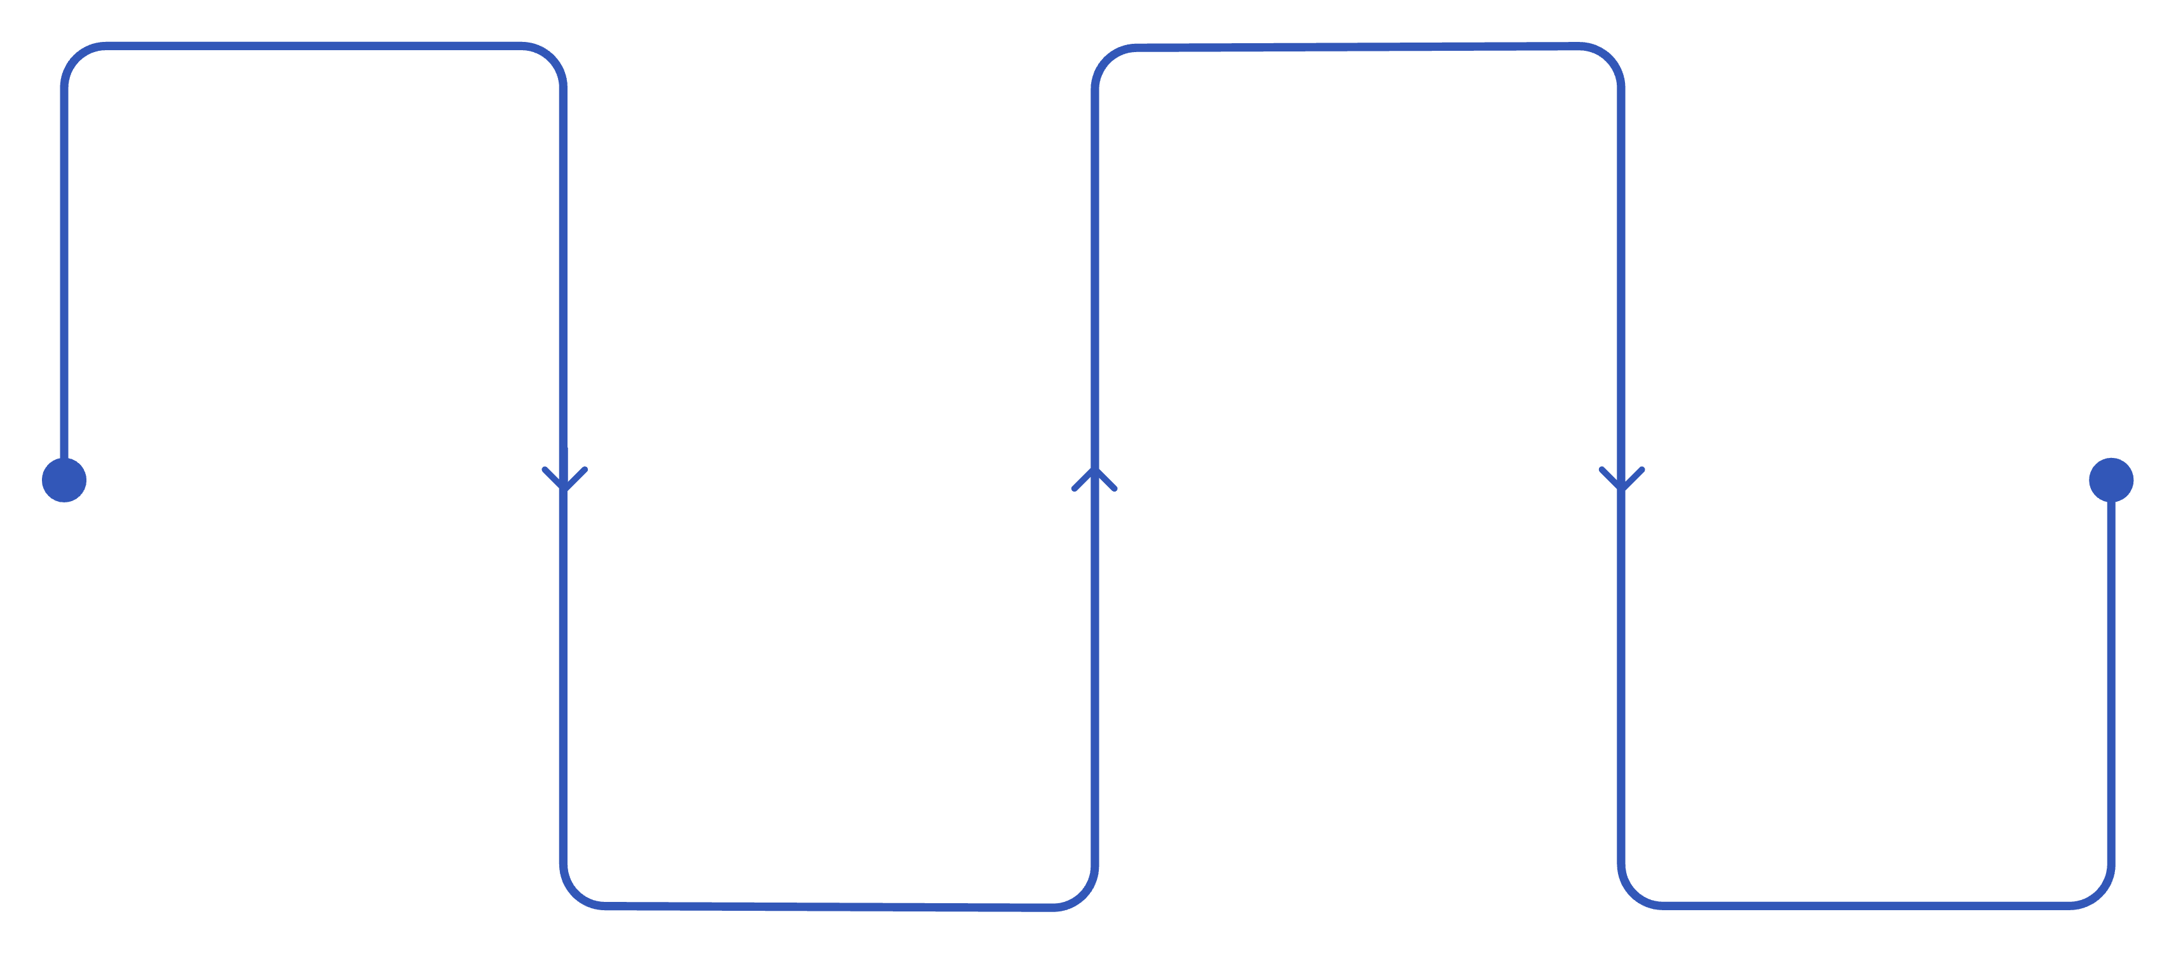
Part 1: ASR/STT - Sound to Text
Sound Waves
Phonemes
Raw audio captured by microphone
Smallest sound units like /f/ /r/ /ɒ/ /g/.
Acoustic Features
Words
Assembled words via dictionary and context.
Pitch, energy, formants extracted

Slide 11
Step
What happens
Sound Waves
Raw audio captured by microphone.
Acoustic Features
AI extracts clues from the sound: pitch, energy, frequency patterns.
Phonemes
The smallest units of sound in a language. English has about 40 phonemes.
Words
AI assembles phonemes into complete words using a dictionary and context.

Slide 12



Part 2: NLU - Natural Language Understanding
Intent
Entities
Sentiment
What action do you want? (e.g., set a reminder, get weather, play music)
Important details (e.g., task = call home, time = 6 PM)
Positive, negative, or neutral tone

Slide 13
Part 3: Response Planning
The AI decides what to say or do next. It might fetch information (weather data), trigger an action (turn on lights), or formulate a text response.
Example: "Remind me to call home at 6 PM"
Step
What happens
Sound Waves
Microphone records your voice.
Acoustic Features
AI extracts pitch and frequency patterns.
Phonemes
/r/ /ɪ/ /ˈm/ /aɪ/ /n/ /d/ /m/ /iː/ /t/ /ə/ /k/ /ɔː/ /l/ /h/ /əʊ/ /m/ /æ/ /t/ /s/ /ɪ/ /k/ /s/ /p/ /iː/ /ˈɛ/ /m/
Words
"Remind me to call home at 6 PM"
NLU
Intent = set_reminder, Task = call home, Time = 6 PM
Response Planning
Text response: "Okay, I'll remind you to call home at 6 PM."

Slide 14
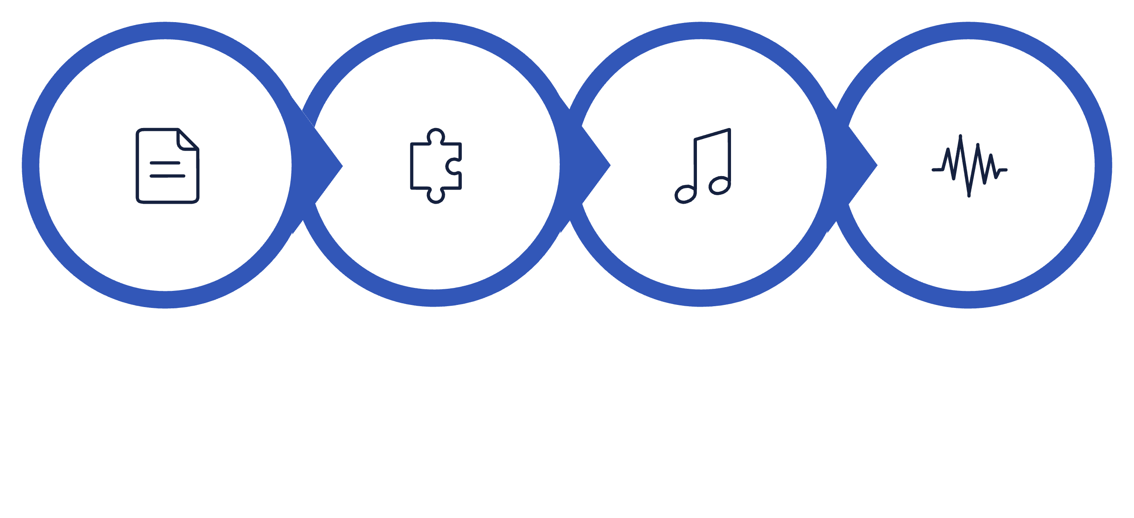
Inside the "Speak" Stage
Once the AI has a text response, it uses Text‑to‑Speech (TTS) to turn words back into sound using this four‑step flow:
Words
Tokens
Prosody
Waveform

Slide 15
Step
What happens
Analogy
Words
The text response from the Process stage.
"Timer set for 5 minutes."
Tokens
Text is broken into small pieces (like Session 8 and 14).
["Timer", "set", "for", "5", "minutes"]
Prosody
The "music" of speech – rhythm, pitch, stress, and emotion. AI predicts how the words should sound.
Like a director telling an actor: "Say this calmly and clearly."
Waveform
AI generates the actual sound wave and plays it through the speaker.
The voice you hear.
Prosody is what makes AI voices sound human. Without it, speech would be flat and robotic. Modern TTS (like ElevenLabs) uses deep learning to predict natural prosody - where to pause, which words to emphasize, and what tone to use.

Slide 16
See It All Together: "Hey Siri, what's the weather?"
Stage
What happens
Hear
Microphone captures "Hey Siri, what's the weather?" as a waveform.
Process (ASR/STT)
Sound Waves → Acoustic Features → Phonemes → Words: "Hey Siri what's the weather"
Process (NLU)
Intent = get_weather; Location = current location.
Process (Response)
AI fetches weather data, forms text: "It's currently 35 degrees and sunny."
Speak
Words → Tokens → Prosody → Waveform: AI speaks the response.
All of this happens in less than a second!

Slide 17
Mini Activity 1: Match the Voice AI Concept
Instructions: For each description, write which Voice AI concept it matches. Choose from: Waveform, Acoustic Features, Phoneme, ASR/STT, TTS, NLU, Prosody, Tokens.
Description
Concept
The process of converting spoken audio into written text.
ASR/STT
(Automatic Speech Recognition / Speech-to-Text)
A visual graph of sound over time - the "shape" of the sound wave.
Waveform
The smallest unit of sound in a language (e.g., /b/ in "bat").
Phoneme
The process of converting text into spoken audio.
TTS (Text‑to‑Speech)
Clues extracted from sound: pitch, energy, frequency patterns.
Acoustic Features
Figuring out the intent and meaning behind the words.
NLU (Natural Language Understanding)
The rhythm, pitch, and stress that make speech sound human.
Prosody
Small pieces that words are broken into for processing.
Tokens

Slide 18
Common Voice AI Tasks
Task
What it does
Speech‑to‑Text (STT) / ASR
Converts spoken words into written text.
Text‑to‑Speech (TTS)
Converts written text into spoken audio.
Voice Commands
Understands and executes spoken instructions.
Speaker Recognition
Identifies who is speaking based on voice characteristics.
Voice Cloning
Creates a synthetic copy of a specific person's voice.

Slide 19
Challenges in Voice AI
Background Noise
Accents & Dialects
Homophones
Bias in Training Data
Privacy Concerns
Emotional Tone
Voice AI is powerful but not perfect. Noise, accents, bias, and privacy are active areas of research and improvement.

Slide 20
Mini Activity 2: Spot the Voice AI Challenge
Instructions: For each scenario, identify which Voice AI challenge is present.
Choose from: Background Noise, Accent, Homophone, Bias, Privacy, Emotional Tone.
#
Scenario
Challenge
1
A smart speaker in a busy kitchen hears "Add milk" but writes "Add silk."
Background Noise
2
A voice assistant fails to understand someone from rural Ireland but works fine for a California accent.
Accent
3
A user says "I need to book a flight" and the AI hears "I need to book a fight."
Homophone
4
An ASR/STT system has a 20% higher error rate for female voices than male voices.
Bias
5
A user says "Oh, wonderful" sarcastically, but the AI thinks it's positive.
Emotional Tone
6
A family discovers their smart speaker recorded a private conversation.
Privacy

Slide 21
Voice AI in the Real World
Voice Assistants
Audiobook Narration
Accessibility Tools
Language Learning Apps
Customer Service Chatbots
Real‑time Translation Earbuds

Slide 22

Hands‑On Activity: Create Your Own AI Voice with ElevenLabs
Goal: Use ElevenLabs to design a custom voice from a text description, then make it speak a sentence you choose.
Tool: ElevenLabs (free tier at elevenlabs.io)

Slide 23


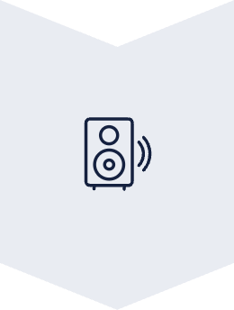

Step 1: Open Voice Design
Log into ElevenLabs. Find Voice Design on the Home page or under the Voices section.
Step 2: Describe Your Voice
In the prompt box, type a short description of the voice you want to create. Click Generate and listen.
Step 3: Use in Text to Speech
Go to Text to Speech. Select your voice, type a sentence, click Generate and listen.
Step 4: Reflection
Answer reflection questions in your head or discuss with your mentor.

Slide 24


Hands‑On Activity: Example Voice Prompts
In the prompt box, type a short description of the voice you want to create.
Example prompts (choose one or create your own):
"A friendly wizard with a warm, slightly crackly voice."
"An energetic sports commentator who talks fast."
"A calm, soft voice for reading bedtime stories."
Click Generate and listen to the result.

Slide 25
Hands‑On Activity:
Text to Speech
Reflection Questions
Go to Text to Speech. Select the voice you just created from the voice dropdown. Type a short sentence into the text box. For example:
Answer these in your head or discuss with your mentor:
How close was the generated voice to what you imagined?
What do you think the AI did to turn your description into a voice?
Where might a tool like this be useful? Where could it be misused?
"Hello! This is my custom AI voice."
"I created this voice just by describing it."
Click Generate and listen.

Slide 26



The Most Important Idea
ASR/STT
NLU
TTS
Sound Waves → Acoustic Features → Phonemes → Words
Figures out meaning and intent
Words → Tokens → Prosody → Waveform
You are the human in the loop.
Voice AI is pattern matching, not true understanding, not true hearing. Be aware of its limits and use it responsibly.

Slide 27
Summary:
Key Term
What It Means
Voice AI
AI that hears, interprets, and generates spoken language.
ASR/STT
Automatic Speech Recognition / Speech‑to‑Text – converts speech to text.
TTS
Text‑to‑Speech – converts text to speech.
Waveform
Visual graph of sound over time.

Slide 28
Summary:
Key Term
What It Means
Acoustic Features
Clues extracted from sound: pitch, energy, frequency patterns.
Phoneme
Smallest unit of sound in a language.
NLU
Understanding intent and meaning from text.
Prosody
The rhythm, pitch, and stress that make speech sound human.
Tokens
Small pieces words are broken into for processing.
Hear → Process → Speak
Voice AI framework.

Slide 29

Homework: Creative Project - From Idea to Audio
Use ChatGPT (or Google Gemini) and ElevenLabs together to create a short narrated story.
1. Brainstorm Ideas
Open ChatGPT or Gemini. Ask for 3 short story ideas using a prompt like: "Give me 3 short story ideas about a mysterious sound heard at night. Each idea should be one sentence." Pick your favorite.
2. Write the Story
Ask the AI to write a short story: "Write a short story based on this idea: [paste idea]. Make it about 100–150 words. Use simple, vivid language." Read the story. Edit anything you want - it's your story now.

Slide 30
3. Create a Voice
4. Narrate Your Story
Log into ElevenLabs. Use Voice Design to create a voice that fits your story's mood. Example descriptions: "A calm, gentle voice for a bedtime story." / "A mysterious, whispery voice." / "An excited, curious voice."
Go to Text to Speech. Select your custom voice. Paste your story and generate the audio. Listen to your story narrated by your own AI voice.

Slide 31

Homework: Reflection Questions
1
2
3
AI Collaboration
Voice & Mood
Multi-Tool Learning
How did the AI help you with the story? What did you change or add?
Did the voice match the mood of your story? Why or why not?
What's one thing you learned about working with multiple AI tools together?

Slide 32
Add to Your Prompt Library
Your New Prompt: "Explain how a voice assistant understands the command 'Set an alarm for 7 AM.' Use the Hear → Process → Speak framework. Describe the ASR/STT steps (Sound Waves → Acoustic Features → Phonemes → Words) and mention prosody in TTS."
Why This Prompt Works
Specific Example
Requires the Framework
Includes Sub‑Steps
It asks for a concrete command: "Set an alarm for 7 AM."
Forces use of the Hear → Process → Speak structure.
Includes the detailed sub‑steps you learned today.

Slide 33
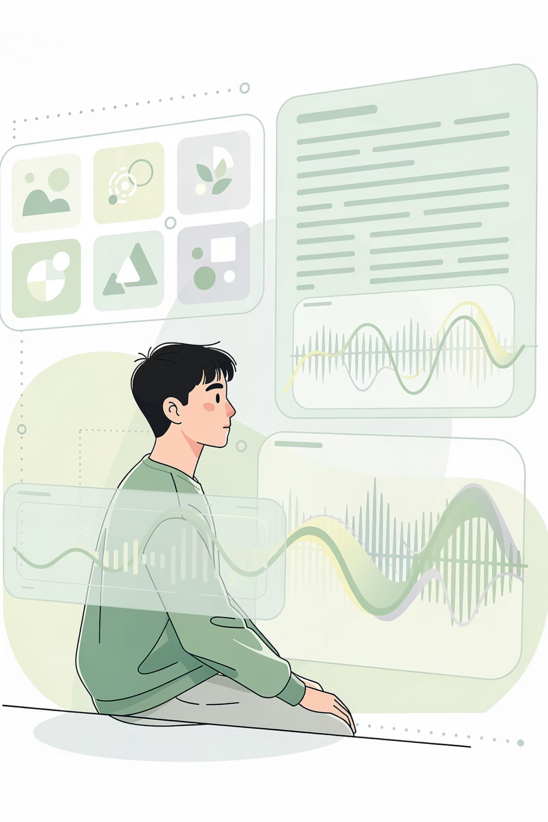
Next Session Preview
AI That Combines Everything - Multimodal AI
Now that you've seen how AI reads (NLP), sees (CV), and hears/speaks (Voice AI), next we'll explore multimodal AI - systems that understand text, images, audio, and video together.

