Slide 1
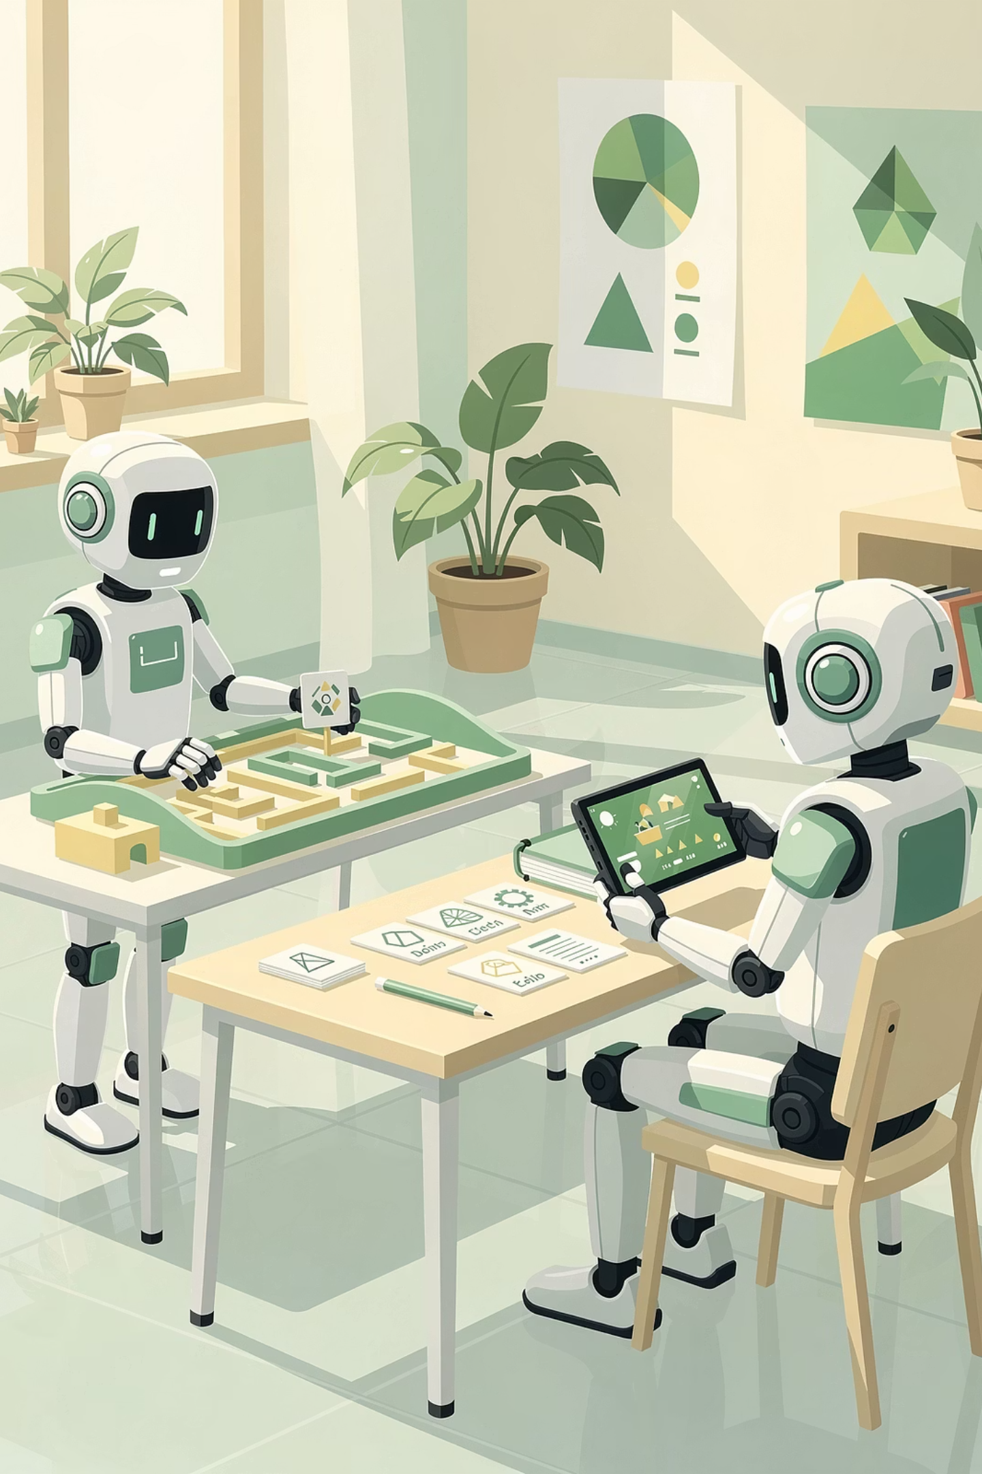
Session 4 :
Types of Machine Learning

Slide 2
Recap : What We Learned in Session 3
Concept
Key Takeaway
Machine Learning
Computers learning patterns from examples instead of following fixed rules
Traditional Programming
Writing step-by-step instructions for a computer
Rule‑Based Systems
Programs that follow fixed rules - great for simple tasks, fail for complex ones
Pattern Recognition
Finding regularities in data - the foundation of ML
Learning from Patterns
Using found patterns to make predictions on new data
ML in Everyday Life
TikTok, Spotify, Netflix, Google Maps - all use ML

Slide 3
Objectives
01
02
Identify Learning Styles
Define Supervised Learning
03
04
Define Unsupervised Learning
Define Reinforcement Learning
05
06
Give Real Examples
Compare Approaches
07
See the Big Picture

Slide 4

Big Question of the Day
How many different ways can machines learn?

Slide 5



Different Ways Machines Learn
What data we have
What we want the machine to do
How we give feedback

Slide 6
The Three Main Types of Machine Learning
Supervised Learning
Unsupervised Learning
Reinforcement Learning
Learning Style: Learning with a teacher
Learning Style: Learning by exploring
Learning Style: Learning by trial and error

Slide 7

Supervised Learning - Learning with Labels
Supervised Learning is when we teach a machine using labeled examples.
Labeled Data
Trained Model
Training
The machine receives labeled data, learns patterns during training, and then can predict labels for new, unseen data.

Slide 8

Supervised Learning - Two Important Tasks
Task 1: Classification - Sorting Things into Categories
Examples
What's Being Predicted
Spam filter
"Spam" or "Not Spam"
Face recognition
"This is Sara" or "This is not Sara"
Cat vs Dog classifier
"Cat" or "Dog"
The answer is one of a fixed set of choices.

Slide 9

Classification - Sorting Things into Categories
Classification is a type of Supervised Learning where the model's job is to put something into a category.
How It Works
Training
Predicting

Slide 10
Supervised Learning
Real-World Examples You Know
Classification Examples
Email Spam Filter
Face Recognition
Google Photos Search
Snapchat Filters

Slide 11
Task 2: Regression
Predicting numbers - The AI predicts a number or value.
Weather app
Sports scores
Car value
Tomorrow's temperature (72°F, 68°F)
How many points a team will score
How much a used car is worth
Both classification and regression use labeled data - they're both Supervised Learning!

Slide 12
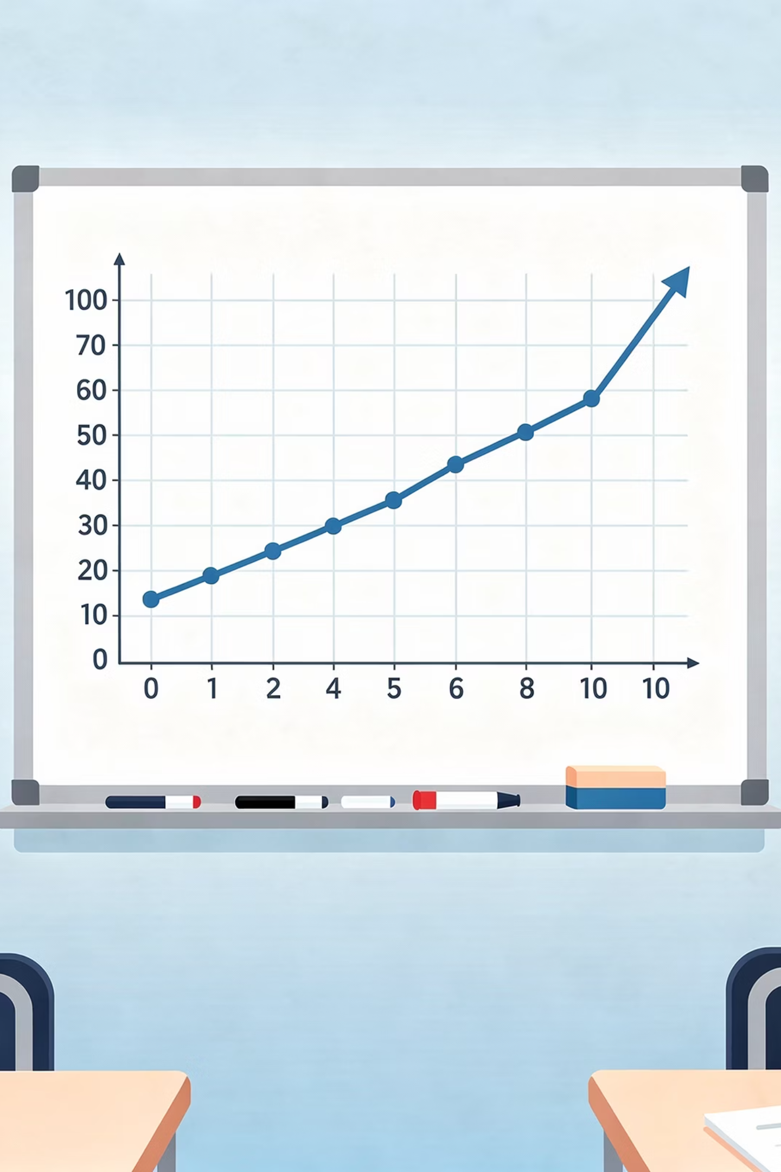
Regression - Predicting a Number
Regression is another type of Supervised Learning where the model's job is to predict a number.
How It Works
Training on Labeled Examples
Predicting a Number
Regression predicts a number on a continuous scale.

Slide 13
Regression Examples
Weather App
Google Maps
Real Estate Apps
Uber

Slide 14
Classification vs. Regression
Parameter
Classification
Regression
Question type
"Which category?"
"How many?" or "How much?"
Output type
A category (from a fixed list)
A number (any value)
Analogy
Multiple‑choice test
Fill‑in‑the‑blank
Example
"Is this movie suitable for kids, teens, or adults?"
"How many tickets will be sold for the movie?"

Slide 15
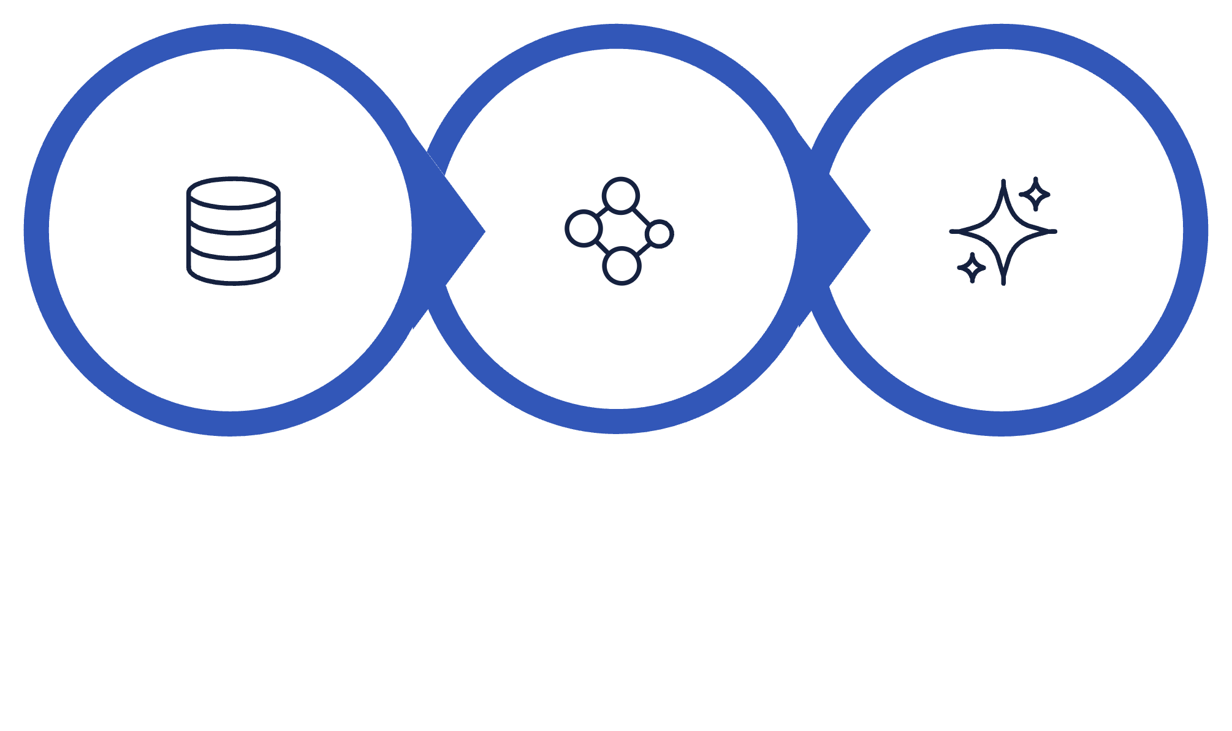
Unsupervised Learning - Finding Hidden Patterns
Unsupervised Learning is when we give a machine unlabeled data and let it find patterns on its own.
Unlabeled Data
Pattern Finding
Discovered Patterns
The machine receives unlabeled data, searches for similarities, and discovers hidden groups or structures on its own.

Slide 16
Unsupervised Learning
Real-World Examples You Know
Clustering Examples
Google News
Customer Segmentation
Spotify / Apple Music
Movie Recommendations

Slide 17
🎮Mini Activity 1 : Supervised or Unsupervised?
For each scenario, identify: Which type of ML? (Supervised, Unsupervised, or Reinforcement). If Supervised: Is it Classification or Regression?
Scenario
ML Type
If Supervised: Class or Reg?
Predicting tomorrow's temperature
Supervised
Regression (predicting a number)
Grouping customers by shopping habits
Unsupervised (clustering)
-
An AI learning to play chess
Reinforcement
-
Identifying if an email is spam
Supervised
Classification (spam or not)
Predicting house prices
Supervised
Regression (predicting a number)
Google News grouping articles
Unsupervised (clustering)
-
Recognizing if a photo shows a cat
Supervised
Classification (cat or not)
A robot learning to walk
Reinforcement
-
Predicting how many points a team will score
Supervised
Regression (predicting a number)
Spotify grouping similar songs
Unsupervised (clustering)
-

Slide 18
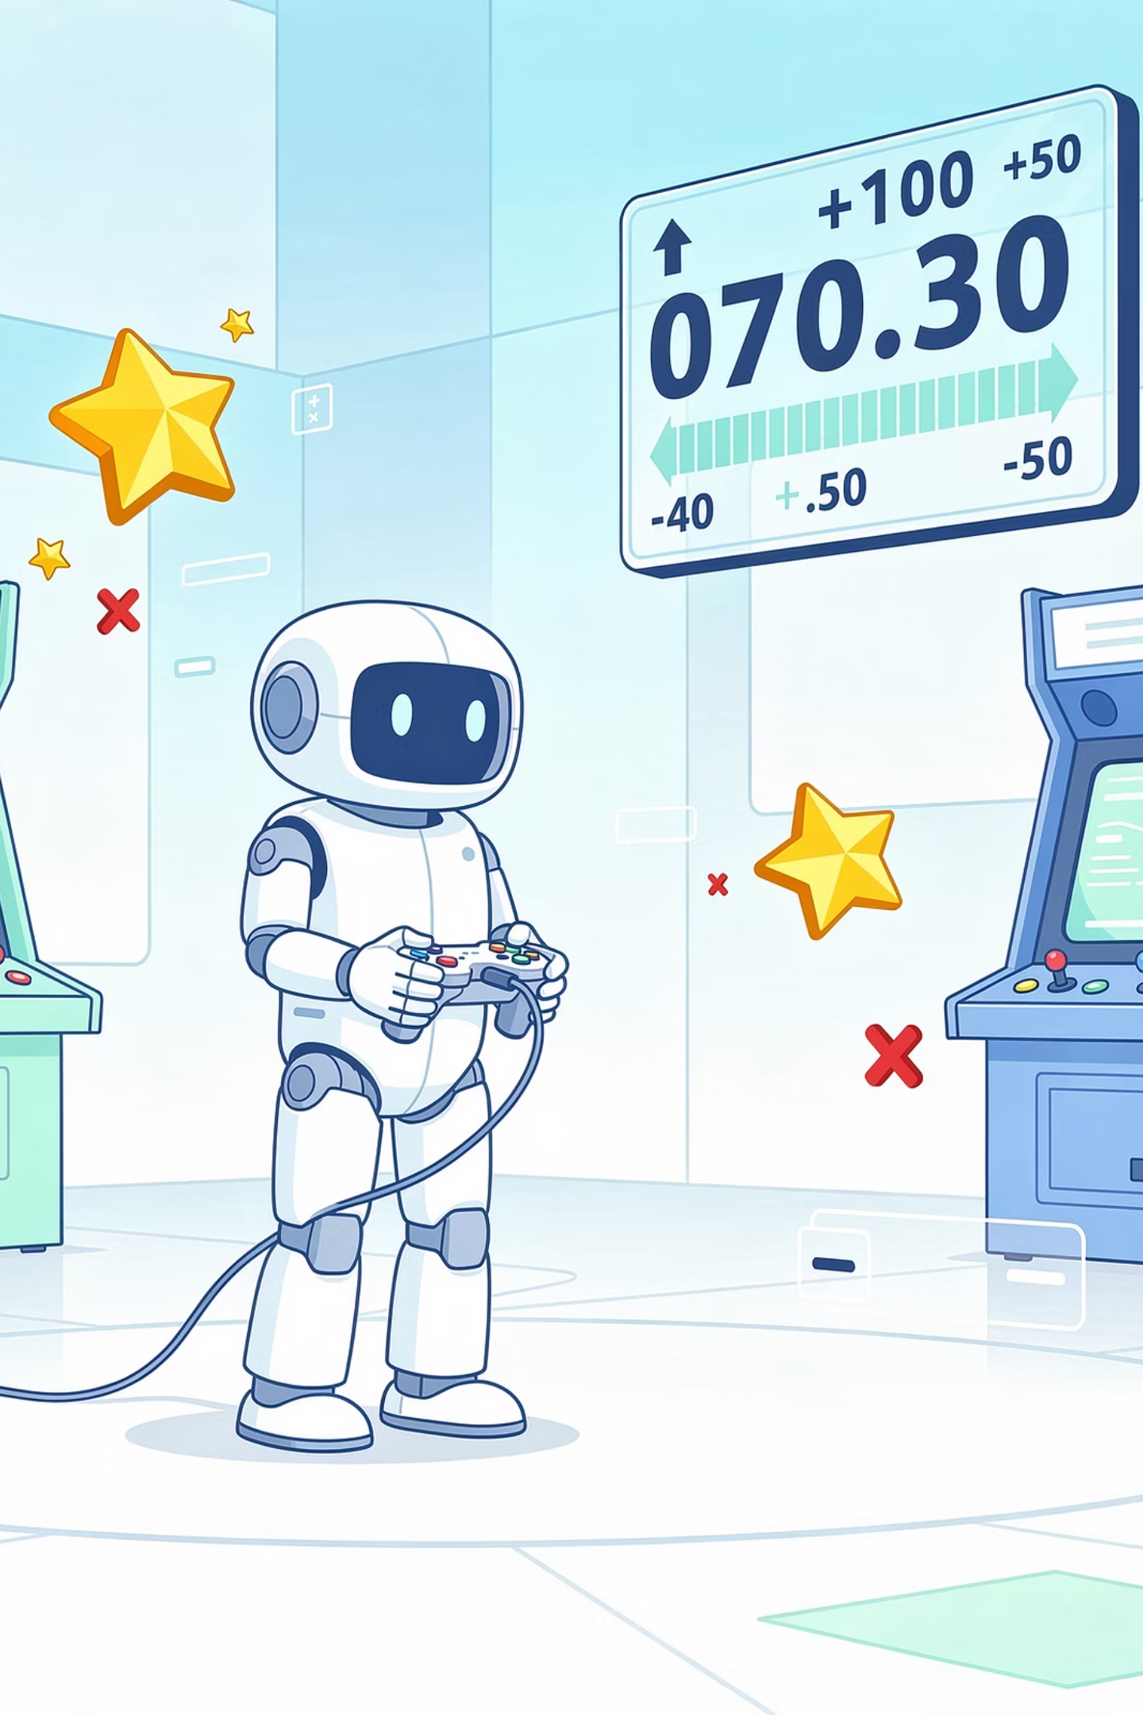
Reinforcement Learning - Learning from Rewards
Reinforcement Learning is when a machine learns by trial and error, receiving rewards for good actions and penalties for bad ones.

Slide 19
Reinforcement Learning - Key Terms
Agent
Environment
State
Action
The thing that's learning
The world the agent interacts with
The current situation or observation
Something the agent can do
Reward
Penalty
Policy
A/B Testing
Positive feedback for good actions
Negative feedback for bad actions
The agent's strategy - what action to take in each state
Testing different strategies to see which gets better rewards

Slide 20

How It Works
Agent Observes State
Choose Action (Policy)
Agent Updates Policy
Environment Returns Reward

Slide 21
Reinforcement Learning
Real-World Examples You Know
AlphaGo
Self-Driving Cars
Game AI
Robot Navigation
Reinforcement Learning is like playing a video game: you start not knowing what to do, try things, and get rewards for doing well or penalties for mistakes. Over time - across thousands of attempts - you learn what actions lead to the most points.

Slide 22




Imagine you're learning to bake cookies 🍪
Supervised
Given a recipe with exact measurements, you bake perfect cookies
Unsupervised
You notice patterns across many cookies - round ones are sweet, flat ones crispy
Reinforcement
You try different recipes and stick with what tastes good

Slide 23
🎮 Mini Activity 2 : Identify the Learning Type
For each real-world application, identify which type of machine learning it uses (or might use):
#
Application
ML Type(s)
Why?
1
Netflix recommendations
Unsupervised + Supervised
Finds patterns (unsupervised) + learns from ratings (supervised)
2
Self-driving car staying in lane
Reinforcement
Learns from rewards (staying safe) and penalties (going off road); observes state (lane position)
3
Google Photos grouping
Unsupervised (clustering)
Finds patterns without labels
4
Face unlock
Supervised (classification)
Trained on labeled photos of your face
5
AlphaGo
Reinforcement
Learned by playing millions of games and getting rewards; state = board positions
6
Amazon suggestions
Unsupervised (clustering)
Finds patterns in purchase data
7
Gmail spam filter
Supervised (classification)
Trained on labeled emails (spam/not spam)
8
Robot learning to walk
Reinforcement
Trial and error with rewards/penalties; state = position, balance
9
Discover Weekly
Unsupervised + Supervised
Finds patterns + learns from your listening
10
Fraud detection
Unsupervised
Finds unusual patterns that might be fraud

Slide 24
Comparison - How They're Different
Aspect
Supervised Learning
Unsupervised Learning
Reinforcement Learning
Data Type
Labeled data
Unlabeled data
No data at start - learns from states, actions, rewards
Main Tasks
Classification, Regression
Clustering
Learning strategies
Goal
Predict correct label or value
Find hidden patterns
Maximize rewards over time
Feedback
Correct answers during training
No feedback - just patterns
Rewards and penalties after actions

Slide 25

Real AI Systems Combine Multiple Types
Real-world AI systems often use multiple types of machine learning together. The three types work together more often than they work alone.

Slide 26




Combined ML Types
Example : Netflix Recommendations
Netflix doesn't use just one type - it combines several:
Collaborative Filtering
Personalization
Content Analysis
A/B Testing
Unsupervised
Supervised
Supervised
Reinforcement Learning

Slide 27
More Real-World Examples
Self-Driving Cars
Voice Assistants (Siri, Alexa)
Object Detection (Supervised)
Path Planning (Reinforcement)
Traffic Pattern Analysis (Unsupervised)
Speech Recognition (Supervised)
Understanding Intent (Supervised)
Personalization (Unsupervised)
Response Generation (Reinforcement)

Slide 28
Summary : What we Learned Today
Supervised Learning
Classification
Regression
Machine learning with labeled examples - like studying with flashcards that have answers on the back
Supervised task where AI predicts a category (spam/not spam, cat/dog)
Supervised task where AI predicts a number (temperature, price)
Unsupervised Learning
Clustering
Reinforcement Learning
Machine learning that finds patterns without labels - like organizing a messy closet without instructions
Unsupervised task where AI finds hidden groups in data
Machine learning through trial and error with rewards and penalties - like playing a video game

Slide 29
Your Homework: ML Type Hunter 🔍
Part 1: Quick Warm‑Up
Match each learning type to its description:
Learning Type
Description
1. Supervised Learning
A. Learning from rewards and penalties
2. Unsupervised Learning
B. Learning with labeled examples
3. Reinforcement Learning
C. Finding patterns without labels
Answers: 1-___ , 2-___ , 3-___

Slide 30
Part 2: Your Mission - Find ML Types
Find one real example of each type of machine learning. They can be apps, websites, or devices you use.
ML Type
Example (App/System)
What does it do?
What makes it this type?
Supervised
Unsupervised
Reinforcement
Need ideas?
Supervised: Face unlock, spam filter, handwriting recognition, Google Translate
Unsupervised: Google News, Amazon "customers also bought," Spotify recommendations, YouTube suggestions
Reinforcement: Game AI (chess, Go), self-driving cars, robot vacuum learning your floor plan, AlphaGo

Slide 31
Part 3: Challenge - Find a System That Combines Types
Can you find an example of a real AI system that probably uses more than one type of machine learning?
System: ___
Supervised part: ___
Unsupervised part: ___
Reinforcement part: ___
Example (Netflix):
Supervised: Learns from your ratings (labeled data)
Unsupervised: Finds patterns in what people watch together
Reinforcement: Tests different recommendations, keeps what works

Slide 32

Next Session Preview
Session 5 : How AI Learns from Data
Next session dives into the data that powers AI — what it looks like, where it comes from, and why its quality determines everything. You'll explore features, data types, and the fine line between memorisation and real learning.

