Slide 1
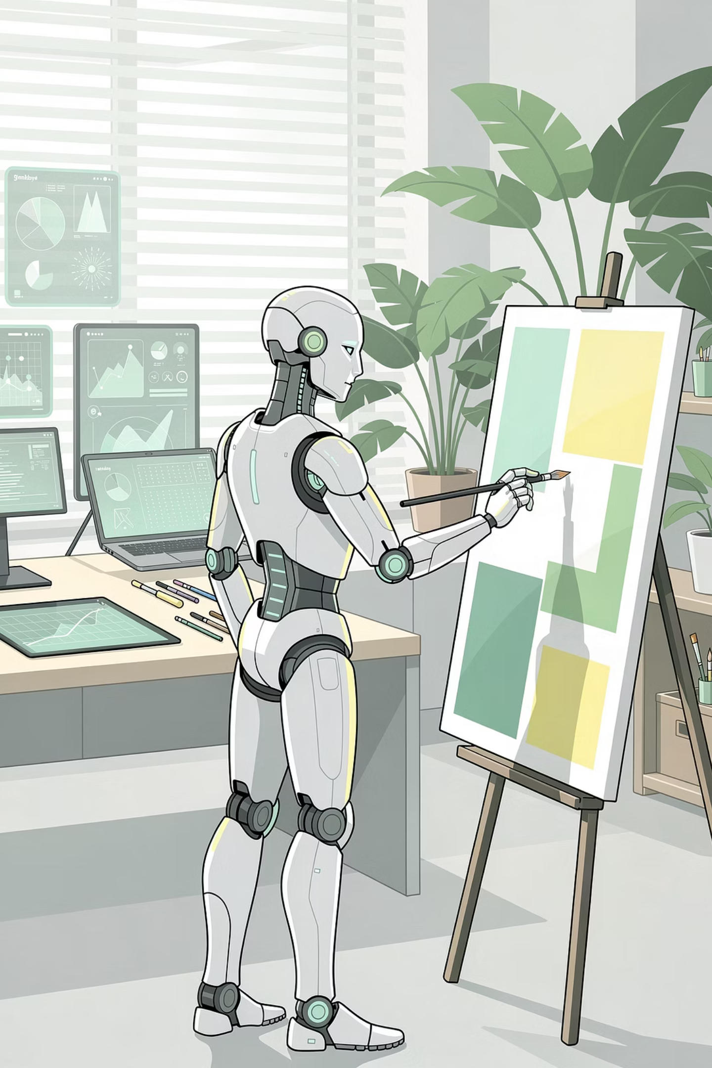
Session 7:
What is Generative AI?

Slide 2
Objectives
By the end of this session, you will be able to:
01
02
03
Define Generative AI
Identify (Generative or Discriminative?)
Explain (How AI Creates)
04
05
06
List main types of GenAI
Recognize GenAI Tools
Use prompts to bring ideas alive

Slide 3
Imagine It's Your Friend's Birthday
Idea
What Would You Need?
A funny birthday poem
A way to generate text
A custom birthday card with their favorite animal
A way to generate images
A silly birthday song about inside jokes
A way to generate audio

Slide 4
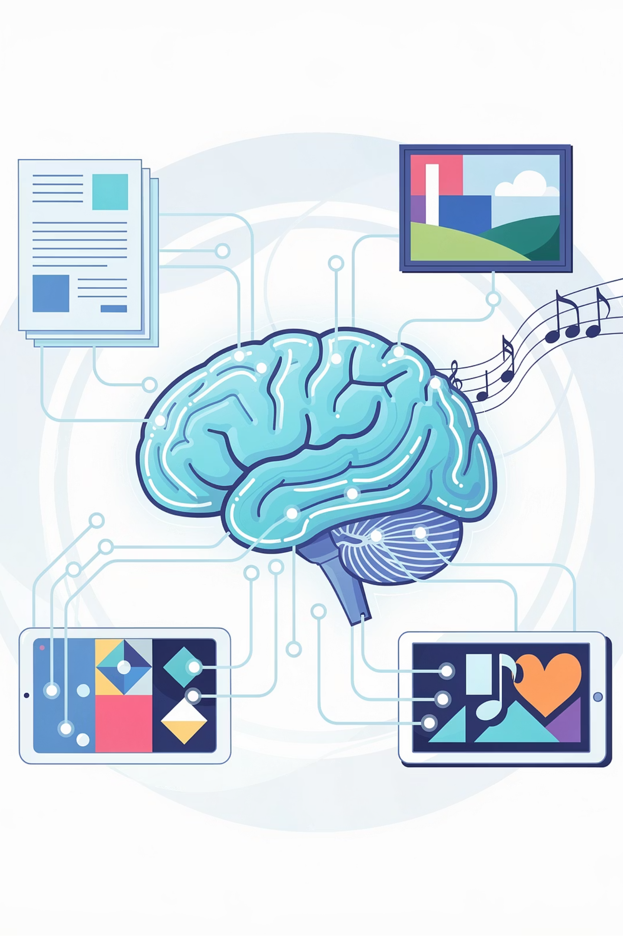
What is Generative AI?
Generative AI is a type of artificial intelligence that creates new content - text, images, music based on patterns it learned from training data.
Creates
Learns patterns
Remixes
Responds to prompts

Slide 5
Generative AI vs Traditional AI (Discriminative)
Generative AI
Traditional (Discriminative) AI
What it does
CREATES new content
ANALYZES / CLASSIFIES existing content
Question it answers
"What can I make?"
"What is this?"
Output
Original text, images, audio
Labels, categories, predictions
You've used
Google Storybook, Gemini
Teachable Machine
Analogy
Artist
Detective

Slide 6
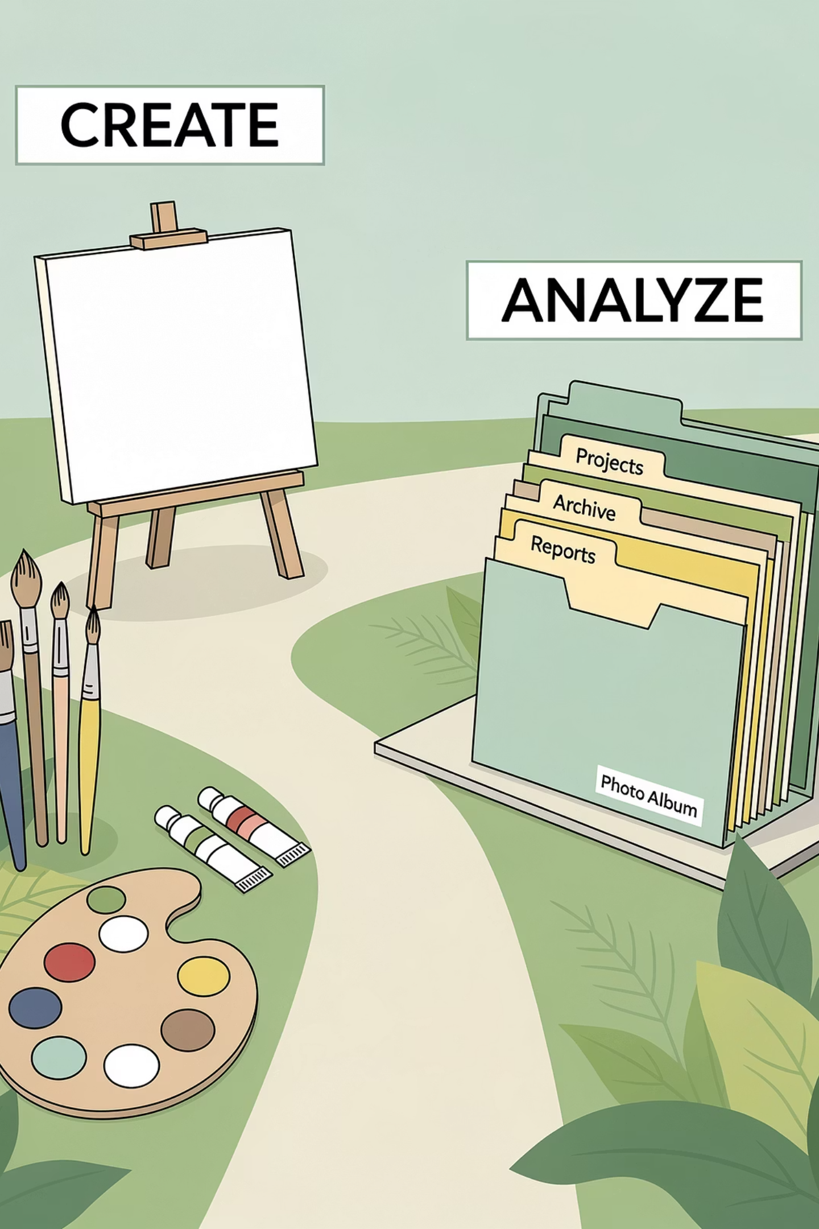


Think of It This Way
🎨 Generative AI
🔍 Discriminative AI
"Write a funny poem for my friend who loves pizza"
"Sort all these party photos by who's in them"
"Draw a birthday card with a unicorn wearing a party hat"
"Check if any comments on the party video are mean or nice"
"Create a birthday song about our inside jokes"
"Count how many people smiled in each photo"
One creates. One analyzes. Both are useful for different tasks!

Slide 7
Mini Activity 1: Generative or Discriminative?
For each birthday-related task, decide: Would you use Generative AI (create) or Discriminative AI (analyze/classify)?
#
Task
Answer
Why?
1
Write a birthday poem
Generative
Creating new text
2
Sort party photos
Discriminative
Classifying/analyzing
3
Draw birthday card
Generative
Creating new image
4
Check comment sentiment
Discriminative
Classifying (positive/negative)
5
Compose birthday song
Generative
Creating new audio
6
Count people in photos
Discriminative
Analyzing/measuring
7
Create invitation text
Generative
Creating new text
8
Predict gift count
Discriminative
Predicting (Regression from S4)
9
Make coloring page
Generative
Creating new image
10
Identify voice
Discriminative
Classifying/recognizing

Slide 8



How Does Generative AI Work?
STEP 1: TRAINING
STEP 2: PATTERNS
STEP 3: GENERATION

Slide 9
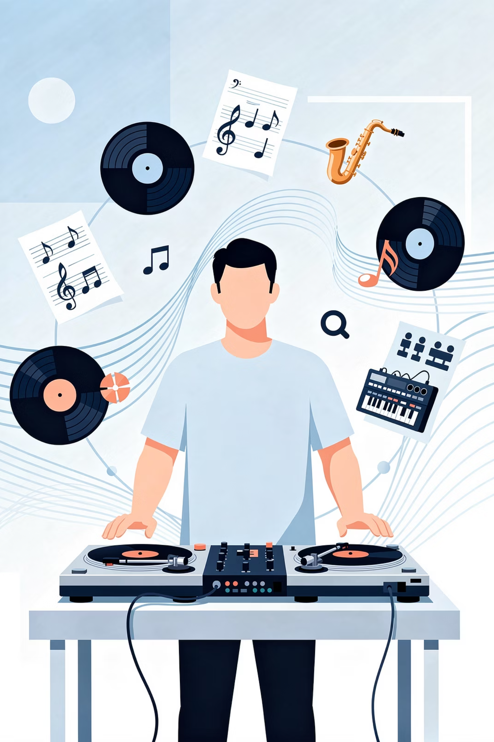
The Remix Artist Analogy
Step 1 (Training)
They listen to everything — pop, rock, jazz, classical — and study how songs are built.
Step 2 (Patterns)
They pick up the patterns — melodies, chords, rhythms, rhymes.
Step 3 (Generation)
They create something brand new — original-sounding, but built from everything they've absorbed.

Slide 10
Key Point: AI Doesn't "Understand"
Common Mistake
Reality
"AI understands what it's creating"
It only finds patterns, but doesn't understand meaning
"AI has original ideas"
It only remixes patterns it has seen
"AI knows what words mean"
It only knows which words usually go together

Slide 11


Example - When AI writes a birthday poem:
It doesn't know what a birthday is
It doesn't know what friendship means
It doesn't know why birthdays are special
It's seen millions of texts where "birthday," "cake," and "friend" naturally cluster together.
Generative AI is a PATTERN REMIXER, not a THINKER.

Slide 12



Types of Generative AI
TEXT
IMAGE
AUDIO

Slide 13
What Training Looks Like
Text
Images
Audio
Trained on: Books, articles, websites, social media
Trained on: Photos, drawings, paintings, designs
Trained on: Songs, speeches, podcasts, sound effects
How much? Billions of pages!
How much? Millions of images!
How much? Millions of hours!

Slide 14
🎮 Mini Activity : Plan a Birthday Artifact
Your mission: You're going to create something special for a friend's birthday using AI. First, let's plan!
Step 1: Choose what you want to create (pick ONE):
TEXT
IMAGE
AUDIO
A funny birthday poem
A heartfelt birthday message
A creative invitation
A birthday-themed joke collection
A short birthday story featuring your friend
A custom birthday card
A coloring page
A birthday poster
A personalized avatar for your friend
A digital gift tag
A silly birthday song
A birthday rap
A voice message "from" a favorite character
Birthday sound effects
A personalized birthday jingle

Slide 15
🎮 Mini Activity : Plan Your Prompt
01
02
Describe your idea
Choose your type
Write your idea in 1-2 sentences.
What TYPE of GenAI will you need? (circle one):
TEXT | IMAGE | AUDIO
03
Draft your prompt
Write a draft prompt here. Be specific! Include:
What you want (poem, card, song)
Style (funny, heartfelt, silly, cute, formal)
Details about your friend (name, age, hobbies, favorite things, inside jokes)
Format (how long, what it should include)
We'll bring this to life in our hands-on activity!

Slide 16
Generative AI in Your Daily Life
TikTok
Instagram
Snapchat
Google Search
YouTube
Spotify

Slide 17
The Magic Word : Prompt
Prompt: : The input you give to an AI to guide its response. It can be an instruction, question, or description — anything that tells the AI what you want. Example: "Write a funny birthday poem for my friend Alex who loves gaming."

Slide 18
Birthday-themed prompt examples:
A birthday poem
A birthday card
A birthday song
"Write a funny birthday poem for my friend Alex who loves gaming. Make it 8 lines and include an inside joke about losing at Mario Kart. Use rhymes."
"Create an image of a unicorn wearing a party hat, holding balloons, at a birthday party with cake. Style: cute, colorful digital art with bright colors."
"Compose a 30-second happy birthday song in the style of pop music. Include lyrics about friendship, cake, and having fun. Make it upbeat and catchy."

Slide 19
Hands-On Activity: GenAI Playground
Bring Your Birthday Artifact to Life!
Your mission: Use ChatGPT and Gemini to create the birthday artifact you planned in Mini Activity 2!
Step 1: Open both tools
Tool
Where to Find It
ChatGPT
chat.openai.com
Gemini
gemini.google.com

Slide 20
Step 2: Based on your artifact type, use these :
If you chose...
Use...
TEXT
ChatGPT or Gemini (try both!)
IMAGE
ChatGPT or Gemini (try both!)
AUDIO
(We'll do this in Session 16!)

Slide 21
For TEXT: Try These Prompts
Use your planned prompt from Mini Activity 2, or try one of these:
What You Want
Prompt
Funny poem
"Write a funny birthday poem for my friend [friend's name] who loves [hobby/food]. Make it 8 lines with a funny ending and include rhymes."
Heartfelt message
"Write a heartfelt birthday message for my best friend. Mention that we've been friends for [X] years and why they're special to me. Make it warm and personal."
Invitation
"Create a birthday party invitation text for a [age]-year-old's party. Include: date (Saturday, March 15), time (2-5 PM), place (Community Center), RSVP info, and what to bring (swimsuits and towels). Make it exciting and fun!"
Joke collection
"Write 5 birthday-themed jokes that would make a 12-year-old laugh. Keep them clean and silly."
Short story
"Write a short story (about 150 words) about a birthday party where something magical happens. Include a cat, a cake, and a surprise."

Slide 22
For IMAGE: Try These Prompts
Use your planned prompt from Mini Activity 2, or try one of these:
What You Want
Prompt
Birthday card
"Create a colorful birthday card with a [dragon/unicorn/dinosaur/cat/dog] wearing a party hat and holding balloons. Include a birthday cake in the background with candles. Style: cute, colorful, digital art with bright colors and friendly look."
Coloring page
"Create a black and white line art coloring page for kids. Show a birthday party scene with a large cake, presents, balloons, and children playing games. No shading, just clear outlines."
Poster
"Design a birthday party poster for a [age]-year-old. Include space for date, time, and location text. Use bright colors, balloons, confetti, and party hats. Style: fun, celebratory, eye-catching."
Avatar
"Create a fun avatar of a [cat/dog/robot/animal] celebrating a birthday with a party hat and holding a small cake with one candle. Style: cartoon, cute, simple, perfect for a profile picture."
Digital gift tag
"Create a digital gift tag image with 'Happy Birthday' and [friend's name]. Include small illustrations of presents, balloons, and stars. Style: colorful, festive, printable."

Slide 23
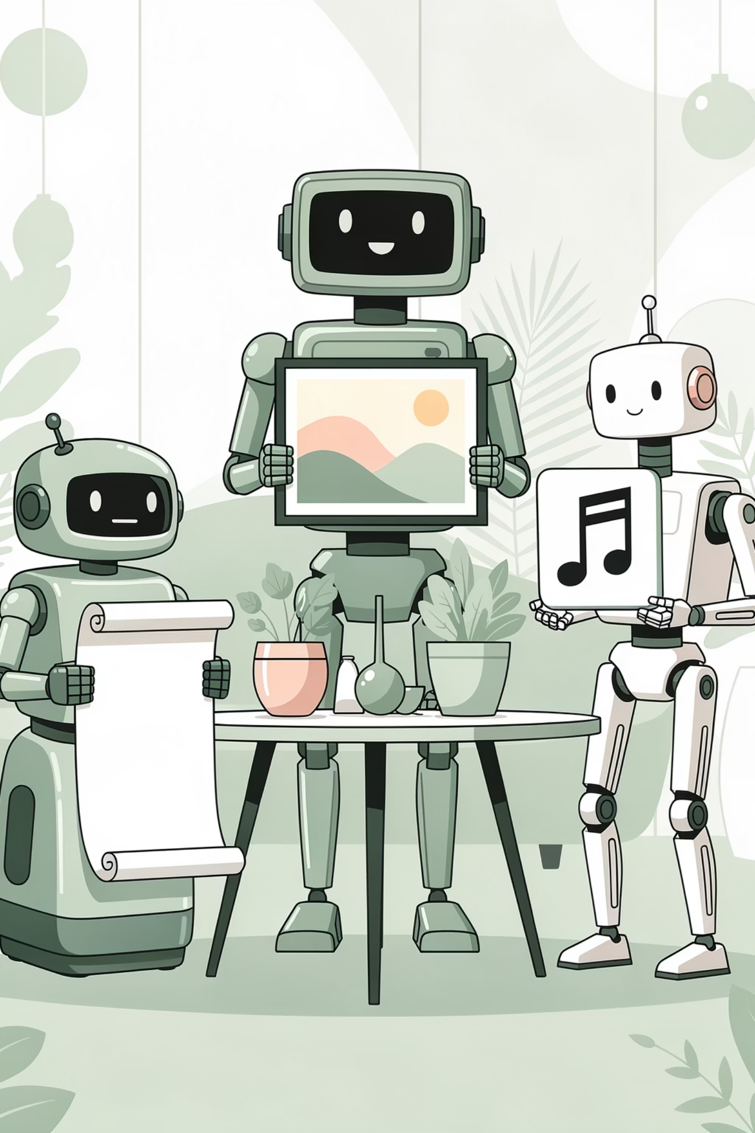

Discussion: What Did You Create?
What did you create?
Describe your birthday artifact.
Which tool did you use?
ChatGPT, Gemini, or both?
Did it turn out how you imagined?
What was similar? What was different?
What would you change?
Your prompt? The tool? The idea? How did your prompt from Mini Activity 2 work?
AI is a creative partner - it takes your ideas and helps bring them to life. But YOU are the director! The quality of what you get depends on the quality of your prompt.

Slide 24
Summary : What We Learned Today
Concept
Key Idea
Generative AI
AI that CREATES new content (text, images, audio)
Traditional (Discriminative) AI
AI that ANALYZES or CLASSIFIES existing content
How it works
1. Trained on millions of examples → 2. Learns patterns → 3. Remixes patterns to create new things
Key insight
AI doesn't "understand" - it's a pattern remixer!
Types
Text, Image, Audio
Your role
You guide it with PROMPTS - your ideas shape what it creates

Slide 25
Homework : Part 1 - Quick Warm-Up
Match each term to its definition:
#
Term
Definition
1
Generative AI
A. AI that analyzes or classifies existing content
2
Discriminative AI
B. Your instruction to an AI about what to create
3
Prompt
C. AI that creates new content
4
Training Data
D. The examples AI learns from
Answers: 1-___, 2-___, 3-___, 4-___

Slide 26
Homework : Part 2 - Improve Your Birthday Artifact
Take your birthday artifact from today's activity and make it BETTER!
Review
Improve your prompt
Try again
Compare
Review what you created in class
Make it more specific, add details, clarify the style, include more about your friend
Try again with your improved prompt using the same tool
Compare the new version to the old one

Slide 27
Original Prompt
Improved Prompt
Your Prompt
What AI Created
(paste or describe)
(paste or describe)
What's better about the new version?

Slide 28
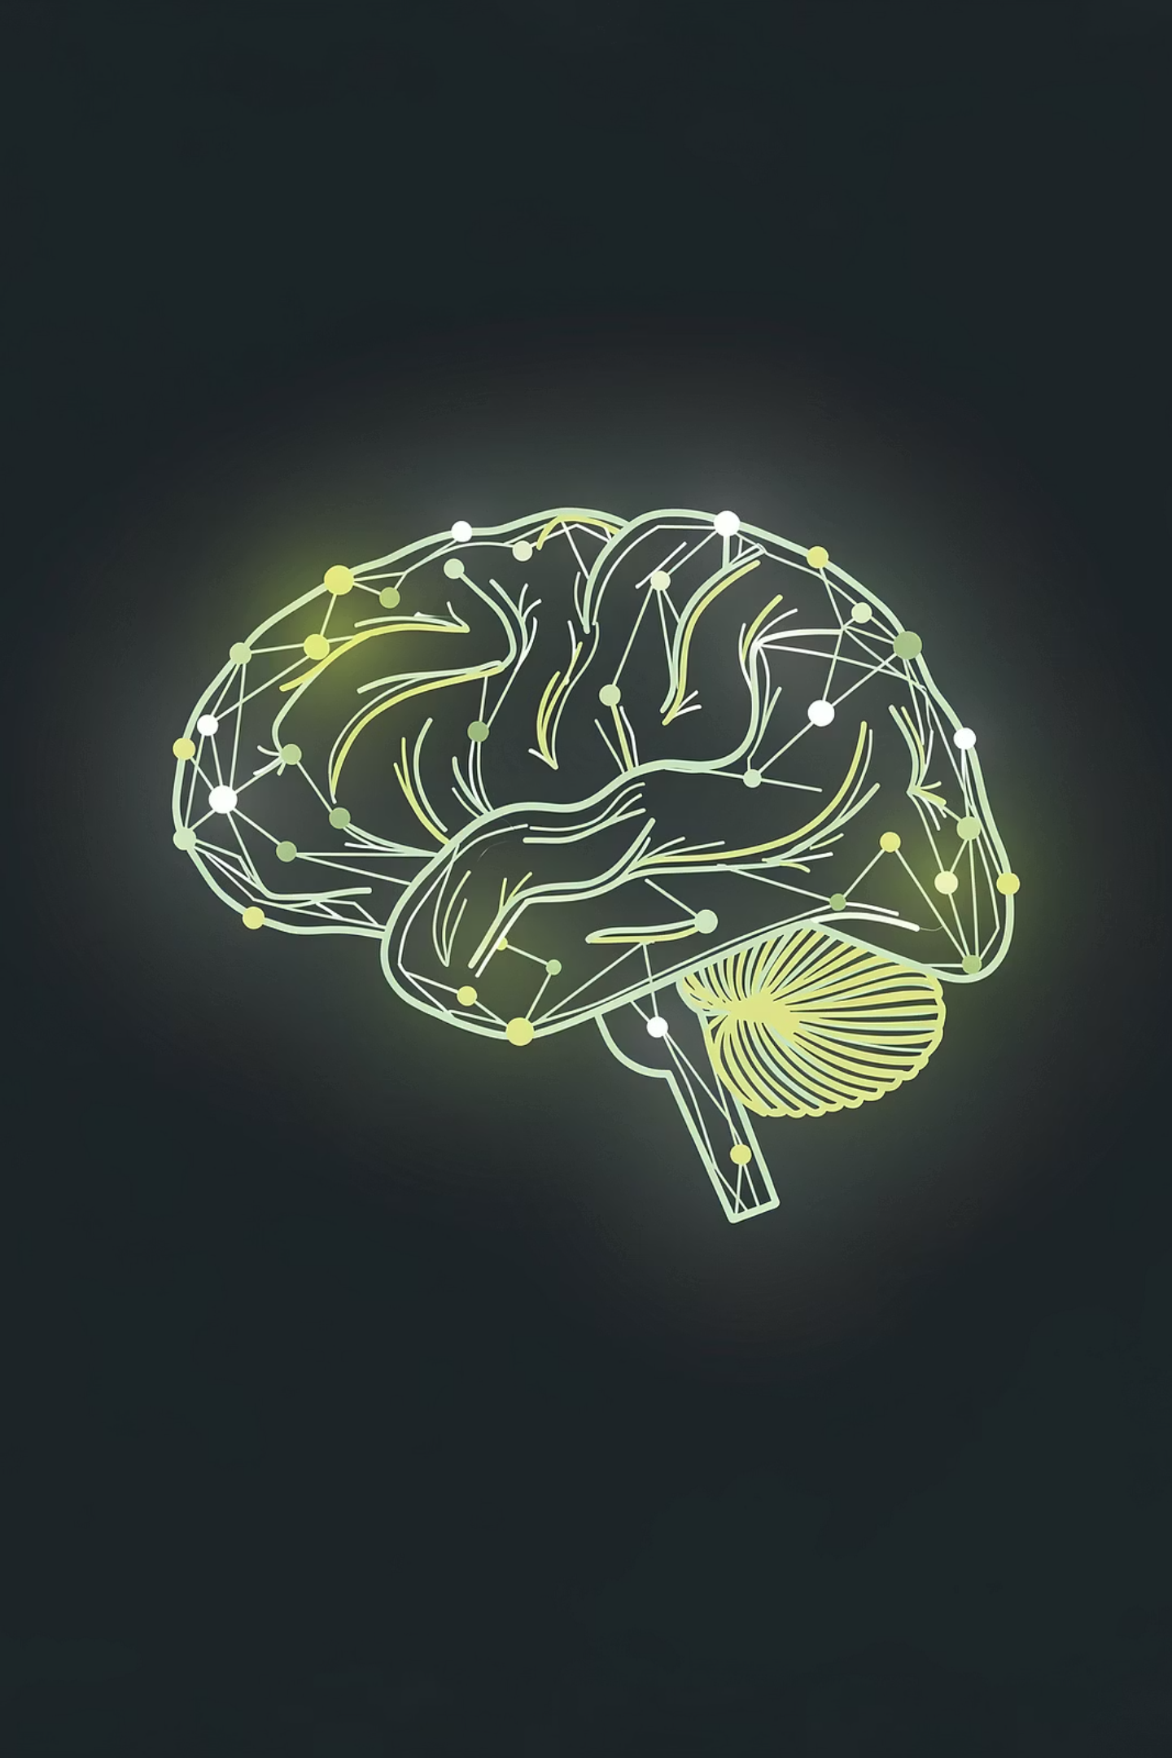
Next Session Preview
Session 8: Large Language Models (LLMs)
You've used ChatGPT and Gemini — next session, we go inside the machine. What makes a language model "large"? How does it predict the next word? What are parameters, and how was it trained? Time to meet the engine behind the magic.

