Slide 1
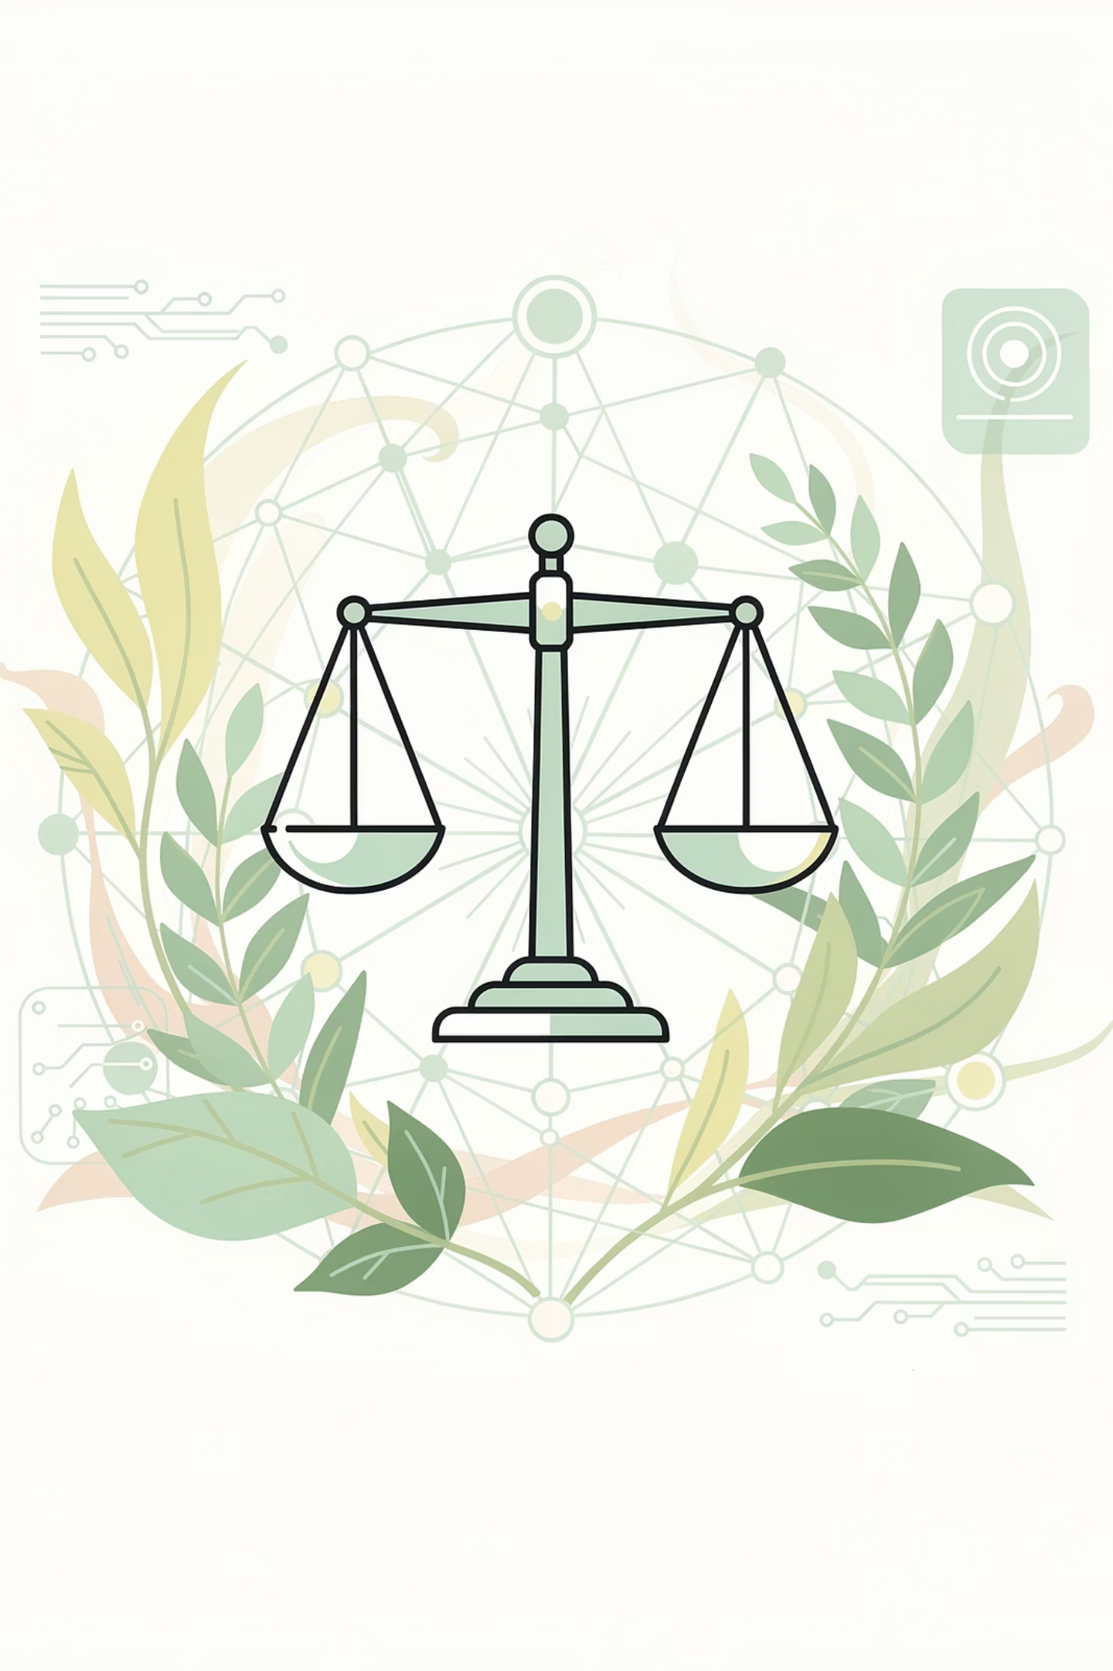
Session 21: AI Safety, Misuse & Governance

Slide 2
Objectives
01
02
03
Identify Misuse
Define AI Safety
Recognize Deepfakes
04
05
06
Understand Privacy
Explore Governance
Human-in-the-Loop

Slide 3

Recap: AI Bias & Fairness
Before we dive into today's session, let's revisit what we covered in Session 20.
Concept
Key Takeaway
Bias
AI produces systematically unfair outcomes when trained on imbalanced data or poorly designed.
Fairness
The active, ongoing effort to ensure AI treats all groups equitably.
Representation
Diverse data and diverse teams are essential for fair AI.
Sources of Bias
Data bias, algorithm bias, and human bias often overlap.
Detection & Mitigation
Auditing data, testing across groups, and Human-in-the-Loop oversight are key.
Real-World Impact
Biased AI has denied jobs, misallocated healthcare, and rendered people invisible.
Today we go further beyond fairness, into safety. When AI is deliberately misused or unintentionally fails, the consequences can be severe, and humans must be ready.

Slide 4
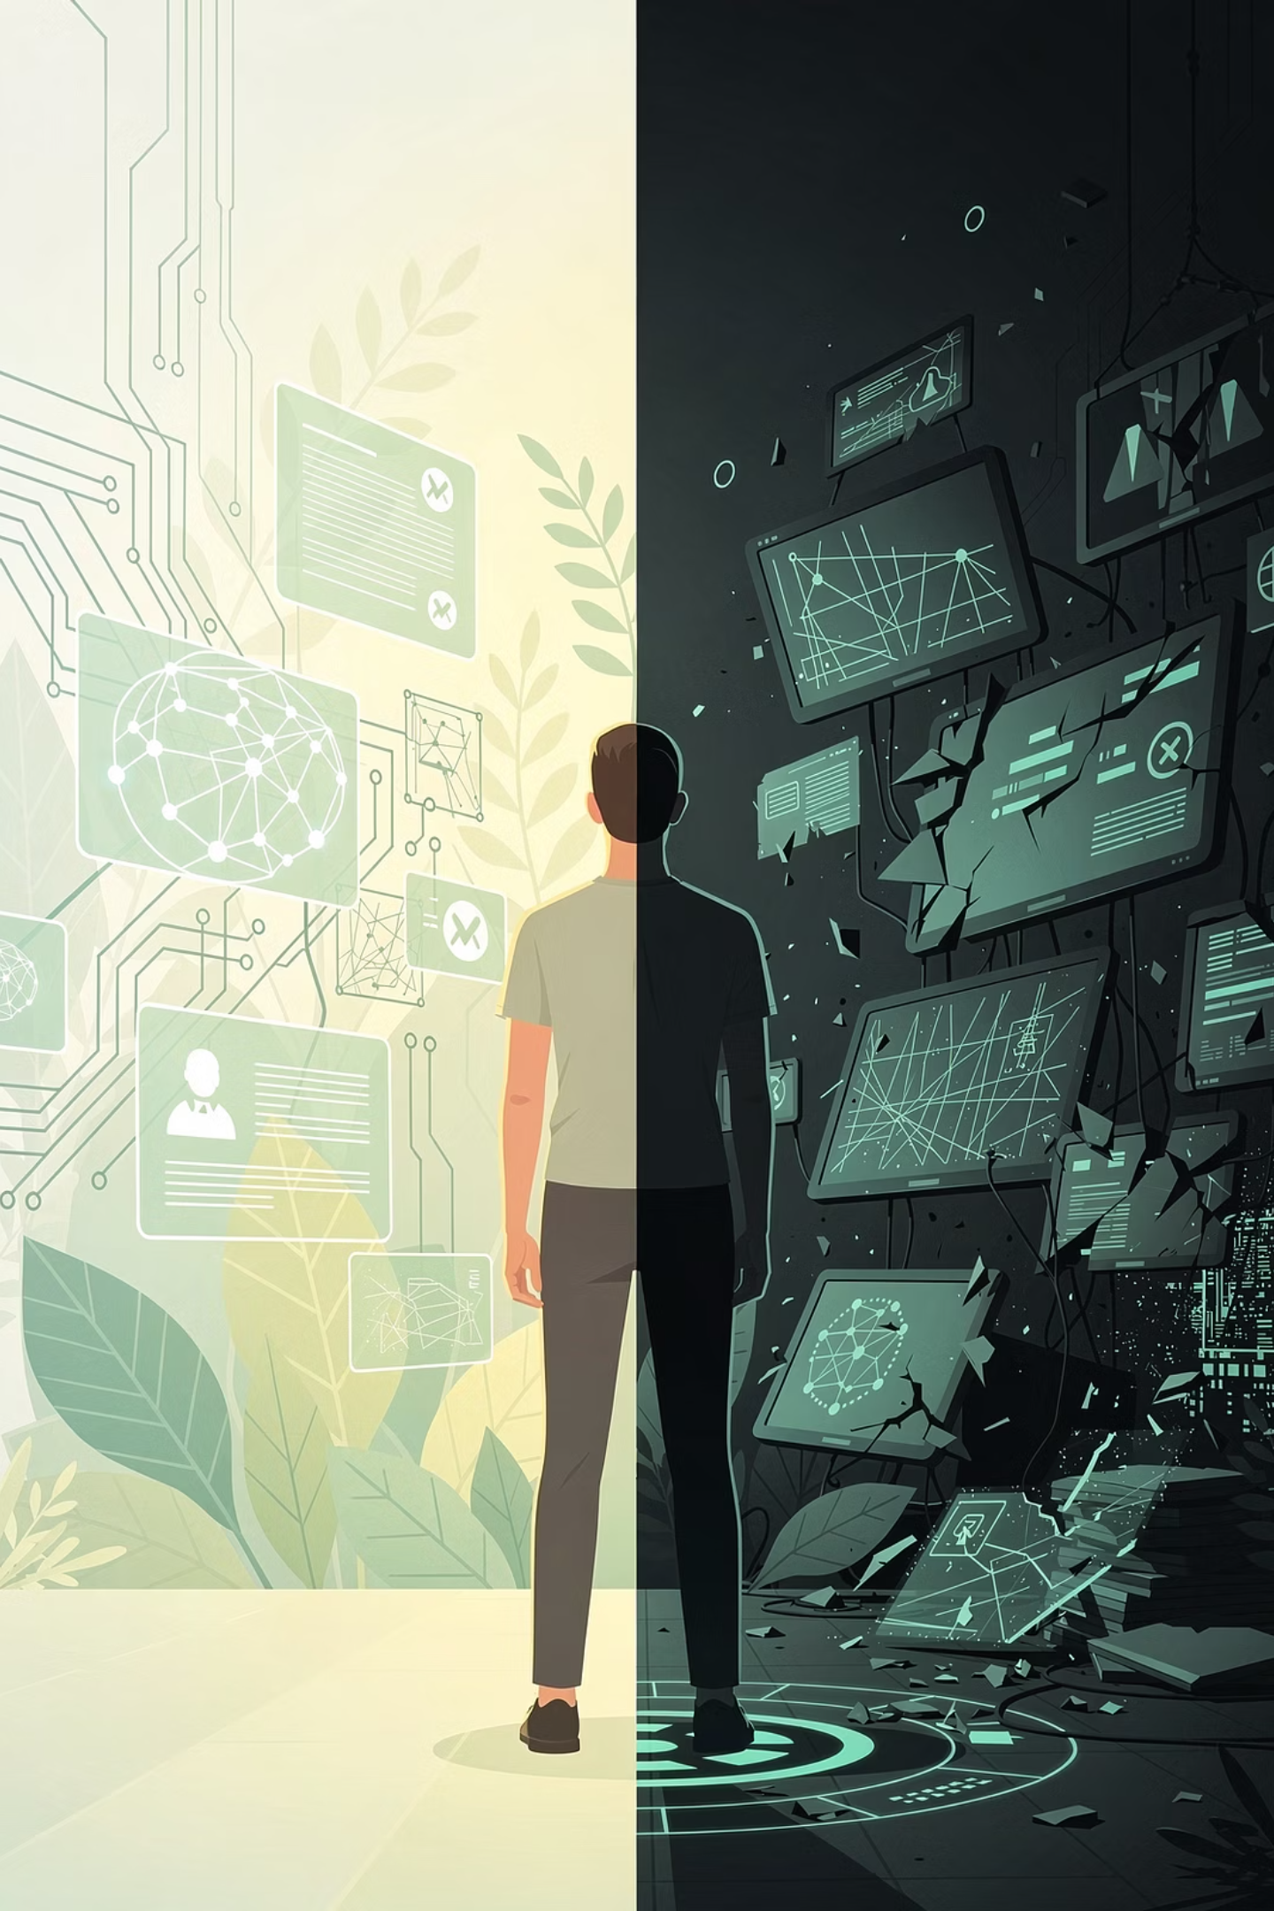

AI Misuse: When AI Becomes a Weapon
AI misuse happens when people deliberately use artificial intelligence to cause harm. The AI itself has no intentions - it is a tool, like a hammer. A hammer can build a house or break a window. The choice belongs to the person holding it.
AI misuse is rarely about AI "going rogue." It is almost always about humans using AI as a tool to harm other humans. The technology amplifies human intent - for better or for worse.

Slide 5
AI Misuse
Disinformation at Scale
Fraud and Impersonation
Cyber Attacks
Harassment & Exploitation

Slide 6
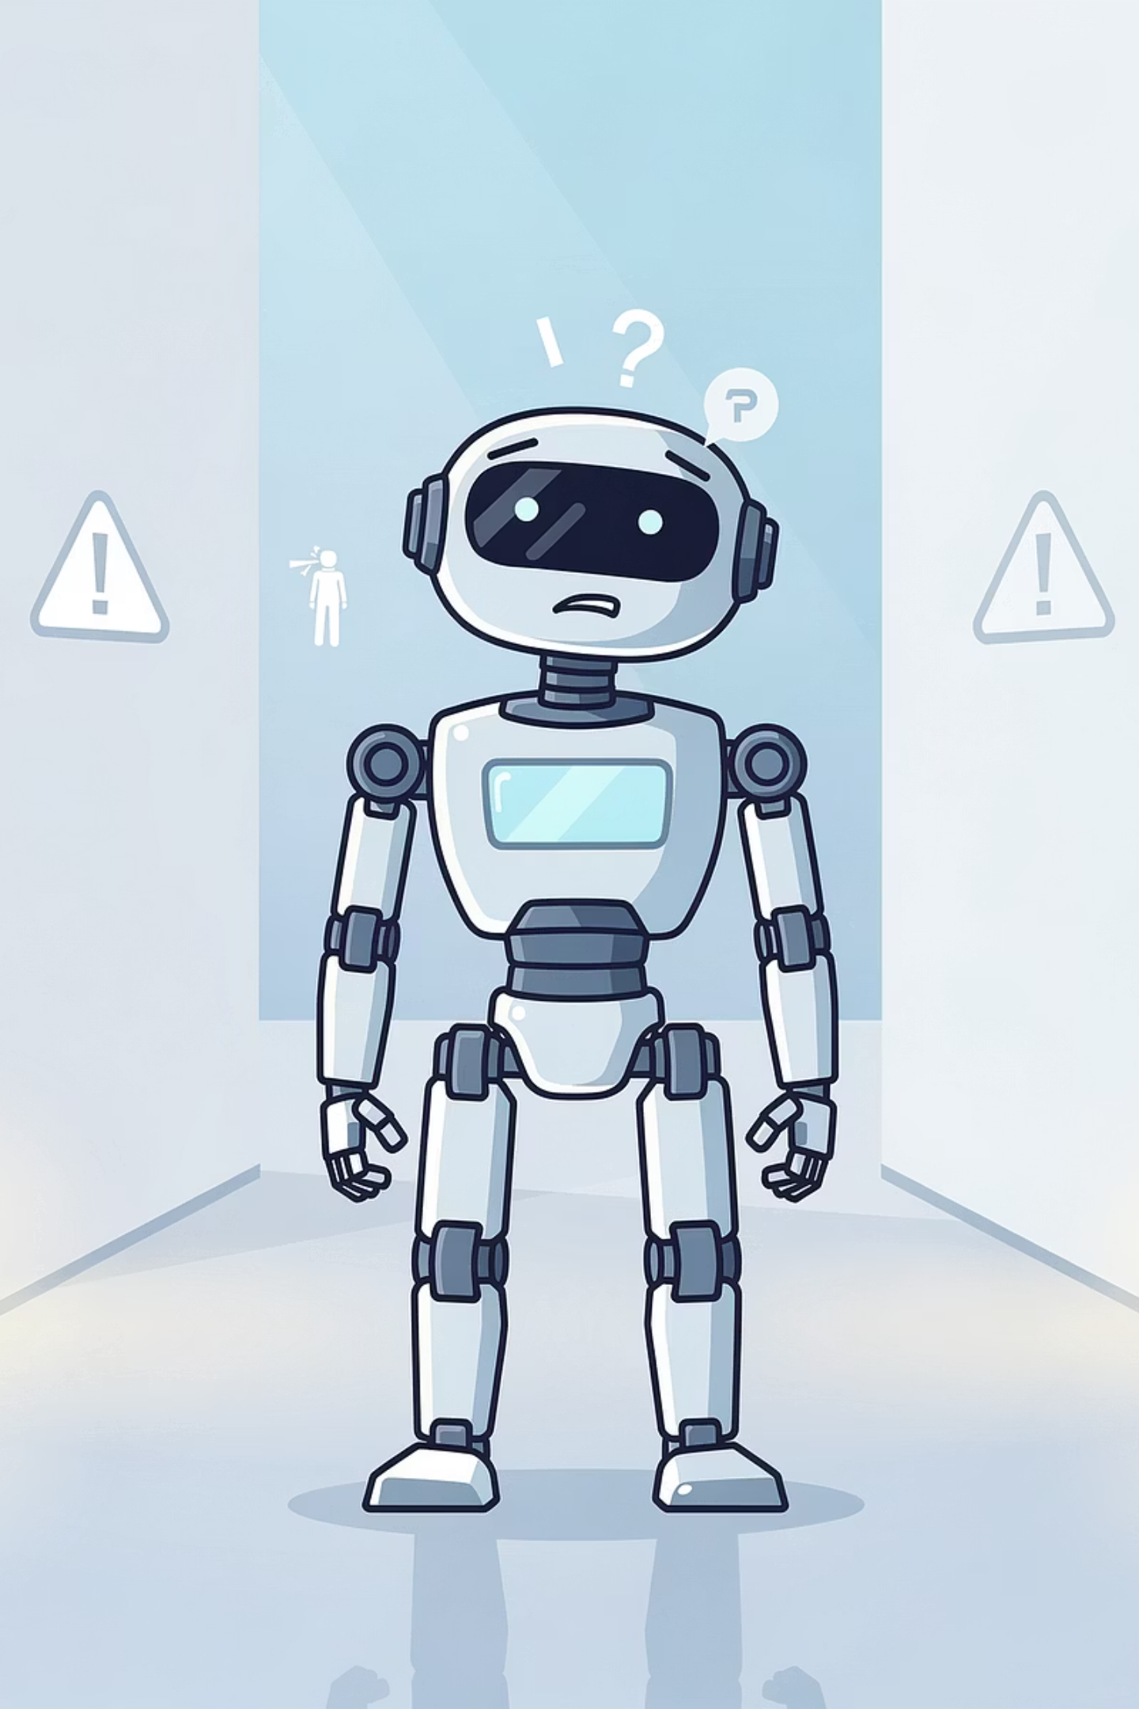

AI Safety
While AI misuse is deliberate, AI safety concerns are about unintended failures - situations where an AI system behaves in a way its creators did not intend, causing harm even though no one meant for it to happen.
AI has no intentions - good or bad. AI Safety depends entirely on how humans design, test, and oversee AI systems before they are deployed.

Slide 7
Examples of AI Safety Failures
🚗 Self-Driving Car
🤖 Medical Chatbot
👤 Facial Recognition
A self-driving vehicle fails to detect a pedestrian in unusual lighting conditions, resulting in a fatal collision. The system was never tested in that specific scenario.
An AI health assistant provides dangerously incorrect medical advice to a user in crisis, because it was trained on general data and lacked clinical safeguards.
A facial recognition system misidentifies an innocent person as a criminal suspect, leading to wrongful arrest with documented higher error rates for darker skin tones.

Slide 8
Mini Activity 1: Misuse or Safety Failure?
Read each scenario. Decide whether the AI incident is a case of AI Misuse (a human deliberately used AI to cause harm) or an AI Safety Failure (the AI caused unintended harm due to a design flaw, bad data, or an unforeseen situation).
Scenario
Answer
Reasoning
A political campaign team uses a generative AI tool to create and distribute thousands of fake videos showing an opponent saying offensive things.
AI Misuse
Humans deliberately used generative AI to deceive voters and damage a reputation.
A self-driving delivery robot fails to recognise a person in a wheelchair as a pedestrian because the training data contained mostly standing adults. The robot does not stop.
AI Safety Failure
The AI was not trained on diverse enough examples - an unintended flaw, not a deliberate act.
A student uses an AI voice-cloning tool to create a fake recording of a classmate saying threatening things about the school, then shares it with the principal.
AI Misuse
The AI tool was intentionally used to harass and deceive. The harm was deliberate.
An AI system used to screen rental applications starts rejecting every applicant from a specific city because a software update accidentally introduced a bug that misreads those addresses.
AI Safety Failure
An accidental software bug caused the harm. There was no human intention to discriminate.
A company trains a customer-service chatbot on its internal help documents, but the chatbot gives dangerously wrong instructions to a customer because the training documents contained errors no one had reviewed.
AI Safety Failure
The AI faithfully learned from flawed training data—an oversight in design and testing, not intentional harm.

Slide 9
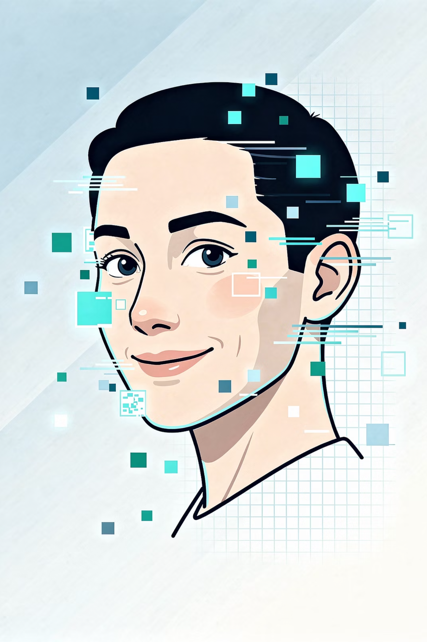
Deepfakes: When Seeing Is No Longer Believing
A deepfake is a piece of media - a video, image, or audio recording—that has been artificially generated or manipulated using AI to make it look or sound like a real person said or did something they never actually did.
The word comes from combining "deep learning" with "fake."

Slide 10




The Harms of Deepfakes
Political Manipulation
Personal Harm
Fraud
Erosion of Trust
Fake videos of leaders can influence elections and destabilise democracies.
Innocent people can be depicted in fake, compromising situations without consent.
Audio deepfakes have already been used to trick companies into transferring large sums of money.
When anyone can claim a real video is "just a deepfake," even genuine evidence becomes questionable.
Deepfakes exploit a fundamental human instinct - we tend to believe what we see and hear. In an age where AI can manufacture evidence, we must learn a new kind of digital skepticism: verify before you trust.

Slide 11
Deepfake Detection Techniques
Blink Rate Analysis
Lighting & Shadow Inconsistencies
Heartbeat Detection
Audio-Visual Mismatch
As detection improves, so does generation. This is why human judgment, skepticism, and verification remain essential - technology alone cannot solve this problem.

Slide 12
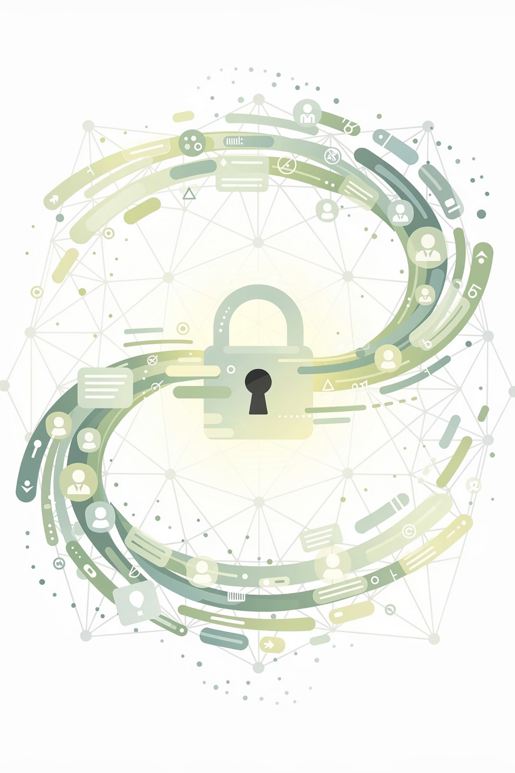
Privacy Risks:
Your Data in the AI Age
Modern AI systems are hungry for data. The more data they consume, the better they perform. But this creates a fundamental tension: the AI that helps you may also be collecting, storing, and analyzing vast amounts of your personal information - often without you fully understanding the extent.

Slide 13
What Kinds of Data Are at Risk?
🎙️ Voice Data
👤 Facial Data
🖱️ Behavioural Data
Smart speakers and voice assistants are always listening. Recordings may be stored and reviewed.
Facial recognition systems capture mathematical maps of your face from cameras and uploaded photos.
Every click, scroll, pause, and purchase is logged. AI builds profiles predicting your interests and emotions.
📍 Location Data
🔬 Biometric Data
Your phone constantly tracks your movements. AI can infer where you live, work, and socialise.
Fingerprints, iris scans, and voiceprints are used for
authentication.
Privacy is not just about hiding things. It is about control - the right to decide what information about you is collected, how it is used, and who can access it.

Slide 14
Why AI Amplifies Privacy Risks
Connecting the Dots
Inference Without Consent
Opacity of Systems
AI can connect dots across datasets to reveal sensitive information you never explicitly shared.
AI can infer things about you - like your mood from your typing speed, or your health from your shopping habits.
AI systems are often opaque: you may not know what data was collected, how it is being used, or who has access to it.

Slide 15
Mini Activity 2: Spot the Concern
Read each scenario. Identify whether it primarily involves a Deepfake concern, a Privacy concern, or Both. Be prepared to explain your reasoning.
Scenario
Answer
Reasoning
A social media account posts a video of a famous singer apparently confessing to a crime. The singer immediately denies it. Analysts find strange shadows around the singer's mouth.
Deepfake
The AI-generated video is used to damage reputation. The primary concern is the creation of convincing fake media.
A smart TV manufacturer admits that their devices were recording living-room conversations even when the TV appeared to be off, and storing those recordings on company servers.
Privacy
Personal audio data was collected without consent, even when users believed the device was off.
A criminal uses AI to clone a child's voice from videos posted online, then calls the child's parent, mimicking the child's voice and claiming to be in trouble, demanding money.
Both
A voice deepfake is used for fraud (deepfake concern), and the child's voice data was scraped from online videos without consent (privacy concern).
A health insurance company buys data from a fitness app that shows users' heart rates, sleep patterns, and running routes. The company uses this to adjust premiums without telling the users.
Privacy
Sensitive personal health data was shared without user knowledge or permission.
A fake video of a school principal making racist remarks goes viral. The video is later proven to be AI-generated, but the principal has already been suspended and received threats.
Deepfake
The AI-generated video caused severe personal and professional harm. The concern is the malicious creation and spread of a deepfake.

Slide 16
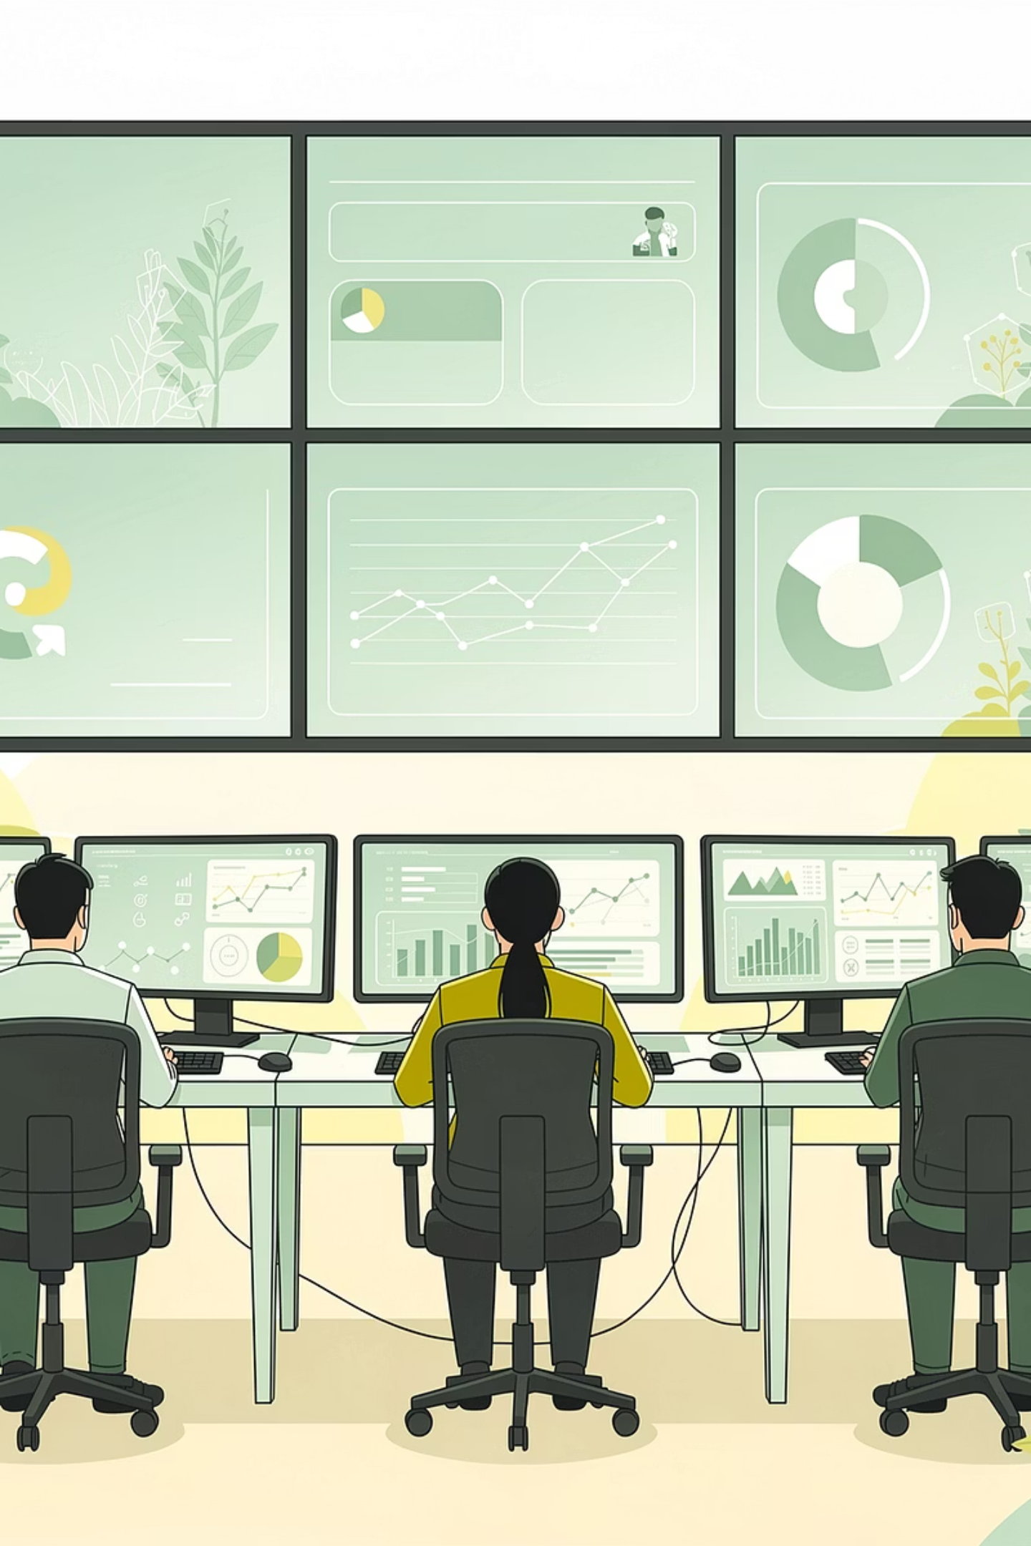
AI Governance & Regulation
AI governance refers to the laws, policies, ethical guidelines, and institutions that shape how AI is developed, deployed, and used.
Who Can Build?
What Testing Is Required?
Who Is Accountable?
Innovation vs. Safety

Slide 17

AI Governance Around the World
EU AI Act
Blueprint for an AI Bill of Rights (USA)
The world's first comprehensive AI law
Classifies AI applications by risk level — from minimal (spam filters) to unacceptable (social scoring by governments)
High-risk AI systems must meet strict requirements before deployment
Establishes principles to guide AI policy
Includes the right to know when AI is being used
The right to opt out
The right to protection from unsafe or discriminatory systems
GDPR (EU)
Global Partnership on AI (GPAI)
Gives individuals rights over their personal data
Includes the right to know what data is collected
The right to have it deleted
The right to object to automated decisions
An international coalition of countries working together
Promotes responsible AI development and shares best practices
Technology moves fast. Laws move slowly.
The gap between what AI can do and what it should do is where governance lives. Closing that gap is one of the great global challenges.

Slide 18
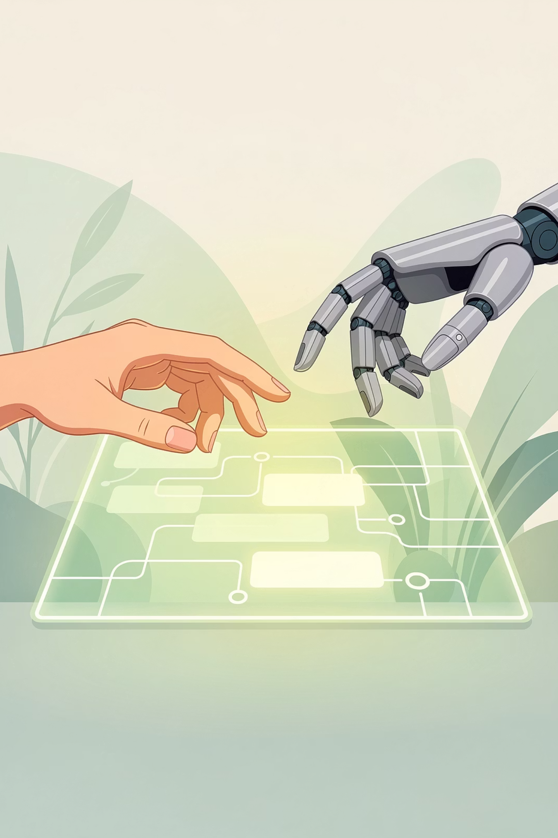
Human-in-the-Loop:
The Ultimate Safeguard
Across every concern discussed today - misuse, safety failures, deepfakes, privacy violations - one principle remains constant: humans must stay in the loop.
What AI Can Do
What AI Can't Do
Analyse millions of data points per second
Spots patterns no human would notice
Processes information at superhuman speed
Cannot make ethical judgments
Cannot understand context the way a human can
Cannot feel the weight of a decision affecting someone's freedom, health, or life

Slide 19

Hands-On Activity:
Investigating an AI Safety Incident
Goal
Tool
Use NotebookLM to analyse a real-world AI safety and misuse incident, and propose governance and oversight measures.
Google NotebookLM
notebooklm.google.com
Task
You will upload a short case study, ask targeted questions, record NotebookLM's grounded answers, and then apply what you have learned today to recommend safeguards. This is the work of AI policy advisors, compliance analysts, and Guardians.

Slide 20
The Case Study: The Deepfake Phone Call
In 2019, the CEO of a UK-based energy company received a phone call from what sounded exactly like his boss - the head of the parent company in Germany. The voice on the line instructed him to urgently transfer €220,000 (about $243,000) to a Hungarian supplier. The CEO recognised the voice, the tone, and even the slight German accent. He authorised the transfer.
The money was gone within hours - routed through accounts in Hungary and Mexico before disappearing. The CEO later discovered his boss had never made that call. Criminals had used AI-powered voice synthesis software, trained on recordings of the executive's public speeches, to create an audio deepfake convincing enough to fool a trained professional.
This was one of the first documented cases of AI-powered voice fraud. No suspects were ever identified, and the money was never recovered.

Slide 21
Hands-On Activity: Steps
01
02
03
Upload to NotebookLM
Ask Guided Questions
Propose Safeguards
Open NotebookLM and create a new notebook titled "AI Safety Case Study." Add the case study text as a source.
Use the questions on the next slide to query NotebookLM and record its grounded answers.
Based on the case study and today's session, write two or three concrete measures to prevent similar incidents.

Slide 22
Hands-On Activity : Questions for NotebookLM
Question
NotebookLM's Answer (Based on the Source)
What AI technology was used in this incident?
What made the deception so convincing?
What was the immediate consequence of the incident?
What made this case difficult to solve?

Slide 23
Hands-On Activity : Propose Safeguards
Based on the case study and today's session, write two or three concrete measures the company or society - could put in place to prevent similar incidents in the future.
Your Proposed Safeguard
1.
2.
3.

Slide 24
Hands-On Activity: Sample Answers
Question
Sample Answer (from Source)
What AI technology was used?
AI-powered voice synthesis software - an audio deepfake.
What made the deception convincing?
The voice matched the boss's exact tone, accent, and speech patterns because it was trained on public recordings.
Immediate consequence?
€220,000 was transferred and routed through multiple countries before disappearing.
Why was it hard to solve?
No suspects were identified; the money was never recovered; audio evidence alone is difficult to trace.
Sample Safeguards
Multi-Factor Verification
Employee Training
Audio Authentication Technology
Require that any financial transfer above a certain amount be confirmed through a second, independent channel - such as a video call or a pre-agreed code word.
Train all employees who handle finances to recognize the possibility of voice-deepfake fraud and to verify unusual requests even when they seem to come from trusted sources.
Invest in or advocate for tools that can analyze audio for subtle digital artifacts that indicate AI generation.

Slide 25
Summary: AI Safety, Misuse & Governance
Concept
Key Idea
AI Misuse
Deliberate harmful use of AI by humans - disinformation, fraud, autonomous weapons, cyber attacks, harassment.
AI Safety
Ensuring AI systems behave as intended and do not cause unintended harm - through robust design, testing, and alignment.
Deepfake
AI-generated fake media that threatens trust, truth, and personal safety.
Privacy Risks
AI's hunger for personal data creates risks around voice, facial, behavioural, location, and biometric information.
Governance & Regulation
Laws, policies, and guidelines (like the EU AI Act and GDPR) that aim to keep AI safe, transparent, and accountable.
Human-in-the-Loop
The essential principle that humans must review and take responsibility for high-stakes AI decisions.

Slide 26

Homework: Safety Detection
Part 1: Spot a Concern
Think of an AI tool you use or have heard about. Write down one specific AI misuse, safety, or privacy concern related to that tool.
1
AI Tool: _______________
Concern: _______________
Part 2: Propose a Safeguard
2
Write one concrete action that could reduce or prevent that concern. Think like a policymaker or a Guardian.
Safeguard: _______________
Part 3: Add to Your Prompt Library
Add this prompt to your Prompt Library:
3
"Explain the difference between AI misuse and an AI safety failure. Give one real-world example of each, and describe how governance or Human-in-the-Loop oversight could address the problem."

Slide 27
Next Session Preview
Discover & Define
Over the next four sessions, you'll research and write a paper investigating how AI is being applied in a domain you choose.
Choose Your Domain
Define Your Question
What area of the world do you want to investigate - healthcare, education, sport, music, climate?
What is the one research question your paper will try to answer?
How can AI be misused to spread disinformation or conduct surveillance?
Find Your Sources
Plan Your Paper
Where does real evidence come from, and how do researchers evaluate what's credible?
What does a research paper actually look like, and how do you structure one from scratch?

