Slide 1

Session 24 :
Analyze & Synthesize

Slide 2
Today's Goals
By the end of this session, you'll have accomplished the following:
01
02
03
Five Lenses Applied
Three Sections Drafted
All Six Sections Polished
04
05
Abstract & Attribution Written
Presentation Started

Slide 3

Today's work adds
New Paper Sections
Additional Deliverables
Bias & Fairness Analysis
AI Attribution Statement
Transparent disclosure of AI tools used
Safety & Governance
Gamma Presentation
Conclusion & Future Work
First three slides started today
Final Abstract
By end of homework after today, your paper is complete and your presentation is ready.
Replaces the placeholder from S22

Slide 4
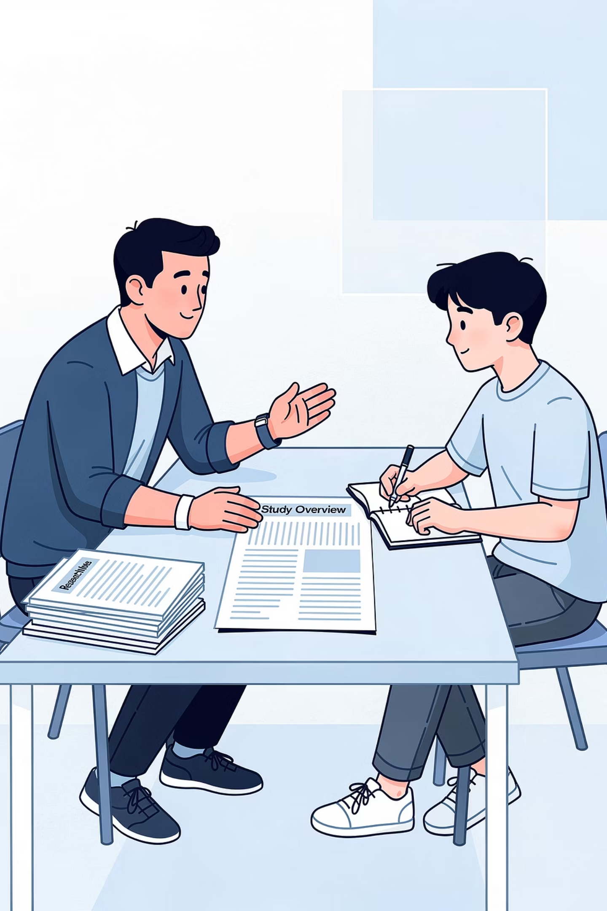
Homework Review
Flag Generated Phrasing
Push on Specificity
Connect Surprises to Analysis
Identify Strongest Observations

Slide 5

The Five Lenses
Lens
What It Examines
Bias & Fairness
Who AI in this domain works well for; who it fails or underserves
Safety & Governance
What harms could result; who's accountable
Ethics
What values are at stake; who benefits, who could be harmed
Human-in-the-Loop
Where human oversight exists or should exist
Voice Integrity
Whether your paper is in your authentic voice
Bias & Fairness and Safety & Governance become their own paper sections. Ethics, Human-in-the-Loop, and Voice Integrity integrate into those sections.

Slide 6

Lens 1 - Bias & Fairness
Data Bias
Algorithmic Bias
What's in and missing from the data AI systems are trained on
How the algorithm processes information and what patterns it amplifies
Human Bias
What assumptions the people building or using the system bring to it

Slide 7
Bias Questions to Ask About Your Domain
Training Populations
Published Failures
Hands-On Patterns
User Testing Signals

Slide 8
Bias - A Concrete Example
Food Allergy Management for Children
What Sources Revealed
The Specific Claim
Allergen-detection systems are typically trained on Western foods, which means they may underperform on foods central to non-Western cuisines.
This data gap means the tool could fail for the populations whose families eat these foods -populations who are not less in need of allergen support, just less represented in training data.
What Exploration Confirmed
The classifier handled Western examples (peanut butter, Snickers) reliably but had no training data for Asian peanut sauces, African peanut stews, or Middle Eastern peanut-based sweets.
This mirrors patterns documented in other AI systems, where narrow training data produces systems that work for some users and fail for others.

Slide 9

Lens 2 - Safety & Governance
Misuse
How AI in this domain could be used to cause harm - intentionally or through negligence
Privacy
What personal data AI applications collect and how that data could be exposed or exploited
Accountability
Who's responsible when AI in this domain fails or causes harm - the developer, the user, the company?

Slide 10




Safety Questions to Ask About Your Domain
Realistic Misuse
Sensitive Data
Accountability Gap
User Concerns

Slide 11

Safety - A Concrete Example
Food Allergy Management for Children
The most serious safety concern in this domain is misplaced trust. Sources reported that consumer-facing allergen detection tools often present results with high confidence even when wrong.
What Exploration Revealed
The Accountability Problem
When the classifier confidently misidentified a Snickers bar as peanut-free - the failure mode most likely to cause harm - a trusting parent or child could face a life-threatening allergic reaction.
When a misclassification causes a child to consume an allergen, responsibility is spread across the parent, tool maker, and hosting platform - with no clear standard governing AI accessibility tools for vulnerable populations like children with allergies.

Slide 12
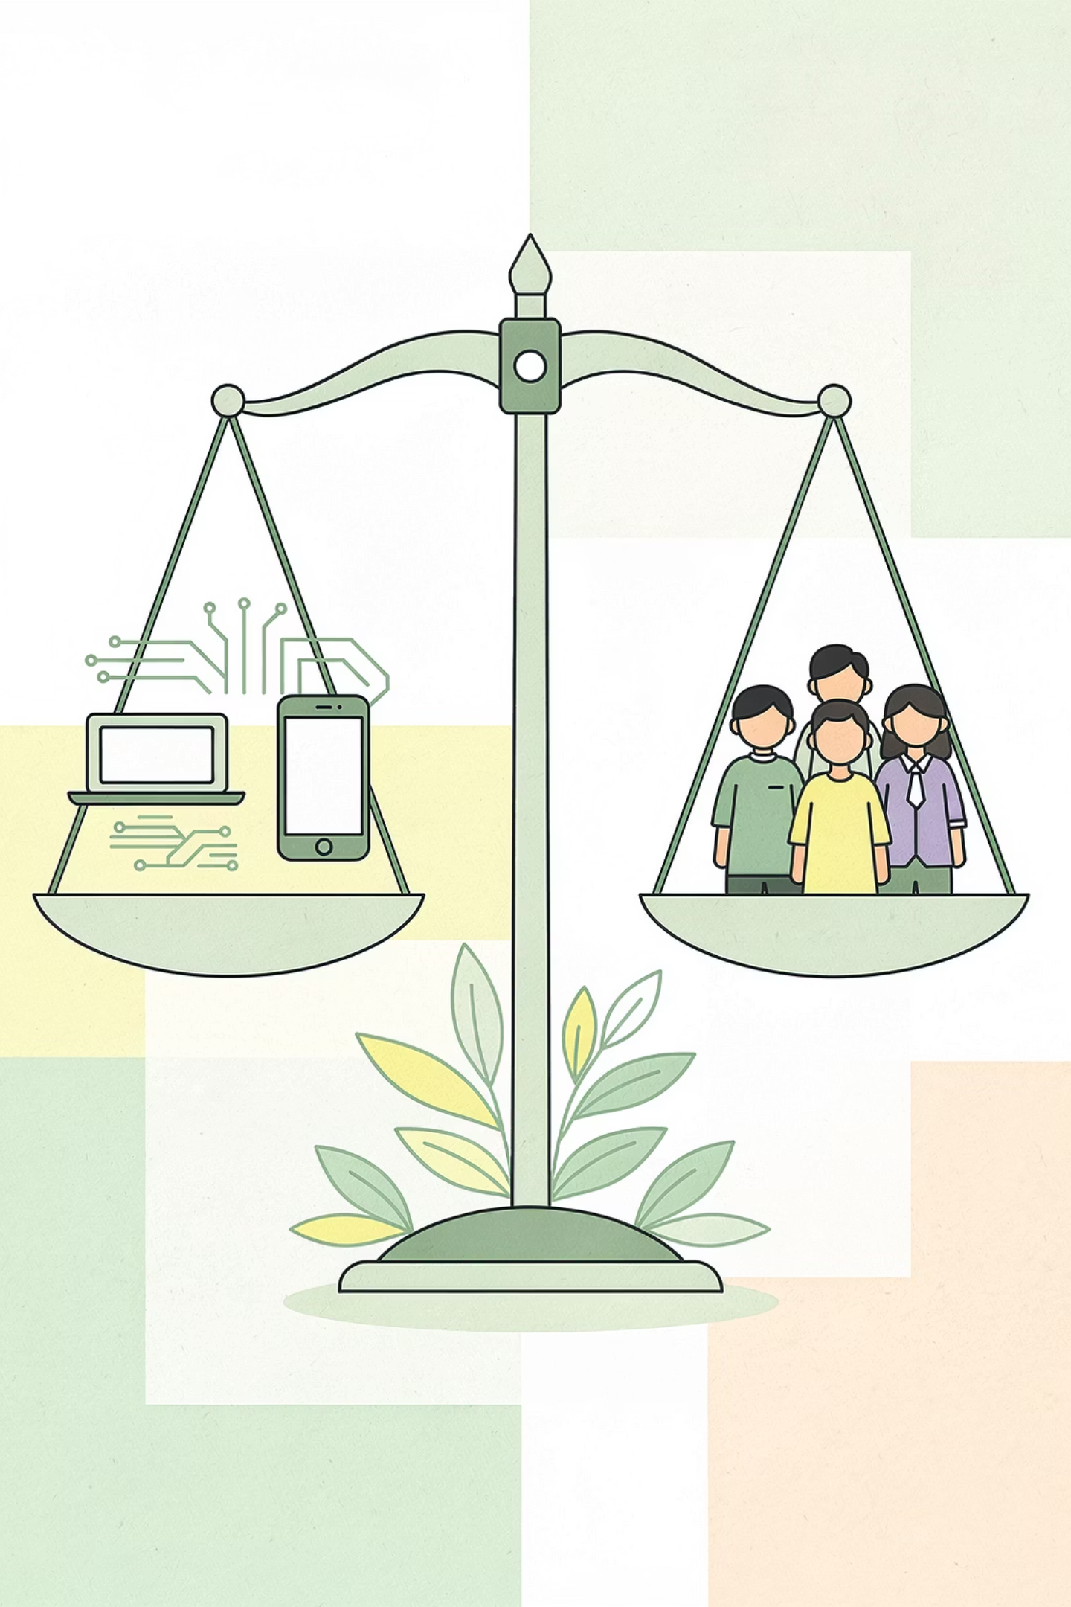
Lens 3 - Ethics
Who Benefits?
Who Could Be Harmed?
Values in Tension

Slide 13

Lens 4 - Human-in-the-Loop
Existing Oversight
Missing Oversight
Recommended HITL

Slide 14

Lens 5 - Voice Integrity
Not Paraphrased AI Output
Not Copy-Pasted from a Source
Your Voice, Your Reasoning, Your Judgment

Slide 15
AI-Sounding Phrases
Overly Polished Sentences
Hollow Phrases
Unusual Vocabulary
Generic Claims
When you spot these, rewrite in your own words. Don't just swap one phrase for another - actually think through what you mean.

Slide 16

Drafting Bias & Fairness - Structure
Use this structure for your Bias & Fairness section. Follow the sequence, then check your target word count by grade.
Connect to Frameworks
Show Exploration Evidence
Show Source Evidence
Link to broader bias frameworks where relevant
State the Issue
What your sources reveal about who AI in this domain works for and against
What your hands-on exploration revealed about bias patterns
Name the most important bias issue in AI applications in your domain

Slide 17
Drafting Safety & Governance - Structure
Use this structure for your Safety & Governance section. Integrate Ethics and Human-in-the-Loop observations here - they don't get separate sections.
Note Human Oversight
Connect to Your Work
Address All Three Categories
Where human oversight is needed and what responsible deployment looks like
Name the Concerns
Link to your hands-on observations and user testing findings
Identify the most serious safety concerns in AI applications in your domain
Cover misuse, privacy, and accountability - even briefly

Slide 18
Polish
Polish doesn't mean making sentences fancier. It means making your paper sharper, clearer, and more authentically yours.
Remove Generated Phrasing
Make Claims Specific
Add Missing Citations
Improve Flow
Cut Filler
A polished paper is shorter, sharper, and more clearly in your voice - not longer or more decorated.

Slide 19

Polish Order
1
2
3
4
Read Aloud for Voice
Check Every Claim
Check Transitions
Cut Filler
Don't polish your draft until it's perfect - that's a trap. Polish until it's clearly in your voice, well-cited, and flows. Then stop.

Slide 20
Drafting the Conclusion
Your Conclusion summarizes what your investigation showed about AI in your domain. It does not introduce new findings.
1
Restate the Investigation
2
Summarize Findings
3
State the Takeaway
4
Point Forward
The Conclusion does not introduce new findings. Everything in it should connect back to something you already showed.

Slide 21
Writing the Final Abstract
Component
Now You Can Fill In
Problem Statement
Why your domain investigation mattered
Research Question
Your sharpened question
Methodology Preview
How you investigated
Findings
What you actually found
Implications
What it means for your domain
The Abstract is the last thing you write - but it appears first in your paper.

Slide 22
AI Attribution Statement
What It Is
Why It Matters
A short statement disclosing which AI tools you used in your investigation and how you used them.
This practice is becoming standard in academic and professional writing. Researchers, journalists, and scientists are increasingly expected to disclose AI assistance clearly and specifically.
What It Isn't
It's not a confession. It's not an apology. It's transparency - being clear about what role AI played in your research process.
By including an AI Attribution Statement, you're aligning with how serious researchers handle AI assistance and demonstrating the kind of intellectual honesty that defines Academic Integrity.

Slide 23
AI Attribution Statement - What to Include
Your statement should cover two things: what AI tools did, and what you did yourself.
For Each AI Tool You Used
What You Did Yourself
Drafting all sections
Polishing in your voice
Conducting the hands-on exploration
Doing user testing
Deciding what claims to make
Which tool
What you used it for
How you verified its output

Slide 24
AI Attribution Statement - Example
"AI tools assisted in this investigation. Perplexity helped discover candidate sources. NotebookLM was used to verify content and extract specific findings, with all extractions cross-checked against original sources. Gemini compared candidate sources during initial filtering. Teachable Machine was the subject of the hands-on exploration. ChatGPT was used briefly for early brainstorming on framing but not for content generation. All paper sections were drafted, polished, and revised by me. Where AI tools suggested phrasing, I rewrote in my own voice. My mentor provided guidance and feedback throughout but did not write any sections of this paper."
This is one example. Yours should reflect what you actually used - the tools, the purposes, and the verification steps that match your real investigation process.

Slide 25

Meet Gamma
Now we move to your presentation. The tool you'll use is called Gamma.
What Gamma Is
How It Works
Why It's Powerful

Slide 26
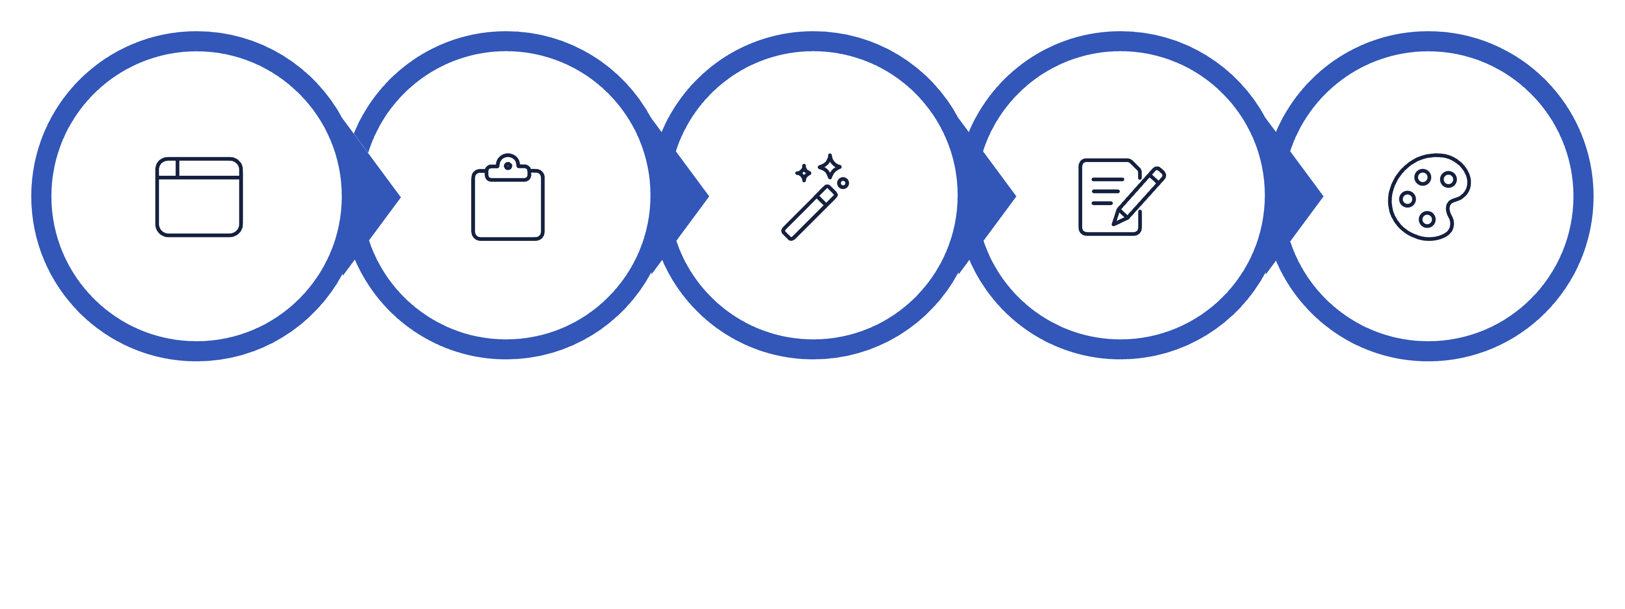
How Gamma Works
Auto‑Design Slide
Edit Text & Visuals
Adjust Theme
Open Gamma
Paste Content

Slide 27
Your Presentation Structure
Slide
Title
Content from Your Paper
1
Title
Paper title + your name + grade
2
Hook
The most striking finding or question from your investigation
3
Research Question
Your sharpened research question
4
Background
Three key findings from your Related Work
5
Methodology
How you investigated (literature + hands-on)
6
Results
Your synthesis of findings
7
Bias & Safety
Main bias concern and main safety concern
8
Conclusion
Main takeaway and one or two future work directions
9
Thank You
Closing

Slide 28
Today's First Three Slides
Slide 1 - Title
Slide 2 - Hook
Slide 3 - Research Question
Your paper title, your name, your grade. Clean and clear - this is your first impression.
One striking sentence that opens your presentation strongly. The most surprising or important thing you found.
Your sharpened research question, prominently displayed. This is what your whole investigation was built to answer.
Six more slides come in homework. By Session 25, your full presentation is ready.

Slide 29
Outputs Checklist
By the end of today's session, you should be able to check off every item on this list.
Paper Sections
Additional Deliverables
Bias & Fairness section drafted
Final Abstract written
Safety & Governance section drafted (with Ethics and HITL integrated)
AI Attribution Statement written
References list complete and consistent
Conclusion & Future Work drafted
All six prior sections polished
First three Gamma slides started

Slide 30
Homework
Final Proofread
Build Slides 4-9
Practice Aloud
Citations consistent, voice consistent, no remaining generated-sounding phrases throughout the full paper
Complete the remaining six Gamma slides - Background, Methodology, Results, Bias & Safety, Conclusion, Thank You
Run through your full presentation aloud, time it, and aim for about 10-15 minutes
By end of homework, your paper is complete and your presentation is ready for Session 25.

Slide 31




What's Next - Session 25
Bring everything to Session 25. You'll present your investigation, defend it, and reflect on the full journey.
Complete Paper
Full Presentation
Practiced Delivery
Readiness to Defend
Session 25 is Deliver & Reflect.

