Slide 1
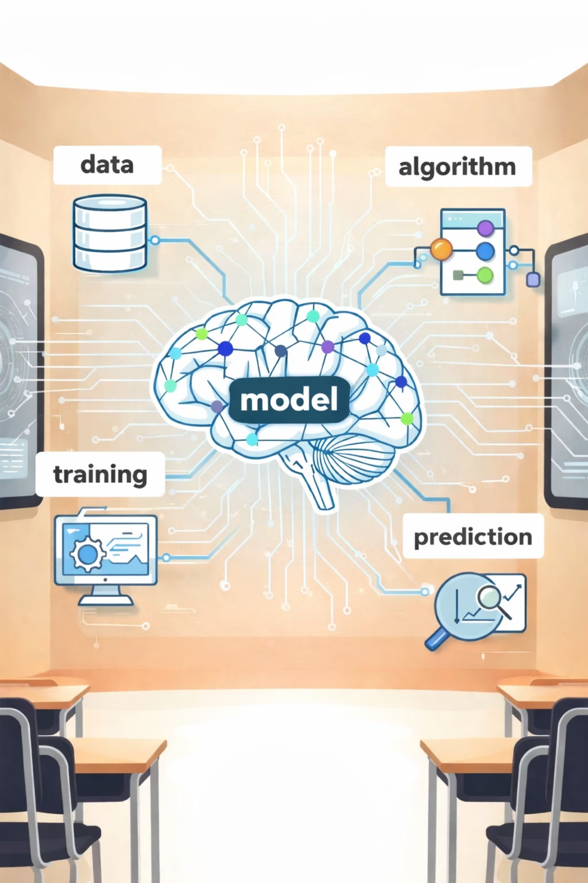
Session 2:
AI Concepts & Terminology

Slide 2
Recap: What We Learned in Session 1
What is AI?
AI in Daily Life
Sense-Think-Act
AI vs Human
Myths Busted
Narrow vs General
AI as Tool

Slide 3
Objectives
01
02
03
04
AI and Its Subsets
Data - The Fuel of AI
Algorithm - The Instructions AI Follows
Training - How AI Learns from Data
05
06
07
08
Model - The Result of Learning
Algorithm vs Model - What's the Difference?
Prediction - AI's Smart Guess
The AI Recipe - Putting It All Together

Slide 4

What Do You Already Know About Terms Related to AI?

Slide 5
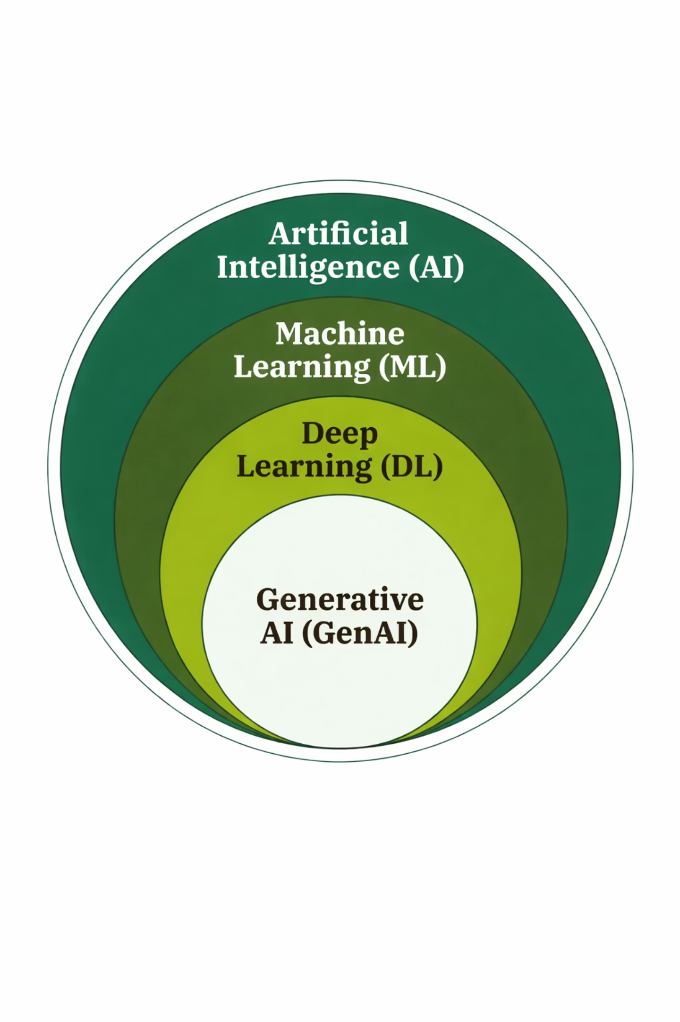
AI and Its Subsets
Artificial Intelligence (AI)
Machine Learning (ML)
Deep Learning (DL)
Generative AI (GenAI)

Slide 6
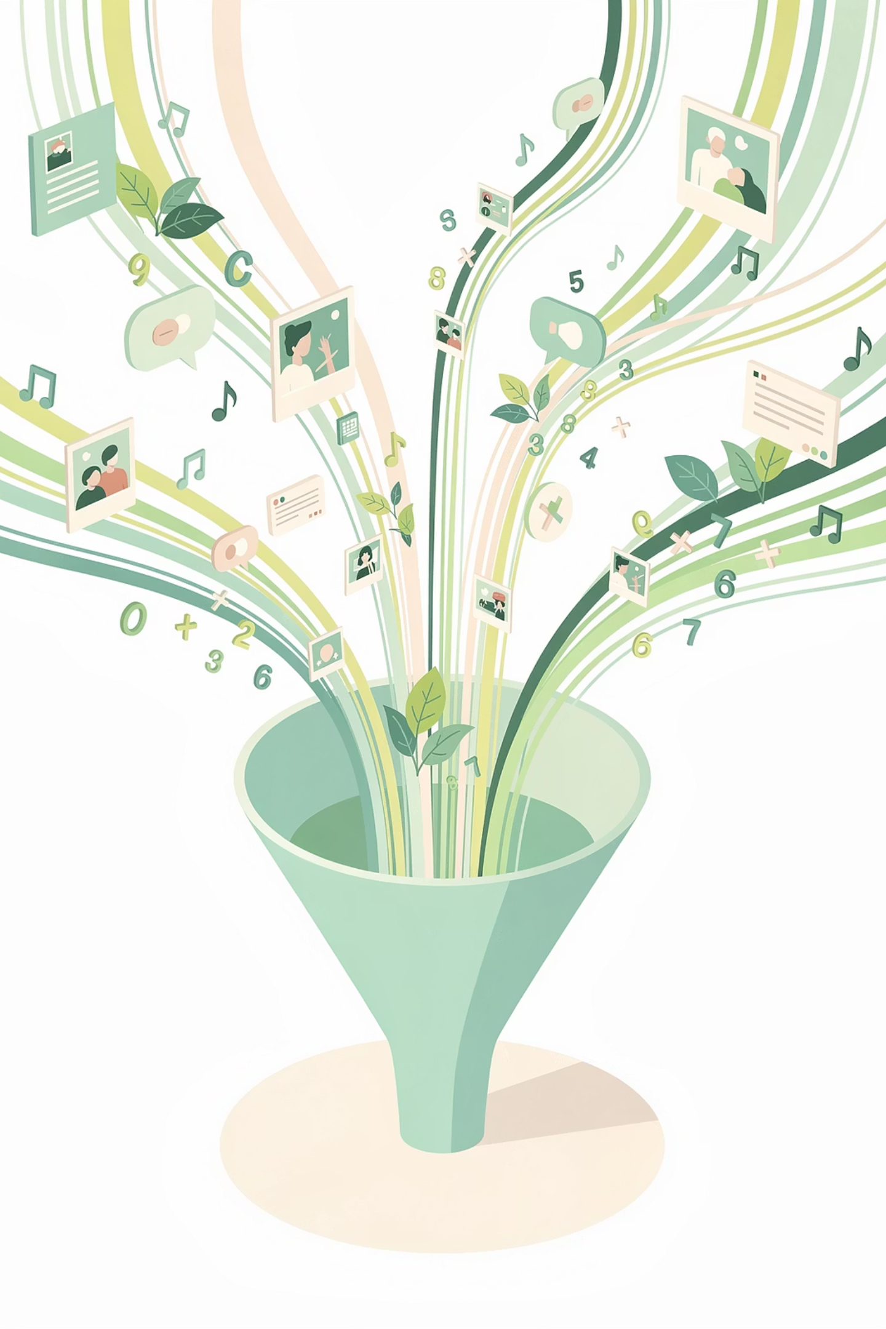
Data - The Fuel of AI
Data is information. It's the raw material that AI systems learn from. Without data, AI has nothing to work with.
In computing and AI, Data refers to facts, statistics, or pieces of information collected together for reference, analysis, or learning.

Slide 7
Types of Data AI Uses
Data Type
Examples
🔢 Numbers
Temperatures, scores, ages, prices, stock values
📝 Text
Books, articles, tweets, messages, reviews
📸 Images
Photos, selfies, drawings, medical X-rays
🎵 Audio
Voice recordings, songs, podcasts, sounds
🎬 Video
Movies, TikToks, YouTube clips, security footage
📍 Sensor Data
GPS location, motion, temperature readings

Slide 8
You Create Data Every Single Day!
👍 Like a video on TikTok
🔍 Search on Google
🗣️ Ask Siri a question
📸 Take a photo
❤️ Heart a song on Spotify
🛒 Buy something on Amazon
📍 Share your location
📱 Scroll through Instagram

Slide 9
The Most Important Rule About Data
Garbage In, Garbage Out (GIGO)
EXAMPLES OF BAD DATA
Only photos of brown dogs
Trained only on sunny day photos
Only text from one country
Teaching a translation app only with formal textbooks
Training a movie-recommendation AI only on action films

Slide 10
🎮 Mini Activity : Data Detective
Read each item and write down whether it's: Number, Text, Image, Audio, or Video.
Item
Data Type?
A selfie you took with your phone
Image
The lyrics to your favourite song printed on paper
Text
The temperature outside right now (72°F)
Number
A TikTok dance video
Video
A text message from your friend saying "See you later!"
Text
A screenshot of your high score in a game
Image
A podcast episode about dinosaurs
Audio/Video
A photograph of your family at the beach
Image
Your heartbeat recorded by a smartwatch
Number

Slide 11
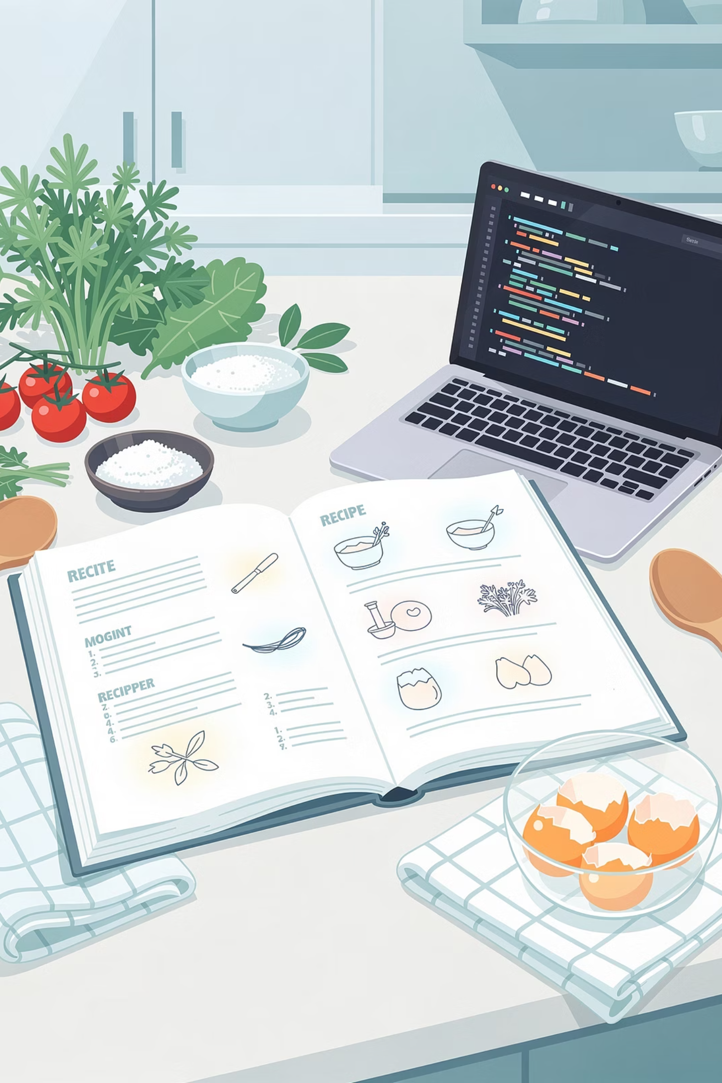
Algorithm - The Instructions AI Follows
An algorithm is a step-by-step set of instructions that tells a computer how to solve a problem.
Algorithms are always:
Clear
Unambiguous
Finite
Effective

Slide 12
Real‑Life Algorithms You Already Know
You follow algorithms every single day without even realizing it! Here are some examples:
Getting Ready for School
Directions to a Friend's House

Slide 13
Think of It This Way
An algorithm is a recipe for a computer.
Recipe
Algorithm
Written for a human cook
Written for a computer
Uses ingredients
Uses data
Produces a dish
Produces a result
Can be followed by anyone
Can be run on any computer

Slide 14
🎮 Mini Activity: Algorithm Hunt
Find 3 things YOU do step‑by‑step every day. Write down your algorithm for each one.
Need Ideas?
How you brush your teeth
How you log into your favorite game
How you make your favourite snack or sandwich
How you get ready for a picnic
How you solve a math problem
How you pack your school bag
How you tie your shoes
How you navigate to a new place on your phone

Slide 15
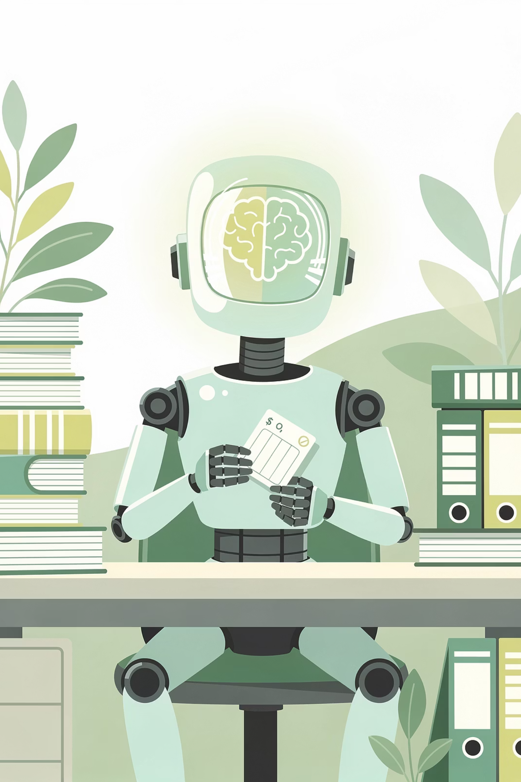




Training - How AI Learns from Data
Training is the process where an AI system learns from data.
How Training Works (Simply)
DATA
ALGORITHM
(Examples)
(Recipe)
TRAINING
MODEL
(Process)
(Result)

Slide 16




What Actually Happens Inside AI During Training?
During training, the algorithm goes through a continuous loop:
Make a guess
Check if guess was right
REPEAT millions of times!
Adjust itself a tiny bit

Slide 17
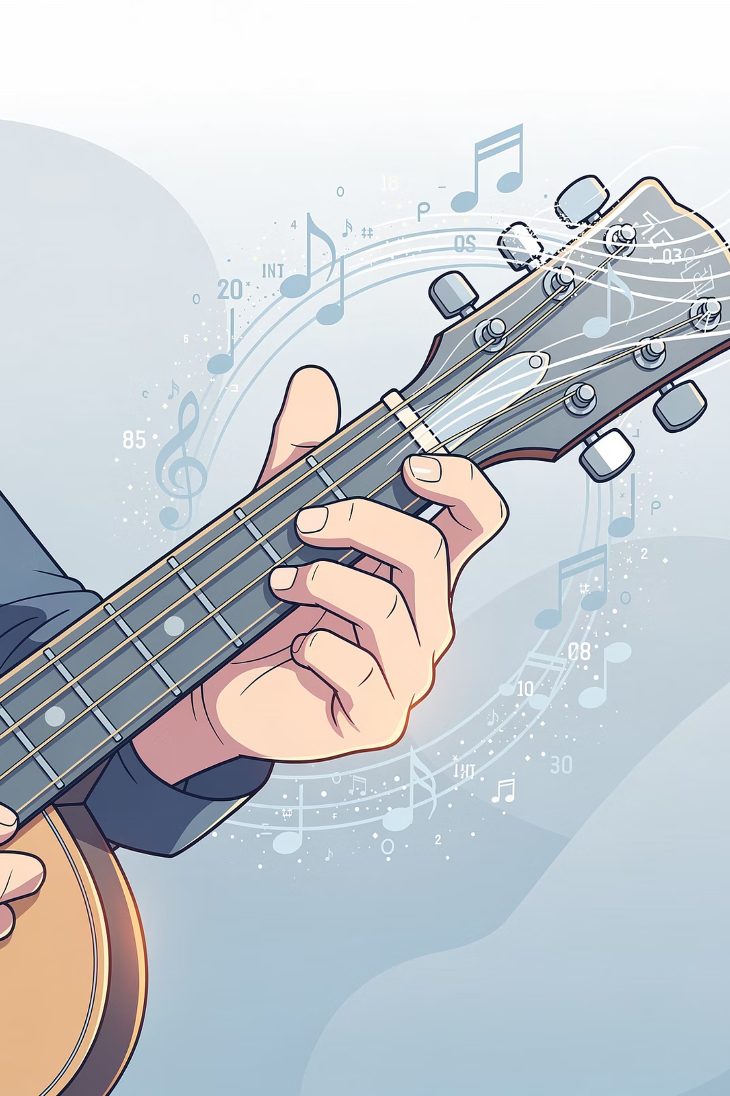
Think of It Like Tuning a Guitar
Think of training an AI like tuning a guitar. You pluck, listen, adjust over and over until it sounds right. AI does the same thing, adjusting millions of tiny numbers until its predictions are accurate.

Slide 18
Training Takes… A LOT of Data and Time!
What's Being Trained
How Much Data
How Long It Takes
Simple image classifier
50‑100 images
A few minutes
ChatGPT / Gemini
Billions of web pages, books, articles - that's petabytes of data!
Months, using thousands of powerful computers running 24/7
Self-driving car AI
Millions of miles of video footage, sensor data
Years of real and simulated driving

Slide 19

Model - The Result of Learning
A model is the output of training - a mathematical representation of patterns learned from data, used to make predictions on new, unseen data.

Slide 20
The Cooking Analogy (Extended)
Cooking Step
AI Step
You have a recipe
You have an algorithm
You gather ingredients
You gather data
You practice making the dish many times, adjusting as you go
Training happens – the algorithm learns from data
You become a skilled chef who knows the recipe by heart
The algorithm becomes a trained model
You cook for friends using your skill
The model makes predictions on new data

Slide 21
Examples of Models You Use Every Day
ChatGPT / Gemini
Face Unlock on Your Phone
Netflix Recommendations
Spotify / Apple Music
Google Translate
Google Maps Traffic Prediction
Spam Filter in Gmail

Slide 22

Key Insight About Models
The model itself is NOT the most important part - the data is!
Same algorithm + Different data
Different algorithms + Same data
= Different models
= Different models
Any model is only as good as the data it learns from.

Slide 23
Algorithm vs. Model - What's the Difference?
Algorithm
Model
The recipe
The trained chef
Blank sheet music
A musician who has practiced and can perform
A workout plan
An athlete who has trained for months
General instructions
Specific knowledge
Everyone can have the same algorithm
Each model is unique - based on its specific training data

Slide 24
Most Important Takeaways
Same algorithm + Different data =
Different algorithms + Same data =
Different models
Different models
No model without algorithm AND data
Algorithm is general; Model is specific

Slide 25

Hands-On Activity : Explore Gemini
Gemini is a type of AI that was trained on enormous amounts of text from the internet, books, articles, and other sources.
Gemini can:
Answer questions on almost any topic
Explain complex concepts in simple terms
Help with creative projects
Translate between languages
And much more!

Slide 26
Hands-On Activity : Explore Gemini
Open Gemini (gemini.google.com) and try these three things. Write your answers below.
Task 1: Ask About Data & Training
Task 2: Ask for Explanations
Ask Gemini:
Ask Gemini:
"What data were you trained on?"
"How much text did you learn from?"
"Explain how a refrigerator works using a simple analogy."
"Now explain it like I'm 5 years old."
What do these answers tell you about the DATA and TRAINING behind Gemini?
How are they different? What does this tell you about the MODEL?

Slide 27
Task 3: Complete These Sentences
The parts of "The AI Recipe" you just experienced:
Ask Gemini to finish these sentences. Observe what it says.
DATA
ALGORITHM
"The first person to walk on the moon was _______________"
"For my birthday, I hope I get _______________"
"Once upon a time, in a galaxy far, far away, _______________"
TRAINING
MODEL
PREDICTION

Slide 28
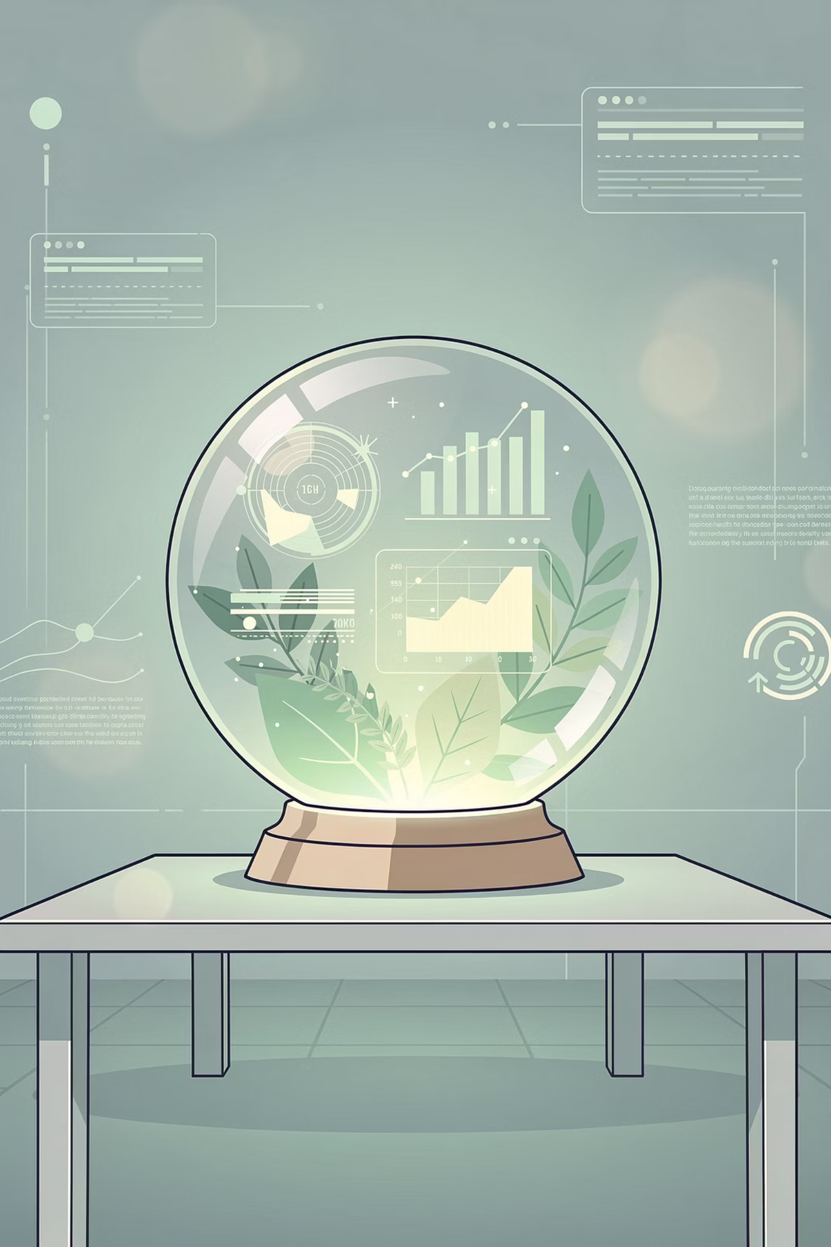
Prediction - AI's Smart Guess
Prediction is what a trained model does when it encounters new data. It's the model making its best "guess" based on everything it learned during training.
Prediction Is Everywhere!
Netflix
Google Maps
Gmail
Amazon
Weather App
Spotify

Slide 29
Training vs. Prediction
Training
Prediction
Learning from examples
Using what was learned
Takes a long time
Happens instantly
Needs lots of data
Needs just one new input
Creates the model
Uses the model

Slide 30
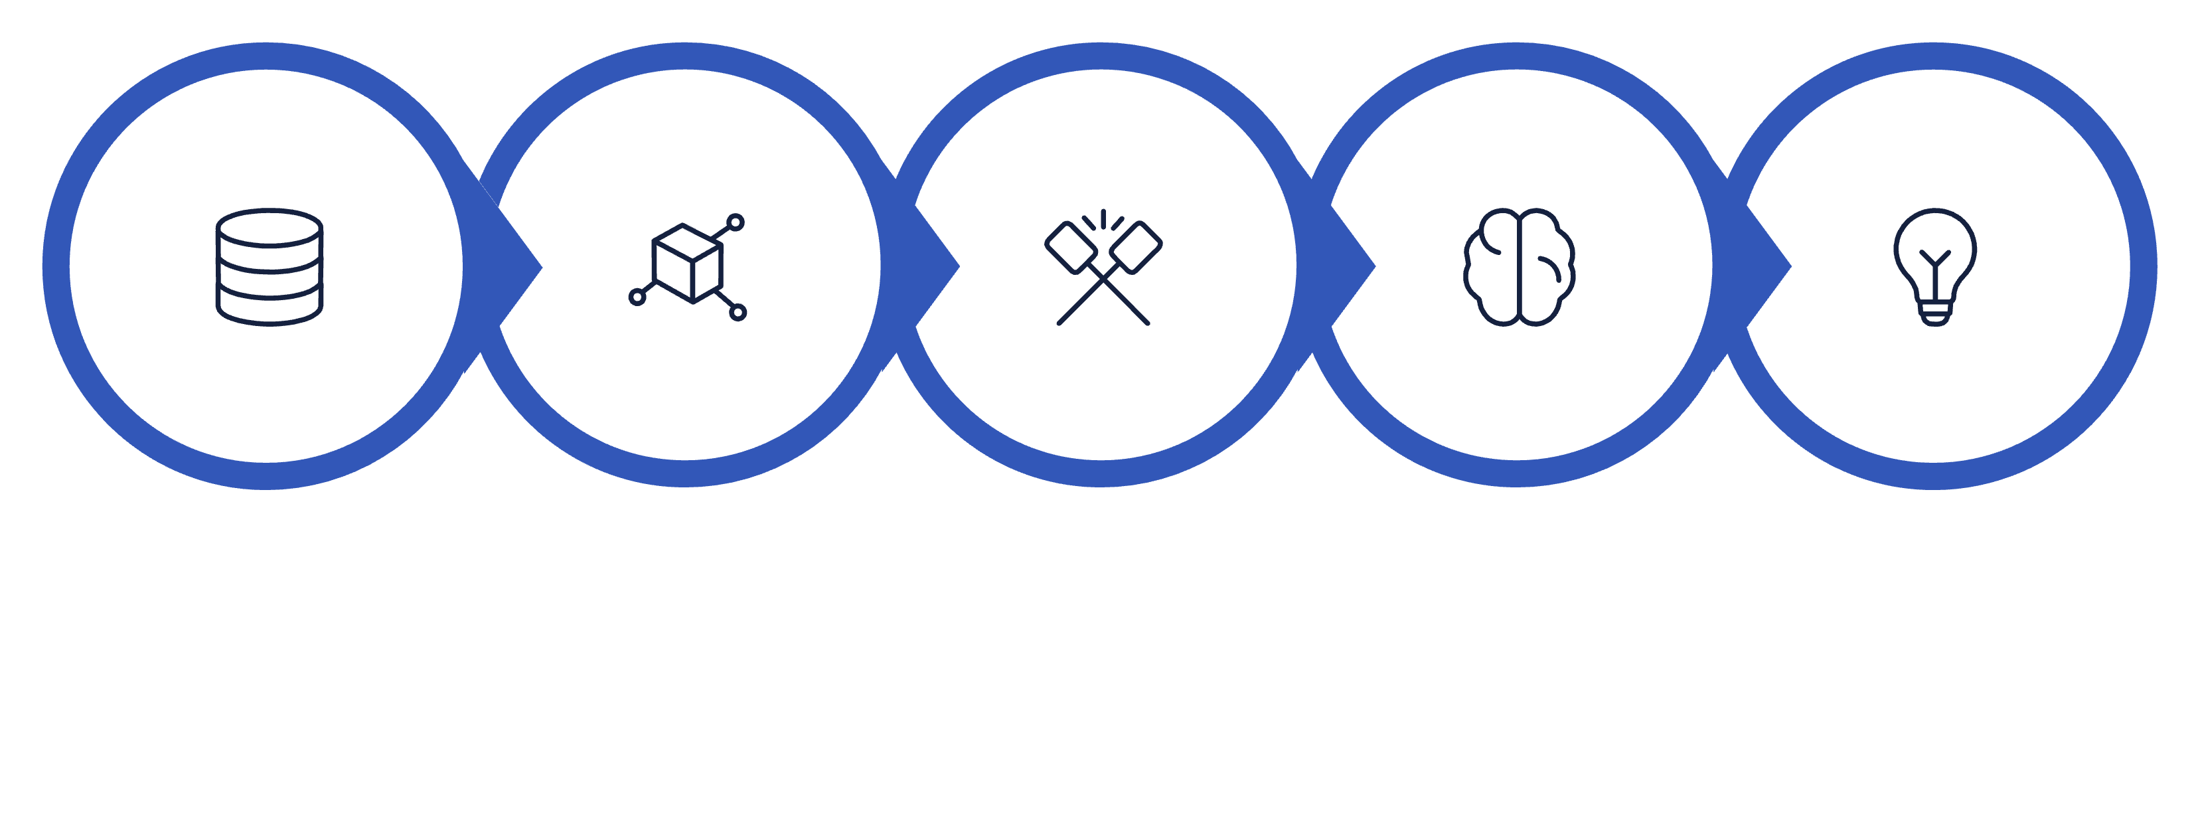

The AI Recipe - Putting It All Together
DATA
ALGORITHM
TRAINING
MODEL
PREDICTION
Data + Algorithm → Training → Model → Prediction

Slide 31

What We Learned Today
The AI Recipe :
Data + Algorithm → Training → Model → Prediction
Data
Information AI learns from
Algorithm
Step‑by‑step instructions for solving a problem
Training
The process where AI learns from examples
Model
What an algorithm becomes after training - the trained expert
Prediction
The model making a statistical guess on new data

Slide 32
Homework: AI Detective
Choose ONE AI system you use regularly:
🎬 Netflix / YouTube recommendations
🎵 Spotify playlists
🗺️ Google Maps
📱 Instagram feed
🗣️ Siri / Google Assistant
📸 Snapchat filters
✉️ Gmail Smart Compose
🛒 Amazon suggestions

Slide 33
Next Session Preview -
Session 3 : What is Machine Learning
Next session we go inside how AI actually learns. You'll define machine learning, compare different learning approaches, and understand why simple rules aren't enough. From spotting patterns in data to identifying ML in your everyday life - and seeing it in action.

