Slide 1
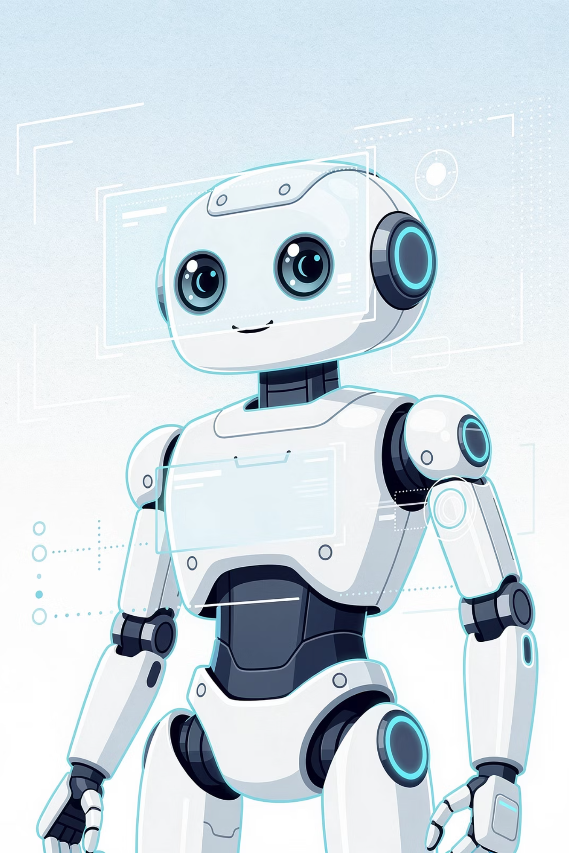
Session 15:
AI That Sees - Computer Vision

Slide 2
Objectives
01
02
03
04
Define Computer Vision
Describe the CV framework: See → Process → Act.
Explain key concepts in Computer Vision
Identify common CV tasks
05
06
07
08
Recognise Challenges in CV
List Real‑world CV applications
How CV powers self-driving cars and social media filters
Add a CV‑focused prompt to your Prompt Library.

Slide 3

Recap: What We Learned in Session 14
Key Idea
What It Means
NLP
AI that reads and understands human language.
Break → Understand → Generate
The three‑stage framework for processing text.
Tokenization, Lemmatization, NER
Ways to break down and label words.
Key insight
NLP is pattern matching, not true understanding.
Today we move from reading text to "seeing" images – Computer Vision.

Slide 4
The Visual Puzzle
Situation
Why it's hard for AI
A photo of your friend wearing a hat vs the same friend without a hat.
The face shape changes - AI might think it's a different person.
A stop sign on a sunny day vs the same stop sign covered in snow.
Colours and edges are hidden - AI may not recognise it.
A cat sitting on a patterned carpet.
AI might learn the carpet pattern instead of the cat.
Big Question: How does AI turn a grid of numbers (pixels) into a meaningful label like "stop sign" or "my friend's face"?

Slide 5
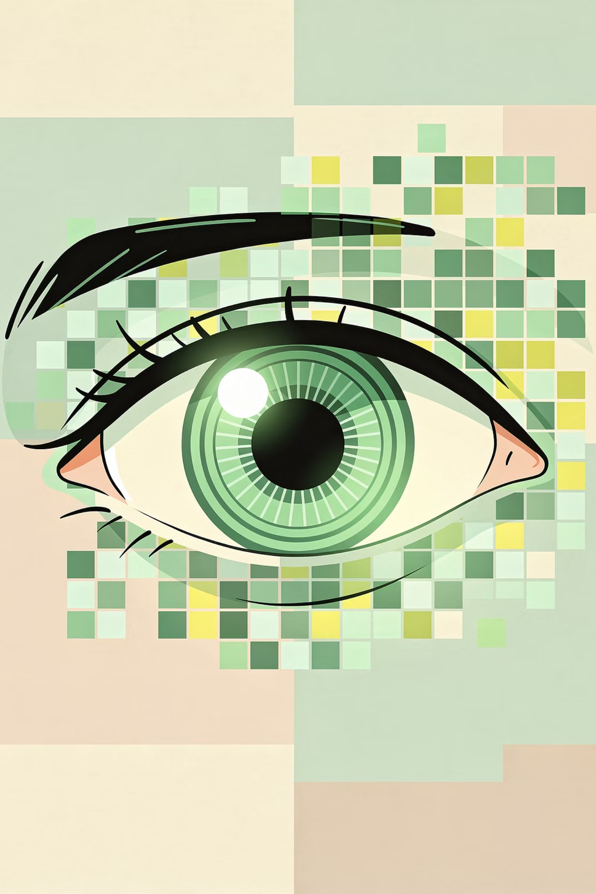
What is Computer Vision?
Computer Vision (CV) is the branch of AI that gives computers the ability to see, interpret, and understand visual information – images and videos.
Think of CV as a translator between the camera and the computer.

Slide 6





Where you see CV every day:
Face Unlock
Social Filters
Google Lens
Self‑Driving Cars
CV does not "see" like you do. It finds mathematical patterns in pixels, then guesses what those patterns represent.

Slide 7
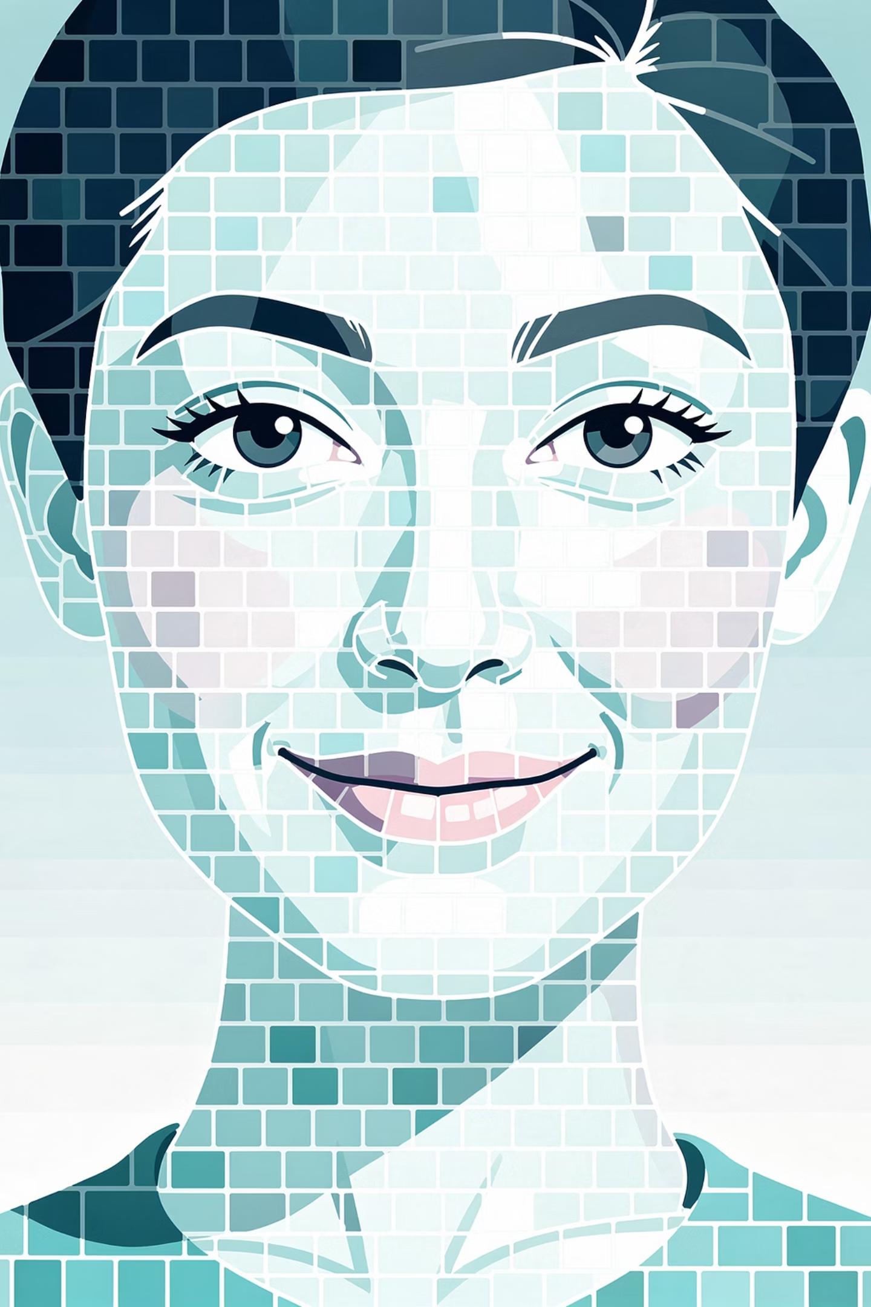
Pixels: The Tiny Building Blocks
Pixel (short for "picture element") is the smallest, fundamental unit of a digital image or display, appearing as a tiny, individual dot or square of color on a screen.
Millions of these pixels are arranged in a grid (matrix) to form the images on televisions, smartphones, and computer monitors.
You see…
AI "sees"…
A red bicycle
A grid of numbers – each pixel has red, green, blue values.
A smiling face
Thousands of pixels with different brightness and colour values.
A moving soccer ball
The same group of pixels changing position over time.

Slide 8
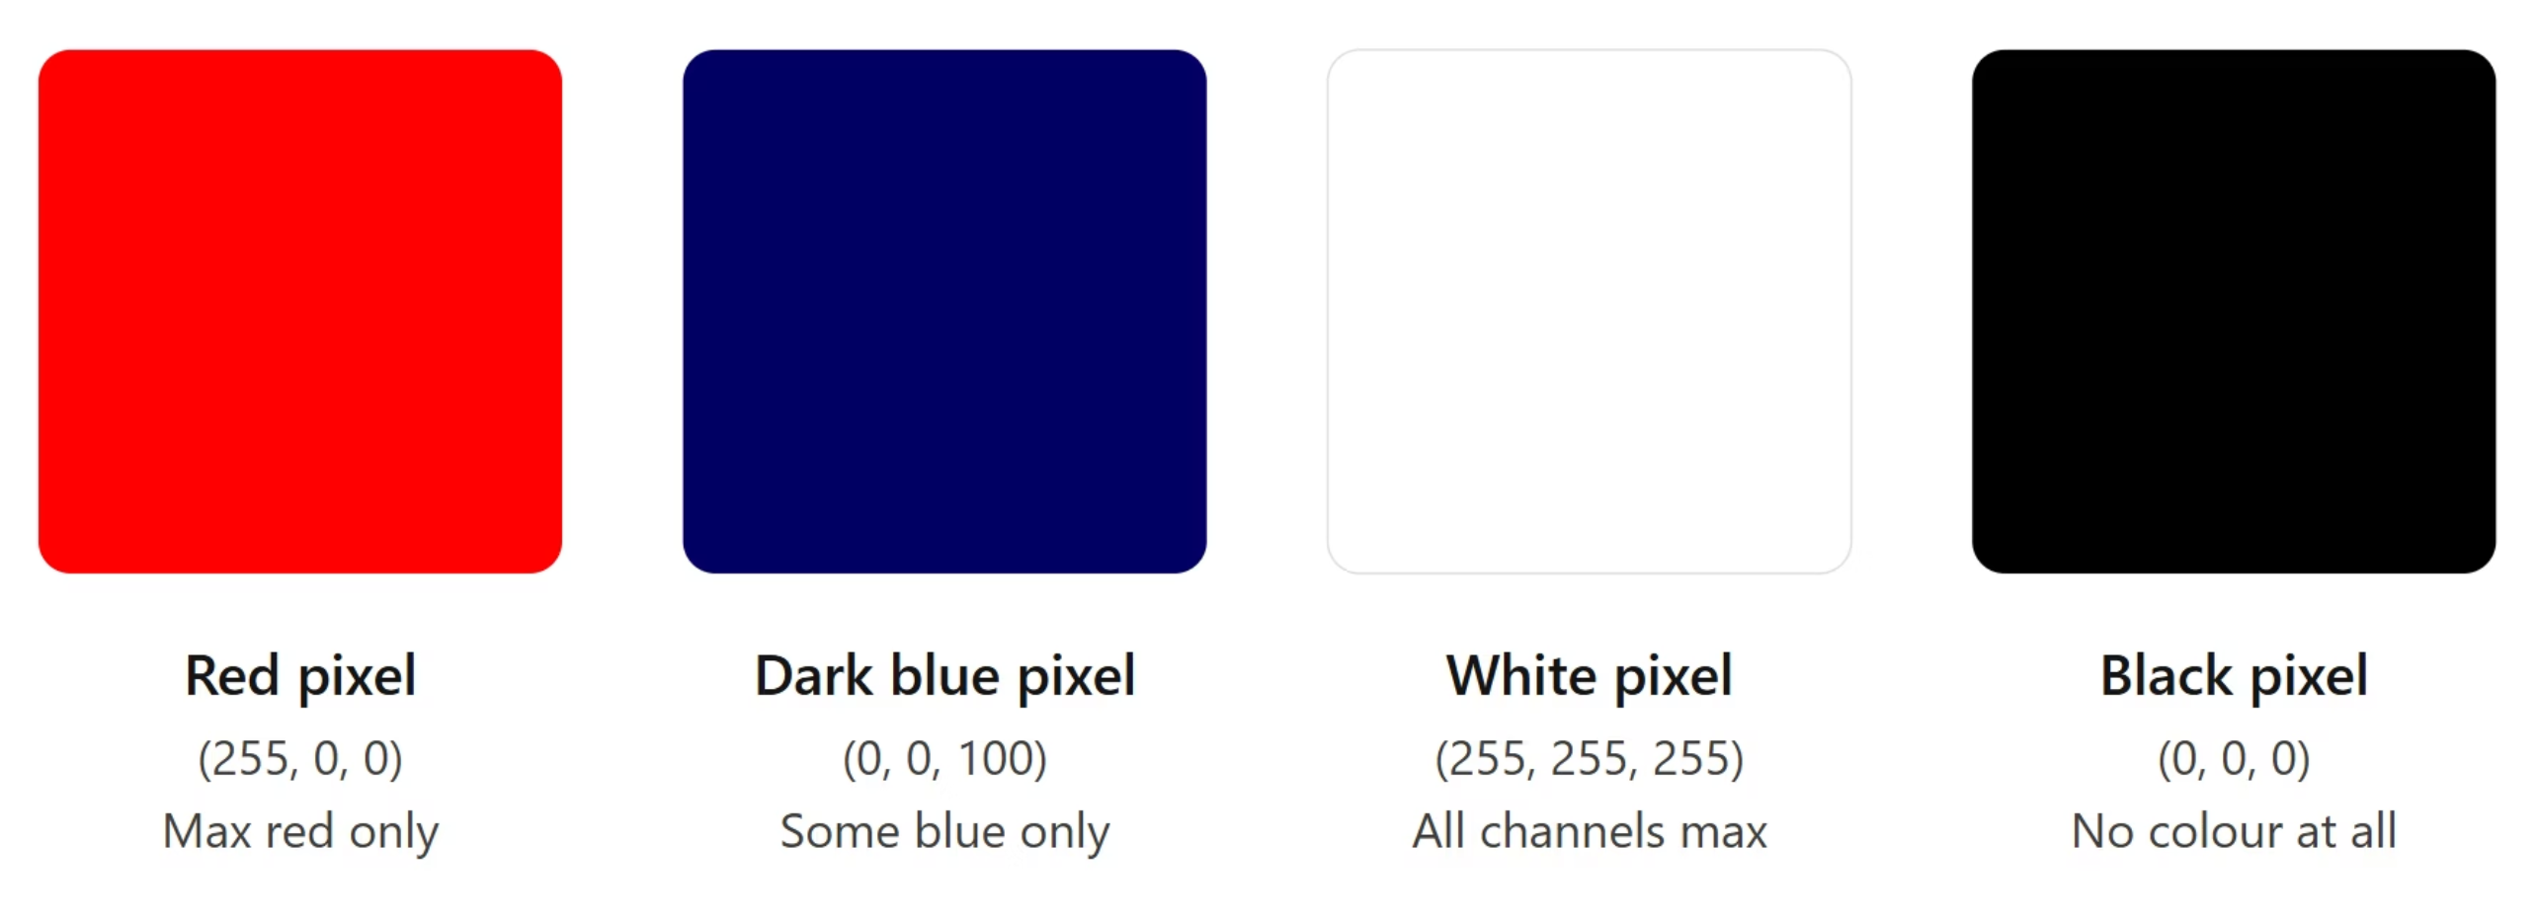
Pixels in Action
Each pixel in a digital image is defined by three numbers — Red, Green, and Blue (RGB) — each ranging from 0 (none) to 255 (maximum). By mixing these three values, any color can be represented.

Slide 9

The CV Framework: See → Process → Act
See
Process
Act

Slide 10
The CV Framework: See → Process → Act
Stage
What happens
Key concepts inside
See
Capture image as pixels.
Pixels - raw numbers.
Process
Extract clues, find patterns, make a decision/prediction.
Features → Patterns → Prediction
Act
Output result or trigger an action.
Action

Slide 11
Inside the "Process" Stage
Term
What it means in CV
Example (face recognition)
Features
Important clues extracted from pixels (edges, corners, colours, shapes).
"Two dark spots in the upper half" → eyes. "A curved line below nose" → mouth.
Patterns
Combinations of features that repeat across many examples.
Eyes + nose + mouth arranged in a certain way → "face pattern".
Prediction
The AI's guess based on learned patterns (also called a decision).
"90% confident – this is a face."

Slide 12

See → Process → Act in Action
A self‑driving car recognising a stop sign.
Stage
What happens
Detailed breakdown
See
Camera captures image as pixels.
Millions of pixels (raw numbers).
Process
Extract features, recognise patterns, make a prediction.
Features: red colour, straight edges, octagon shape, letters S-T-O-P.
Pattern: matches training examples of stop signs.
Prediction: "95% confident – this is a stop sign."
Act
Trigger an action.
Apply brakes.
The "Process" stage is pattern matching, not true understanding. The AI doesn't know what "stop" means - it has learned that certain pixel patterns usually appear together with the word "stop sign".

Slide 13
Mini Activity 1 : Match the CV Concept
Instructions: For each description, write which CV concept it matches: Pixel, Feature, Pattern, Prediction, Action.
#
Description
Concept
1
The AI's guess based on learned patterns, often with a confidence score.
Prediction
2
An important clue extracted from pixels, such as an edge, corner, or colour patch.
Feature
3
What the system does with the prediction (e.g., unlock a phone, apply brakes).
Action
4
The smallest unit of a digital image – a dot of colour.
Pixel
5
A combination of features that repeats across many training examples.
Pattern

Slide 14
Common Computer Vision Tasks
Each CV task follows the same See → Process → Act framework with different goals.
Image Classification
Object Detection
Facial Recognition
Optical Character Recognition (OCR)
Labels the main object in an image.
Finds where objects are (bounding boxes).
Identifies who a face belongs to.
Reads text from image.

Slide 15
Challenges in Computer Vision
Lighting
Pose & Angle
Occlusion
Background clutter
Bias
Scale

Slide 16
Mini Activity 2 : Spot the CV Challenge
Instructions: For each real‑world scenario, identify which CV challenge is present. Choose from: Lighting, Pose & Angle, Occlusion, Background clutter, Bias, Scale.
Scenario
Challenge
A self‑driving car fails to recognise a stop sign because the sign is partly covered by a tree branch.
Occlusion
A facial recognition system works well for people with light skin but often fails for people with darker skin.
Bias
A smartphone camera recognises a friend's face from the front, but not when the friend turns their head sideways.
Pose & Angle
A road sign detection AI works perfectly during the day but misses signs at night.
Lighting
An AI trained to recognise cats only on a red sofa gets confused when the same cat sits on a green sofa.
Background clutter
A pedestrian detection system fails to see a person who is very far away - the person is only a few pixels tall.
Scale

Slide 17
Computer Vision in the Real World
Self‑Driving Cars
Medical Imaging
Social Media Filters
Agriculture
Security

Slide 18
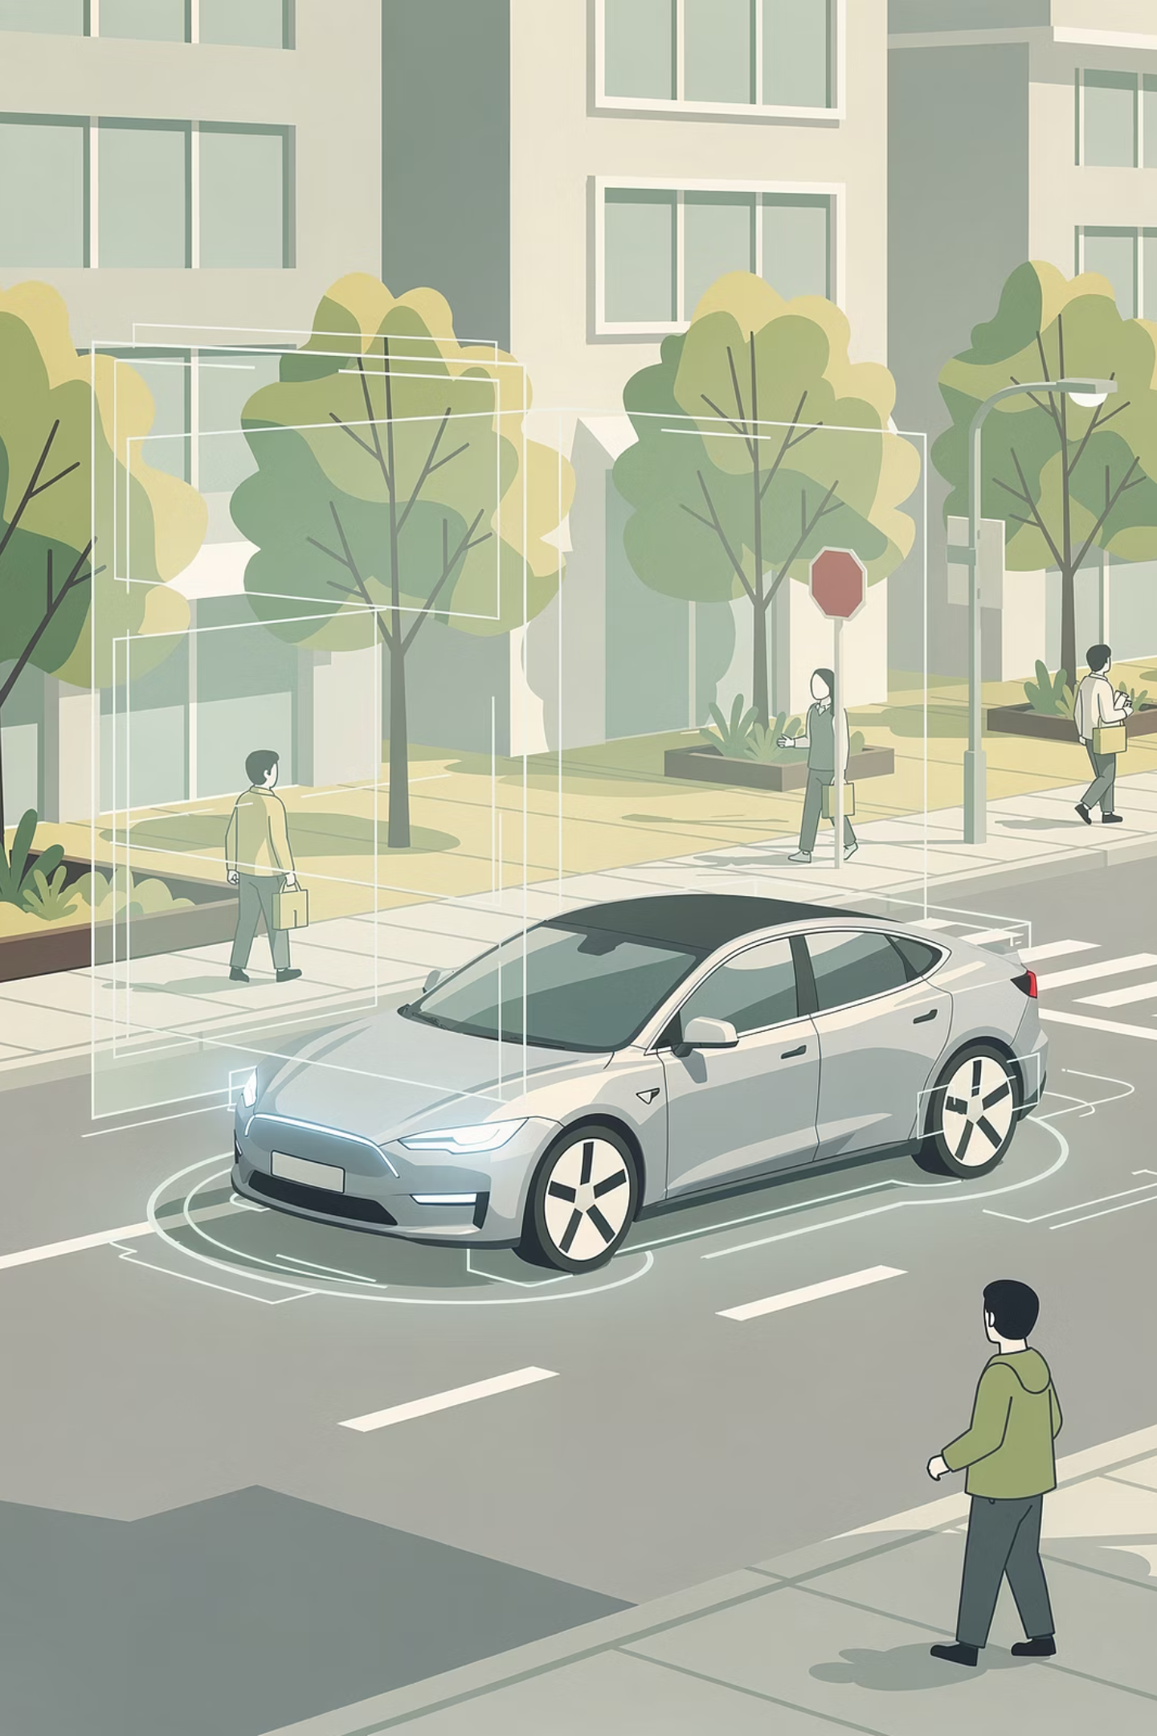
Hands‑On Activity:
Real‑World Computer Vision Analysis
Goal : Act as a computer vision engineer. For two real‑world CV applications - Self‑Driving Cars and Social Media Filters - you will identify the features, patterns, predictions, and actions for objects the AI must recognize.

Slide 19
Part A: Self‑Driving Car Vision
A self‑driving car's camera must recognise three things: Stop Sign, Pedestrian, and Traffic Light (Red).
For each one, fill in the table:
CV Stage
Stop Sign
Pedestrian
Traffic Light (Red)
See
Red, octagon shape, white letters
Person shape, two legs, two arms, head
Red circle/arrow, on a pole, glowing
Features
Red colour, 8 straight edges, letters S-T-O-P
Vertical body, horizontal limbs, head at top
Red colour, circular shape, brightness
Pattern
Red + octagon + S-T-O-P = stop sign
Vertical + horizontal limbs + head = person
Red + circle + brightness = red light
Prediction
Stop sign
Pedestrian
Red traffic light
Act
Apply brakes
Stop and wait
Stop completely

Slide 20
Part B: Social Media Filter
A social media filter must track your face to add bunny ears. For it to work, the AI must recognise: Face, Eyes, and Mouth.
For each one, fill in the table:
CV Stage
Face
Eyes
Mouth
See
Oval shape, two dark spots, curved line below
Two dark ovals, white around them, above nose
Horizontal curved line, below nose, between cheeks
Features
Oval outline, two eyes, one nose, one mouth
Dark circle, white surround, eyelid curve
Curved line, pink/red colour, horizontal orientation
Pattern
Oval + two eyes + nose + mouth = face
Dark circle + white surround = eye
Horizontal curved line + pink colour = mouth
Prediction
Face
Eye
Mouth
Act
Place bunny ears on top of face
Track eye position to keep ears aligned
Detect smile to change filter effect

Slide 21
Reflection Questions
Question 1
Question 2
Question 3
Question 4 - Ethics Connection
Which object was easiest to analyse? Why? (What features were most obvious?)
For the self‑driving car, what challenge (lighting, occlusion, bias, etc.) could make it fail to recognize a pedestrian? Give an example.
For the social media filter, what challenge could make it fail to track your eyes? Give an example.
If a self‑driving car's pedestrian detection system was trained mostly on adults, what might happen when it sees a child? Why is that a problem?

Slide 22
Add to Your Prompt Library
Your New Prompt
Why This Prompt Works
"Explain how a self‑driving car recognizes a red traffic light. Use the See → Process → Act framework and list three features."
It asks for a specific real-world application
It requires use of the See → Process → Act framework
It asks for three concrete features - making the answer structured and detailed
You can adapt it for any CV application (pedestrian, stop sign, face, etc.)

Slide 23
Summary
Key Term
What It Means
Computer Vision (CV)
AI that interprets images and videos.
Pixel
Smallest unit of an image - a dot of colour.
Feature
Important clue extracted from pixels (edge, corner, colour patch).
Pattern
Combination of features that repeats across examples.
Prediction
AI's guess based on learned patterns (with confidence score).
Action
What the system does with the prediction.

Slide 24
Summary
Key Term
What It Means
CV framework
See (pixels) → Process (Features → Patterns → Prediction) → Act.
Common tasks
Image classification, object detection, facial recognition, OCR.
Challenges
Lighting, pose, occlusion, bias, scale.
Real‑world use
Self‑driving cars, medical imaging, social media, agriculture, security.

Slide 25
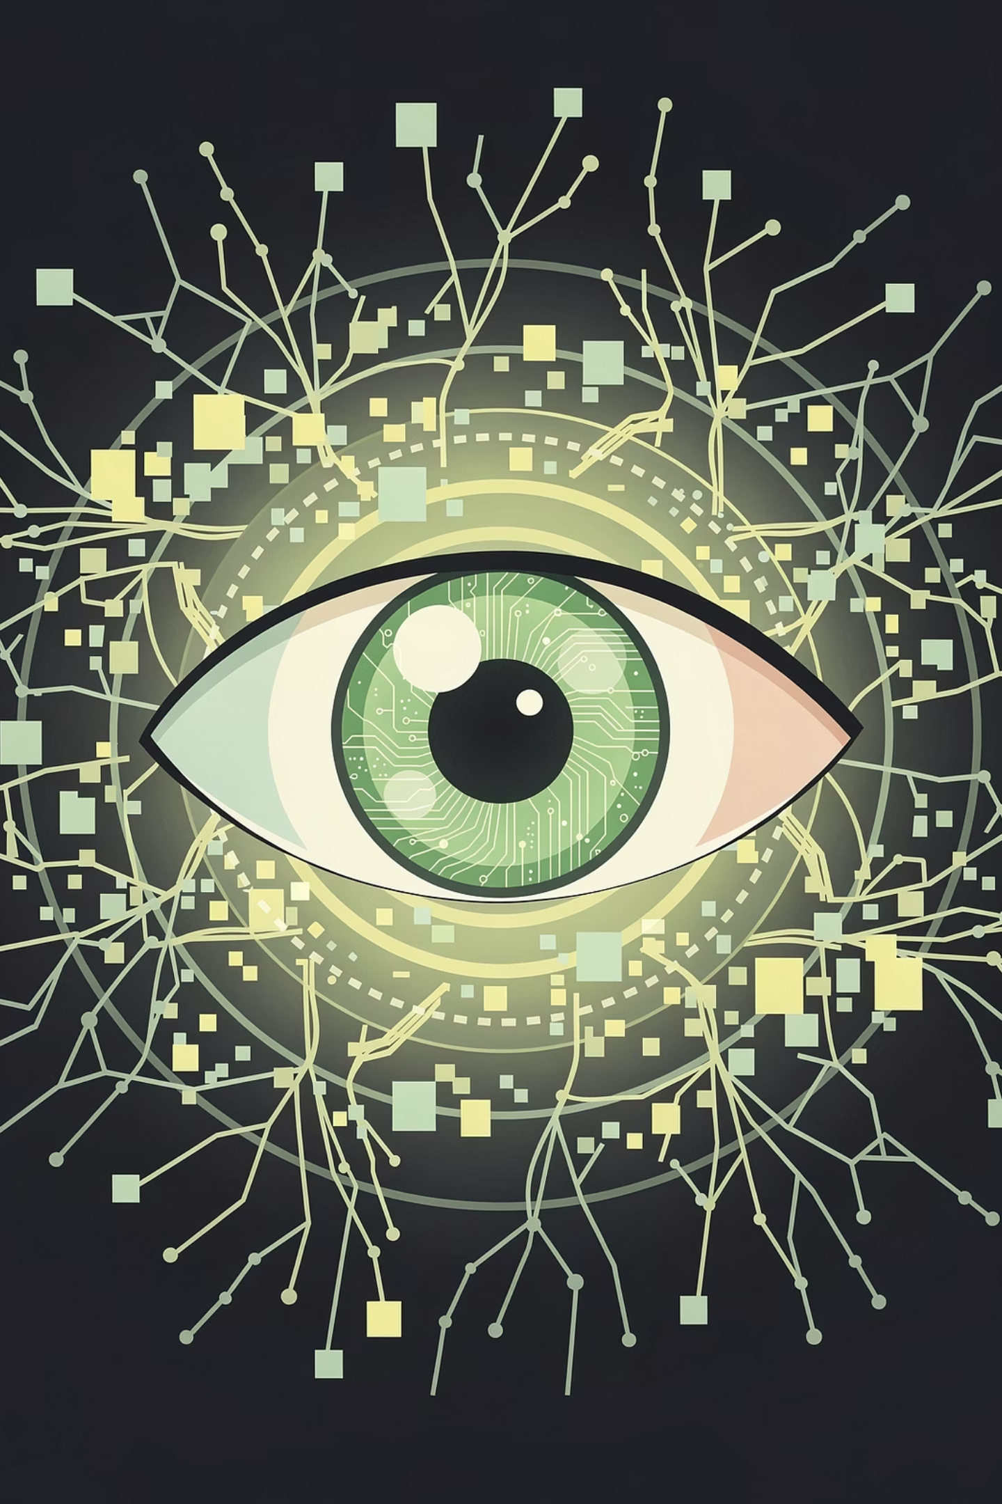
The Most Important Idea:
Computer Vision (CV) is a field of AI that takes pixel data as input, extracts features and patterns from it, and produces outputs like classifications, detections, or segmentations.

Slide 26
Homework
Part 1: Quick Matching
Match each term to its correct description.
#
Term
Letter
Description
1
Pixel
A
The AI's guess based on learned patterns
2
Feature
B
What the system does with a prediction
3
Pattern
C
A combination of features that repeats across examples
4
Prediction
D
The smallest unit of a digital image
5
Action
E
An important clue extracted from pixels (edge, colour, shape)

Slide 27
Homework
Part 2: Identify the CV Stage
For each scenario, write See, Process, or Act.
Scenario
Stage
A camera captures a photo of a red apple.
________
The AI detects a round shape and red colour, then predicts "apple".
________
The AI displays the label "apple" on the screen.
________

Slide 28
Part 3: Challenge Spotting
Read the sentence and identify which CV challenge it shows: Lighting, Pose, Occlusion, Bias, Scale.
"A self‑driving car fails to recognise a stop sign because it is covered in snow." → ________
Part 4: Add to Your Prompt Library
Add a prompt like:
"Explain how a self‑driving car uses computer vision to recognise a stop sign. Use the See → Process → Act framework."

Slide 29

Next Session Preview
AI That Hears & Speaks -
Voice AI

