Slide 1
Campus WLAN Optimization
Using Access Point Placement
and Network Segmentation
SRM Institute of Science and Technology
Five-member academic capstone team
Cisco Packet Tracer 9.0.1.0858
Notes:
Simulation-based hypothetical campus. Team names and register numbers were not supplied; no names have been invented.

Slide 2
Campus scenario and problem statement
Floor | Functional zone | Representative clients
Ground | Classrooms | PC0, Students
Ground | Computer laboratory | PC1, Students; PC2, IoT proxy
Ground | Common area | Laptop0, Students
First | Library | PC3, Faculty; Laptop1, Guests
First | Faculty and administration | PC4, Administration; PC5, Management
Simulation assumption: eight campus endpoints, two APs and one external test host.
A shared client LAN exposes departmental resources. AP placement and channel choices need explicit planning.
02
Notes:
Source: approved user scenario and actual campus endpoint inventory. Logical canvas positions are illustrative, not surveyed floor dimensions. PC2 is a PC-PT network-policy proxy, not a validated campus IoT appliance.

Slide 3
Project objectives
1. Build two functioning and comparable campus topologies.
2. Retain distinct core, distribution and access layers.
3. Segment six roles and enforce permitted access.
4. Verify routing, DHCP and basic wireless forwarding.
5. Report observed outcomes and simulator limits.
03
Notes:
The project evaluates a combined architecture, segmentation and AP-planning treatment. It does not estimate the separate causal effect of each change or claim physical RF performance measurements.

Slide 4
Technical literature and validation gap
Verified reference | Relevant guidance | Project application
Cisco campus design [1] | Separate access, policy and transport roles | Explicit three-tier academic constraint
Cisco site survey [2] | Validate coverage and capacity in the environment | No measured RF-coverage claim
Cisco RF channels [3] | Avoid overlapping adjacent channel choices | Configured channel plan, not measured gain
RFC 2131 [4] | DHCP addressing and relay behavior | Verify leases across the routed core
Validation gap: production guidance does not prove feature behavior in a Packet Tracer model.
[1–4] Full verified URLs and reference candidates appear in the report evidence package.
04
Notes:
[1] https://www.cisco.com/c/en/us/td/docs/solutions/CVD/Campus/cisco-campus-lan-wlan-design-guide.html
[2] https://www.cisco.com/c/en/us/support/docs/wireless/5500-series-wireless-controllers/116057-site-survey-guidelines-wlan-00.html
[3] https://www.cisco.com/c/en/us/support/docs/smb/wireless/CB-Wireless-Mesh/2069-tz-Changing-RF-Channels.html
[4] R. Droms, Dynamic Host Configuration Protocol, RFC 2131, March 1997, https://www.rfc-editor.org/rfc/rfc2131
These are verified technical references, not a claimed exhaustive peer-reviewed literature review.

Slide 5
Baseline and optimized systems
Aspect | Baseline | Optimized
Device and client population | Same 16 devices | Same 16 devices
Campus client connectivity | Shared VLAN 1 and /24 | Six role VLANs and /24s
Departmental policy | No departmental ACLs | Distribution SVI ACLs
AP arrangement | Central clustering, channels 1 / 1 | Spread by zone, channels 1 / 6
Wireless technology | Standalone AP-PT, WPA2-PSK | Same AP and client models
External test path | Distribution, core, edge | Same routed path
Both reference networks function. The comparison exposes policy differences without creating faults.
05
Notes:
AP placement and channel choices are design assumptions. The logical canvas does not model real building materials or validate coverage gains. Both use the same endpoint identities and four-packet ICMP tests.

Slide 6
Project methodology
01 Audit files and preserve historical evidence
02 Build and verify the functioning flat baseline
03 Apply role VLANs, SVI routing, DHCP relay and ACLs
04 Use standalone APs after the WLC forwarding failure
05 Run permitted and denied probes with positive controls
06 Save, reopen and connect every result to its evidence
06
Notes:
Initial ARP and convergence results remain in raw transcripts. A bounded repeated positive test may establish steady-state connectivity. A denied probe requires a working endpoint and an allowed control.

Slide 7
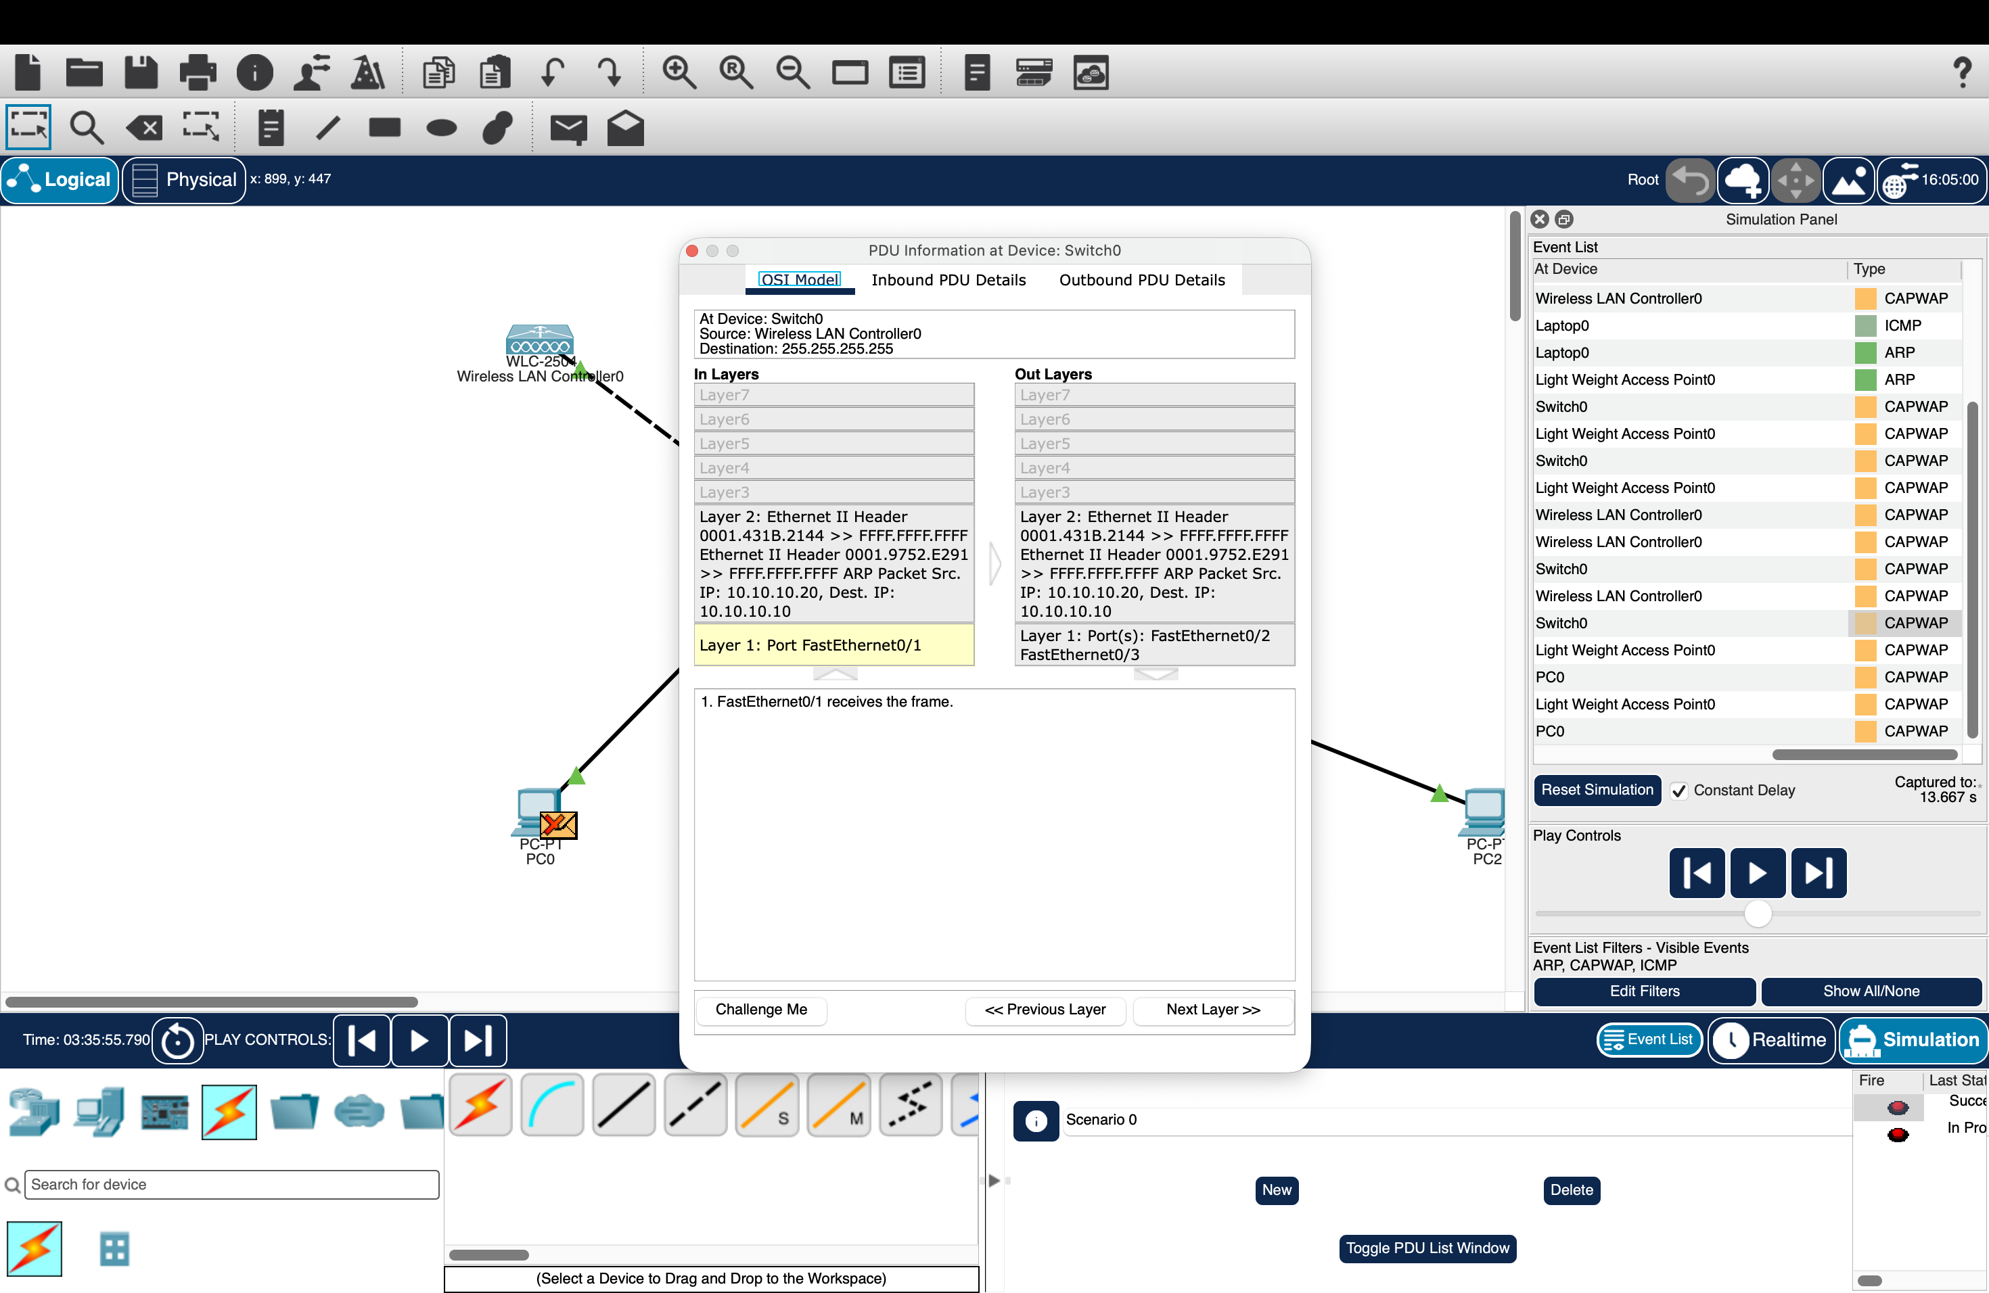
Root cause analysis and wireless fallback
Observed in Test H:
Client associates but data fails.
Fresh client traffic appears in VLAN 99.
The intended VLAN 10 target is absent.
Root cause remains unresolved.
Decision: preserve the failed WLC result and demonstrate basic wireless using tested standalone APs.
07
Notes:
Historical source: PT-Capability-Lab/reports/task-7-execution-report.md and task-7/screenshots/77_H02_WLC_to_switch_packet_OSI.png. The specific tested WLC 2504 / 3702i configuration failed VLAN 10 delivery; this is not proof that all WLC models are unsupported. Current standalone AP results are recorded separately.

Slide 8
Three-tier architecture and VLAN design
2911 Edge and DHCP
VLAN | Role | Subnet
10 | Students | 10.10.10.0/24
20 | Faculty | 10.10.20.0/24
30 | Administration | 10.10.30.0/24
40 | Guests | 10.10.40.0/24
50 | IoT proxy | 10.10.50.0/24
99 | Management | 10.10.99.0/24
3650 Core transport
3560 Gateways and policy
2960 Access switches
Distribution owns .1 gateways.
Access uplinks use 802.1Q.
Core links use routed /30s.
interface vlan 10
ip helper-address 10.255.0.1
ip access-group STUDENTS_IN in
08
Notes:
Actual model and interface outputs are in submission-evidence/logs/. Both topology files contain distinct devices for each tier. This single-path academic implementation does not provide redundancy. The external endpoint uses documentation address 203.0.113.10, not the real Internet.

Slide 9
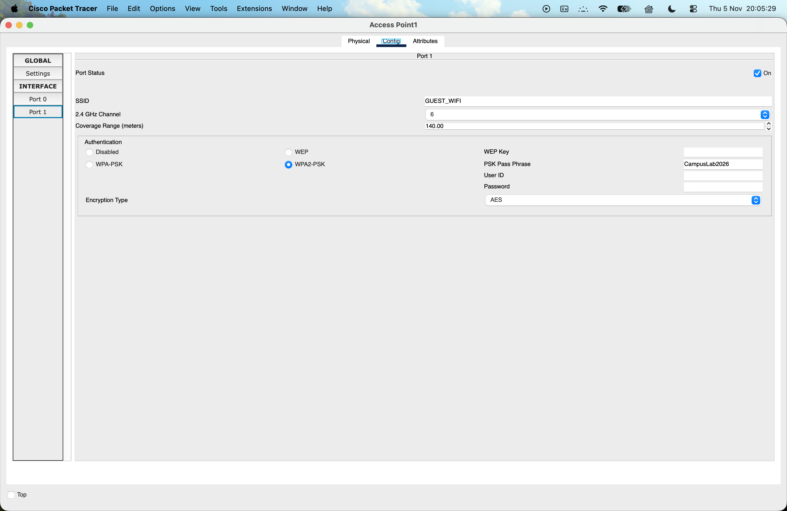
AP placement and wireless strategy
Two APs in both scenarios
STUDENT_WIFI on access VLAN 10
GUEST_WIFI on access VLAN 40
WPA2-PSK with AES in the lab
Channels 1 and 6 in the optimized copy
Zone placement is illustrative. No coverage percentage, RF capacity or roaming improvement was measured.
09
Notes:
Actual AP-PT controls and wireless forwarding tests support the implemented basic WLAN. Cisco channel reference: https://www.cisco.com/c/en/us/support/docs/smb/wireless/CB-Wireless-Mesh/2069-tz-Changing-RF-Channels.html. Production guidance does not establish Packet Tracer interference fidelity.

Slide 10
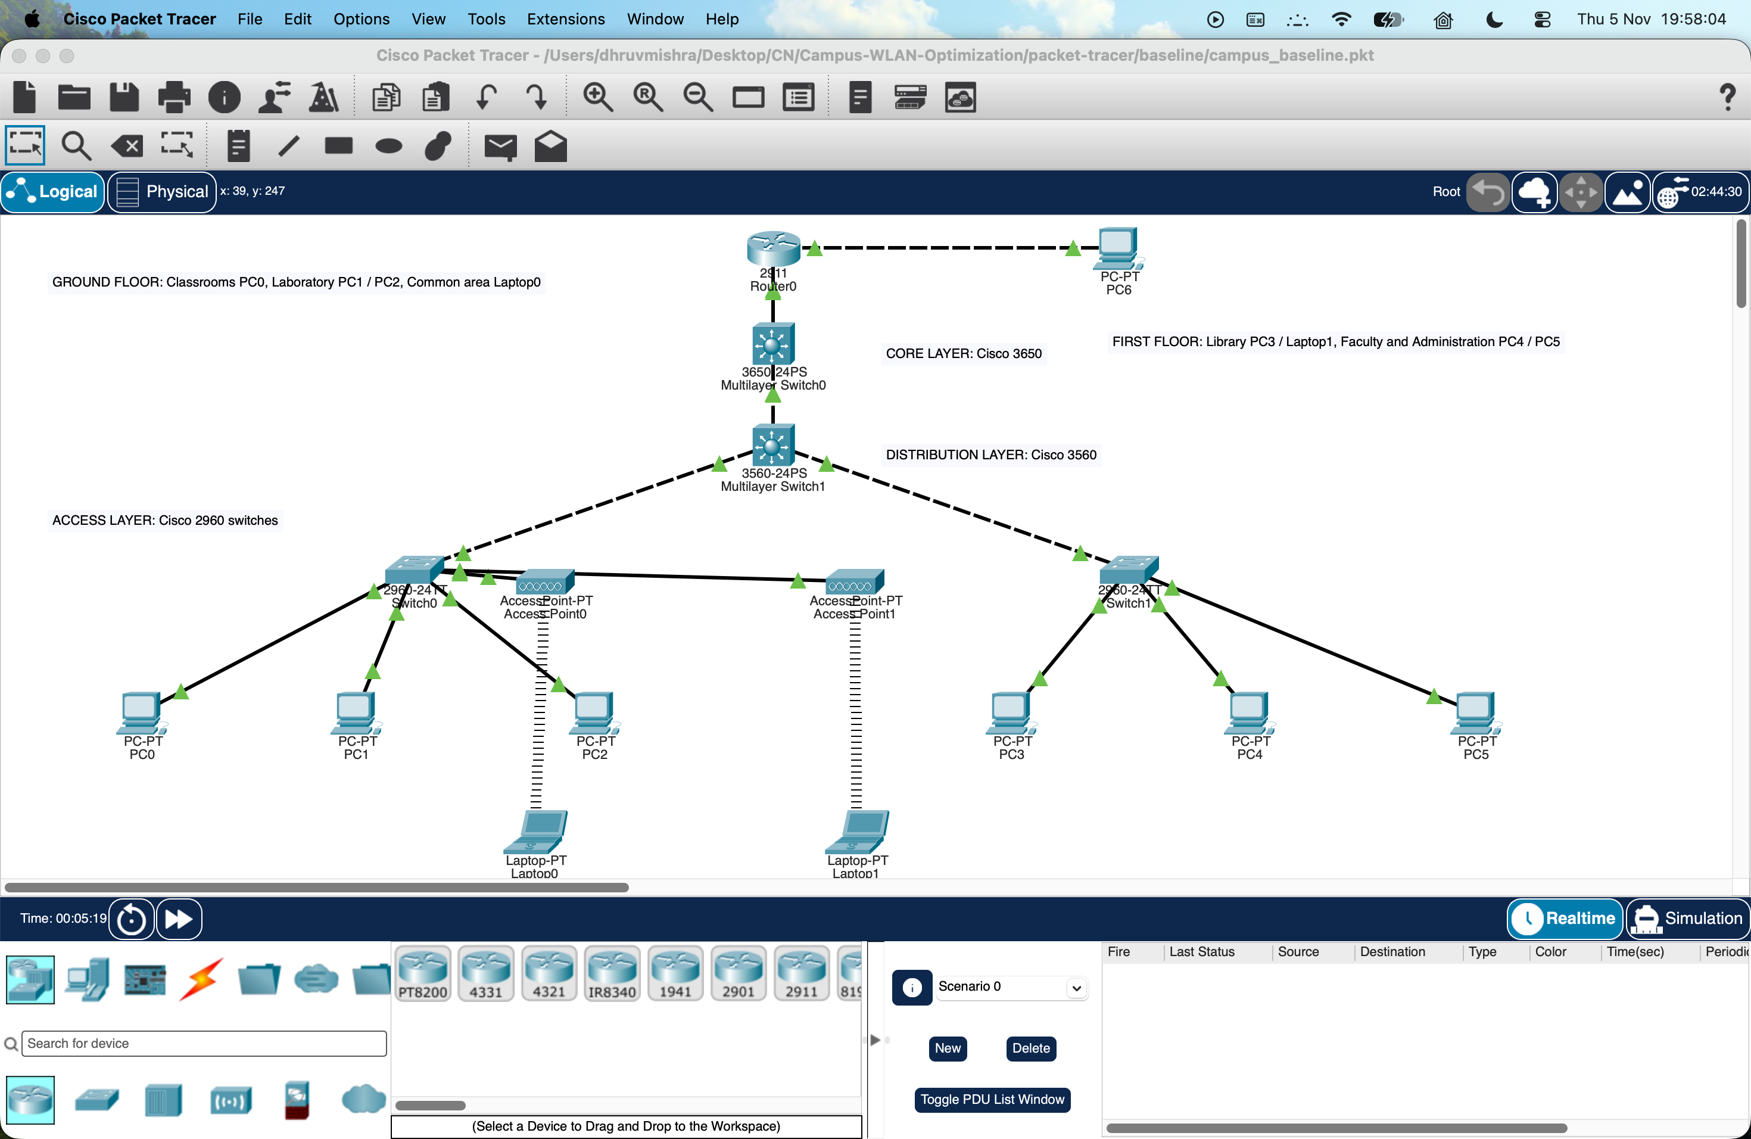
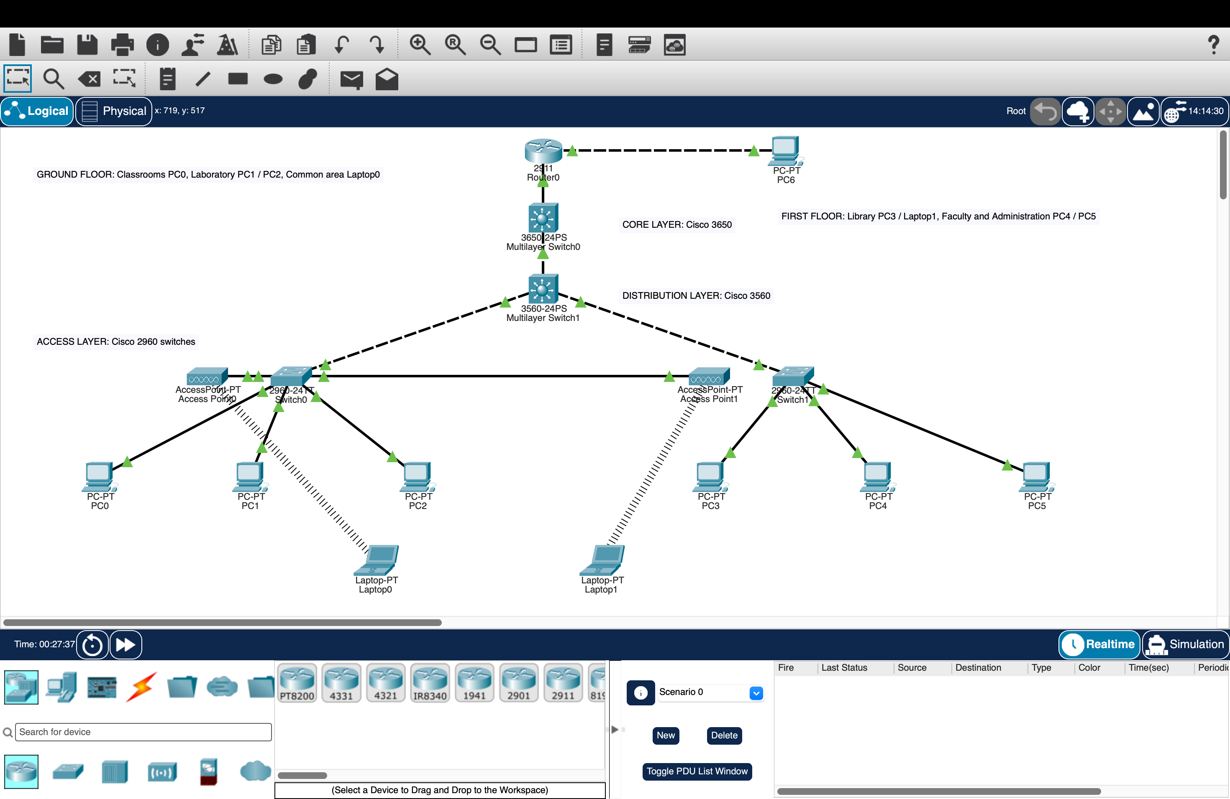
Actual Packet Tracer implementation
Baseline
Optimized
Native .pkt files, configuration transcripts, DHCP bindings, ACL counters and screenshots accompany this deck.
10
Notes:
Sources: packet-tracer/baseline/campus_baseline.pkt and packet-tracer/optimized/campus_optimized.pkt. Both were saved and reopened in the actual installed application. Screenshots are genuine captures, not rendered topology illustrations.

Slide 11
Verified functional comparison
Four-packet probe | Baseline | Optimized
Student to Administration | 4/4 | 0/4
Faculty to Administration | 4/4 | 4/4
Guest to Administration | 4/4 | 0/4
Guest to external host | 4/4 | 4/4
Zero replies on unauthorized flows indicate intended policy denial, supported by allowed controls and ACL evidence.
No throughput or RF coverage claim. These are completed functional probes, not a packet-loss benchmark.
11
Notes:
Data source: results/comparison.csv and linked raw command transcripts. Each chart value is the received count in a completed four-packet trial. Initial ARP/convergence trials remain retained. No statistics, confidence intervals or real throughput/coverage improvements are claimed.

Slide 12
Conclusion, limitations and future scope
The campus demonstrator implements distinct network tiers and role-based policy.
Standalone wireless provides a defensible basic WLAN demonstration.
WLC VLAN forwarding remains unresolved in its separate historical fixture.
RF coverage, congestion, roaming and throughput require stronger measurement tools.
Next: apply the supplied report template, add team identities and rehearse the saved-file demonstration.
12
Notes:
Submission limits: PC2 represents IoT network policy only. DNS, NAT, live Internet, enterprise authentication, redundancy, roaming and production RF coverage are outside the verified minimum implementation. Final report formatting awaits the user-provided template.

