Slide 1
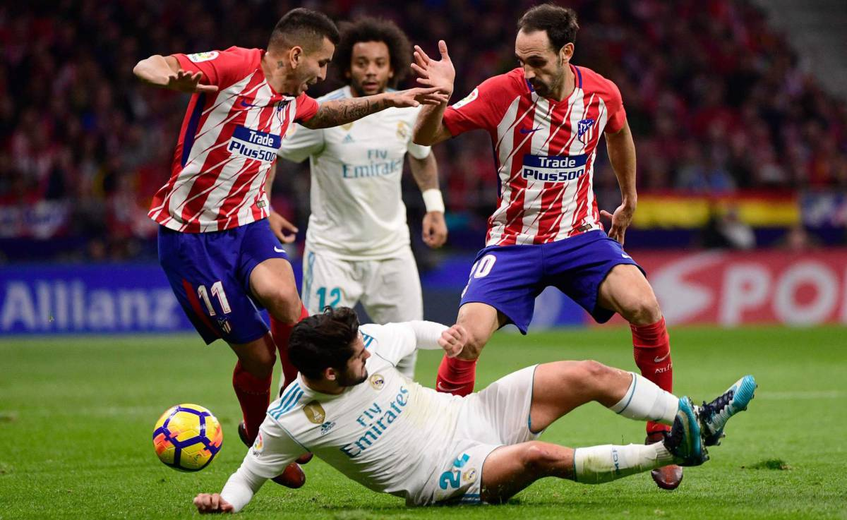
2023/24 · TOP-5 EUROPEAN LEAGUES
SCOUT ENGINE
Forward Player Recommendation System
ML-Powered
Cosine Similarity
K-Means · k=5
17 Elite Clubs
Powered by Python · scikit-learn · pandas · matplotlib

Slide 2



PROJECT OVERVIEW
A data-driven scouting tool that identifies the best young forward signings for 17 of Europe's top clubs — using machine learning to match playing styles, not just statistics.
385
206
17
Players
in Dataset
Eligible
Forwards
Club
Profiles Built
WHAT IT DOES
Filters forwards aged ≤ 29 with ≥ 900 minutes played · Engineers 9 attacking features · Clusters players into 5 archetypes · Scores every candidate by cosine similarity to the club's forward profile

Slide 3

LEAGUES COVERED
ENG
Premier League
ESP
La Liga
THE DATASET
ITA
Serie A
385
Total Players
GER
Bundesliga
5
Leagues
FRA
Ligue 1
75+
Clubs Represented
KEY COLUMNS
› Goals / Assists / xG / Shots / Key Passes
17
Columns / Features
› All stats per 90 minutes
› Age · Position · Nation · Minutes Played

Slide 4
FEATURE ENGINEERING
9 attacking features engineered from raw counting stats — all scaled and fed into the ML pipeline.
Goals / 90
Key Passes / 90
Finishing rate per 90 mins
Passes leading to shots per 90
Assists / 90
Goal Contribution/90
Chance creation per 90 mins
Goals + Assists per 90 mins
xG / 90
Shot Conversion
Expected goals per 90 mins
Goals ÷ Shots (efficiency)
Shots / 90
Creativity / 90
Shot volume per 90 mins
Assists + Key Passes per 90 mins
Attack Volume / 90
Shots + Key Passes per 90 mins

Slide 5
K-MEANS CLUSTERING
Players divided into 5 forward archetypes using K-Means (k=5) on StandardScaler-normalised features
C0
C1
C2
C3
C4
Elite
Finishers
Creative
Forwards
Wide
Attackers
Pressing
Forwards
Box-to-Box
Attackers
High goals, xG & shots.
Pure goal scorers.
High assists & key passes.
Playmaking attackers.
Balanced dribbling &
crossing specialists.
High vol, moderate
finishing. Work rate.
All-round contribution.
Goals + creativity.
StandardScaler normalisation → KMeans (n_init=10, random_state=42) → PCA 2D visualisation

Slide 6
TEAM PROFILES &
SIMILARITY SCORING
17 CLUBS PROFILED
Barcelona
Aston Villa
Real Madrid
AC Milan
01
Filter Club Forwards
Take all eligible forwards (age ≤29, ≥900 mins) currently at the club.
Atletico Madrid
Inter Milan
Manchester City
Juventus
02
Compute Mean Vector
Average their 9 feature values to produce a single profile vector for the club.
Manchester United
Bayern Munich
03
Scale the Profile
Liverpool
Borussia Dortmund
Apply the fitted StandardScaler to the club vector for consistent comparison.
Chelsea
Paris Saint-Germain
04
Cosine Similarity
Arsenal
Marseille
Score every external candidate by the angle between their vector and the club vector.
Tottenham

Slide 7
SAMPLE OUTPUT
Top-3 forward recommendations — Atletico Madrid
#1
Julian Alvarez
FIT SCORE
92.4%
0.641
0.283
0.580
2.84
1.12
Atletico Madrid → External · Age 24 · ST
Gls/90
Ast/90
xG/90
Sh/90
KP/90
C0 · Elite Finisher
#2
Ollie Watkins
FIT SCORE
89.7%
0.571
0.321
0.510
2.91
1.08
Aston Villa · Age 28 · ST
Gls/90
Ast/90
xG/90
Sh/90
KP/90
C0 · Elite Finisher
#3
Lautaro Martinez
FIT SCORE
87.1%
0.612
0.256
0.570
3.10
0.97
Inter · Age 26 · ST
Gls/90
Ast/90
xG/90
Sh/90
KP/90
C0 · Elite Finisher

Slide 8







PIPELINE SUMMARY & CONCLUSIONS
›
›
›
›
›
Load &
Filter Data
Feature
Engineering
Standardise
(Scaler)
K-Means
Clustering
Team
Profiles
Cosine
Similarity
KEY TAKEAWAYS
Age & minutes filter ensures recommendations are ready-to-play, high-potential players
Cluster archetypes capture playing style — clubs get players who fit tactically, not just statistically
Cosine similarity is direction-aware: a prolific dribbler won't be recommended for a target-man club
System is fully extensible — swap in real FBref data via scout_engine.py for live scouting
Scout Engine · Python · scikit-learn · pandas · openpyxl · matplotlib | 2023/24 Season

