Slide 1
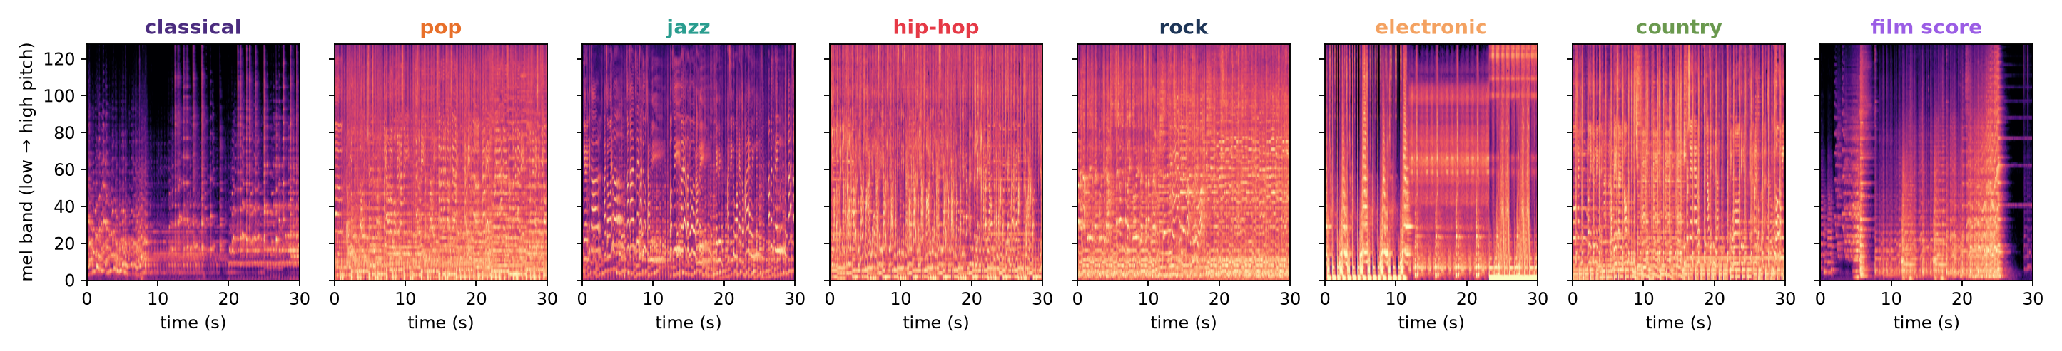
Which genre is this song?
A convolutional net that reads the spectrogram of a 30-second clip and names the genre
FYS · Karol Dąbrowski · 21 October 2026
12 699
8
1 119
75 %
30 s clips scraped from Deezer
genres, from classical to film score
artists, split so test artists are never seen in training
test accuracy across 8 genres (chance = 12.5 %)
The most typical clip per genre (closest to the genre's average spectrum), same colour scale. Classical and film score are sparse and quiet, pop / rock / hip-hop are dense walls of sound, electronic has hard-edged blocks and a steady beat.

Slide 2
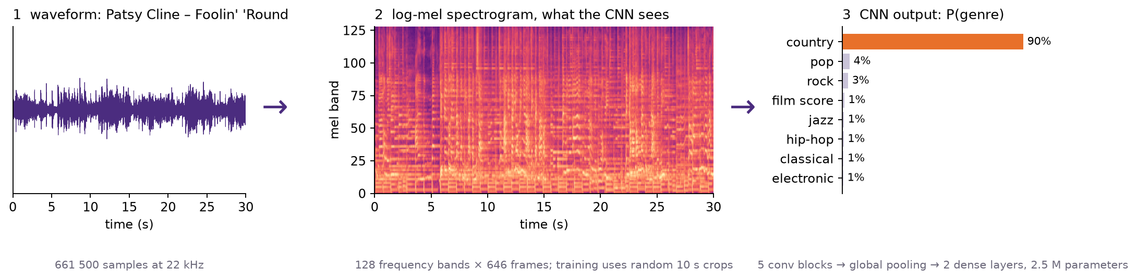
Method: a 30-second preview in, a genre out
1
Collect
2
Represent
3
Train
4
Test
Deezer API · album genre = label
log-mel spectrogram, 128 × 646
CNN, 2.5 M params, 10 s crops
artists never seen in training
Split by artist, 80 / 10 / 10 per genre. Trained with SpecAugment masking, AdamW and a one-cycle schedule: 40 epochs on 7 genres, then 9 more after adding film score.

Slide 3
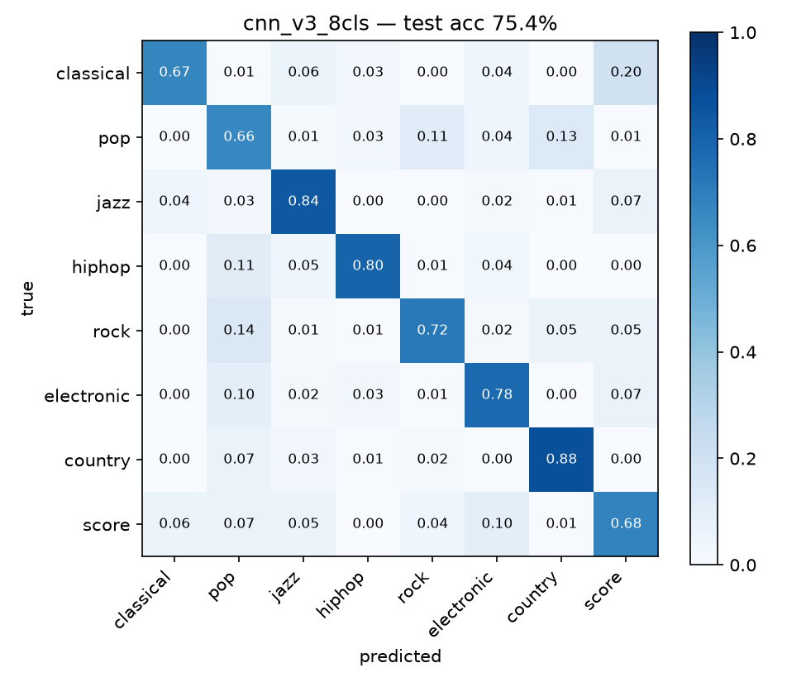
75 % of songs by unseen artists land in the right genre
Pop is the catch-all. 11 % of pop songs are called rock and 13 % country; rock, hip-hop and electronic each leak 10–14 % into pop. Country, hip-hop and jazz are the easy ones.
Classical vs film score is the hard pair. 20 % of classical clips are called a film score and 6 % of scores classical; scores also drift to electronic (10 %). Same orchestra, different production.
Confusion matrix: rows = true genre, columns = prediction, normalised per row. Chance = 12.5 %. Accuracy vs clip length: 2 s 52 %, 5 s 67 %, 10 s 75 %, 30 s 76 %.

