Slide 1
A slightly better model, and a different approach
Genre classifier · 28 October 2026
75 → 77 %
79 %
82 %
the CNN, after doubling the training data (new artists only) and widening the net
a tiny classifier on top of CLAP, a public audio model. Trained in 3 minutes.
both together, on 504 brand-new songs from artists no model had seen (was 78 %)
Same test songs as before, so the numbers are comparable. Chance is 12.5 %.
More data helped a little. Borrowing a model that has already heard a lot of music helped more.
Numbers: results/comparison.json · test split 1 204 clips, fresh set 504 clips, 8 genres

Slide 2
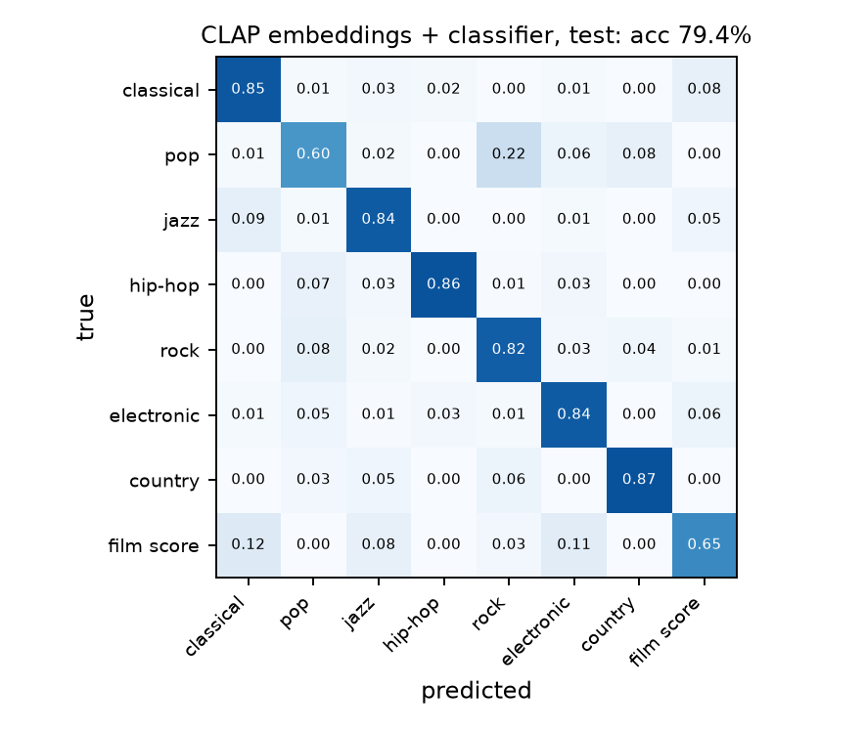
The different approach: let CLAP do the listening
CLAP (LAION) was trained on hundreds of thousands of audio clips with captions. It turns any clip into 512 numbers that describe how it sounds.
We embed each of our clips once, then train a small network (512 → 256 → 8) on those numbers with our labels. CLAP stays frozen.
Our CNN
CLAP + classifier
learns what music sounds like from 23 000 clips, from scratch. 5.5 M parameters, 2 hours.
already knows what music sounds like; our labels only teach it where the genre lines are. 130 k parameters, 3 minutes.
Same mistakes as the CNN, just fewer of them: pop still leaks into rock and country, classical and film score still trade places.
Zero-shot CLAP (no training, text prompts only) was also tried: 69 %, below our CNN. Not shown further.

Slide 3
Where things stand
More data: +2 points
Useful, not dramatic. The curve says 100k clips would reach the low 80s.
Pretrained model: +4 points
Three minutes of training beat two hours from scratch.
Combining them: +0.3
They get the same songs wrong, the genuinely ambiguous ones.
Next
Fine-tune CLAP itself, clean up the pop labels, try full songs.
Demo app updated: compare mode (CNN vs CLAP classifier) and an ensemble option · report: genre/report/final_report.pdf

