Slide 1
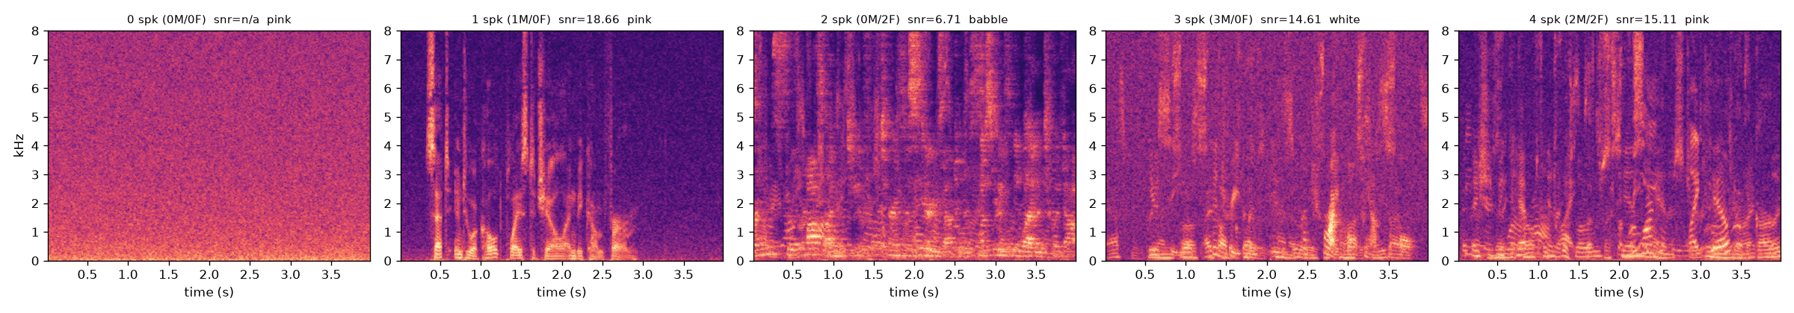
Counting voices in a noisy room
A neural network that listens to 4 seconds of audio and reports how many people are talking, and how many are male or female
Five generated clips as the network sees them: 0, 1, 2, 3 and 4 people talking over background noise
1
Data
2
Input
3
Model
4
Experiment
5
Real data
a public speech corpus, turned into 20,000 synthetic clips
each clip becomes a mel spectrogram
a small CNN trained and tested on unseen voices
mel vs plain spectrogram as input
tested and retrained on real meeting recordings
Karol Dabrowski · First-Year Seminar · October 2026
1
Notes:
Project: a neural network that listens to 4 seconds of a noisy room and reports how many people are talking, and how many are male and female. Four steps: get data, build the input, train the network, compare two inputs.

Slide 2
Step 1: a public speech corpus, turned into 20,000 synthetic noisy clips
Source: LibriSpeech
Free public corpus of audiobook readings (LibriVox), widely used in speech research
291 speakers used, 146 male / 145 female, each recorded alone in a quiet room
No overlapping speech and no noise, so it cannot be used directly
Generation recipe
Pick 0 to 4 speakers; overlay a 4-second excerpt from each
Add reverb with probability 0.5; add white, pink or babble noise at 0 to 20 dB SNR
Labels (people, male, female) are exact by construction; test speakers are never seen in training
2
Notes:
Step one, data. Source: LibriSpeech, a public corpus of audiobook readings, 291 speakers each recorded alone, labelled male or female. Since it has no overlap or noise, I generated my own clips: pick 0 to 4 speakers, overlay 4-second excerpts, add reverb half the time, add white, pink or babble noise at 0 to 20 dB SNR. Labels are exact by construction. 20,000 training clips, 1,500 validation, 2,000 test, with test speakers held out entirely.

Slide 3
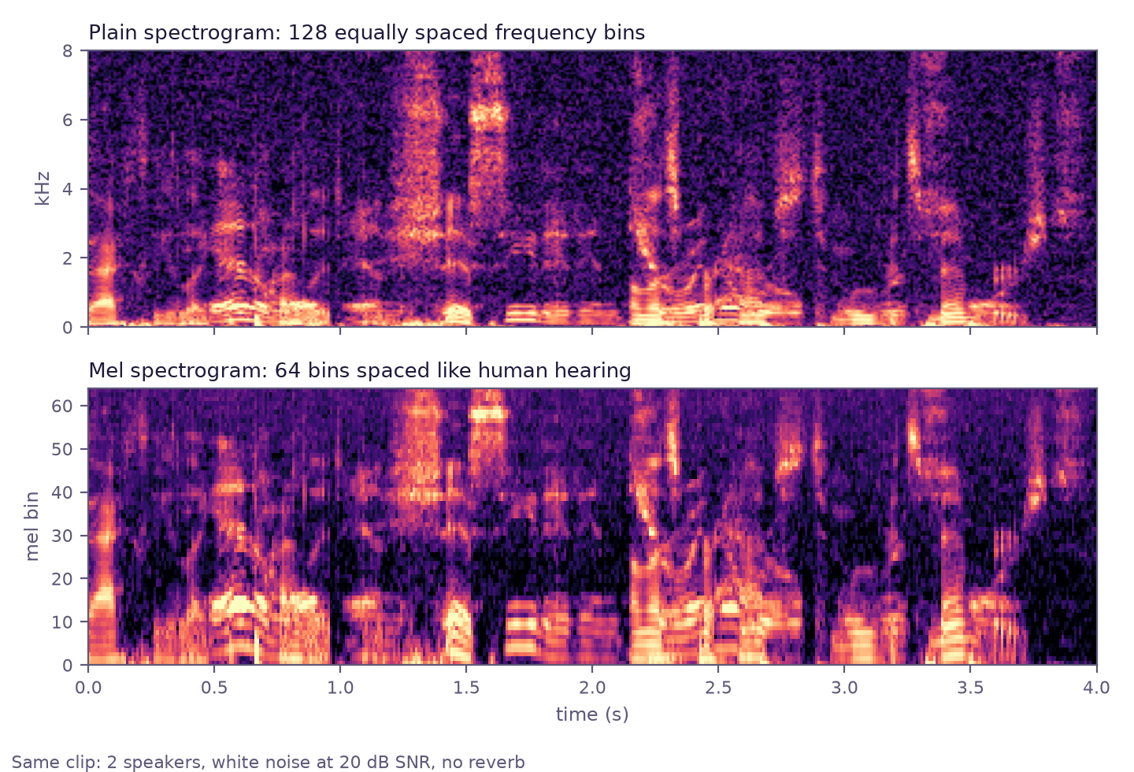
Step 2: each clip becomes a spectrogram, read by a small convolutional network
Spectrogram: time left to right, frequency bottom to top, brightness is energy. A voice is a stack of horizontal harmonics; two voices interleave.
Mel scale: 64 bands spaced like human hearing, fine at low frequencies and coarse at high. The plain version (top) keeps 128 equal bins; I compare both in step 4.
Model: a CNN, the standard architecture for images. Four stages detect patterns and halve the picture, then three output heads each pick a count from 0 to 4. About 580,000 parameters.
Spectrogram
Stage 1
Stage 2
Stage 3
Stage 4
Pooled summary
3 heads
64 × 401
32 filters
64 filters
128 filters
128 filters
128 numbers
people, male, female
3
Notes:
Step two, input and model. Each clip is converted to a spectrogram: time left to right, frequency bottom to top, brightness is energy. I used the mel version, 64 bands spaced like human hearing. The model is a small convolutional neural network: four stages that detect patterns and halve the picture, a pooled summary, and three output heads for people, male and female, each a 5-way choice. About 580,000 parameters.

Slide 4
Step 3: trained for 30 passes, tested on 2,000 clips from unseen speakers
80%
exact speaker count
99%
within one speaker
75% / 78%
exact male / female count
30 passes over the training clips; the version with the best validation score is kept
About 1.5 h per model on a laptop GPU
Hardest case: three simultaneous speakers (56%). Low SNR, reverb and babble noise hurt most.
4
Notes:
Step three, training and results. Thirty passes over the 20,000 clips; after each pass the model is scored on the 1,500 validation clips and the best version is kept. Final test on 2,000 clips from unseen speakers: exact speaker count 80 percent, within one 99 percent, male and female counts 75 and 78 percent. Three simultaneous speakers is the hardest case; low SNR, reverb and babble noise hurt most.

Slide 5
Step 4: mel vs plain spectrogram as input, everything else identical
 | mel | plain
input size | 64 × 401 | 128 × 401
exact count, 2,000-clip test | 80.0% | 79.2%
exact count, 1,000-clip test | 83.4% | 81.4%
within one speaker | 98.6% | 98.5%
time per pass | 165 s | ~320 s
Only the input changed: same clips, network, settings and random seed.
Mel is 1 to 2 points better and trains twice as fast, since its input is half the size.
One run each, so the gap is suggestive, not proven.
5
Notes:
Step four, the experiment. Same data, network, settings and seed; only the input changed from the 64-band mel spectrogram to the 128-bin plain spectrogram. Mel learned faster and finished 1 to 2 points ahead on both test sets, at half the training time per pass. One run each, so the gap is suggestive rather than proven.

Slide 6
Step 5: on real meeting recordings the synthetic model collapses; retraining on real data recovers it
Real data: the AMI Meeting Corpus, about 100 h of real 4-person meetings with time-stamped speaker turns and participant sex. Each 4 s window gets exact labels from the turns.
Setup: 42,000 balanced training windows from 136 meetings (far-field table mic and headset mix); 8,000 test windows from 16 unseen meetings at the natural distribution.
Same network, same recipe; only the training audio changed.
model | trained on | exact | within one
cnn_v4 | synthetic clips only | 25% | 78%
cnn_v6 | real meetings, from scratch | 68% | 97%
cnn_v7 | cnn_v4 fine-tuned on real | 66% | 97%
baseline | always answer "1" | 60% | 91%
Why cnn_v4 fails: it labels most real speech as silence. Far-field room audio is quieter and more echoey than the synthetic clips.
Retrained model by true count: 0: 98%, 1: 77%, 2: 45%, 3: 57%, 4: 3% (only 89 four-speaker windows exist).
Fine-tuning from cnn_v4 did not help and that model fell to 38% on the synthetic test: it forgot the old domain.
6
Notes:
Step five, real recordings. The synthetic clips felt artificial, so I tested on the AMI Meeting Corpus: about 100 hours of real four-person meetings with time-stamped speaker turns and each participant's sex, which gives exact labels per 4-second window. On 8,000 real windows from unseen meetings, the synthetic-only model gets just 25 percent exact: it hears most real speech as silence, because far-field room audio is quieter and more echoey than anything it trained on. Retraining the same network on 42,000 real windows lifts that to 68 percent exact and 97 percent within one. The comparison that matters is against always answering one, which already scores 60 percent because real meetings are mostly one person at a time. Two and four simultaneous speakers remain hard.

Slide 7
Step 5, by count: both real-data models fail on 2 and 4 speakers
Same 8,000 real test windows, split by the true number of speakers. Natural distribution, so one speaker dominates.
cnn_v6, from scratch: random starting weights, 20 passes over the 42,500 real windows, learning rate 5e-4.
cnn_v7, fine-tuned: starts from cnn_v4's trained weights, then 8 passes over the same real windows at a lower learning rate (2e-4), so the synthetic knowledge is adjusted rather than overwritten. All layers updated, no synthetic clips mixed in.
model | 1 speaker | 2 speakers | 3 speakers | 4 speakers
windows | 4,768 | 1,975 | 642 | 89
cnn_v6 (scratch) | 77% | 45% | 57% | 3%
cnn_v7 (fine-tuned) | 75% | 40% | 61% | 8%
cnn_v4 (synthetic) | 31% | 9% | 2% | 1%
One speaker: the scratch model wins, 77% vs 75%, and this is most of a real meeting.
Two speakers is the real weakness: 45% and 40%; most misses are heard as one person, since real overlaps are brief.
Four speakers: only 89 windows, and 80 of them are counted as three. Off by one, not lost.
Exact count accuracy on the natural AMI test set. Orange marks the better of the two real-data models at each count. Silent windows (526) are near 98% for both and are left out.
7
Notes:
The two real-data models by number of speakers. A word on how they were trained: cnn_v6 started from random weights and saw the real windows twenty times. cnn_v7 started from cnn_v4, the synthetic model, and saw the same real windows eight times at a lower learning rate, the standard fine-tuning recipe, so it began knowing what voices look like and only had to adapt to real rooms. One speaker, the common case in meetings, is where the scratch model is clearly better: 77 versus 75 percent. Two speakers is the big weakness for both, 45 and 40 percent, usually heard as one. At three speakers the fine-tuned model is slightly ahead, 61 versus 57. Four speakers is essentially unsolved, 3 and 8 percent, but there are only 89 such windows and almost all of them are counted as three, so the models are off by one rather than lost. The synthetic-only model is below 10 percent at every count from two up. The baseline of always answering one scores 60 percent only because single-speaker windows dominate.

Slide 8
Step 6: single-sex training helps a little, and only for that sex
Question: is counting easier when every voice in the clip is the same sex?
Setup: two new synthetic sets with the same recipe, one from the 146 male speakers only and one from the 145 female speakers only; 20,000 training clips each, separate test speakers.
Same network, same recipe; three models compared on three test sets.
model | trained on | male test | female test | mixed test
cnn_v4 | both sexes | 80% | 77% | 80%
cnn_v8 | male voices only | 82% | 75% | 80%
cnn_v9 | female voices only | 70% | 79% | 77%
Specialists win on their own sex, by 2.3 points (male) and 2.2 points (female): a real but small gain.
They do not transfer: each loses 5 to 9 points on the other sex, so one mixed model is the safer choice.
Female voices are harder for every model: two or three overlapping female voices score about 10 points below the same counts for male voices.
Exact speaker-count accuracy, 2,000 clips per test set. Within-one accuracy is 96 to 98% for every pair.
8
Notes:
Step six, does counting get easier when all the voices are the same sex? I generated two more synthetic sets with the same recipe, one using only the male LibriSpeech speakers and one using only the female ones, 20,000 training clips each, and trained the same network on each. On its own sex's test set, each specialist beats the mixed model by about two and a half points: 82 versus 80 percent for male voices, 79 versus 77 for female. Swap the sexes and the specialists lose five to nine points, so the gain is real but modest and it does not transfer. Female voices are harder for every model: two or three overlapping female voices score about ten points below the same counts for male voices, probably because female pitch ranges overlap more.

Slide 9
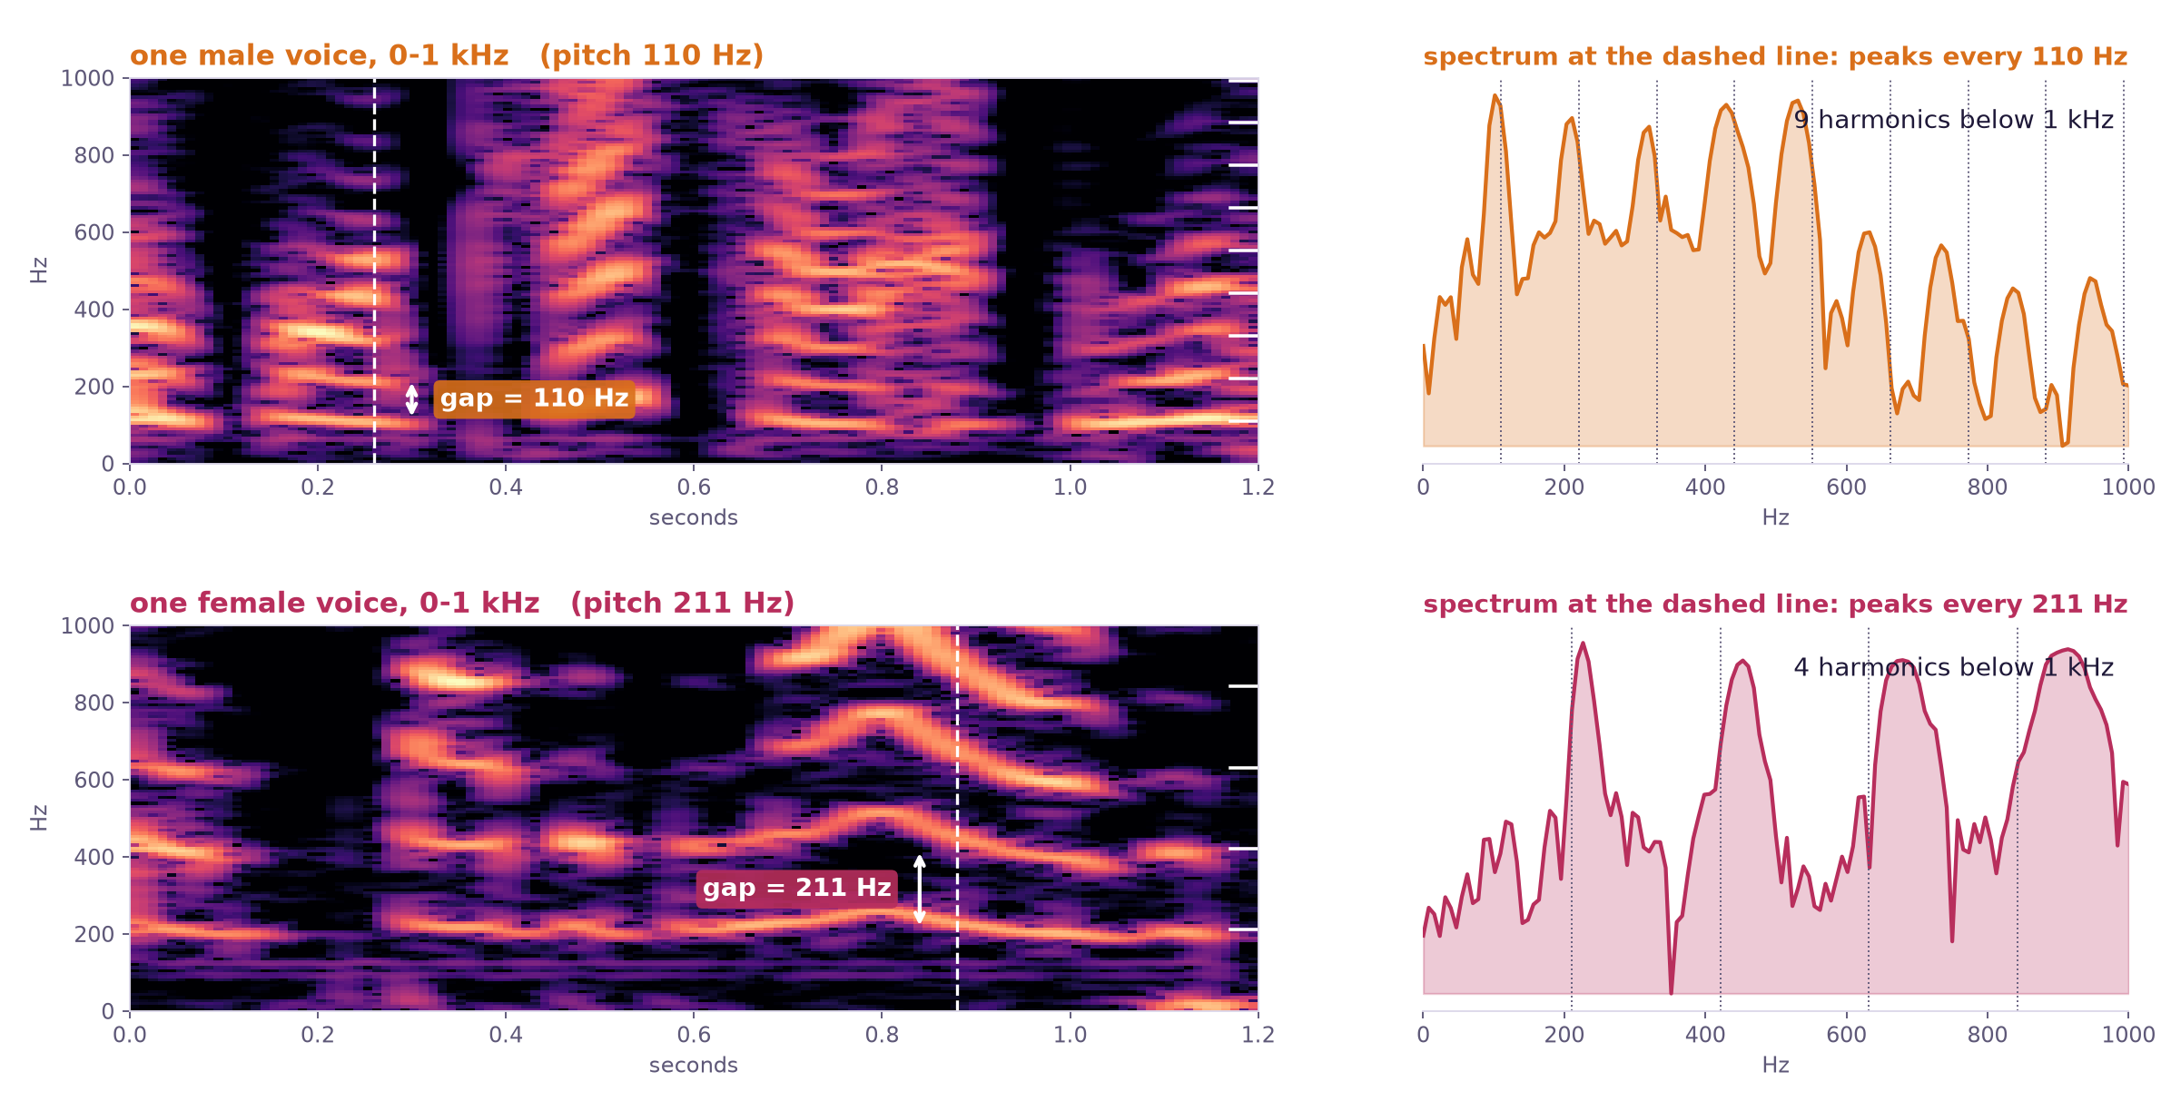
Step 6, continued: male vs female voices on the spectrogram
A voice is a stack of harmonics spaced by its pitch. Male: ~110 Hz apart, 9 lines below 1 kHz. Female: ~210 Hz apart, only 4. Clean LibriSpeech audio, 100 ms analysis window.
9
Notes:
What is the difference between a male and a female voice on a spectrogram? One clean voice of each, from the LibriSpeech readings, zoomed into the lowest kilohertz. A voice is a stack of harmonics: a bottom line at the pitch and copies at every multiple of it. This man's pitch is 110 hertz, so his lines are 110 hertz apart and nine of them fit below one kilohertz. This woman's pitch is 211 hertz, so her lines are twice as far apart and only four fit. On the right is the spectrum at the dashed instant: the same thing as a row of evenly spaced peaks. That spacing is what tells the sexes apart, and it is also why two female voices are harder to count: fewer lines per voice means less evidence that a second voice is present.

Slide 10
Step 6 on real data: how many talk matters more than who
Same real-data model (cnn_v6), 8,000 real meeting windows split by who was talking: only men, only women, or both. No retraining.
Mixed windows always contain 2 or more speakers, so compare at a fixed count, not overall.
windows | overall | 1 speaker | 2 speakers | 3 speakers
all male (3,202) | 72% | 80% | 46% | 32%
all female (2,832) | 68% | 75% | 40% | 52%
mixed (1,440) | 49% | n/a | 46% | 61%
Exact count accuracy of cnn_v6 on the natural AMI test set. The 3-speaker single-sex groups have only 71 and 77 windows; 4-speaker windows are too rare to score.
Female-only is hardest on real data too: 75% vs 80% for one speaker, 40% vs 46% for two.
Mixing sexes does not hurt: at 2 speakers mixed equals all-male; at 3 it is the best group. A male and a female voice sit in different pitch ranges and are easier to tell apart.
Overall gaps are mostly about count: real meetings are mostly one person at a time, and single-speaker windows are the easy ones.
10
Notes:
Does the sex pattern hold on real recordings? The AMI labels say who is talking in every window, so I split the real-data model's test predictions into windows where only men talk, only women talk, or both. Overall, all-male windows score 72 percent, all-female 68 and mixed 49, but that mostly reflects how many people were talking: mixed windows always have at least two speakers. At a fixed count the picture is different. With two speakers, mixed equals all-male at 46 percent and beats all-female at 40. With three, mixed is the best of the three, though the single-sex groups have only about 70 windows each. So a man and a woman together are, if anything, slightly easier to count than two voices of the same sex, and female-only remains the hardest case on real data too, by about five points.

