Slide 1

TOMATO
중고거래 사이트 제작 프로젝트
윤형식 임현수 박온리 이창훈 김효준

Slide 2
01
시스템설계
목차
02
클래스설계
03
시퀀스 다이어그램
04
유스케이스 다이어그램
05
Restful 설계

Slide 3
01.시스템 설계
MVC2 모델 설계
들어갈 자리

Slide 4
02. 클래스 설계
클래스 설계
들어갈 자리

Slide 5
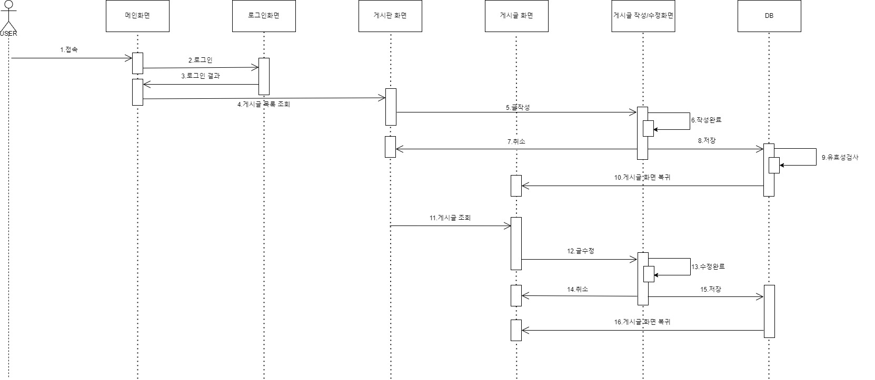
03. 시퀸스 다이어그램
<회원-글등록>

Slide 6
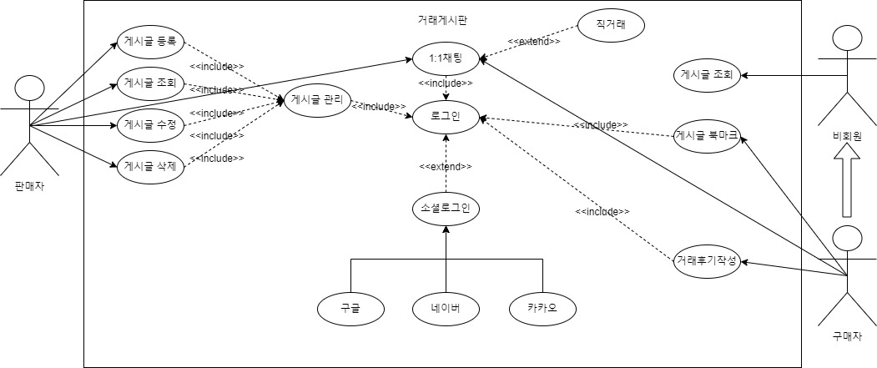
04. 유스케이스 다이어그램
<거래게시판>
Example Text : Get a modern PowerPoint Presentation that is beautifully designed. I hope and I believe that this Template will your Time, Money and Reputation. Get a modern PowerPoint Presentation that is beautifully designed. I hope and I believe that this Template will your Time, Money and Reputation. You can simply impress your audience and add a unique zing and appeal to your Presentations.

Slide 7
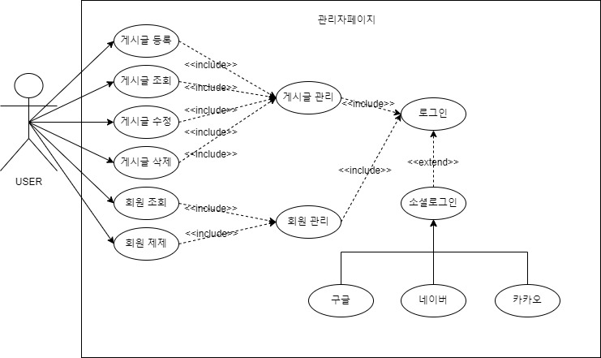
04. 유스케이스 다이어그램
<관리자페이지>
Example Text : Get a modern PowerPoint Presentation that is beautifully designed. I hope and I believe that this Template will your Time, Money and Reputation. Get a modern PowerPoint Presentation that is beautifully designed. I hope and I believe that this Template will your Time, Money and Reputation. You can simply impress your audience and add a unique zing and appeal to your Presentations.

Slide 8
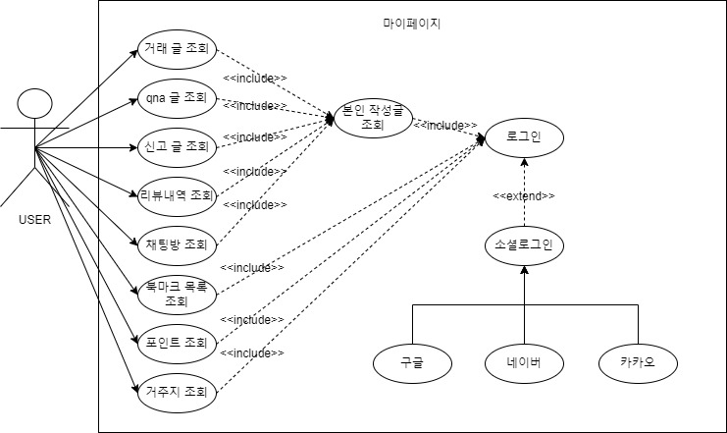
04. 유스케이스 다이어그램
<마이페이지>
Example Text : Get a modern PowerPoint Presentation that is beautifully designed. I hope and I believe that this Template will your Time, Money and Reputation. Get a modern PowerPoint Presentation that is beautifully designed. I hope and I believe that this Template will your Time, Money and Reputation. You can simply impress your audience and add a unique zing and appeal to your Presentations.

Slide 9
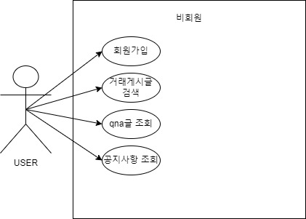
04. 유스케이스 다이어그램
<비회원>
Example Text : Get a modern PowerPoint Presentation that is beautifully designed. I hope and I believe that this Template will your Time, Money and Reputation. Get a modern PowerPoint Presentation that is beautifully designed. I hope and I believe that this Template will your Time, Money and Reputation. You can simply impress your audience and add a unique zing and appeal to your Presentations.

Slide 10
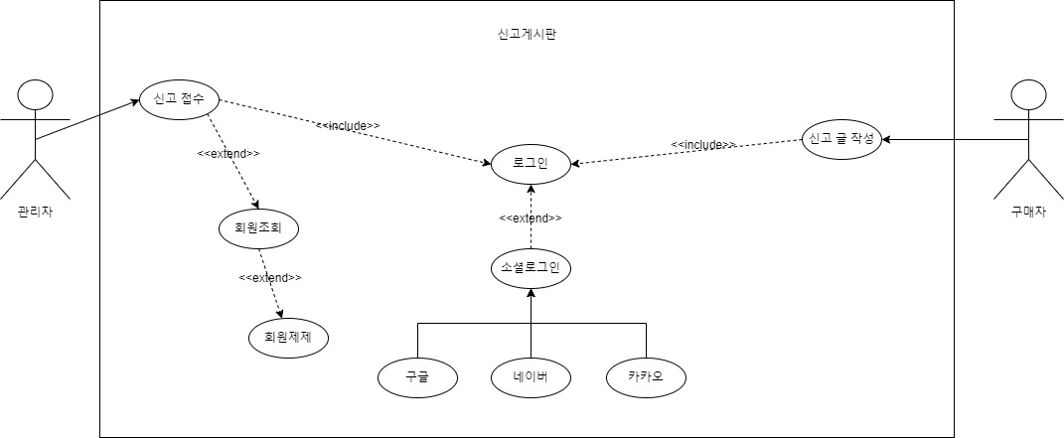
04. 유스케이스 다이어그램
<신고게시판>
Example Text : Get a modern PowerPoint Presentation that is beautifully designed. I hope and I believe that this Template will your Time, Money and Reputation. Get a modern PowerPoint Presentation that is beautifully designed. I hope and I believe that this Template will your Time, Money and Reputation. You can simply impress your audience and add a unique zing and appeal to your Presentations.

Slide 11
05. Restful 설계

