Slide 1

CSD33
Development of an architectural solution for the information security system
of a critical information infrastructure object.
Leack Detector
Team Members:
Olexander Marchuk
Vladyslav Savchuk
Olexandr Karpyshynets

Slide 2
Problem Description
Problem statement: unauthorized access to information at critical infrastructure objects.
Negative impact: the difficulty of critical infrastructure objects personnel control of non-volatile critical information carriers usage, unauthorized VPN connections *, the use of various families of operating systems (Windows, Linux…) on critical infrastructure facilities, the difficulty of adopting for usage in armed forced forces information protection software with "closed" program code.
Expected outcomes of a successful solution:
1. Network security ensuring: propose parameters of cryptographic algorithms and x.509 certificates using DSTU 9041:2020 for usage in generally accepted information security protocols based on Openssl and OpenVPN for information exchange between elements and components of the unauthorized access protection subsystem for USB devices.
2. Protecting workstations and the information system in general: offer our own solution for protecting workstations from unauthorized usage of USB devices and VPN tunnels.
3. Improve the efficiency of responding to cyber threats by implementing event logging and visualization software using ELK Stack by components of a critical information infrastructure object.
Stakeholders of the solution: Armed Forces of Ukraine.

Slide 3
Project Description
Main idea of the solution: to use national standardized cryptosystems for critical infrastructure cybersecurity systems building.
Goal: increase the efficiency of the information protection system against data leakage at critical infrastructure objects.
Key elements : IEEE x.509v3, DSTU 9041:2020, USB-devices, SIEM
Used OpenSource solutions: ELK Stack, OpenVPN, OpenSSL

Slide 4
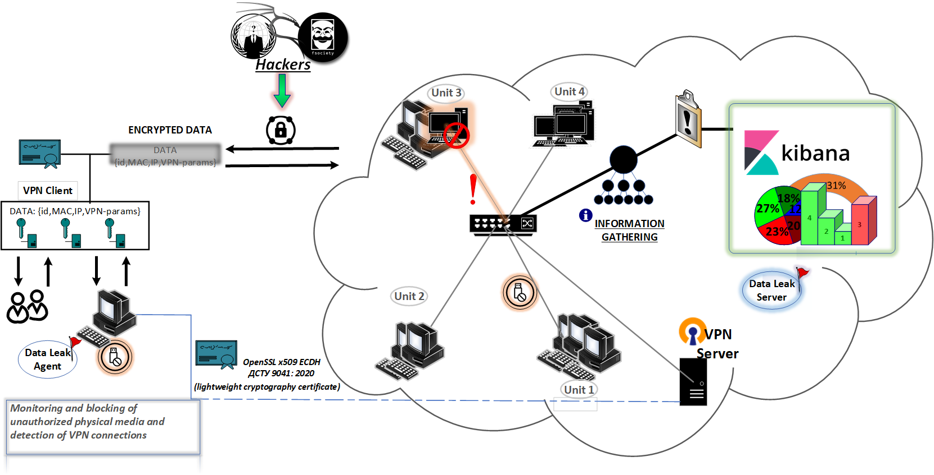
Project Description

Slide 5
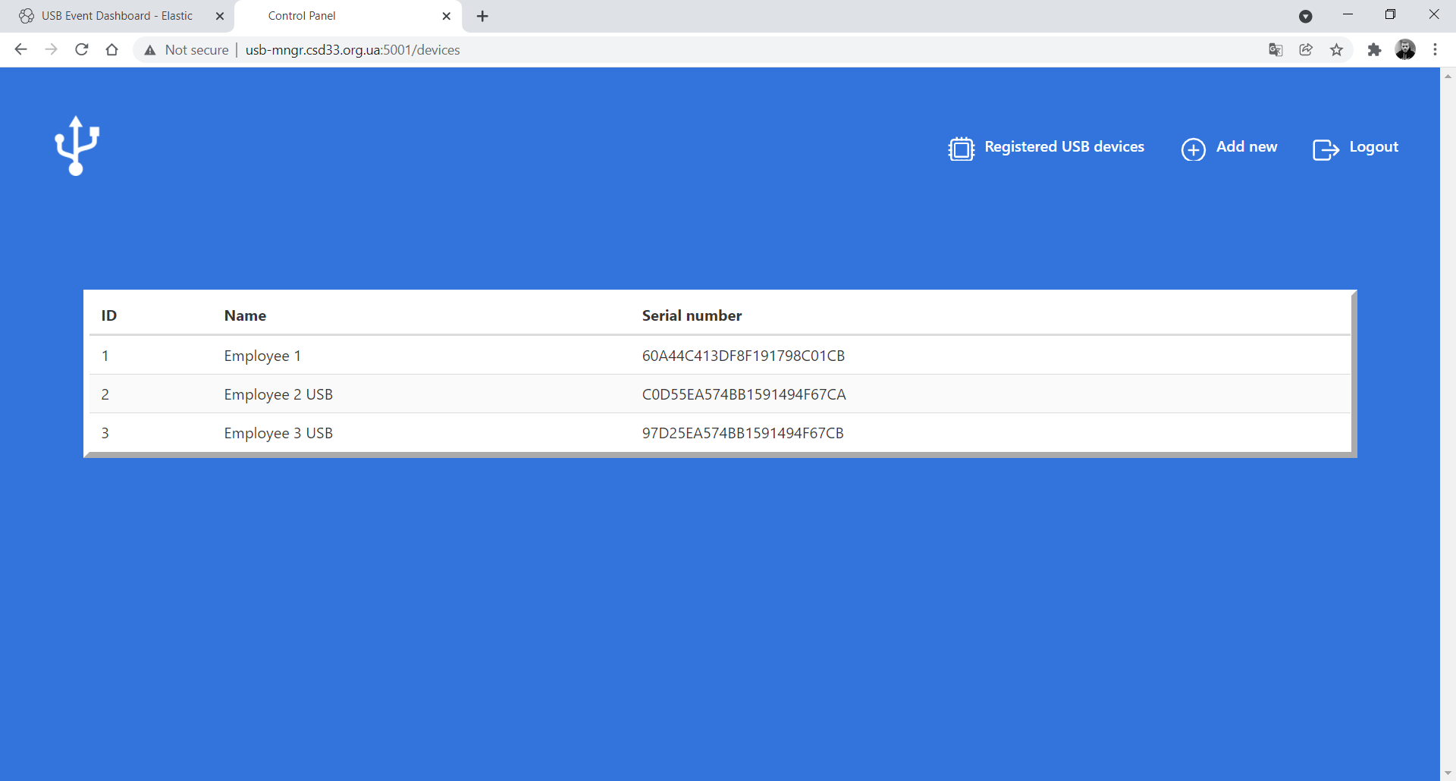
Project Description

Slide 6
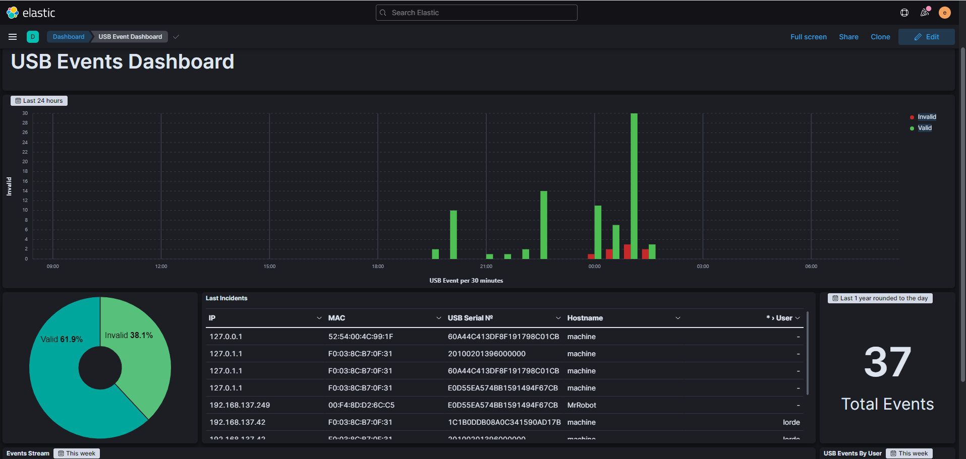
Project Description

Slide 7
Results
Main results:
1. The parameters of the elliptic curve were generated using the software modpol and sea to create public key certificates in accordance with the standard DSTU 9041: 2020.
2. Secure VPN connection using OpenVPN was created.
3. Components for detecting unauthorized connection of USB devices and creating VPN tunnels * were developed (software detector for USB carriers and VPN tunnels "USB Agent v.0.3a" for Windows and Linux, instructions for setting up and configuring ELK Stack, workstation blocking component * ).
Created artefacts: USB Agent v.0.3a
Proofs of goal reach: демонстрація роботи компоненти, програмний код на Gitlab.

Slide 8
Results
Efficiency assessment in comparison with existing solutions:
1. Open source software that allows you to develop your own additional solutions.
2. The openness of the code allows to receive certificates for comprehensive systems of information protection in the future
3. Usage of ELK Stack software components in the Armed Forces of Ukraine and agencies of the sector.

Slide 9
Self-assessment
Meet Real Needs: the number of incidents related to the unauthorized use of USB-carriers in the Armed Forces is very high, as well as the number of malware infections of Armed Forces of Ukraine information system workstations by malware.
Innovation: usage of standardized cryptosystems for building elements of subsystems of critical infrastructure protection from unauthorized leakage.
Completeness: posed tasks were fully completed.
Implementability: in the Armed Forces of Ukraine and other agencies of the security sector.

Slide 10
Questions?

