Slide 1

Report of group 15
search year: 2018
presenter: 蒋祚竑
member: 李泳劭 李镔达 刘育麟

Slide 2


1.Search Process
目录
CONTENTS
2.Search Result

Slide 3
01
Search Process

Slide 4
1.1 Venues and databases
venue/journal | database
Empirical Software Engineering Journal (EMSE) | Springer https://www.springer.com/journal/10664
International Symposium on Empirical Software Engineering and Measurement (ESEM) | ACM digital library https://dl.acm.org
International Conference on Evaluation and Assessment in Software Engineering (EASE) | ACM digital library https://dl.acm.org

Slide 5
1.2 Criteria
Inclusion Criteria
C1 | Published in 2018
C2 | Must use empirical research methods
C3 | No less than 6 pages
C4 | Must be full research paper
Research method | Feature
Experiments | variable, comparison, repeat
Case studies | certain phenomena, context, real
Survey | cluster, interview
Ethnographies | community culture, observation
Action Research | put thoughts into practice
Systematic reviews | summary pre work
Expert opinions | Interview domain expert
Notes:
Feature:研究方法具备的一些鲜明特征，用于辅助分类

Slide 6
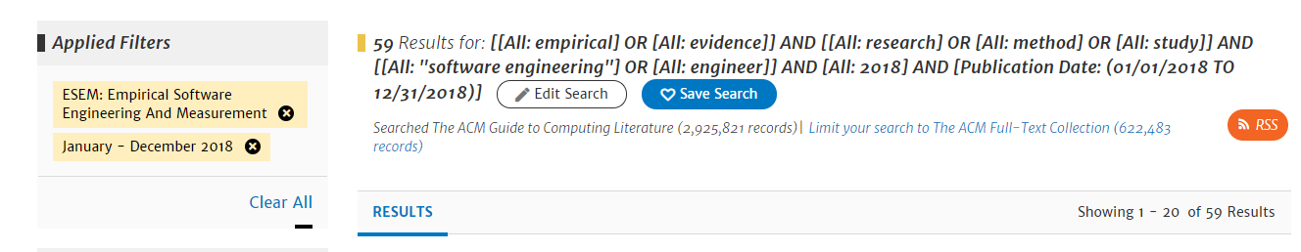
1.3 Execution process
Step1: get papers list and download by sci-hub(ESEM)
Set search string and condition as above

Slide 7
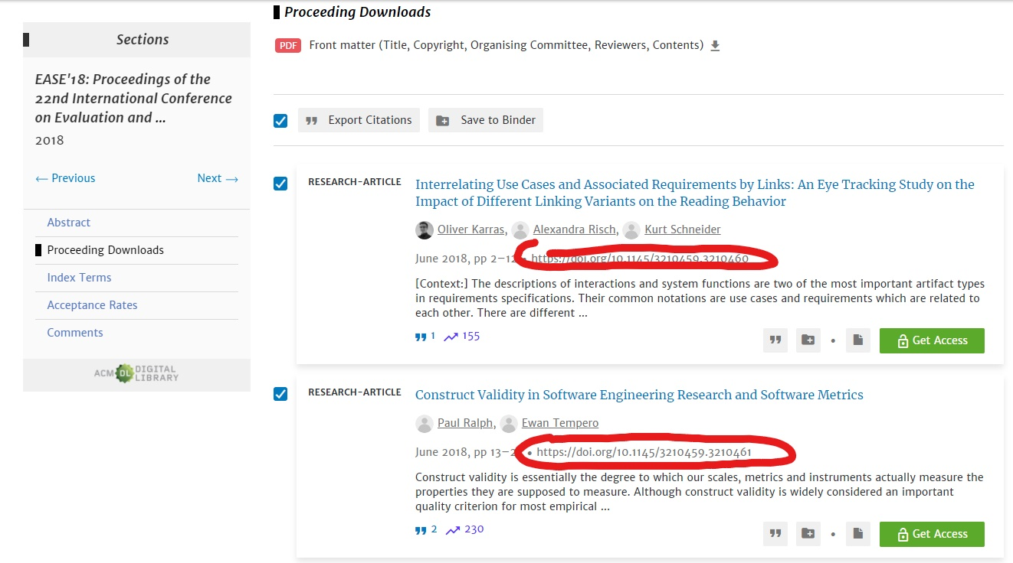
1.3 Execution process
Step1: get papers list and download by sci-hub(EASE)
Get all papers’doi from EASE’18 proceeding page

Slide 8
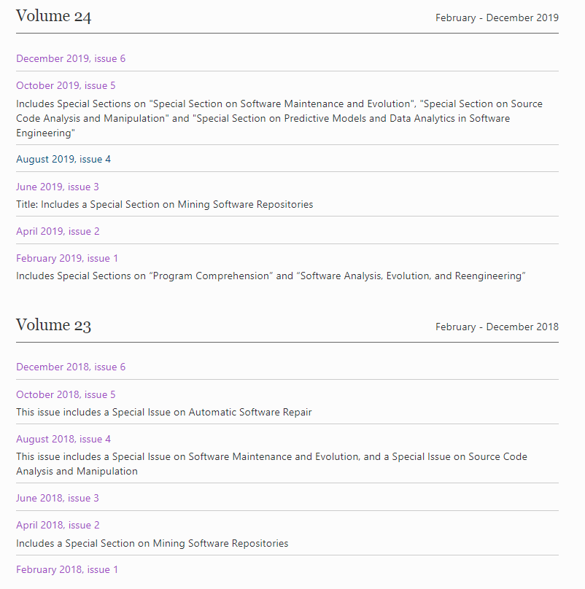
1.3 Execution process
Step1: get papers list and download by sci-hub(ESME)
Check each issue papers list between 2018 – 2019 and download papers that published in 2018

Slide 9
1.3 Execution process
Step2: screening, selecting and categorizing the empirical studies.
Screening:
ESEM:59->41
Categorize Method:
1.Check the key sentence and keywords in abstract
e.g.
We conducted a action research..
interview, participants -> survey
2.Scan the whole article and classify them by their research features
3.Mark those papers which are hard to classify
4.Discuss and solve

Slide 10
1.4 Problem
Problem1: Some papers use multiple research methods
Solution: check the research detail and find the main research method
Problem2: some papers focus on introducing an algorithm or a concrete tech, like a test framework.
Solution: These kind of papers usually use experiment to validate their algorithm/tech, so classify them into experiment

Slide 11
1.5 Experience
1.Survey usually play a role as an addtional research method for case study, because survey can offer perception from practitioners.Practitioners’insight help researcher switch their perspective or fullfill their evidence.
2.Survey is flexible to conduct.However, survey has a fairly low efficiency.The interviewees may be not representative and large enough.
e.g. interview practitioners, collect practiontioners’online articles, usually limited in a small range like a company, a web community, or a university.
Notes:
1.Data collection (Power and Politics of User Involvement in Software Development)

Slide 12
02
Search result

Slide 13
2 Search Result
venues | count
EASE | 26
EMSE | 80
ESEM | 41
Total | 147

Slide 14
2 Search Result
Experiment
27%
Experiment
23%
Experiment
40%
Survey
19%
Case study
31%
Case study
30%

Slide 15
2 Search Result
Research Methods | counts
Total | 147
Case study | 43
Experiments | 42
Survey | 27
Action Research | 11
systematic literature review | 14
Ethnographies | 6
Expert opinion | 3
Daily experience sampling | 1
Experiment
29%
Survey
18%
Case study
29%

Slide 16
Thank you!

