Slide 1
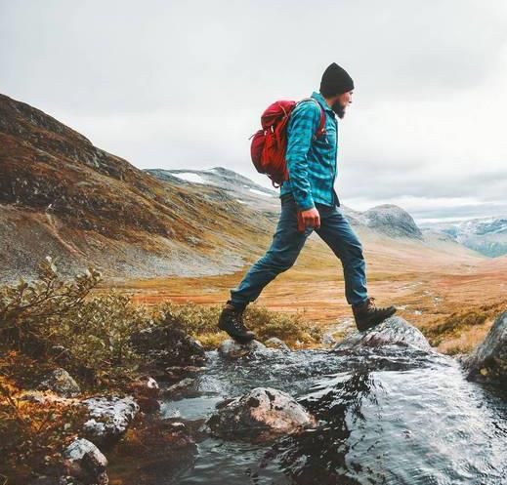
TRIP PLANNER
Pacific Northwest 20XX

Slide 2

Travel plan overview
Itinerary
Activities
Accommodations
Budget
Pros & cons

Slide 3
Itinerary
SAN FRANCISCO, CA
SEATTLE, WA
VICTORIA, BC
Day 1-4
Day 6-9
Day 11-14
PORTLAND, OR
VANCOUVER, BC
Day 4-6
Day 9-11

Slide 4
ACTIVITIES
San
Francisco, ca
Portland,
or
Seattle,
WA
Vancouver,
BC
VICTORIA,
BC
Bay boat tour
Art museums
Ball game
Hiking
Farmer’s market
City tour
Oyster tasting
Coffee shops
Tea ceremony
Butchart Gardens

Slide 5
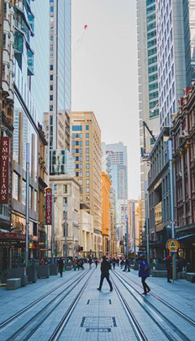
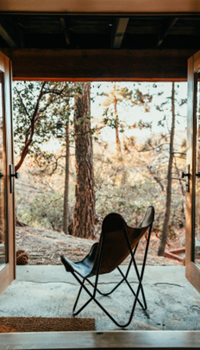
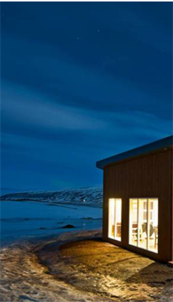
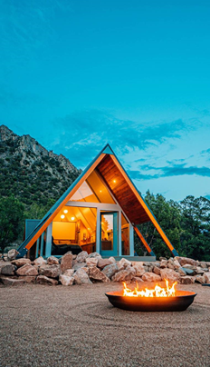
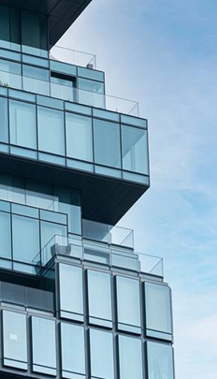
Accommodations
The Rosehip Hotel
Sunset and Sea
The Seattle Sea Home
Mindful Mini Cabin
Glass + Cedar Inn
San Francisco, CA
$$
Portland, OR
$
Seattle, WA
$$
Vancouver, BC
$
Victoria, BC
$$$

Slide 6
Budget
WEEK 1 & 2
Category | Name | Location | Date | Price
Accommodations | The Rosehip Hotel | San Francisco | 06/01/20XX | $300
Accommodations | Sunset and Sea | Portland | 06/08/20XX | $200
Activity | Bay boat tour | San Francisco | 06/02/20XX | $50
Activity | Portland game | Portland | 06/10/20XX | $150
Restaurant | Wasabi-Wabi Sushi | San Francisco | 06/02/20XX | $50
Restaurant | Larkspur West | Portland | 06/11/20XX | $50
Week 1 & 2 total |  |  |  | $800
6

Slide 7
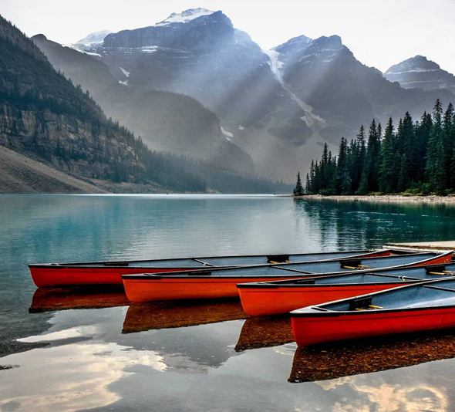

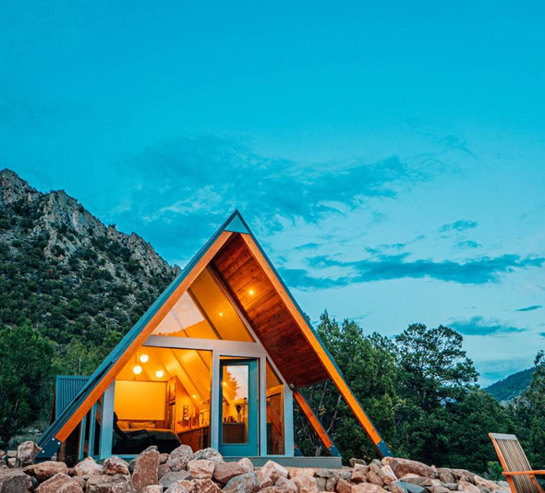
Trip inspiration Mood Board

Slide 8
PROS & Cons
Pros
Cons
Good for mental health
Exciting activities
Optimal time to travel
Weather might be gloomy and cold
Too many places, too little time
Need to rent a car

