Slide 1
Big Data Internal Assessment Question set: 02 Part 1: MongoDB Part 2: Hadoop
Submitted by
KEERTHI K V
1NT18IS079

Slide 2
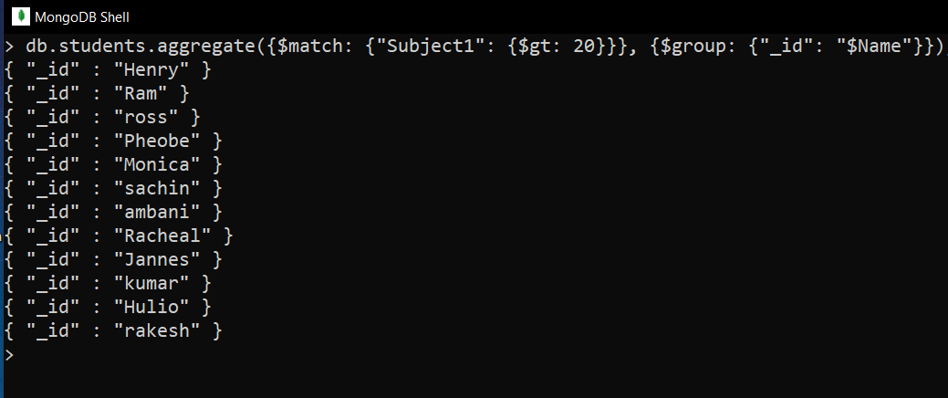
Part 1: MongoDB
Demonstrate the usage of $match, $group, aggregate pipelines
> db.students.aggregate({$match: {“Subject1”: {$gt: 20}}}, {$group: {“_id” : “$Name”}});

Slide 3
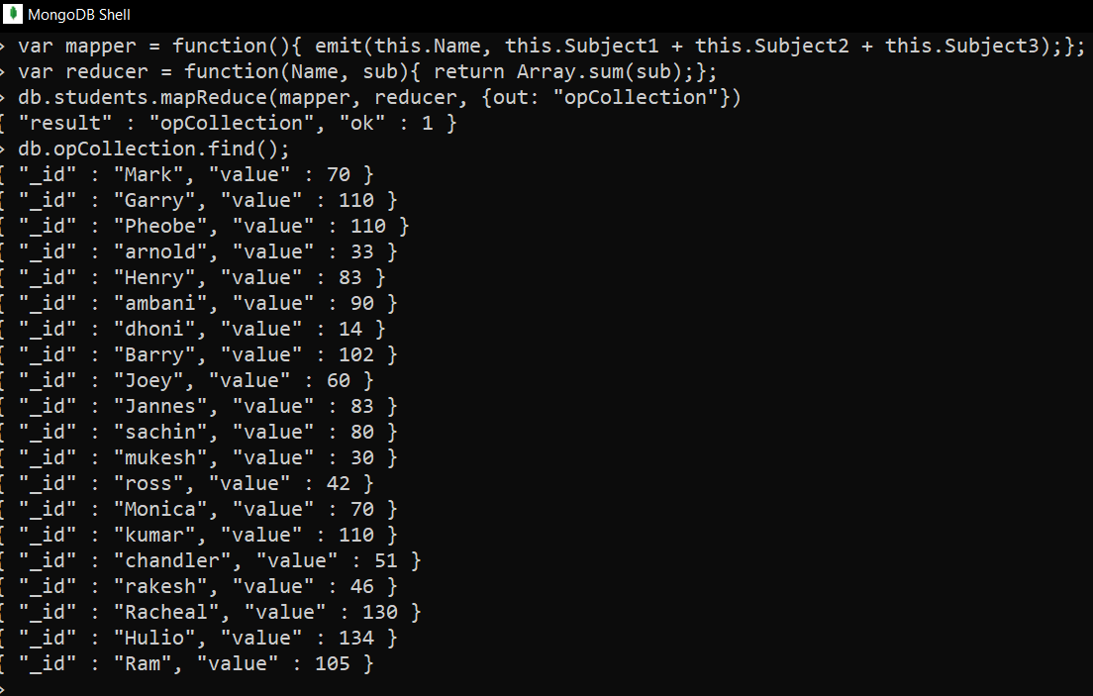
2. Demonstrate the map-reduce aggregate function on this dataset
> var mapper = function(){
emit(this.Name, this.Subject1 + this.Subject2 + this.Subject3);
};
> var reducer = function(name, sub){ return Array.sum(sum);};
> db.students.mapReduce(mapper, reducer, {out: “opCollection”});

Slide 4
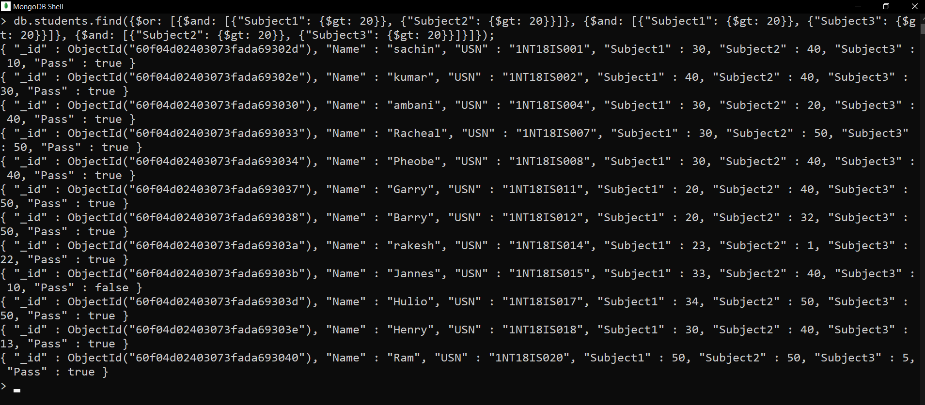
3. Count the number of students who had passed in at least 2 subjects.
db.students.find({$or: [{$and: [{“Subject1”: {$gt: 20}}, {“Subject2”: {$gt: 20}}]}, {$and: [{“Subject1”: {$gt: 20}}, {“Subject3”: {$gt: 20}}]}, {$and: [{“Subject2”: {$gt: 20}}, {“Subject3”: {$gt: 20}}]}]});

Slide 5
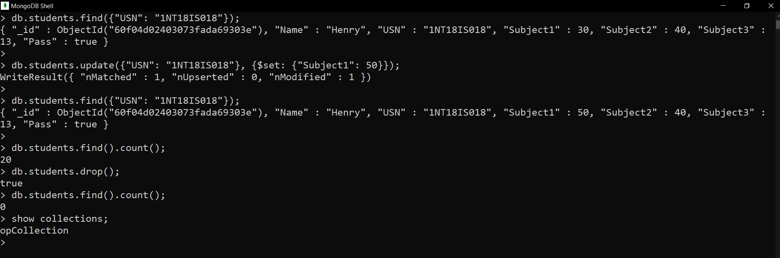
4. Demonstrate the Alter and Drop commands on this dataset.
db.students.update({“USN”: “1NT18IS018”}, {$set: {“Subject1”: 50}});
db.students.drop();

Slide 6
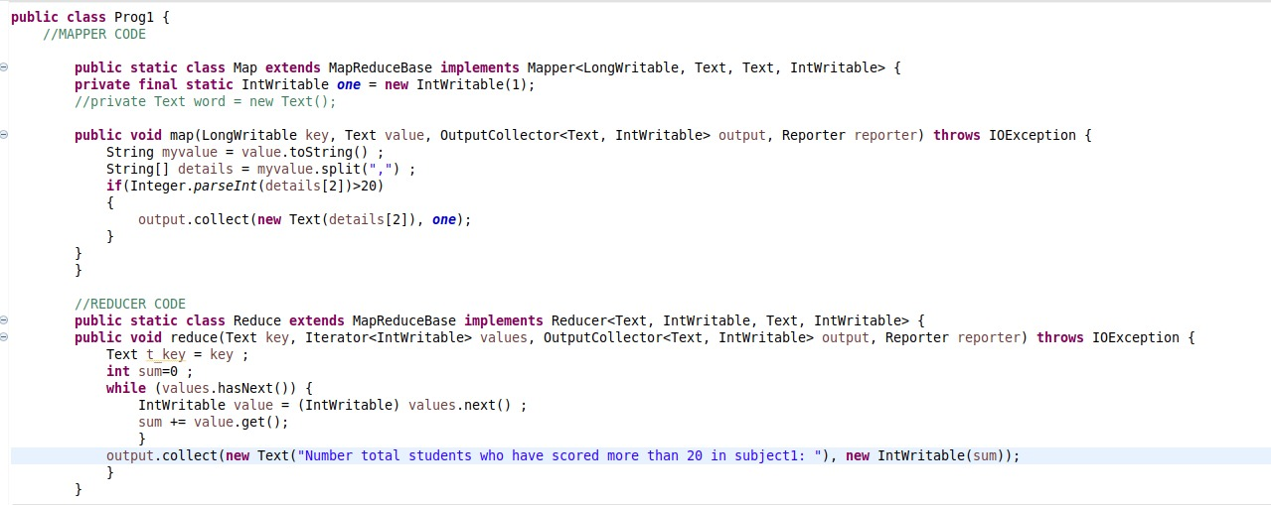
Part 2: Hadoop
1. Total number of students who have scored more than 20 in subject 1.

Slide 7
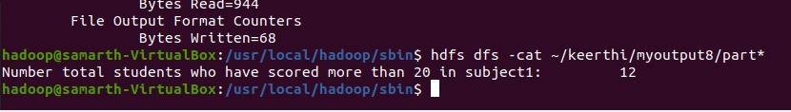
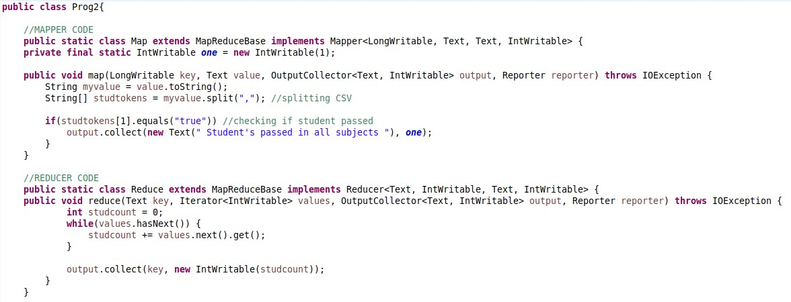
2. Total number of students who have passed in all subjects.

Slide 8

Github link:
https://github.com/1NT18IS079/1NT18IS079_keerthi_B_bdLab/tree/main/Internals

