Slide 1
BD Internal Assessment
Question Set - 1

Slide 2
Part 1 - MongoDB

Slide 3
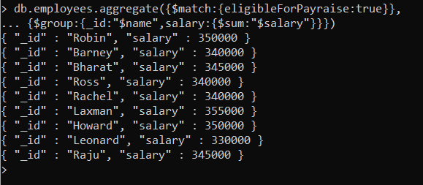
Demonstrate the usage of $match, $group, aggregate pipelines.

Slide 4
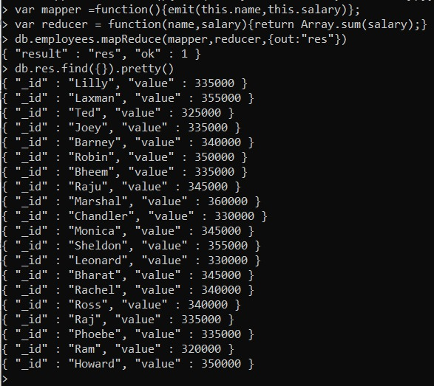
Demonstrate the Map-Reduce aggregate function on this dataset.

Slide 5
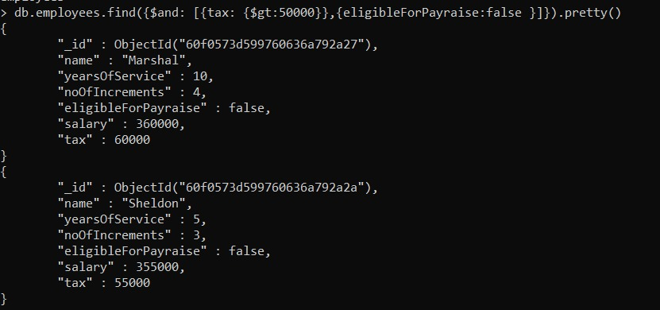
Find out all the Employees, who are paying tax>50000 and are not eligible for pay raise.

Slide 6
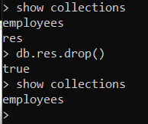
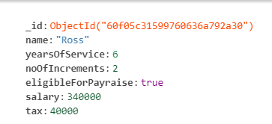
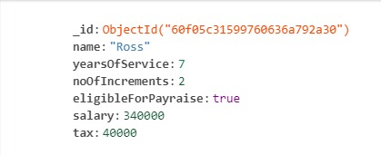
Demonstrate the Alter and Drop commands on this dataset.

Slide 7
Part 2 - Hadoop

Slide 8
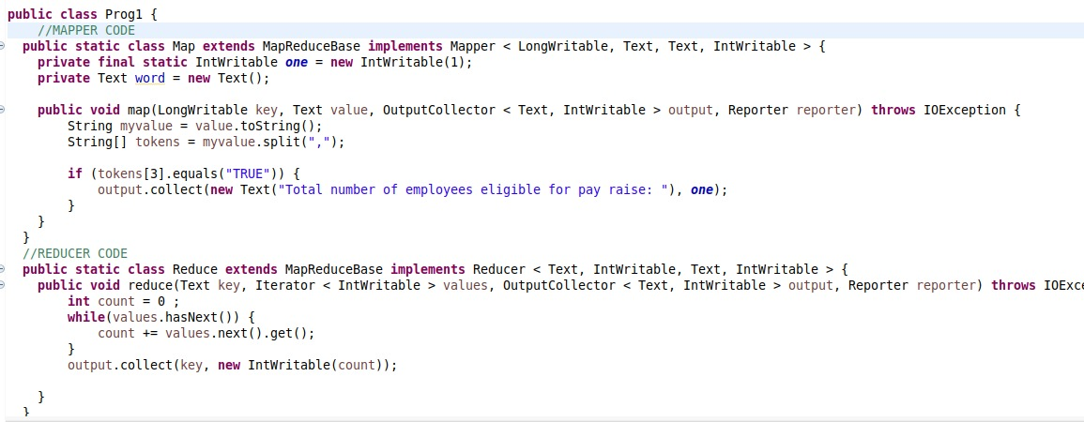
Find out the total number of employees who are eligible for pay raise.

Slide 9

Find out the total number of employees who are eligible for pay raise.
Output :

Slide 10
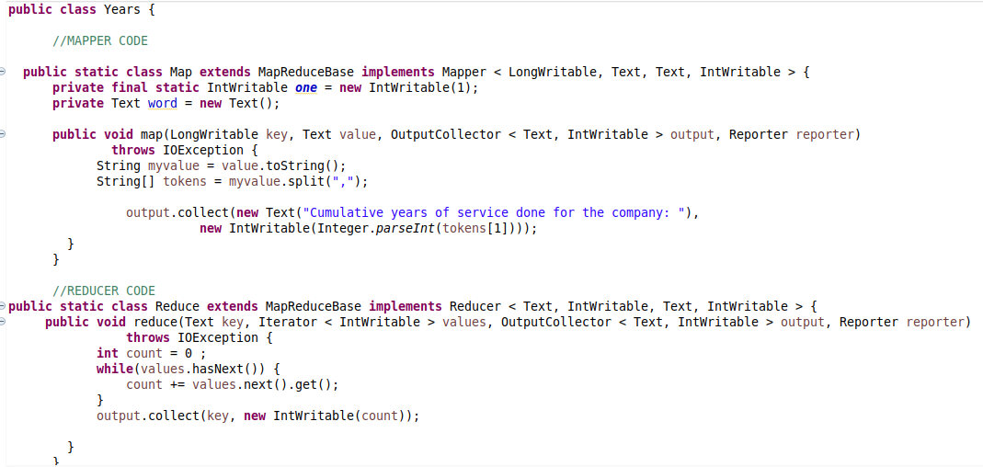
Find out the cumulative years of services done for the company by all the employees.

Slide 11
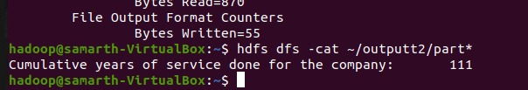
Find out the cumulative years of services done for the company by all the employees.
Output :

Slide 12
Done By
Samarth M N
1NT18IS133

