Slide 1
DEPARTMENT OF INFORMATION SCIENCE AND ENGINEERING NITTE MEENAKSHI INSTITUTE OF TECHNOLOGY (An autonomous institution with A+ Grade by NAAC /UGC, Affiliated to Visvesvaraya Technological University, Belgaum, Approved by UGC/AICTE/Govt. of Karnataka) Yelahanka, Bengaluru-560064
BIG DATA LAB INTERNALS
SHREE RAKSHITHA L
1NT18IS147
QUESTION-I

Slide 2
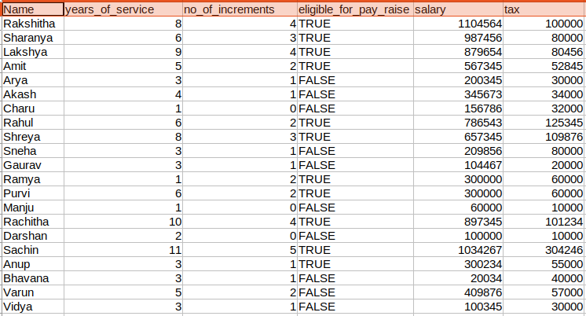
DATASET

Slide 3
MONGODB
1.Demonstrate the usage of $match, $group, aggregate pipelines.

Slide 4
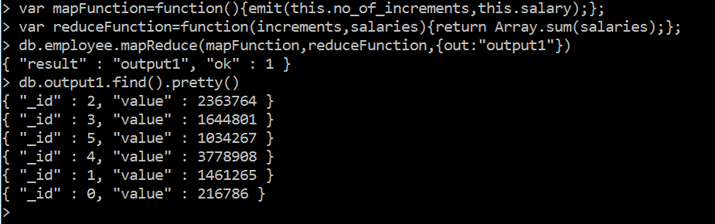
2. Demonstrate the Map-Reduce aggregate function on this dataset.

Slide 5
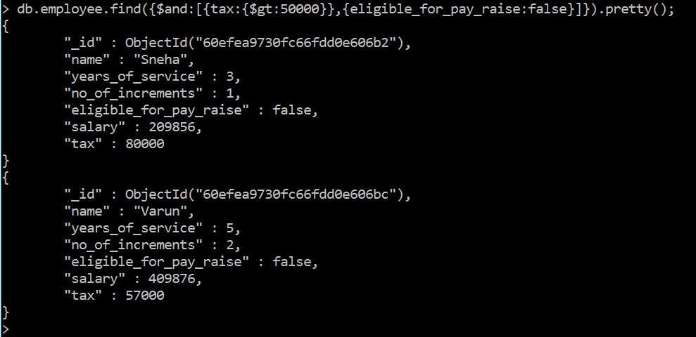
3. Find out all the Employees, who are paying tax>50000 and are not eligible for pay raise.

Slide 6
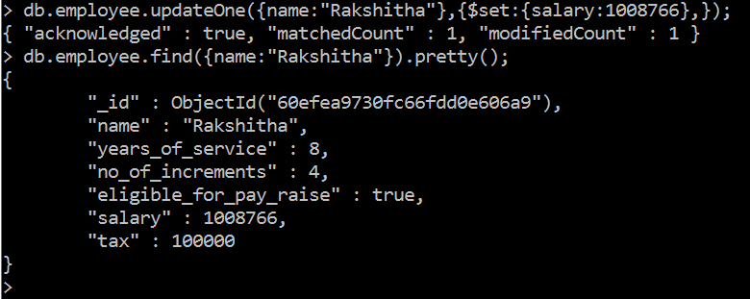

4. Demonstrate the Alter and Drop commands on this dataset.

Slide 7
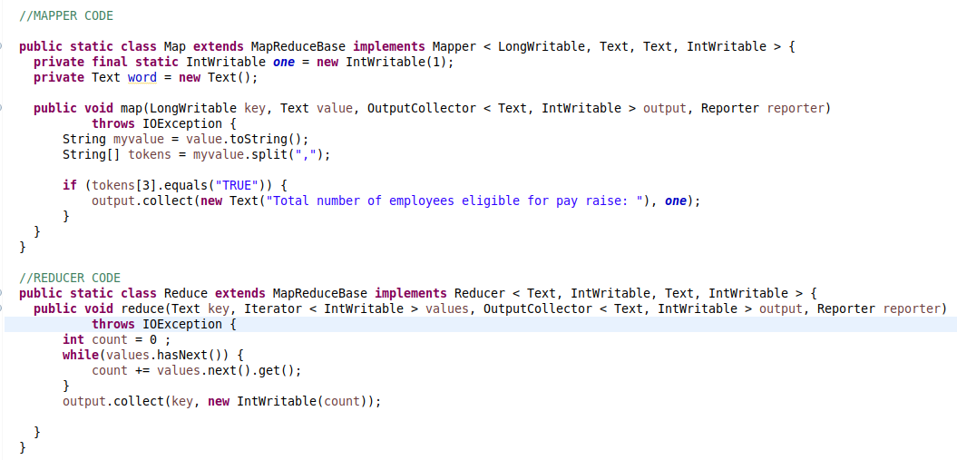
Hadoop-MapReduce
1. Find out the total number of employees who are eligible for pay raise.

Slide 8
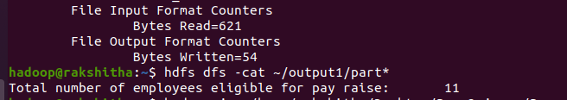
Output

Slide 9
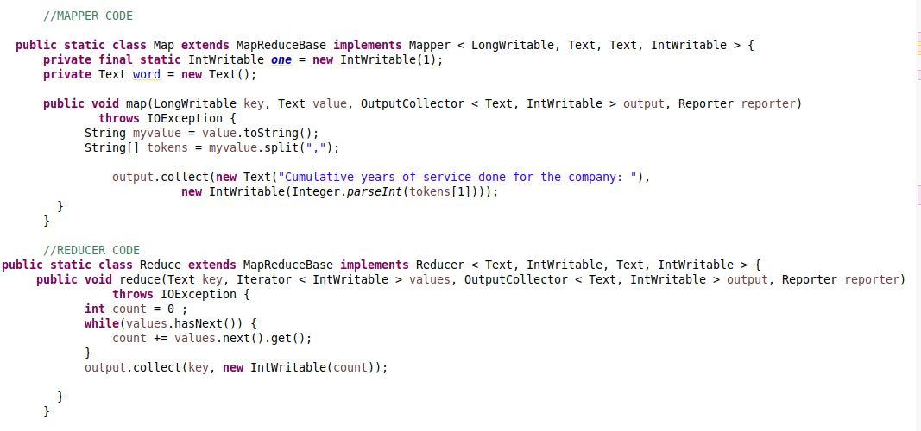
2.Find out the Cumulative years of services done for the company by all the employees.

Slide 10
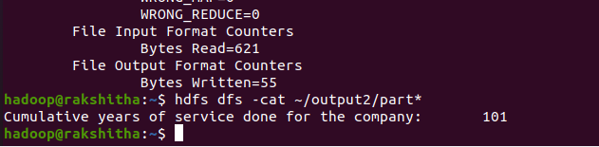
Output

Slide 11
THANK YOU

