Slide 1
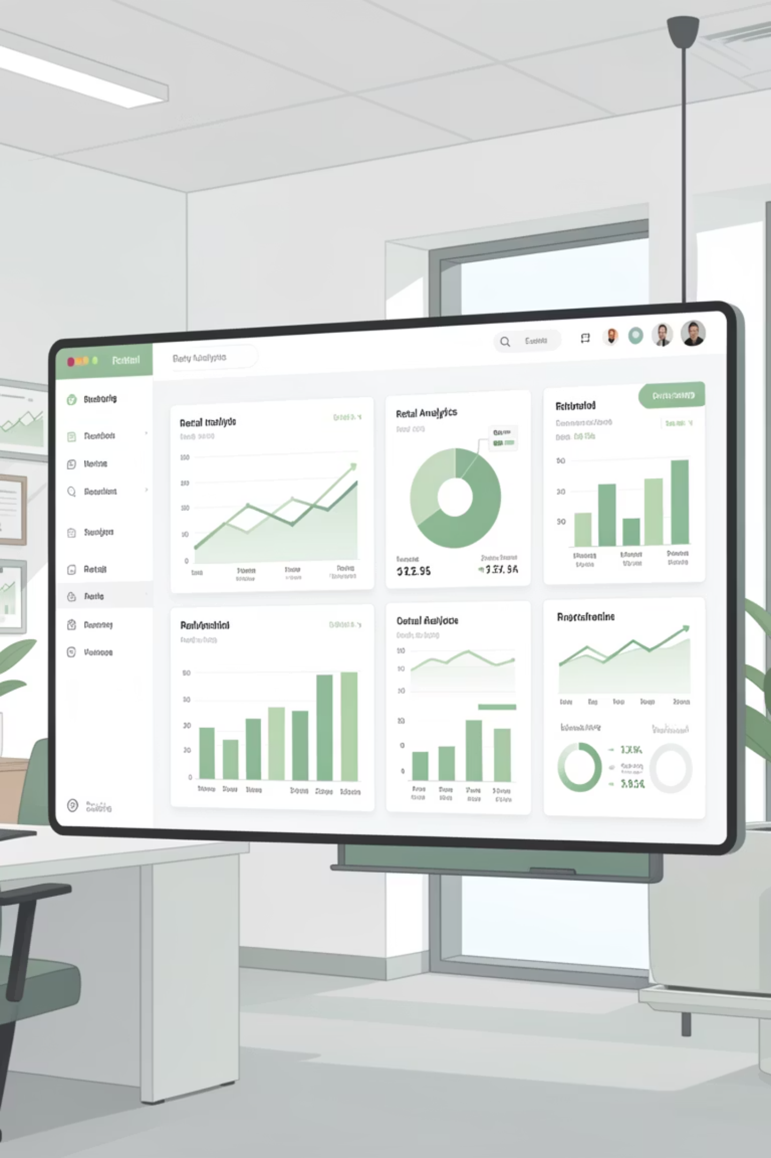
Customer Shopping Behavior Analysis
Uncovering insights from 3,900 customer transactions to drive strategic business decisions through data-driven analysis of spending patterns, preferences, and behavior.

Slide 2
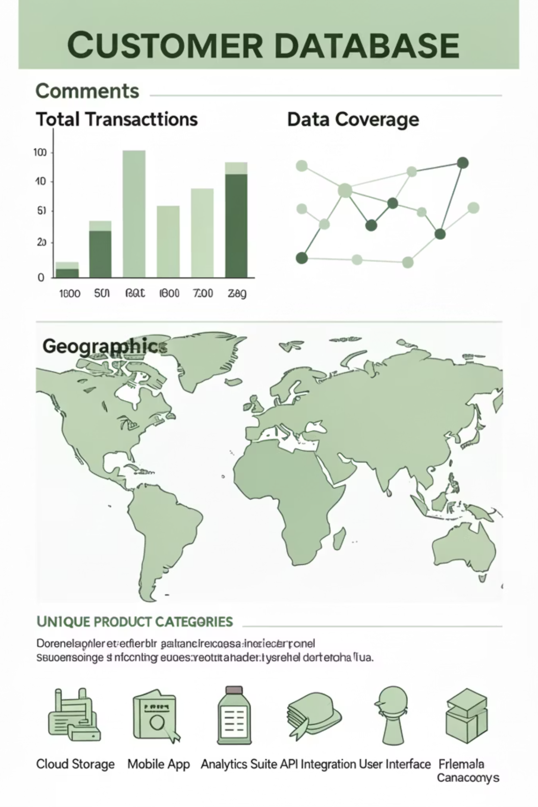
DATASET OVERVIEW
The Foundation: Our Data
3,900
18
50
Total Transactions
Data Points
Locations
Customer purchases analyzed
Features per transaction
Geographic coverage
25
Products
Unique items tracked
Dataset captures comprehensive customer demographics, purchase details, and shopping behavior across multiple categories including Clothing, Accessories, Footwear, and Outerwear.

Slide 3


PYTHON ANALYSIS
Data Preparation & Cleaning
01
Data Loading & Exploration
Imported dataset using pandas and performed initial structure analysis with df.info() and summary statistics.
02
Missing Data Handling
Imputed 37 missing Review Rating values using median rating by product category.
03
Feature Engineering
Created age_group bins and purchase_frequency_days columns for deeper analysis.
04
Database Integration
Connected to PostgreSQL and loaded cleaned data for SQL analysis.

Slide 4

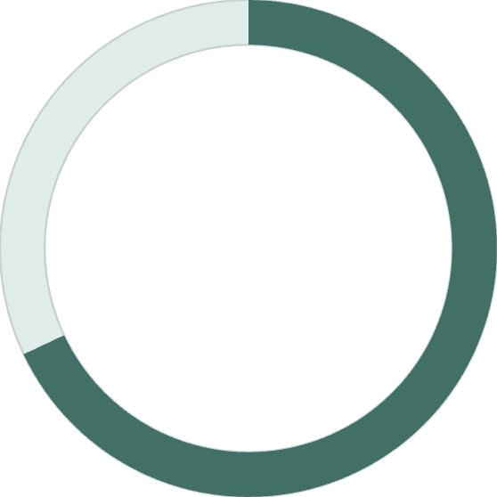
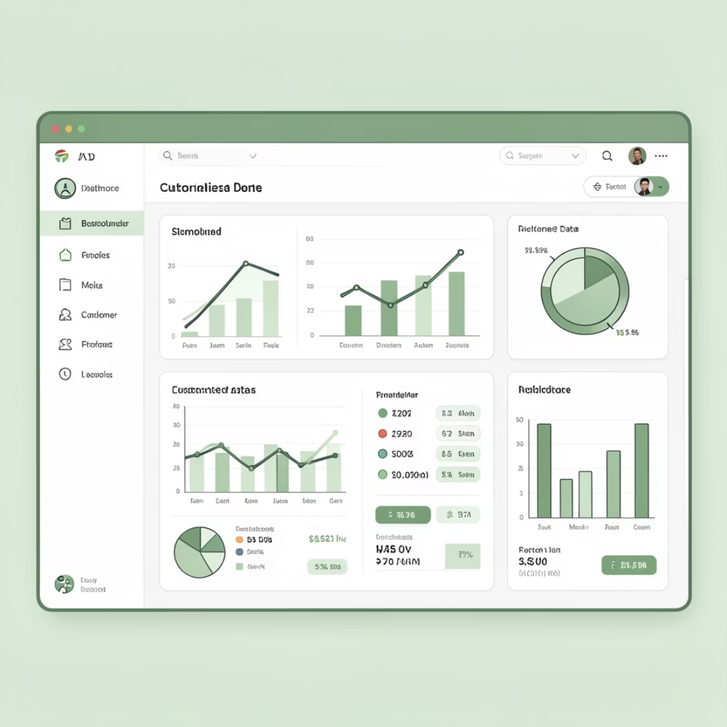
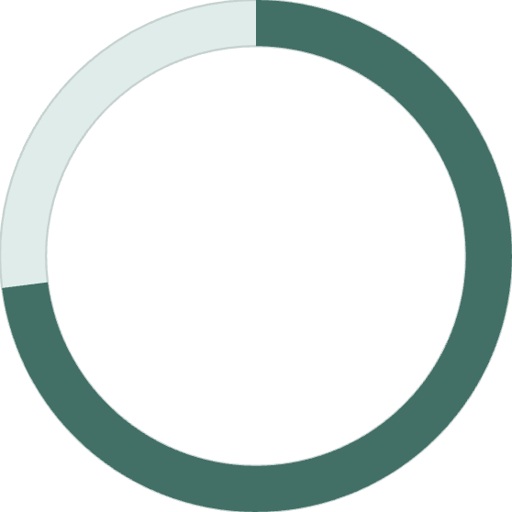
KEY STATISTICS
Customer Profile Snapshot
Demographics
Average age: 44 years (range 18-70)
Average purchase: $59.76
68%
Average rating: 3.75/5.0
Most common size: Medium
Male Customers
Gender distribution
73%
Non-Subscribers
Subscription status

Slide 5

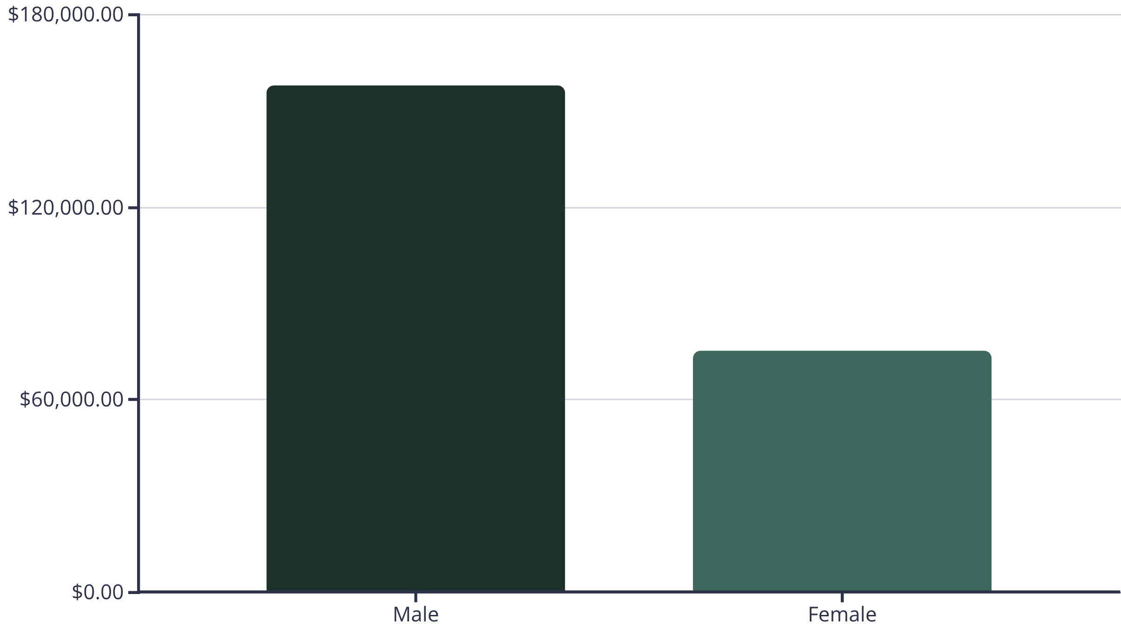
SQL INSIGHTS
Revenue & Gender Analysis
Male Dominance
Strategic Opportunity
Male customers generate 2.1x more revenue than female customers, representing 68% of total revenue.
Significant potential to grow female customer segment through targeted marketing and product offerings.

Slide 6
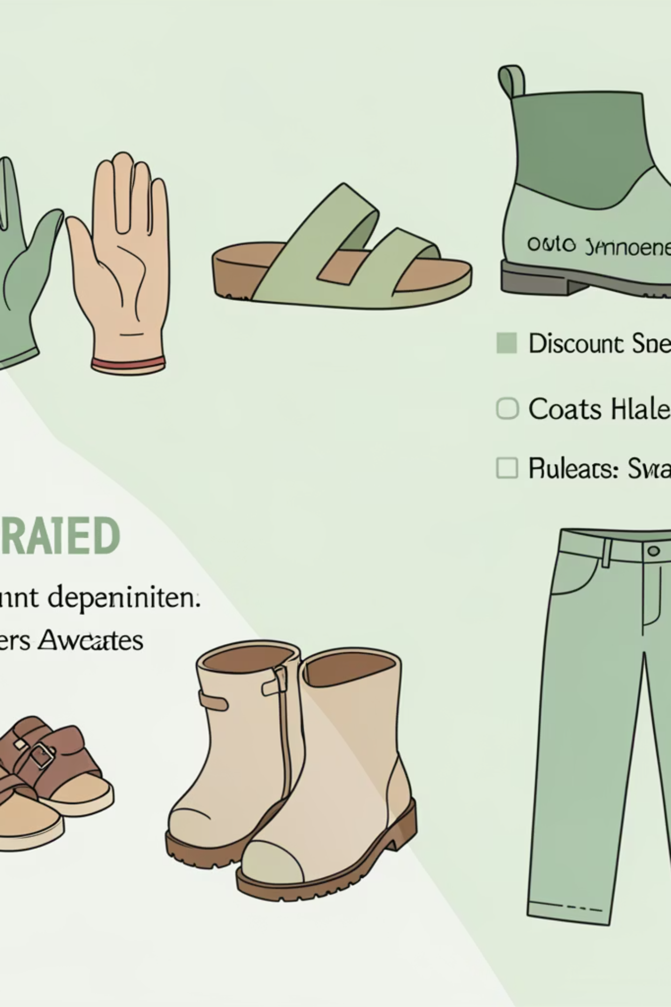


Product Performance Leaders
Top Rated Products
Discount-Dependent Items
3.9
Hat (50% discount rate)
Sneakers (49.66%)
Gloves
Coat (49.07%)
Sweater (48.17%)
3.8
Pants (47.37%)
Sandals
3.8
Boots

Slide 7



CUSTOMER SEGMENTS
Understanding Customer Loyalty
1
New (83)
2
Returning (701)
3
Loyal (3,116)
80% of customers fall into the Loyal segment, demonstrating strong retention. However, only 27% have active subscriptions, revealing untapped potential for recurring revenue growth.
Subscribers
Non-Subscribers
1,053 customers | $59.49 avg spend | $62,645 total revenue
2,847 customers | $59.87 avg spend | $170,436 total revenue

Slide 8
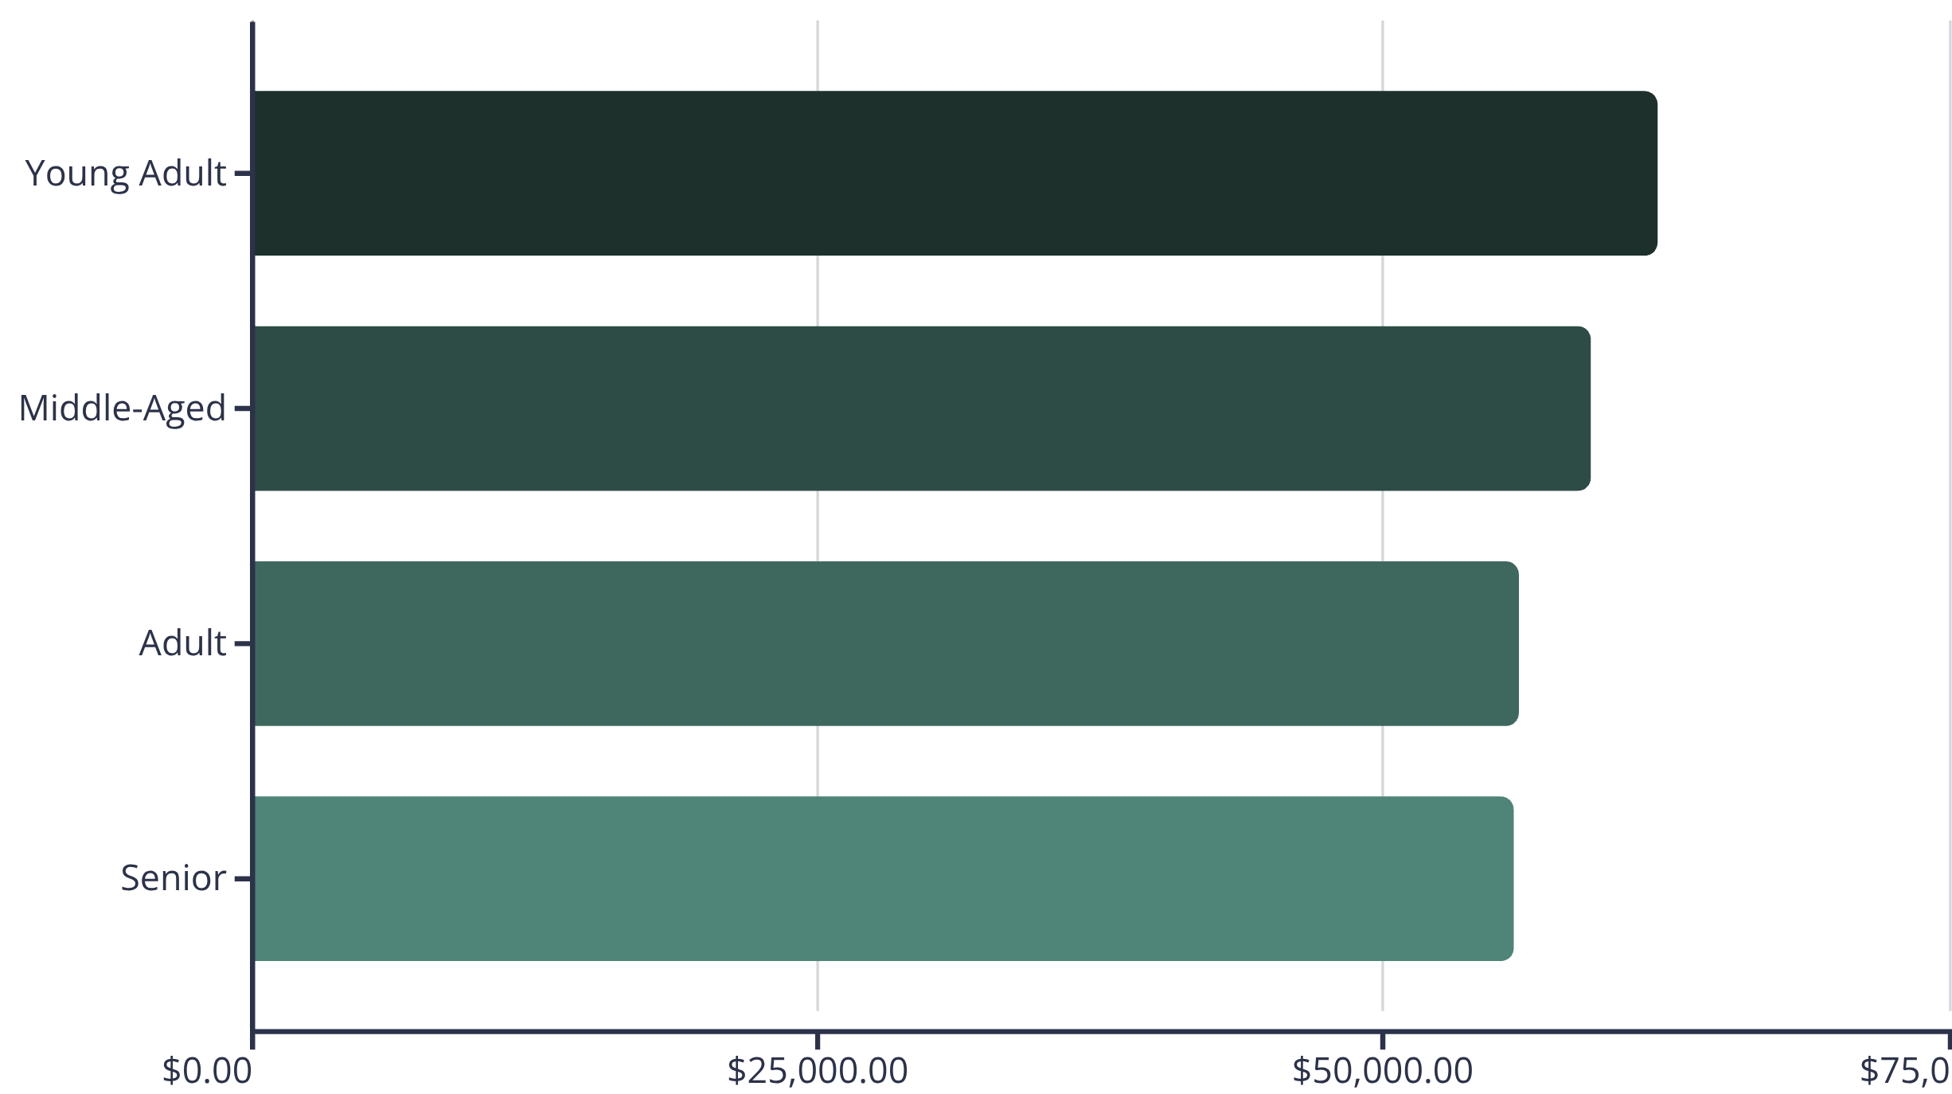
Revenue Distribution Insights
Young Adults lead revenue generation, followed closely by Middle-Aged customers. Clothing dominates category sales at $100K, with Accessories second at $80K.
Shipping Preferences
Express: $60.48 avg
Standard: $58.46 avg

Slide 9
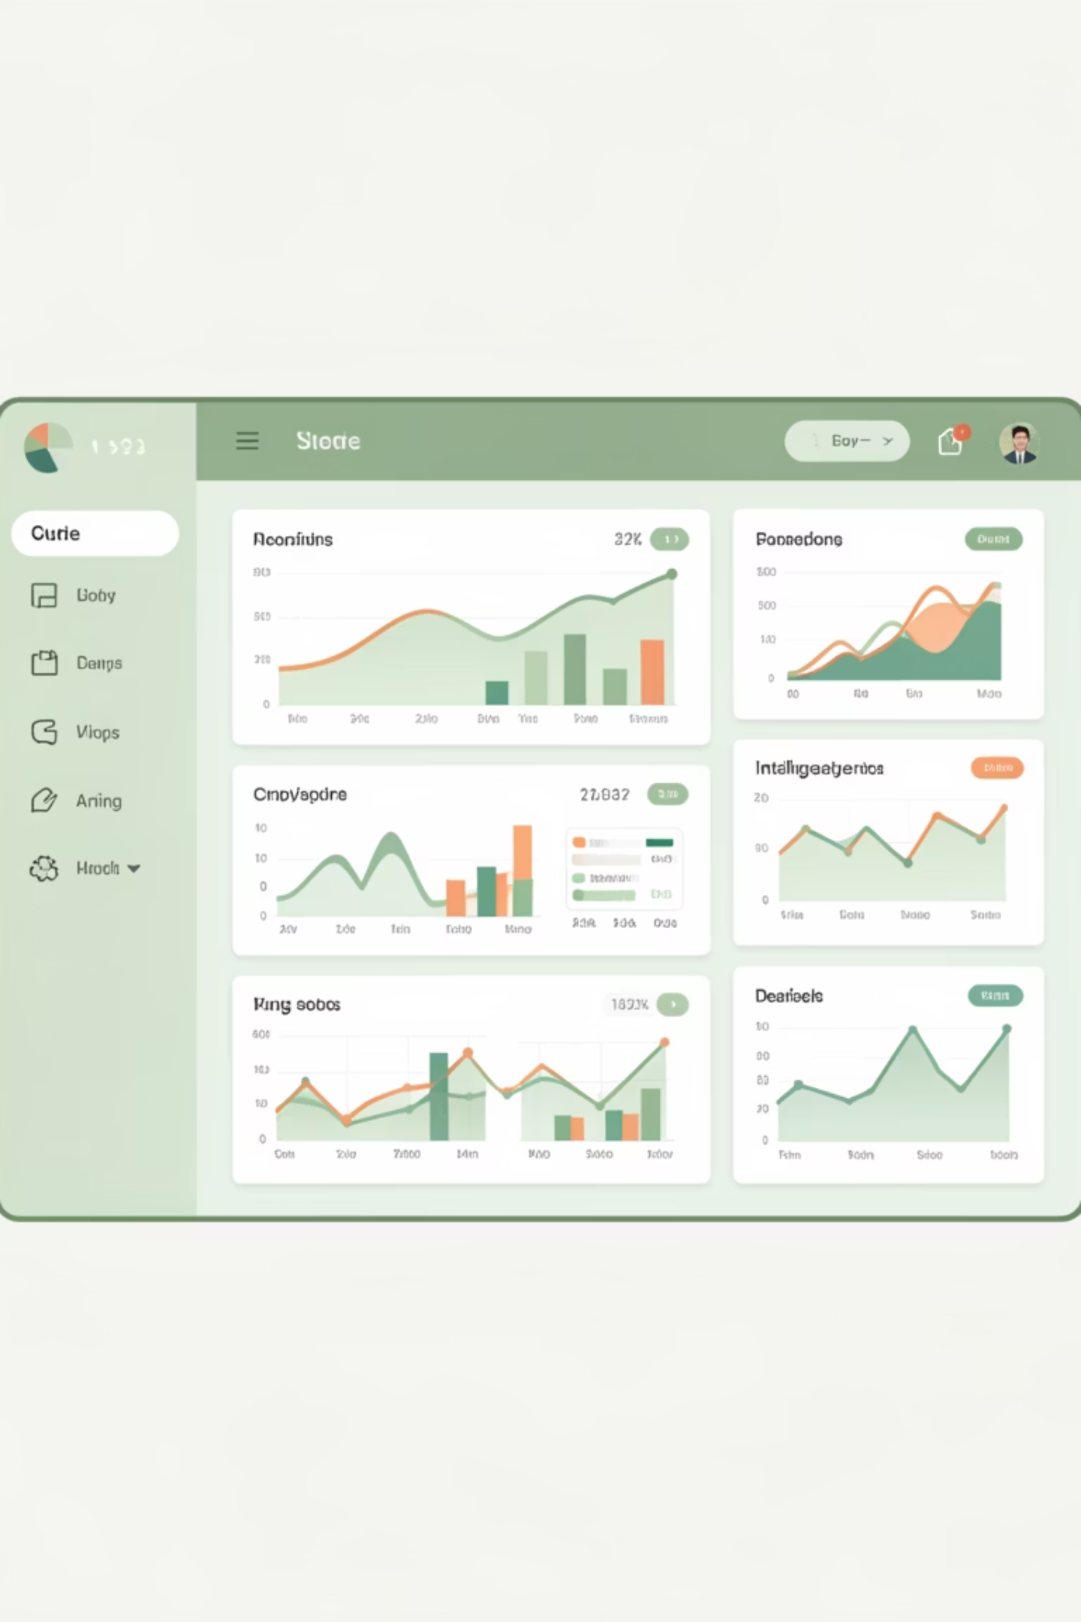




POWER BI
Interactive Dashboard Highlights
Subscription Analysis
Visual breakdown of 27% subscribers vs 73% non-subscribers with revenue impact.
Category Performance
Revenue and sales comparison across all four product categories.
Demographic Insights
Age group analysis showing revenue contribution and purchase patterns.

Slide 10





ACTION PLAN
Strategic Recommendations
Boost Subscriptions
Loyalty Programs
Targeted Marketing
Promote exclusive benefits to convert the 73% non-subscriber base into recurring revenue.
Reward repeat buyers to strengthen the already strong 80% loyal customer segment.
Focus on high-revenue Young Adults and express-shipping users for maximum ROI.
Review Discount Strategy
Product Positioning
Balance promotional sales with margin control—50% of Hat purchases use discounts.
Highlight top-rated items (Gloves, Sandals, Boots) in marketing campaigns.

