Slide 1


Chess Engines
Konstantin Preußer

Slide 2
Outline
Basic Chess Concepts
Computer Engines
Alpha Zero
Theory
Implementation
Outcomes

Slide 3
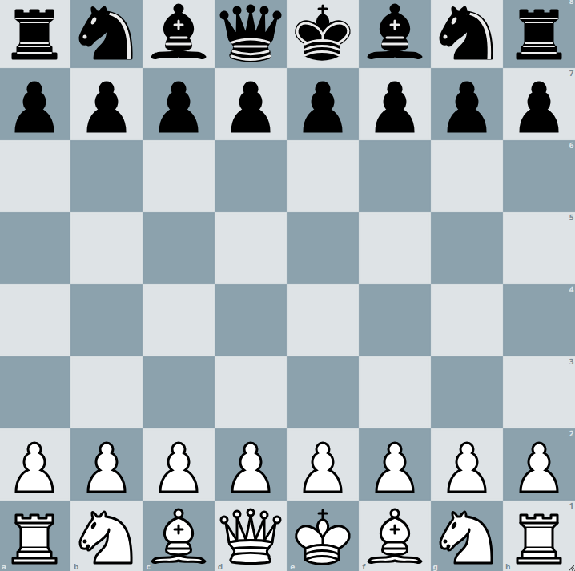
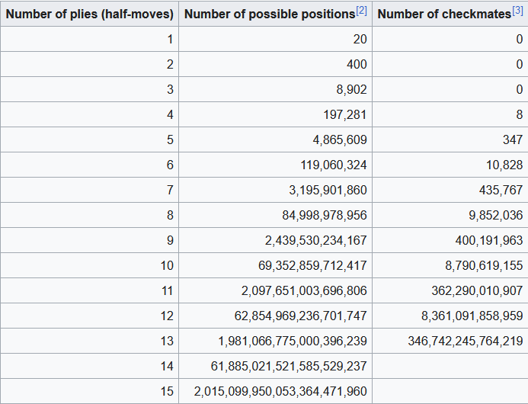
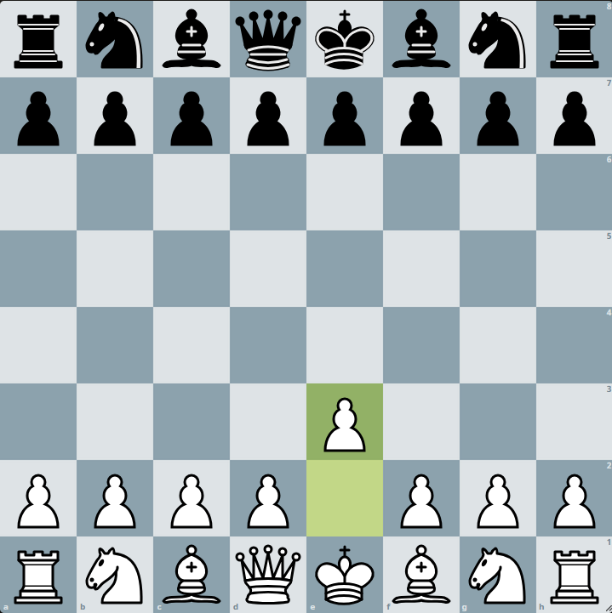
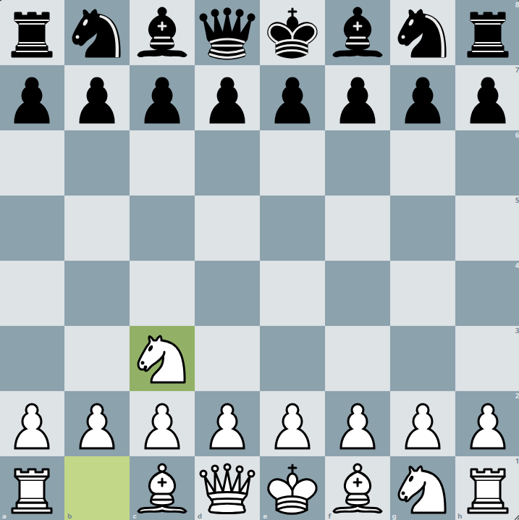
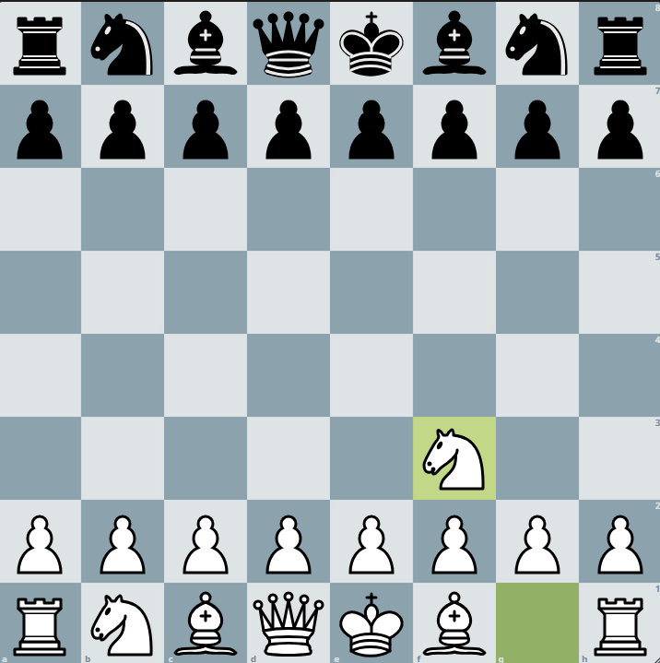
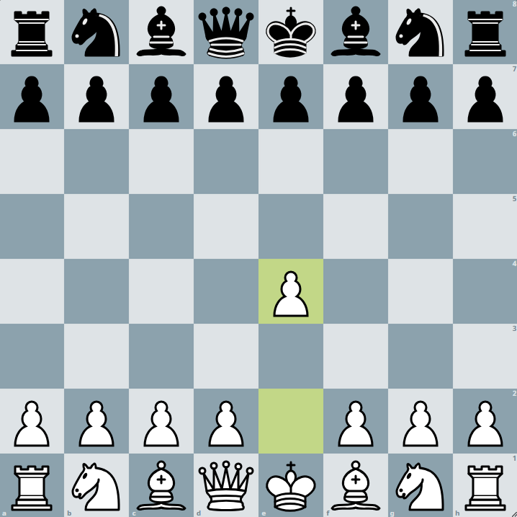
Chess Basic Concepts
1.
Very complex computational problem

Slide 4
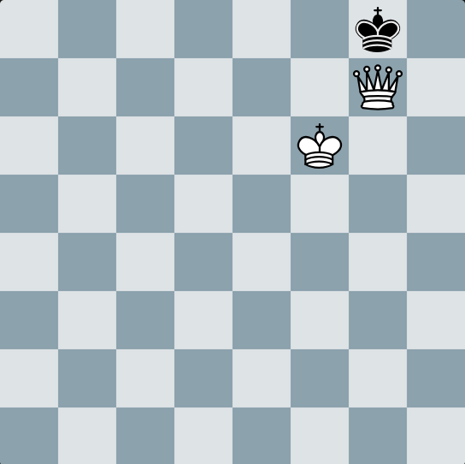
Goal
What you do not want:
Draw by Stalemate
Draw after 50 boring Moves
Draw by Force
Draw by Repetition
Checkmated by Opponent
Checkmate!

Slide 5
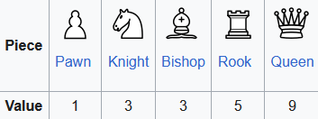

Basic Human Evaluation
Typical addition for better beginners:
+1 for Bishop pair
+1 for King safety

Slide 6
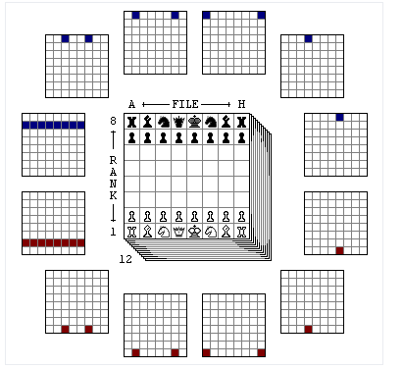
Computer Engine - Board

Slide 7
Computer Engine – Reinforcement Learning
Board = State
Move = Action
Action Space = all possible Moves
Value ≈ Winning Probability

Slide 8
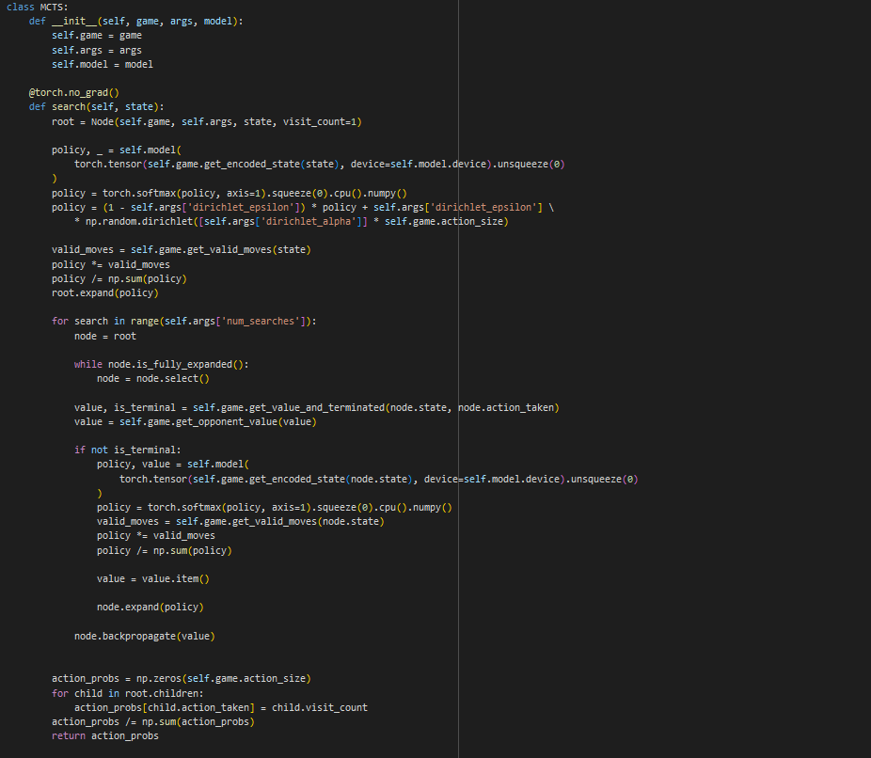
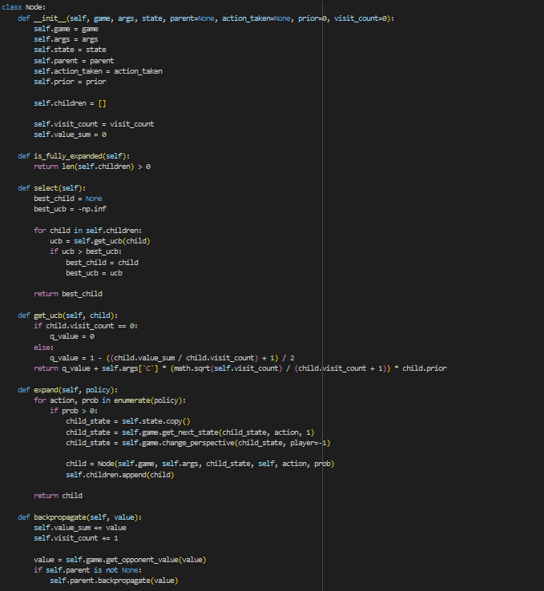
Alpha Zero - MCTS
Selection
Expansion
Simulation
Backpropagation
NN Evaluation

Slide 9
Alpha Zero - MCTS
Root
w₀ = 0
n₀ = 0
P₀ = /
S₀
S₁
S₂
S₃
S₄

Slide 10
Alpha Zero - MCTS
Root
w₀ = 0
n₀ = 0
P₀ = /
S₀
S₁
S₂

Slide 11
Alpha Zero - MCTS
Root
w₀ = 0
n₀ = 0
P₀ = /
S₀
a1
a2
w₁ = 0
n₁ = 0
P₁ = 0.6
w₂ = 0
n₂ = 0
P₂ = 0.4
S₁
S₂
ɸ(S₀) = (p,v) = ((0.6,0.4) , 0.4)

Slide 12
Alpha Zero - MCTS
Root
w₀ = 0.4
n₀ = 1
P₀ = /
S₀
a1
a2
w₁ = 0
n₁ = 0
P₁ = 0.6
w₂ = 0
n₂ = 0
P₂ = 0.4
S₁
S₂
ɸ(S₀) = (p,v) = ((0.6,0.4) , 0.4)

Slide 13
Alpha Zero - MCTS
Root
w₀ = 0.4
n₀ = 1
P₀ = /
S₀
a1
a2
w₁ = 0
n₁ = 0
P₁ = 0.6
w₂ = 0
n₂ = 0
P₂ = 0.4
S₁
S₂
UCT₁ = 1.2
UCT₂ = 0.8
ɸ(S₀) = (p,v) = ((0.6,0.4) , 0.4)

Slide 14
Alpha Zero - MCTS
Root
w₀ = 0.4
n₀ = 1
P₀ = /
S₀
a1
a2
w₁ = 0
n₁ = 0
P₁ = 0.6
w₂ = 0
n₂ = 0
P₂ = 0.4
S₁
S₂
a3
a4
S₃
S₄

Slide 15
Alpha Zero - MCTS
Root
w₀ = 0.4
n₀ = 1
P₀ = /
S₀
a1
a2
w₁ = 0
n₁ = 0
P₁ = 0.6
w₂ = 0
n₂ = 0
P₂ = 0.4
S₁
S₂
a3
a4
w₃ = 0
n₃ = 0
P₃ = 0.5
w₄ = 0
n₄ = 0
P₄ = 0.5
S₃
S₄
ɸ(S ₁) = (p,v) = ((0.5,0.5) , 0.1)

Slide 16
Alpha Zero - MCTS
Root
w₀ = 0.5
n₀ = 2
P₀ = /
S₀
a1
a2
w₁ = 0.1
n₁ = 1
P₁ = 0.6
w₂ = 0
n₂ = 0
P₂ = 0.4
S₁
S₂
a3
a4
w₃ = 0
n₃ = 0
P₃ = 0.5
w₄ = 0
n₄ = 0
P₄ = 0.5
S₃
S₄
ɸ(S ₁) = (p,v) = ((0.5,0.5) , 0.1)

Slide 17
Alpha Zero - MCTS
Root
w₀ = 0.5
n₀ = 2
P₀ = /
S₀
a1
a2
w₁ = 0.1
n₁ = 1
P₁ = 0.6
w₂ = 0
n₂ = 0
P₂ = 0.4
S₁
S₂
a3
a4
w₃ = 0
n₃ = 0
P₃ = 0.5
w₄ = 0
n₄ = 0
P₄ = 0.5
S₃
S₄
ɸ(S ₁) = (p,v) = ((0.5,0.5) , 0.1)
Repeat for n iterations

Slide 18
Alpha Zero - MCTS
CODE

Slide 19
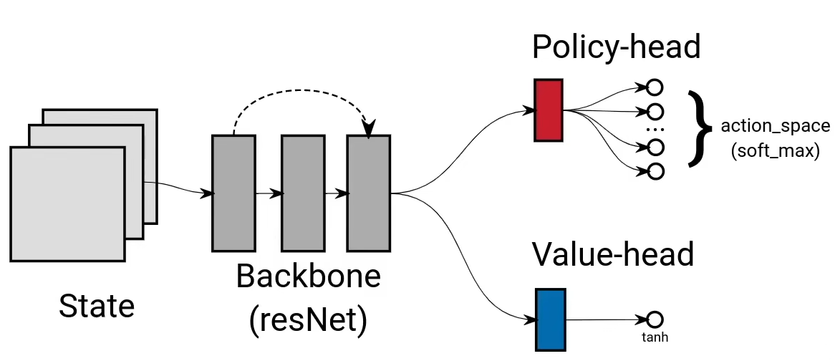
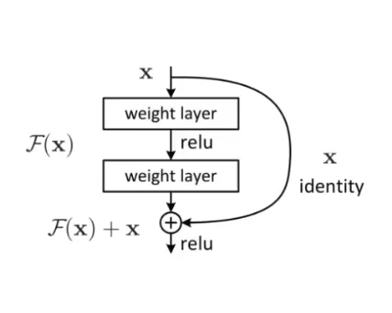
Alpha Zero – Neural network

Slide 20
Alpha Zero – Neural network
CODE

Slide 21
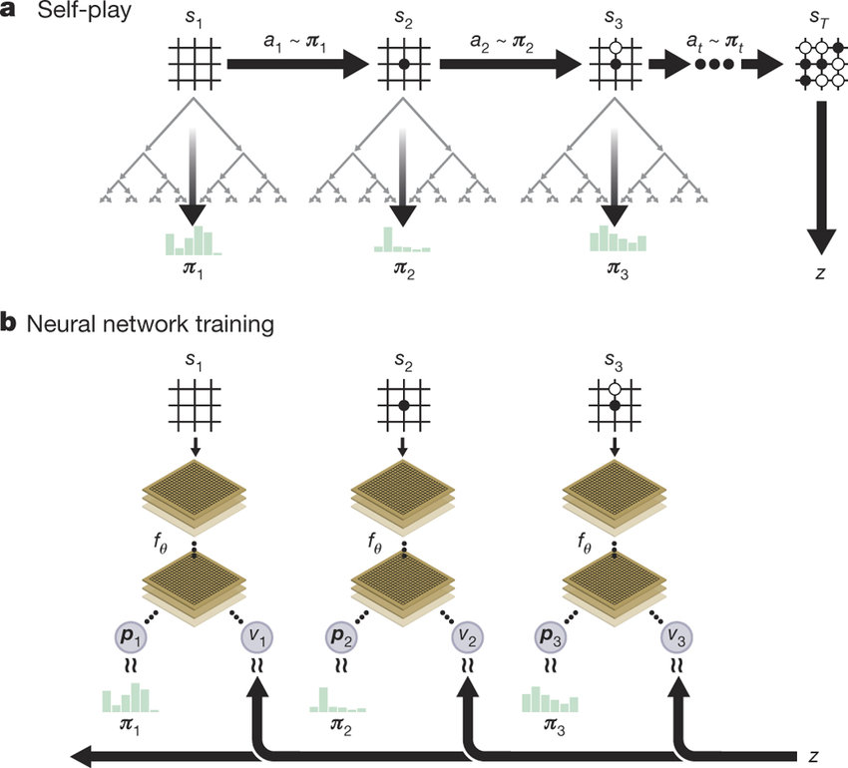
Alpha Zero – Self play
Run MCTS for each position
Update Neural Network after each game
No human input needed
Unbias learning

Slide 22

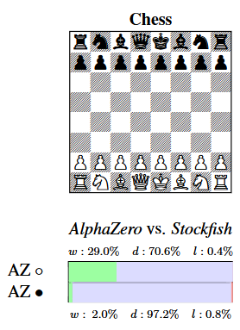
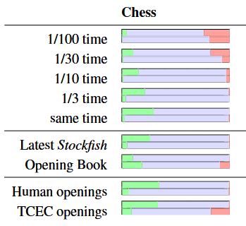
Alpha Zero - Evaluation
AlphaZero beats Stockfish:

Slide 23
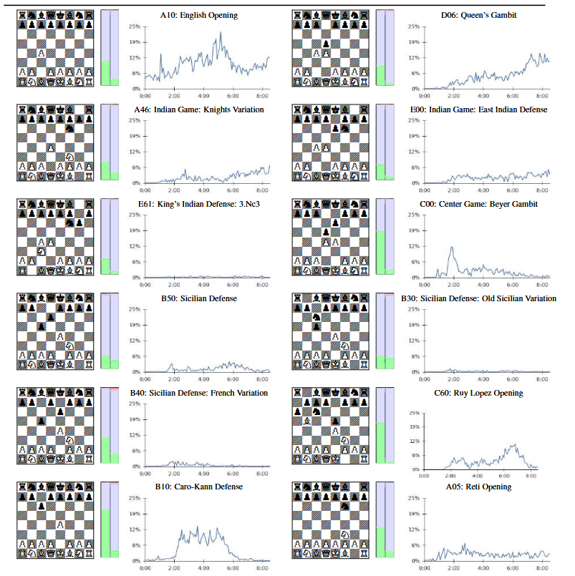
Alpha Zero – 12 most played Human openings

Slide 24
Sources
https://en.wikipedia.org/wiki/Shannon_number

