Slide 1
CHAPTER 4 / SUPPLEMENTARY MATERIAL
Cyber–Physical Security and
Mission Assurance for
Unmanned Aerial Vehicles
UAS Data Links: Functions, Attributes,
Latency, and Security Constraints
Companion figures, service requirements, a latency-budget
example, and a communication-assessment exercise
Learning goal: define what each link must deliver and verify its behavior under degraded conditions.
Notes:
This supplement contains the four figures supplied for Chapter 4 and five complementary teaching slides. Learning objectives: distinguish internal buses from external links; specify service-level requirements; construct a timing budget; select controls without ignoring timing and availability; design an evidence-based communication assessment. All added numerical values are illustrative assumptions, not experimental results or universal UAS requirements. Source artwork: material_ch4.pptx. Original image attribution and reuse permissions remain those of the supplied material.

Slide 2
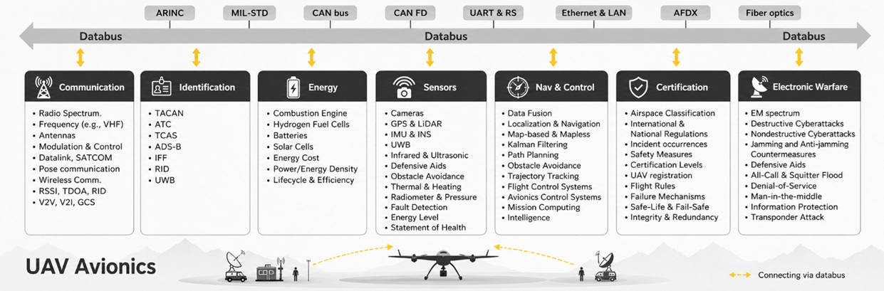
CHAPTER 4 / SUPPLEMENTARY MATERIAL
Onboard networks and external data links
Figure S4.1. Internal buses connect onboard components. External links carry services
between aircraft, operators, and other systems. This avionics map is illustrative.
Conceptual illustration. Applicable requirements and performance depend on the selected UAS implementation.
02
Notes:
The diagram lists example technologies and functional domains, not a required or standardized UAS architecture. ARINC and MIL-STD are families of standards rather than individual buses. Certification is an assurance activity and set of requirements, not necessarily an endpoint on a common bus. Identification, navigation, and communication are separate functions even when they share hardware. UWB can support ranging and data exchange depending on implementation. Treat the diagram as a map for discussion, not a procurement or compliance checklist. Discussion: which services cross a trust boundary when passing from an internal Ethernet network to an external radio link?
Original figure retained from supplied material_ch4.pptx. The illustration does not establish compliance with any aviation or communication standard.

Slide 3
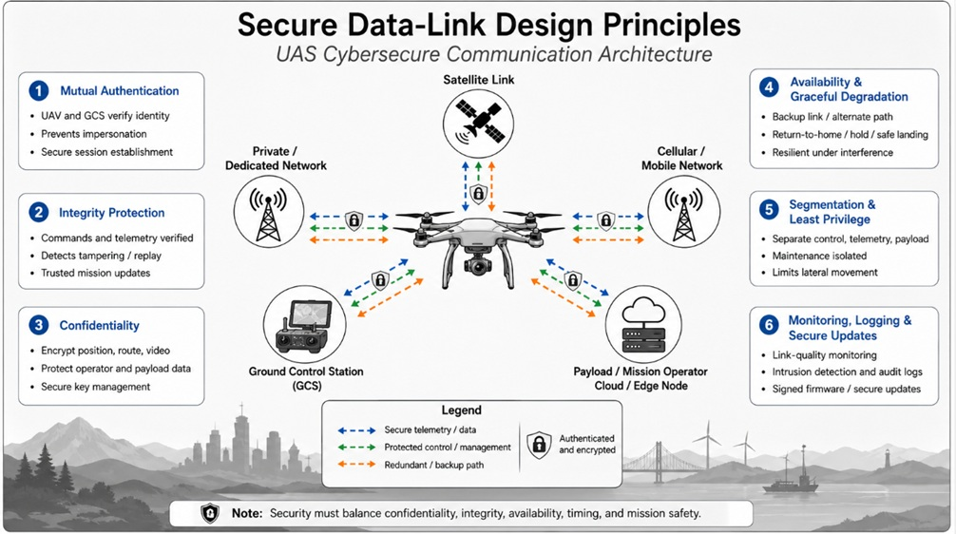
CHAPTER 4 / SUPPLEMENTARY MATERIAL
Secure data-link design principles
Figure S4.2. Authentication, integrity, confidentiality, and availability address different
requirements. Message freshness and recovery behavior need explicit design choices.
Conceptual illustration. Applicable requirements and performance depend on the selected UAS implementation.
03
Notes:
Mutual authentication helps establish peer identity. Integrity protection detects unauthorized message changes. Replay protection additionally requires freshness state, such as sequence numbers, and correct session handling. Encryption does not prevent RF jamming or guarantee timely delivery. Key management, authorization, trusted endpoints, and update handling remain part of the system design. A return-to-home response requires valid navigation and mission-specific safety assessment. Sources: https://www.rfc-editor.org/rfc/rfc4303.html ; https://csrc.nist.gov/pubs/sp/800/82/r3/final
Original figure retained from supplied material_ch4.pptx. The illustration does not establish compliance with any aviation or communication standard.

Slide 4
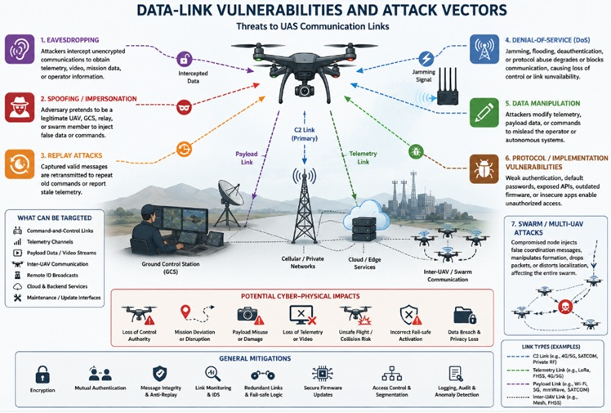
CHAPTER 4 / SUPPLEMENTARY MATERIAL
Data-link threats and mission consequences
Figure S4.3. Exposed interfaces can support interception, impersonation, replay, or disruption.
The consequence depends on access, implementation, and the receiving application.
Conceptual illustration. Applicable requirements and performance depend on the selected UAS implementation.
04
Notes:
The source figure illustrates hypothetical threat relationships, not a demonstrated attack chain or incident attribution. Separate RF interference from network-layer flooding and application-layer replay. Remote ID broadcasts are not intrinsically command channels. Loss of throughput or link quality alone does not identify a malicious source. Map each proposed mitigation to a threat and then test its operating assumptions. Discussion: why can an encrypted message still be unsafe to accept if it is stale or unauthorized?
Original figure retained from supplied material_ch4.pptx. The illustration does not establish compliance with any aviation or communication standard.

Slide 5
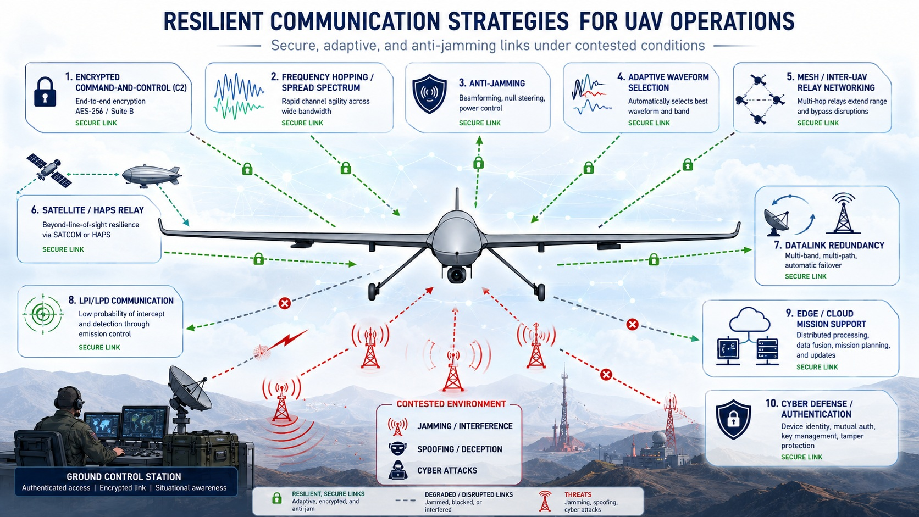
CHAPTER 4 / SUPPLEMENTARY MATERIAL
Communication resilience and recovery
Figure S4.4. Diversity, adaptive links, and local fallback can improve resilience within
defined conditions. Shared dependencies and switching delays can limit their benefit.
Conceptual illustration. Applicable requirements and performance depend on the selected UAS implementation.
05
Notes:
The figure describes candidate approaches, not guaranteed continuity under attack. Frequency diversity, coding, directional antennas, relays, and multiple paths depend on the actual interference, channel, hardware, and implementation. LPI/LPD means low probability of intercept/detection and does not imply invisibility or assured availability. A satellite or cellular route may share power, antennas, compute, credentials, or service infrastructure with the primary link. Preserve authentication, sequencing, freshness, and command authority across handover. Edge/cloud services are not substitutes for a validated local fallback when connectivity fails. Electronic countermeasure details are outside this supplement.
Original figure retained from supplied material_ch4.pptx. The illustration does not establish compliance with any aviation or communication standard.

Slide 6
CHAPTER 4 / SUPPLEMENTARY MATERIAL
Link services and their requirements
A shared radio can carry several services. Each service still needs its own timing and failure policy.
Service | Requirement to define | Behavior to validate
Command and control | Authorized commands, freshness, and an application deadline | Reject stale or invalid commands and enter a defined fallback
Telemetry | Update interval, age limit, and critical-state visibility | Flag stale data and distinguish missing data from unchanged state
Payload stream | Useful throughput, confidentiality, and acceptable quality loss | Reduce payload demand before it starves critical traffic
Inter-UAV coordination | Peer identity, shared-state age, and consistency requirements | Handle missing peers and reject obsolete state updates
Maintenance and updates | Authorized access, update integrity, and permitted operating modes | Prevent unauthorized changes and verify recovery behavior
Define priorities and limits at the application level, then verify them under shared-load conditions.
06
Notes:
Author-created service comparison for teaching, informed by the supplied chapter figures and NIST OT guidance: https://csrc.nist.gov/pubs/sp/800/82/r3/final . This is not an aviation service specification. Timing requirements depend on the command abstraction and controller design. A remote high-level mission command and a flight-control inner-loop command do not have interchangeable deadlines. Specify bandwidth budgets, message size, update intervals, authentication and authorization, deadline behavior, and outage tolerance. Confirm scheduling actually isolates critical service traffic. Encryption alone does not establish command authority.

Slide 7
CHAPTER 4 / SUPPLEMENTARY MATERIAL
Worked example: sensing-to-actuation budget
Illustrative assumptions: 50 Hz sampling, a 125-byte frame, a 1 Mbit/s link, and a 60 ms deadline.
Budget component | Assumed time (ms) | Interpretation
Sampling wait | 20 | Maximum wait within one sampling interval
Queueing / scheduling | 8 | Wait before channel access or transmission
Frame serialization | 1 | 125 × 8 bits ÷ 1,000,000 bit/s
Transport and forwarding | 12 | Additional network / relay delay
Security and application checks | 4 | Verification, freshness, and authorization
Actuation processing | 5 | Application of the accepted command
Total = 20 + 8 + 1 + 12 + 4 + 5 = 50 ms
The assumed 60 ms deadline leaves 10 ms of margin. Retries, bursts, and handovers can consume it.
07
Notes:
All values are teaching assumptions, not measured performance or a worst-case execution proof. At 50 Hz the sampling period is 20 ms. A 125-byte serialized frame contains 1,000 bits and occupies 1 ms at 1 Mbit/s. This assumes the 125 bytes already include all bits counted for serialization. Add framing overhead, coding, contention, and retransmissions separately if they are not included. The 12 ms transport term excludes the separately listed serialization, queue, and application terms, avoiding double counting. Sum = 50 ms. Margin to an assumed 60 ms deadline = 10 ms. This sensing-to-actuation budget includes sampling wait and should not be reported as network one-way delay. Measure actual distributions and worst observed behavior under load. One-way network delay measurements require stated timestamp locations and clock-error bounds. Source: https://www.rfc-editor.org/rfc/rfc7679.html . Exercise: add a 15 ms retransmission cost. The revised total is 65 ms and exceeds the assumed deadline by 5 ms.

Slide 8
CHAPTER 4 / SUPPLEMENTARY MATERIAL
Security controls and engineering trade-offs
Control selection should preserve message validity, timely delivery, and a defined response to failure.
Control | Benefit and limitation | Verification question
Authenticated messaging and replay protection | Protect origin and integrity. Freshness still needs explicit state. | Do duplicates, stale sessions, and out-of-order messages behave correctly?
Segmentation and traffic scheduling | Restrict exposure and contention. Shared compute can remain a bottleneck. | Can a payload or maintenance load delay critical command processing?
Redundant links and handover | Provide alternate paths. Common failures can affect both. | Does switching preserve authority and meet the interruption budget?
Monitoring and local fallback | Detect degradation and bound impact. Thresholds can cause false alarms. | Do mode transitions remain safe when link or navigation data are stale?
A secure session can still miss a deadline. A backup path can still carry stale or invalid state.
08
Notes:
Sources: ESP security services and anti-replay handling, https://www.rfc-editor.org/rfc/rfc4303.html ; OT performance, reliability, and security considerations, https://csrc.nist.gov/pubs/sp/800/82/r3/final . These are general design references, not UAS certification requirements. Authentication and integrity do not guarantee physical correctness of sensor data, endpoint integrity, or availability. Protocol-level anti-replay protection is distinct from application-level timeliness and command expiry. After a link change, account for reordered or duplicated traffic and command authority. Review shared power, clock, GNSS, antennas, processors, network operators, and key material as potential common dependencies.

Slide 9
CHAPTER 4 / SUPPLEMENTARY MATERIAL
Practical exercise: communication assessment
Compare a baseline, increased payload traffic, a link outage, and recovery in a repeatable simulation or bench test.
1. Service contract
Choose one critical message. Define its size, rate, deadline, freshness limit, and fallback.
2. Measurement record
Log sequence IDs, timestamps, acceptance decisions, link state, and applied commands.
3. Performance analysis
Report delivery ratio, delay percentiles, deadline misses, outage duration, and recovery time.
4. Review and evidence
Separate network receipt from timely application. Explain failures and residual uncertainty.
Deliverable: a service specification, event log, and baseline-versus-degraded comparison.
09
Notes:
Use a controlled simulation or authorized bench setup with packet delay, drop, duplication, and reordering. No over-the-air jamming is required for this exercise. Define measurement boundaries and denominators before testing. Network delivery ratio = unique received messages divided by messages sent. Timely application ratio = valid messages applied within deadline divided by messages sent. Count expired, rejected, duplicated, and missing messages separately. Report observation duration and sample count. Do not infer one-way delay as half of round-trip time without justifying path symmetry. State clock synchronization uncertainty, especially in GPS-denied scenarios. Use a common acquisition clock or an independently verified synchronization method when appropriate. Jitter requires a stated definition: for RTP, RFC 3550 defines a specific smoothed interarrival estimate. Do not silently equate it with generic delay standard deviation. Sources: https://www.rfc-editor.org/rfc/rfc7679.html ; https://www.rfc-editor.org/rfc/rfc3550.html . Optional UWB extension: log the age and reference revision of each anchor update and verify how stale data affects the estimator.

Slide 10
CHAPTER 4 / SUPPLEMENTARY MATERIAL
References and terminology
Primary references provide general measurement and security guidance for the teaching examples.
RFC 7679
A One-Way Delay Metric for IP Performance Metrics (2016).
www.rfc-editor.org/rfc/rfc7679.html
RFC 4303
IP Encapsulating Security Payload (ESP) (2005).
www.rfc-editor.org/rfc/rfc4303.html
RFC 3550
RTP: A Transport Protocol for Real-Time Applications (2003).
www.rfc-editor.org/rfc/rfc3550.html
NIST
SP 800-82 Rev. 3, Guide to Operational Technology Security (2023).
csrc.nist.gov/pubs/sp/800/82/r3/final
C2: command and control GCS: ground control station PDR: packet delivery ratio
RTT: round-trip time HAPS: high-altitude platform station
10
Notes:
References accessed 3 November 2026:
delay: https://www.rfc-editor.org/rfc/rfc7679.html
esp: https://www.rfc-editor.org/rfc/rfc4303.html
rtp: https://www.rfc-editor.org/rfc/rfc3550.html
ot: https://csrc.nist.gov/pubs/sp/800/82/r3/final
These references explain general IP security, measurement, and OT concepts. Their inclusion does not mandate ESP or RTP for a specific UAS, establish aviation compliance, or demonstrate prototype performance. NIST SP 800-82 Rev. 3 is cited as a published edition, without claiming it is the newest work in progress. Original illustrations: supplied material_ch4.pptx. Added examples and exercises are teaching material. Source figures remain raster images. New titles, captions, tables, and teaching content remain editable.

