Slide 1
CHAPTER 13 / SUPPLEMENTARY MATERIAL
Cyber–Physical Security and
Mission Assurance for
Unmanned Aerial Vehicles
UAS Intelligence, Surveillance, and Reconnaissance Security
Notes:
Scope: retain the four supplied figures and complement them with a risk-record example, a scalar range-consistency calculation, an evaluation protocol, and a practical exercise. Learning objectives: distinguish anomalies from their causes; state uncertainty in sensor consistency tests; evaluate accuracy together with timing and resource overhead; document residual mission risk. All added numerical values are synthetic teaching assumptions. Source illustrations: supplied material_ch6.pptx. Retain original attribution and reuse permissions.

Slide 2
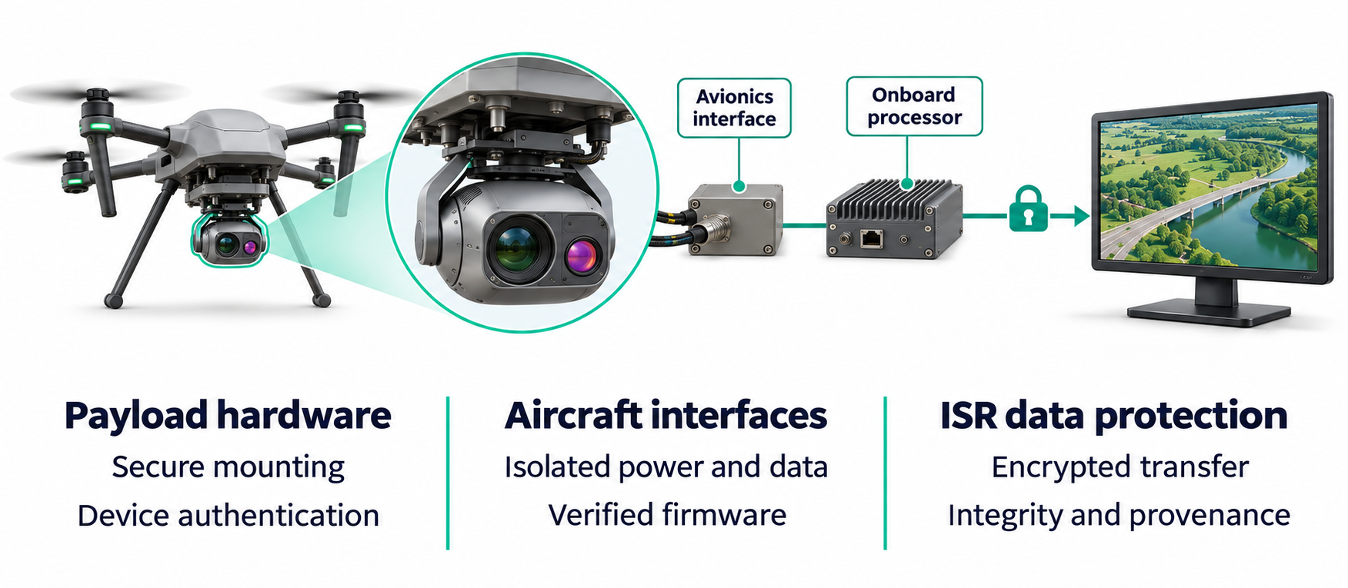
CHAPTER 13 / SUPPLEMENTARY MATERIAL
Secure Payload Integration for ISR Platforms
Figure S13.1. Secure payload integration for intelligence, surveillance, and reconnaissance (ISR) platforms. A securely mounted and authenticated electro-optical/infrared (EO/IR) payload connects to the onboard processor through an avionics interface with isolated power and data paths. Firmware verification, encrypted transmission, and data integrity and provenance checks protect the imagery from capture to ground-station review.
02

Slide 3
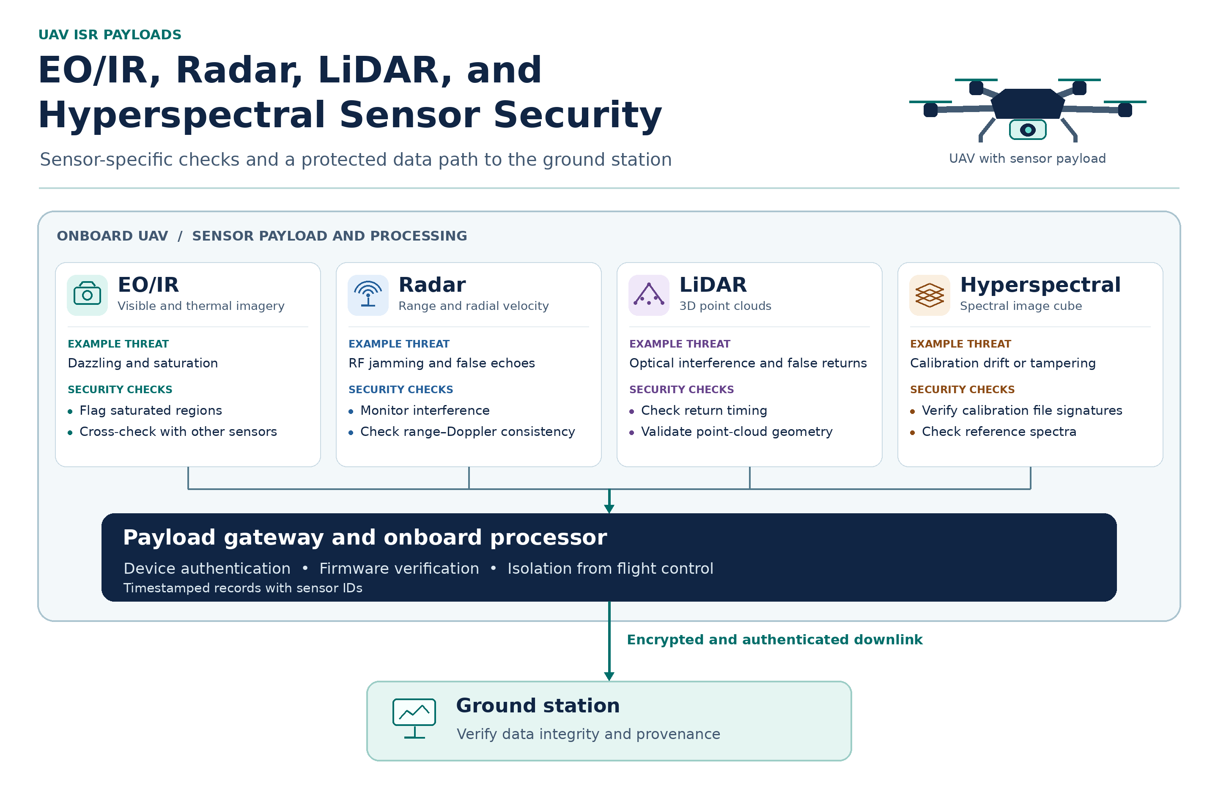
CHAPTER 13 / SUPPLEMENTARY MATERIAL
EO/IR, Radar, LiDAR, and Hyperspectral Sensor Security
Figure S13.2. Sensor security for UAV-based intelligence, surveillance, and reconnaissance (ISR). The schematic pairs EO/IR, radar, LiDAR, and hyperspectral sensors with example threats and validation checks. A shared onboard gateway authenticates devices, verifies firmware, and isolates the payload from flight control. An encrypted and authenticated downlink carries sensor data to the ground station for integrity and provenance checks.
03
Notes:
Firmware verification reference: NIST SP 800-193, Platform Firmware Resiliency Guidelines.

Slide 4
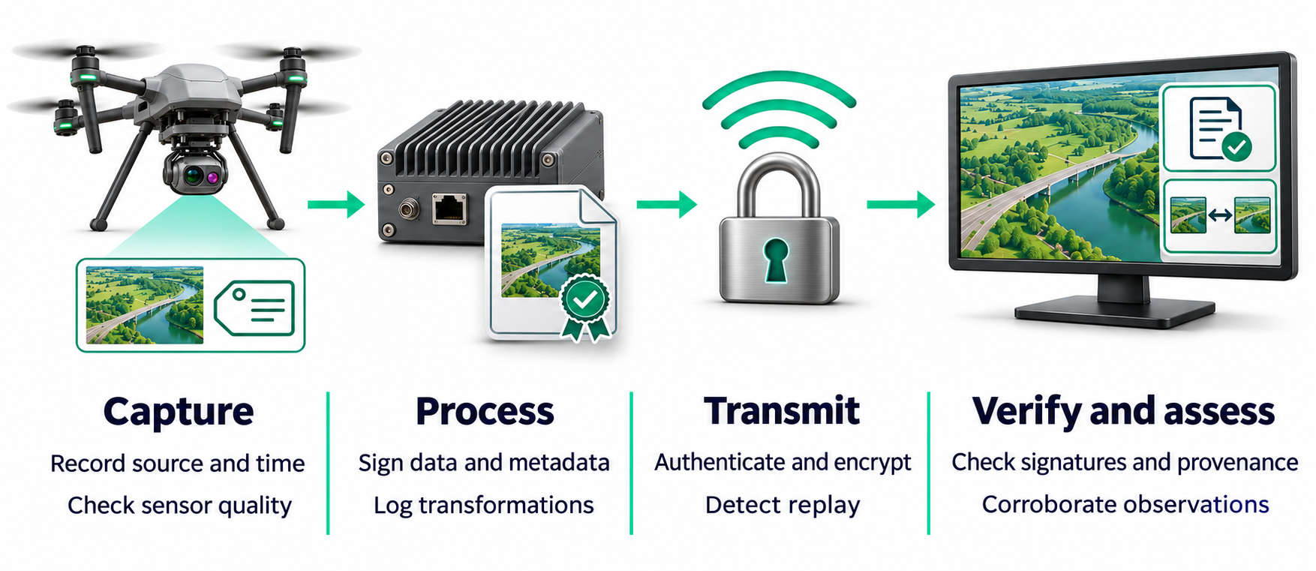
CHAPTER 13 / SUPPLEMENTARY MATERIAL
Data Integrity and Trustworthiness in ISR Pipelines
Figure S13.3. Data integrity and trustworthiness in UAV intelligence, surveillance, and reconnaissance (ISR) pipelines. The UAV records the source and time of capture, signs the data and metadata, and logs processing steps before sending the record over an authenticated, encrypted link. At the ground station, signature and provenance checks verify the digital record, while independent observations help assess the reliability of what the sensor captured.
04

Slide 5
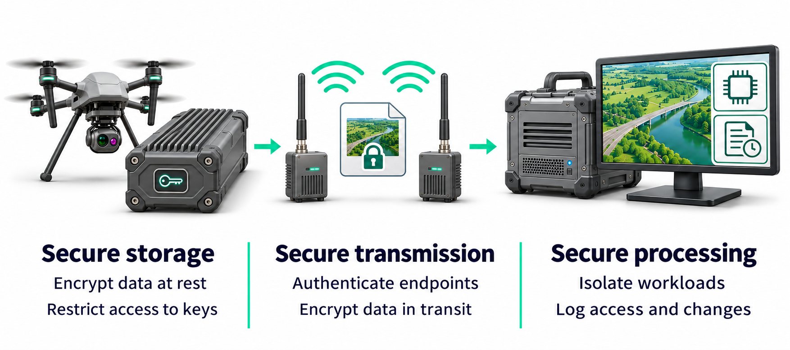
CHAPTER 13 / SUPPLEMENTARY MATERIAL
Secure Storage, Transmission, and Processing of ISR Data
Figure S13.4. Secure storage, transmission, and processing of intelligence, surveillance, and reconnaissance (ISR) data. The UAV encrypts stored sensor data and restricts access to encryption keys. An authenticated, encrypted wireless link protects data in transit. At the ground station, isolated workloads process the imagery, and audit logs record access and changes.
05

Slide 6
CHAPTER 13 / SUPPLEMENTARY MATERIAL
AI-Assisted ISR and Vulnerabilities of Intelligent Perception
Mission scenario
A UAV uses electro-optical (EO) and thermal infrared (IR) cameras to survey an industrial site on an intelligence, surveillance, and reconnaissance (ISR) mission.
Onboard detection
An AI detector identifies vehicles in sensor imagery.
Track fusion
The fusion module combines detections into vehicle tracks.
Ground-station review
The ground station scores each track and decides whether to accept it or send it for operator review.
Compare a weighted score with a rule that also enforces minimum input quality.
06

Slide 7
CHAPTER 13 / SUPPLEMENTARY MATERIAL
AI-Assisted ISR and Vulnerabilities of Intelligent Perception
Weighted trust model
τ(t) = αS(t) + βM(t) + γF(t) + δD(t) + ηC(t)
All inputs lie in [0, 1]. Weights are nonnegative and sum to 1.
Input | Weight | What the input represents
S Sensor quality | 0.25 | Quality of the sensor observations
M Model confidence | 0.25 | Confidence reported by the detector
F Fusion agreement | 0.20 | Apparent agreement among fused inputs
D Metadata validity | 0.15 | Validity of timestamps and source identifiers
C Context consistency | 0.15 | Agreement with independent evidence and mission context
07

Slide 8
CHAPTER 13 / SUPPLEMENTARY MATERIAL
AI-Assisted ISR and Vulnerabilities of Intelligent Perception
Simulated observations
Case | Sensor S | Model M | Fusion F | Metadata D | Context C
A. Nominal | 0.90 | 0.92 | 0.88 | 1.00 | 0.90
B. Sun glare | 0.45 | 0.95 | 0.50 | 0.95 | 0.70
C. Invalid timestamp | 0.92 | 0.96 | 0.89 | 0.30 | 0.85
D. Shared data source | 0.90 | 0.97 | 0.94 | 0.95 | 0.35
In Case D, fusion treats two products from the same EO frame as independent. A separate IR observation provides no corroboration for the track.
08

Slide 9
CHAPTER 13 / SUPPLEMENTARY MATERIAL
AI-Assisted ISR and Vulnerabilities of Intelligent Perception
Student tasks and deliverable
1. Score each track
Compute τ for A–D. Accept when τ ≥ 0.80. Send all other tracks for review.
2. Explain the decisions
Explain why glare can leave model confidence high. Identify which accepted tracks have suspect evidence.
3. Apply minimums
Keep τ ≥ 0.80 and require S ≥ 0.50, D ≥ 0.60, and C ≥ 0.50. Record every failed requirement.
4. Test the weights
For D, shift 0.10 from β to η and recompute τ. Compare reweighting with a context minimum and propose a source-provenance check.
Submit
A table with each score, both decisions, and all review reasons. Add a short paragraph explaining why source independence matters in sensor fusion.
09

Slide 10
CHAPTER 13 / SUPPLEMENTARY MATERIAL
AI-Assisted ISR and Vulnerabilities of Intelligent Perception
Scores and track decisions
Case | Score τ | Score only | With minimums | Reason for review
A | 0.9160 | Accept | Accept | All requirements met
B | 0.6975 | Review | Review | Score and sensor quality
C | 0.8205 | Accept | Review | Metadata validity
D | 0.8505 | Accept | Review | Context consistency
Case D with β = 0.15 and η = 0.25 scores 0.7885 and goes to review.
Glare can obscure vehicle features while leaving patterns the detector associates with vehicles. A context minimum blocks weak corroboration regardless of the total score. Track source-frame IDs to detect shared inputs before fusion.
10

Slide 11
CHAPTER 13 / SUPPLEMENTARY MATERIAL
Mission Resilience for ISR UAV Operations
Mission scenario
In simulation, a UAV surveys a flood-affected area and sends imagery to a ground station to help assess road access.
Command and control
The operator uses a command-and-control (C2) link to supervise the aircraft.
Imagery delivery
A separate payload data link sends imagery. Onboard storage is available if that link degrades.
Mission decisions
At each checkpoint, use five quality scores to assess whether the ISR task can continue.
The thresholds and actions in this exercise apply to the simulated mission.
11

Slide 12

CHAPTER 13 / SUPPLEMENTARY MATERIAL
Mission Resilience for ISR UAV Operations
Mission resilience score
Each quality score ranges from 0 to 1. Higher values indicate better condition.
Quality input | Weight | Meaning
C2 | 0.25 | Availability and reliability of command and control
NAV | 0.25 | Reliability of the navigation estimate
PAY | 0.20 | Ability of the sensor payload to collect usable data
DATA | 0.15 | Timely delivery of ISR products to the ground station
SAFE | 0.15 | Margin relative to simulated flight safety limits
12

Slide 13
CHAPTER 13 / SUPPLEMENTARY MATERIAL
Mission Resilience for ISR UAV Operations
Simulated mission checkpoints
Checkpoint | C2 | NAV | PAY | DATA | SAFE
A. Nominal | 0.95 | 0.95 | 0.90 | 0.95 | 1.00
B. ISR downlink loss | 0.90 | 0.92 | 0.88 | 0.40 | 0.95
C. Navigation degradation | 0.96 | 0.45 | 0.95 | 0.95 | 0.90
D. C2 and safety degrade | 0.55 | 0.93 | 0.95 | 0.90 | 0.55
In B, the imagery downlink degrades while the C2 link remains usable.
In C, navigation quality drops even though the other inputs remain high.
13

Slide 14
CHAPTER 13 / SUPPLEMENTARY MATERIAL
Mission Resilience for ISR UAV Operations
Decision rules and student tasks
1. Score-only rule
Calculate the resilience score for A–D. Mark “continue” if the score is at least 0.80 and “pause” otherwise.
2. Ordered mission rules
Apply the first matching rule in the table. Record the trigger for each checkpoint.
Priority | Condition | Simulated action
1 | C2 < 0.70 or SAFE < 0.80 | End ISR and invoke the contingency mode
2 | NAV < 0.60 or score < 0.80 | Pause ISR and reassess
3 | DATA < 0.60 | Continue limited ISR and buffer imagery
4 | All other cases | Continue ISR as planned
Recalculate C with NAV = 0.76 and all other inputs fixed. Submit scores, both decisions, and the triggers for A–D and the recovery check.
14

Slide 15
CHAPTER 13 / SUPPLEMENTARY MATERIAL
Mission Resilience for ISR UAV Operations
Checkpoint scores and decisions
Case | Score | Score only | Ordered rules | Trigger
A | 0.9475 | Continue | Continue ISR | All requirements met
B | 0.8335 | Continue | Limited ISR | DATA below minimum
C | 0.8200 | Continue | Pause ISR | NAV below minimum
D | 0.7775 | Pause | End ISR | C2 and SAFE below minimum
B continues in limited mode. The UAV buffers imagery while C2 remains usable.
C passes the overall score threshold but pauses because NAV falls below its minimum.
15

Slide 16
CHAPTER 13 / SUPPLEMENTARY MATERIAL
Mission Resilience for ISR UAV Operations
Worked example and recovery
Case C at the degraded checkpoint
0.25 × 0.96 + 0.25 × 0.45 + 0.20 × 0.95 + 0.15 × 0.95 + 0.15 × 0.90
Score = 0.8200. Pause ISR because NAV = 0.45 is below 0.60.
Case C after navigation improves
0.8200 + 0.25 × (0.76 − 0.45) = 0.8975
The recovered score meets the overall threshold and all input minimums. The simulated mission can resume ISR as planned.
16

