Slide 1
CHAPTER 6 / SUPPLEMENTARY MATERIAL
Cyber–Physical Security and
Mission Assurance for
Unmanned Aerial Vehicles
Risk Analysis, Attack Detection, and
Cyber–Physical Monitoring Techniques
Companion figures, risk records, a sensor-consistency example,
and a detector-evaluation exercise
Learning goal: connect monitoring evidence to validated detection performance and mission risk.
Notes:
Scope: retain the four supplied figures and complement them with a risk-record example, a scalar range-consistency calculation, an evaluation protocol, and a practical exercise. Learning objectives: distinguish anomalies from their causes; state uncertainty in sensor consistency tests; evaluate accuracy together with timing and resource overhead; document residual mission risk. All added numerical values are synthetic teaching assumptions. Source illustrations: supplied material_ch6.pptx. Retain original attribution and reuse permissions.

Slide 2
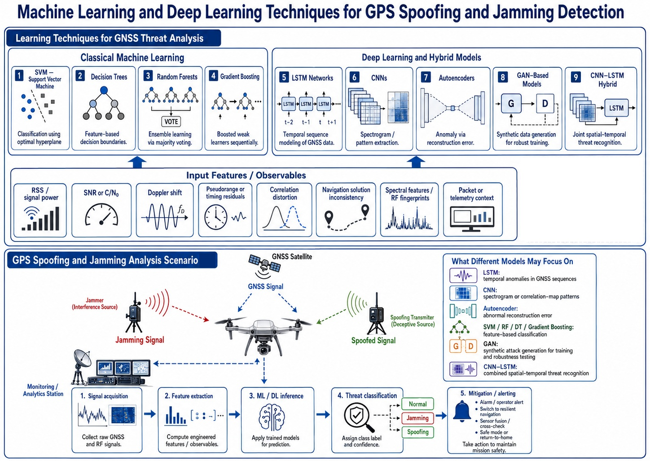
CHAPTER 6 / SUPPLEMENTARY MATERIAL
AI-based detection: models and evidence
Figure S6.1. Feature selection and model choice depend on available signals and test conditions.
An anomaly score or class label requires validation before it supports a response decision.
Conceptual overview. Listed methods and outcomes do not establish measured detection performance.
02
Notes:
The figure lists candidate model families, not proven performance rankings. Compare a learned detector with a simple baseline on the same held-out data. A model output is not automatically a calibrated probability of attack. Model confidence may be unreliable under distribution shift. Autoencoder reconstruction errors can reflect faults, environmental changes, or unfamiliar maneuvers. Synthetic GAN-generated examples do not establish coverage of real attacks. Report which input signals the hardware actually exposes, label provenance, dataset splits, and deployment conditions. Source: https://www.nist.gov/publications/artificial-intelligence-risk-management-framework-ai-rmf-10
Original illustration retained from supplied material_ch6.pptx.

Slide 3
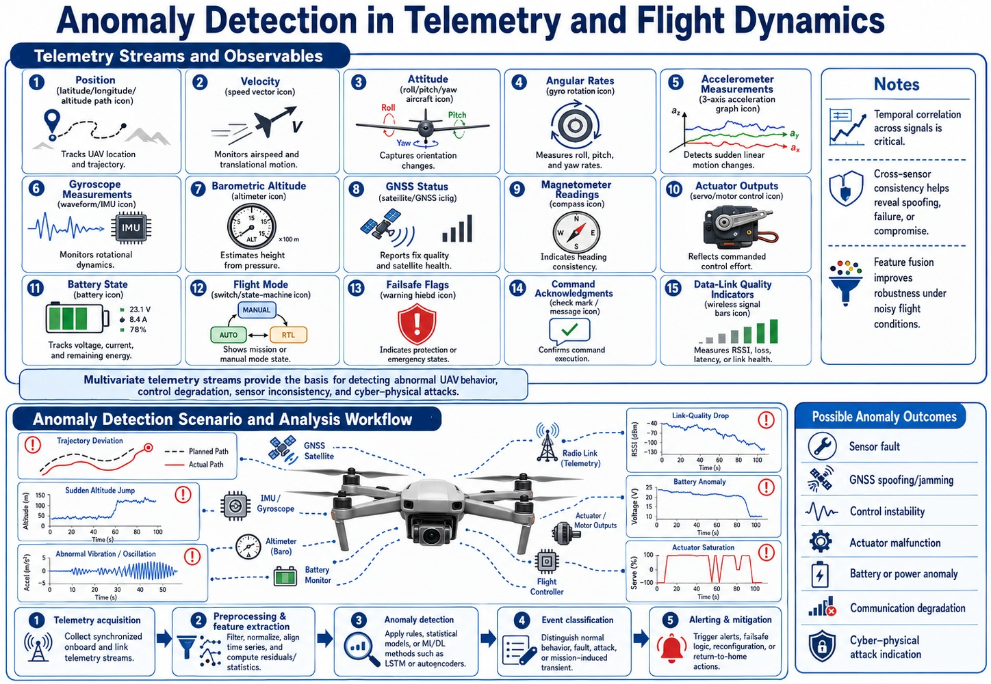
CHAPTER 6 / SUPPLEMENTARY MATERIAL
Telemetry and flight-dynamics anomalies
Figure S6.2. Telemetry monitoring combines timing, vehicle dynamics, and operating context.
Faults, disturbances, stale data, and attacks can produce overlapping symptoms.
Conceptual overview. Listed methods and outcomes do not establish measured detection performance.
03
Notes:
Time-align measurements and commands before comparing them. Account for expected maneuvers, flight mode, reference-frame changes, missing samples, and vehicle dynamics. Avoid treating a command change as proof of unauthorized action without evidence of its origin. Example benign causes include aggressive turns, wind, vibration, poor illumination, sensor saturation, and ordinary link loss. Maintain data-quality flags and separate missing data from valid zero values. Discussion: how would a mode transition alter the expected relationship between commanded and measured velocity?
Original illustration retained from supplied material_ch6.pptx.

Slide 4
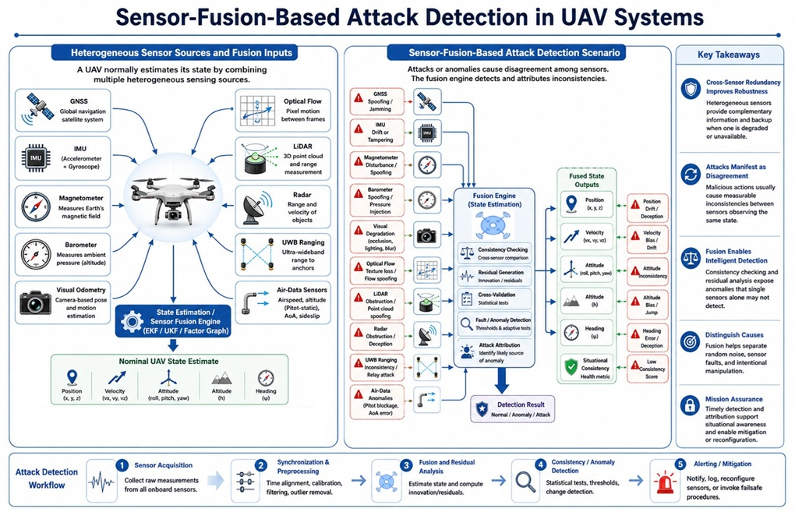
CHAPTER 6 / SUPPLEMENTARY MATERIAL
Sensor fusion and consistency monitoring
Figure S6.3. Cross-sensor residuals can reveal inconsistency when timing and uncertainty are modeled.
Correlated errors or shared failures can reduce the value of redundant sensors.
Conceptual overview. Listed methods and outcomes do not establish measured detection performance.
04
Notes:
Cross-sensor disagreement supports detection of inconsistency, not automatic attribution to a specific attack or sensor. Sensor fusion requires time synchronization, calibrated transforms, units, reference frames, and appropriate uncertainty models. GNSS, inertial, vision, and UWB measurements can share dependencies such as clocks, estimator state, power, or environmental assumptions. Correlated measurements must not be counted as independent evidence. UWB range comparisons require current anchor coordinates and height constraints. A shared bias can remain hidden if all compared channels are affected similarly. The source figure labels several outcomes as attacks; treat these as hypotheses requiring corroboration.
Original illustration retained from supplied material_ch6.pptx.

Slide 5
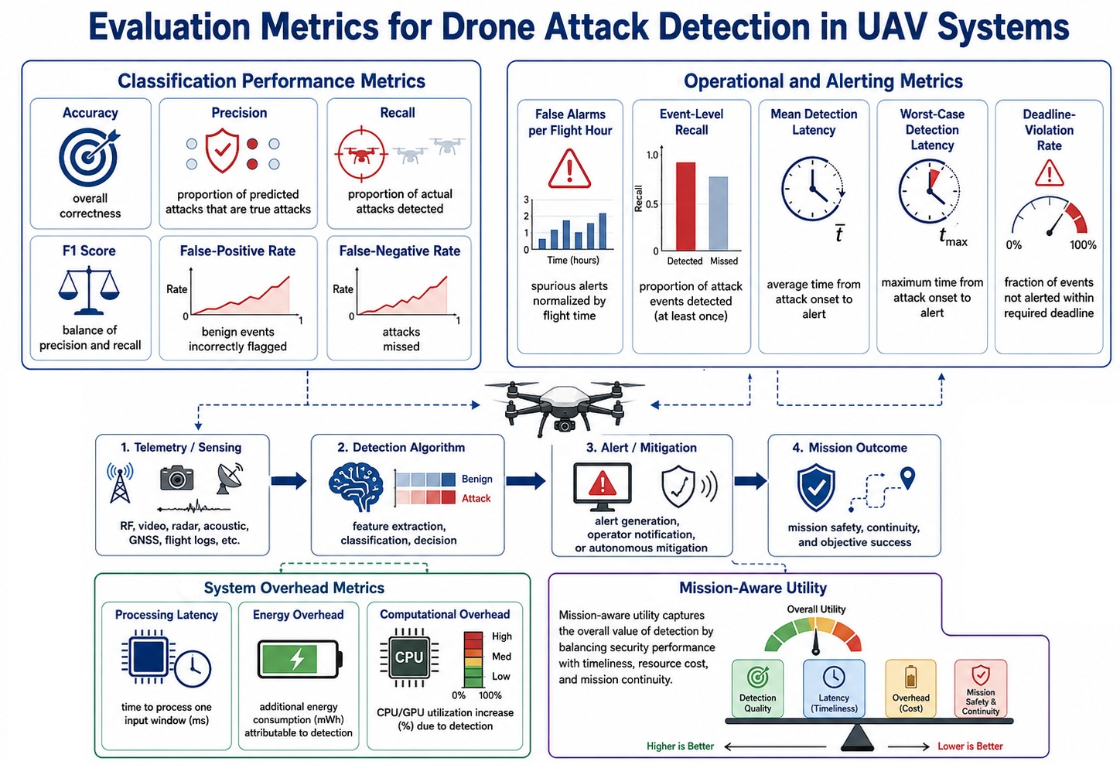
CHAPTER 6 / SUPPLEMENTARY MATERIAL
Detection performance and operational cost
Figure S6.4. Evaluation should combine detection quality, alert timing, false alarms, and resource use.
State event definitions, denominators, test conditions, and the treatment of missed detections.
Conceptual overview. Listed methods and outcomes do not establish measured detection performance.
05
Notes:
The source illustration is a metric overview, not experimental evidence. Accuracy can conceal poor performance on rare attacks. Report event-level detection and false alarms per unit of benign operating time, together with classification metrics where appropriate. Processing latency is distinct from elapsed time between event onset and alert. Report misses and deadline failures explicitly. The largest observed latency is not a proven worst-case bound. Measure incremental energy or power relative to a matched baseline. A mission-utility score requires declared weights and assumptions and does not replace individual metrics. Source: https://www.nist.gov/publications/artificial-intelligence-risk-management-framework-ai-rmf-10 ; https://airc.nist.gov/airmf-resources/airmf/5-sec-core/
Original illustration retained from supplied material_ch6.pptx.

Slide 6
CHAPTER 6 / SUPPLEMENTARY MATERIAL
Risk record: stale Wi-Fi drone commands
Illustrative Wi-Fi drone case: delayed control messages remain in the queue after their useful deadline.
Risk-record field | Illustrative entry | Evidence / review needed
Threat or failure scenario | A delayed or replayed message reaches the command application | Generation and reception times, sequence IDs, and acceptance log
Likelihood assessment | Not estimated from the information in this example | Observed delays, losses, exposure, and a stated confidence rationale
Mission consequence | Stale setpoints or delayed recognition of a degraded C2 link | Vehicle state, command age, watchdog timing, and mode trace
Candidate controls | Authenticated messages, freshness checks, sequencing, and link watchdog | Delayed-message and outage tests with explicit acceptance criteria
Residual risk and owner | To be reviewed after controls are tested in the stated conditions | Remaining failures, accountable reviewer, and retest decision
Likelihood, consequence, and confidence should remain explicit throughout the assessment.
06
Notes:
Author-created Wi-Fi drone risk example. Assume a controller and drone exchange application control messages over a Wi-Fi link. Network delay, application queues, reconnection, or malicious replay may create stale traffic, but these causes require separate evidence. Link encryption and authentication do not by themselves guarantee application timeliness or authorize each command. Application freshness checks depend on a protected generation timestamp or equivalent validity mechanism, session and sequence handling, and a trusted clock-error bound. Define what the local controller does after rejecting stale commands and during link outage. A watchdog timeout and fallback mode must match the vehicle dynamics, navigation validity, and mission context. Do not claim a universal safe return-to-home policy or Wi-Fi deadline. This is a teaching scenario, not measured performance or an identified product vulnerability. Sources: NIST SP 800-30 Rev. 1, https://csrc.nist.gov/pubs/sp/800/30/r1/final ; RFC 7679, https://www.rfc-editor.org/rfc/rfc7679.html ; RFC 4303, https://www.rfc-editor.org/rfc/rfc4303.html (accessed 3 November 2026). ESP is an example of security properties, not a mandated Wi-Fi drone protocol.

Slide 7
CHAPTER 6 / SUPPLEMENTARY MATERIAL
Worked example: Wi-Fi command freshness
Synthetic application timestamps. Assume a verified ±2 ms relative clock-error bound.
Quantity | Assumed value | Meaning
Command generation timestamp | 10.000 s | Protected timestamp from the controller
Drone reception timestamp | 10.085 s | Timestamp at the freshness check
Relative clock-error bound | ±2 ms | Total uncertainty in the time difference
Application freshness limit | 80 ms | Maximum permitted age for this example
Observed age = (10.085 − 10.000) s = 85 ms
True command age lies between 83 ms and 87 ms
Minimum age = 83 ms > 80 ms freshness limit
Reject this stale command. The timing result alone does not establish an attack.
07
Notes:
All values are synthetic teaching assumptions. The controller generation timestamp is 10.000 s and the receiving-drone timestamp at the application freshness check is 10.085 s. Their difference is 0.085 s, or 85 ms. A verified total relative clock-error bound of ±2 ms gives a true age interval of 83 to 87 ms, assuming negligible or separately included timestamp-capture uncertainty. The entire interval exceeds the illustrative 80 ms application freshness limit, so this command fails the freshness rule. This is application message age, not a claim about radio airtime or pure network one-way delay. Treat timestamp capture, processing delay, drift, clock resets, and session changes explicitly. In a GPS-denied system the clock-error bound must come from a trusted alternative timing arrangement and be maintained during the observation interval. A timestamp must be integrity protected and its sender authorized. Freshness complements session/sequence checks and does not by itself establish authenticity or stop RF interference. On rejecting a command, the local controller follows a separately validated fallback policy. The 80 ms limit is not a universal Wi-Fi drone requirement. Thresholds and observed age do not prove hostile intent. Source for clock uncertainty and measurement boundaries: RFC 7679, https://www.rfc-editor.org/rfc/rfc7679.html . Security-property background: RFC 4303, https://www.rfc-editor.org/rfc/rfc4303.html (accessed 3 November 2026).

Slide 8
CHAPTER 6 / SUPPLEMENTARY MATERIAL
Detector evaluation and reporting protocol
Freeze the detector and its thresholds before final testing. Keep test flights separate from development data.
Evaluation area | Record and report | Pitfall to avoid
Data and generalization | Split by flight or session, record conditions, labels, and model version | Overlapping windows from one flight in both training and testing
Detection and false alarms | Event recall, precision, false alarms per benign flight hour, and counts | High accuracy dominated by normal data or duplicate alerts
Timing and mission behavior | Event onset, alert time, misses, deadline failures, and state changes | Reporting only processing time or ignoring missed detections
Compute and energy | Target hardware, load, incremental power, energy, and baseline | Comparing unmatched workloads or confusing power with energy
Assess expected maneuvers and unseen conditions, then report uncertainty and the limits of the test set.
08
Notes:
Teaching protocol informed by NIST AI RMF measurement principles: https://www.nist.gov/publications/artificial-intelligence-risk-management-framework-ai-rmf-10 ; https://airc.nist.gov/airmf-resources/airmf/5-sec-core/ . Specific flight/session split and leakage checks are author recommendations for this time-series setting. Fit scaling, feature selection, and thresholds only on development data. Preserve a final untouched test set. Correlated windows are not independent repeated trials. State the unit of analysis and estimate uncertainty at the appropriate level, for example flight or event. Include benign faults and environmental changes to examine specificity. Report time-to-alert only with the treatment of misses stated. Energy example for teaching: an incremental 1.8 W for 20 minutes adds 1.8×(20/60)=0.60 Wh. Relative to a 60 Wh battery this is 1% of nominal stored energy, not necessarily a 1% loss of flight time because propulsion and other loads vary. Measure on the deployment hardware, not only a desktop training system.

Slide 9
CHAPTER 6 / SUPPLEMENTARY MATERIAL
Practical exercise: monitoring and risk review
Use a repeatable simulator or recorded dataset with known labels, independent reference data, and a benign baseline.
1. Baseline and hypothesis
Select one monitored quantity. Record normal variation, data quality, and the mission consequence.
2. Controlled comparison
Compare a benign maneuver, a sensor fault, and a simulated stale-data or navigation anomaly.
3. Detection evaluation
Measure residuals, alerts, missed events, false alarms, time-to-alert, and resource overhead.
4. Risk and response review
Explain what the detector establishes. Validate a bounded fallback and record remaining uncertainty.
Deliverable: a labeled event log, detector report, and risk record with a justified response policy.
09
Notes:
Suggested UWB example: a target estimator uses current and stale anchor-reference revisions in separate simulated runs. Compare them against a benign moving-anchor transition and an ordinary noisy-range case. Log acquisition times, update age, reference revision, geometry, range residuals, estimator validity, controller mode, and independent ground truth. Keep a frozen test configuration and repeat under held-out conditions. Avoid attributing a threshold crossing to malicious activity without additional evidence. Response options must depend on available navigation and the mission context. Reducing speed, pausing reference updates, or entering a degraded mode are candidate policies for evaluation, not universal safe actions. Sources for risk review and ongoing monitoring: https://csrc.nist.gov/pubs/sp/800/30/r1/final ; https://csrc.nist.gov/pubs/sp/800/137/final .

Slide 10
CHAPTER 6 / SUPPLEMENTARY MATERIAL
References and terminology
Primary references support risk analysis, AI evaluation, and continuous-monitoring principles.
NIST SP 800-30r1
Guide for Conducting Risk Assessments (2012).
csrc.nist.gov/pubs/sp/800/30/r1/final
NIST AI 100-1
Artificial Intelligence Risk Management Framework, AI RMF 1.0 (2023).
www.nist.gov/publications/artificial-intelligence-risk-management-framework-ai-rmf-10
NIST AIRC
AI RMF Core. MEASURE function and evaluation documentation.
airc.nist.gov/airmf-resources/airmf/5-sec-core/
NIST SP 800-137
Information Security Continuous Monitoring (2011).
csrc.nist.gov/pubs/sp/800/137/final
GNSS: global navigation satellite system IMU: inertial measurement unit UWB: ultra-wideband
Residual: observation minus prediction W: power Wh: energy
10
Notes:
Full references, accessed 3 November 2026:
risk: https://csrc.nist.gov/pubs/sp/800/30/r1/final
ai: https://www.nist.gov/publications/artificial-intelligence-risk-management-framework-ai-rmf-10
measure: https://airc.nist.gov/airmf-resources/airmf/5-sec-core/
monitor: https://csrc.nist.gov/pubs/sp/800/137/final
The references provide general principles rather than UAS certification or detector-performance claims. The scalar residual calculation, risk example, energy example, and exercise are newly authored teaching material. They do not report experimental results. Original artwork: supplied material_ch6.pptx. Original illustrations remain raster images. Added headings, captions, tables, and teaching content remain editable.

