Slide 1
CHAPTER 2 / SUPPLEMENTARY MATERIAL
Cyber–Physical Security and
Mission Assurance for
Unmanned Aerial Vehicles
Airspace Cybersecurity:
Attack Taxonomy and Real-World Incidents
Companion figures: threat classification, passive observation,
navigation interference, and multi-UAV coordination
Conceptual scenarios support the chapter discussion. These figures do not document specific incidents.
Notes:
Purpose: support Chapter 2 with a classification guide and conceptual threat figures. Learning objectives: distinguish observation, interference, and manipulation; identify affected interfaces; connect threats to mission consequences. The supplied deck contains no incident records, so this supplement makes no claims about particular incidents. Original diagrams originate from the supplied material_ch2.pptx. Illustration authorship and reuse permissions remain those of the source material.

Slide 2
CHAPTER 2 / SUPPLEMENTARY MATERIAL
Airspace attack taxonomy
Threat classes overlap. A single event can affect several interfaces and mission functions.
Threat class | Exposed interface / examples | Potential mission consequence
Passive observation | RF links, metadata, imagery Eavesdropping and traffic analysis | Disclosure of data or operating patterns
Communication disruption | C2, telemetry, inter-UAV links Interference and denial of service | Delayed commands, lost links, or reduced coordination
Navigation deception | GNSS receiver and PNT inputs Spoofing and meaconing / replay | Incorrect position or time, route deviation
System or data compromise | Mission plans, software, shared state Waypoint or telemetry manipulation | Unauthorized behavior or corrupted situational awareness
Swarm coordination attacks | Leader, membership, consensus Impersonation and false shared data | Formation errors, inconsistent decisions, or mission interruption
Classification guide: the interface, mechanism, and observed consequence should be recorded separately.
C2: command and control PNT: positioning, navigation, and timing
02
Notes:
Editorial synthesis of the threat families in the supplied deck. The categories are not mutually exclusive and are not a standardized exhaustive taxonomy. Passive observation can support reconnaissance without changing the aircraft state. Unintentional interference can resemble deliberate disruption. A mission consequence alone does not establish attacker identity or intent. Discussion: select one scenario and identify the exposed interface, required evidence, and possible alternative explanations. GNSS background: FAA, Global Navigation Satellite System Interference Resource Guide, https://www.faa.gov/about/office_org/headquarters_offices/avs/offices/afx/afs/afs400/afs410/GNSS (accessed 3 November 2026).

Slide 3
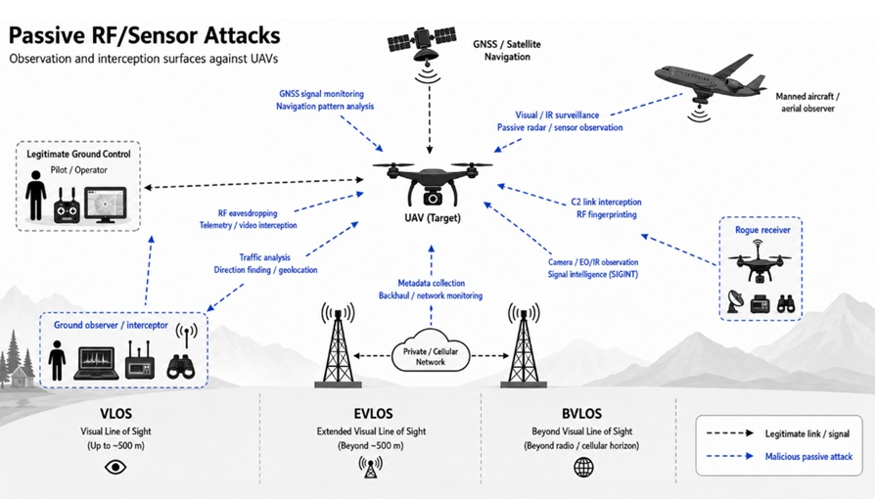
CHAPTER 2 / SUPPLEMENTARY MATERIAL
Passive RF and sensor observation
Figure S2.1. Passive collection can reveal communications, location, and operating patterns.
Observation alone does not demonstrate control of the aircraft.
Black dashed links: legitimate signals. Blue dashed paths: conceptual observation or interception.
03
Notes:
Passive observation involves reception or sensing rather than deliberate alteration of transmitted data. RF fingerprinting is a possible identification aid, not conclusive attribution. The blue paths denote exposure relationships, not literal packet direction. The source figure includes the label “GNSS signal monitoring”; reception of satellite signals by itself does not reveal a specific target’s receiver position. Geolocation requires observations of target emissions or other target-specific evidence. Discussion: which information could an observer collect from encrypted traffic without reading its payload?
Source illustration: supplied material_ch2.pptx. Original artwork retained with display cropping. The original lower operation-mode strip has been omitted because it implies universal distance boundaries. VLOS depends on continuous unaided visual contact, rather than a fixed 400 ft altitude or 500 m distance. BVLOS describes an operation outside VLOS and does not require cellular or satellite service or a position beyond the radio horizon. EVLOS is a legacy term in these source figures. EASA SORA 2.5 uses BVLOS with airspace observer (AO). Sources: EASA Easy Access Rules for UAS, June 2026, https://www.easa.europa.eu/en/document-library/easy-access-rules/easy-access-rules-unmanned-aircraft-systems ; EASA Explanatory Note to ED Decision 2025/018/R, https://www.easa.europa.eu/sites/default/files/dfu/explanatory_note_to_ed_decision_2025-018-r.pdf (accessed 3 November 2026).

Slide 4
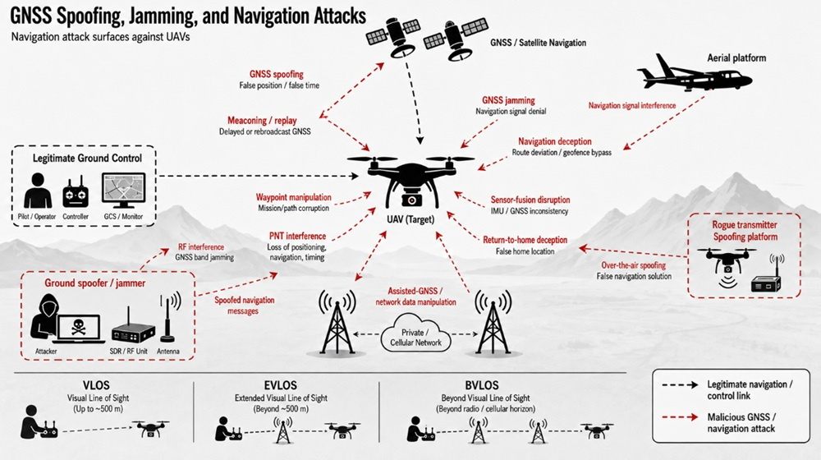
CHAPTER 2 / SUPPLEMENTARY MATERIAL
GNSS interference and navigation manipulation
Figure S2.2. Jamming can deny GNSS reception. Spoofing can corrupt position or time.
Waypoint manipulation requires a separate compromised interface.
Black dashed links: legitimate signals. Red dashed paths: conceptual interference or manipulation.
04
Notes:
Distinguish RF jamming, deceptive GNSS signals, and software or mission-data manipulation. Meaconing refers to reception and rebroadcast of navigation signals, potentially with delay. Waypoint changes and return-to-home parameter changes are distinct from over-the-air GNSS spoofing, although their effects can interact. Sensor inconsistencies and degraded performance support diagnosis but do not independently prove malicious intent. Discussion: what independent measurements would help distinguish GNSS denial from an incorrect navigation solution? GNSS definitions and operational effects: FAA, Global Navigation Satellite System Interference Resource Guide, https://www.faa.gov/about/office_org/headquarters_offices/avs/offices/afx/afs/afs400/afs410/GNSS (accessed 3 November 2026).
Source illustration: supplied material_ch2.pptx. Original artwork retained with display cropping. The original lower operation-mode strip has been omitted because it implies universal distance boundaries. VLOS depends on continuous unaided visual contact, rather than a fixed 400 ft altitude or 500 m distance. BVLOS describes an operation outside VLOS and does not require cellular or satellite service or a position beyond the radio horizon. EVLOS is a legacy term in these source figures. EASA SORA 2.5 uses BVLOS with airspace observer (AO). Sources: EASA Easy Access Rules for UAS, June 2026, https://www.easa.europa.eu/en/document-library/easy-access-rules/easy-access-rules-unmanned-aircraft-systems ; EASA Explanatory Note to ED Decision 2025/018/R, https://www.easa.europa.eu/sites/default/files/dfu/explanatory_note_to_ed_decision_2025-018-r.pdf (accessed 3 November 2026).

Slide 5
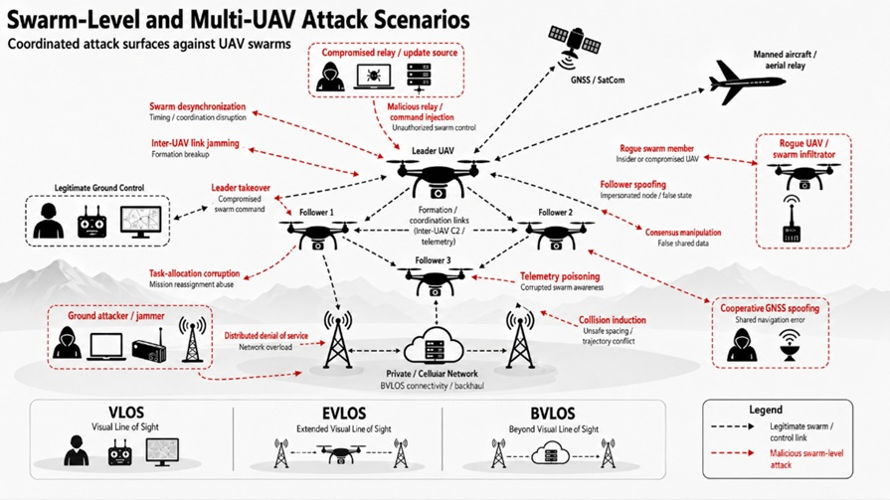
CHAPTER 2 / SUPPLEMENTARY MATERIAL
Swarm and multi-UAV coordination threats
Figure S2.3. Corrupted links, identities, or shared state can affect formation and task allocation.
The impact depends on the coordination protocol and available fallback behavior.
Black dashed links: legitimate coordination. Red dashed paths: conceptual threat relationships.
05
Notes:
The figure presents possible threat relationships rather than a demonstrated attack sequence. Leader takeover presumes a compromised control or identity interface. Consensus manipulation depends on the actual protocol and trust model. Formation errors can also result from ordinary packet loss, sensing error, or control limitations. Discussion: which decisions depend on a leader, and which could continue using independent local observations?
Source illustration: supplied material_ch2.pptx. Original artwork retained with display cropping. The original lower operation-mode strip has been omitted because it implies universal distance boundaries. VLOS depends on continuous unaided visual contact, rather than a fixed 400 ft altitude or 500 m distance. BVLOS describes an operation outside VLOS and does not require cellular or satellite service or a position beyond the radio horizon. EVLOS is a legacy term in these source figures. EASA SORA 2.5 uses BVLOS with airspace observer (AO). Sources: EASA Easy Access Rules for UAS, June 2026, https://www.easa.europa.eu/en/document-library/easy-access-rules/easy-access-rules-unmanned-aircraft-systems ; EASA Explanatory Note to ED Decision 2025/018/R, https://www.easa.europa.eu/sites/default/files/dfu/explanatory_note_to_ed_decision_2025-018-r.pdf (accessed 3 November 2026).

