Slide 1
CHAPTER 3 / SUPPLEMENTARY MATERIAL
Cyber–Physical Security and
Mission Assurance for
Unmanned Aerial Vehicles
Threat Modeling and Security
Assessment Methodologies for UAS
Learning goal: connect system interfaces to threats, controls, and verifiable evidence.
Notes:
Scope: supplement Chapter 3 with four source figures and five complementary teaching slides. Students should identify trust boundaries, classify plausible threats, distinguish scoring from evidence, and propose validation criteria. The UWB case is an illustrative assessment exercise, not a report of demonstrated attacks or verified prototype security. Artwork source: supplied material_ch3.pptx. Retain the source artwork attribution and permissions.

Slide 2
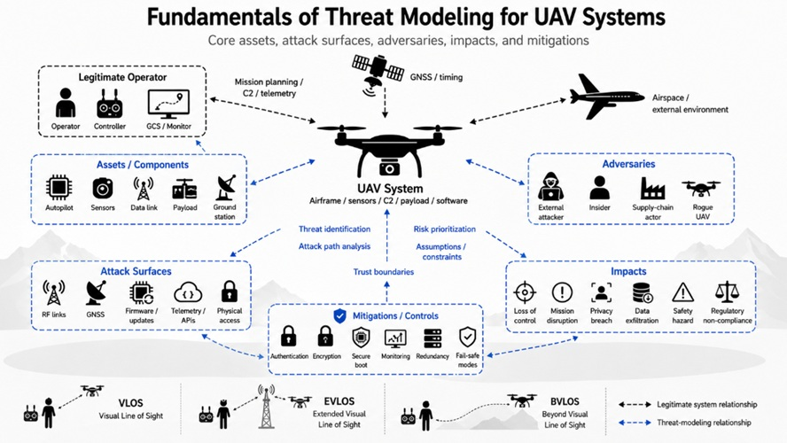
CHAPTER 3 / SUPPLEMENTARY MATERIAL
Threat-modeling fundamentals
Figure S3.1. A threat model relates assets, exposed interfaces, adversary assumptions,
mission consequences, and controls. Its scope determines what the assessment can claim.
Conceptual relationships, not a demonstrated attack sequence. Teaching notes expand the assessment questions.
02
Notes:
The original caption described active RF attacks, but the illustration actually summarizes a threat model. Start with mission goals, architecture, assets, assumptions, and trust boundaries. Then identify threats and evaluate controls. Threat models require updates when system architecture or deployment changes. Question: which assumptions would change when a direct radio link becomes a network-mediated link?
Operational context: VLOS depends on continuous unaided visual contact, not a universal distance. BVLOS does not specify a communication technology. EVLOS is legacy terminology in these illustrations. EASA SORA 2.5 uses BVLOS with an airspace observer. Source: https://www.easa.europa.eu/sites/default/files/dfu/explanatory_note_to_ed_decision_2025-018-r.pdf (accessed 3 November 2026). Original lower operation-mode strip omitted from display. Original illustration retained from material_ch3.pptx.

Slide 3
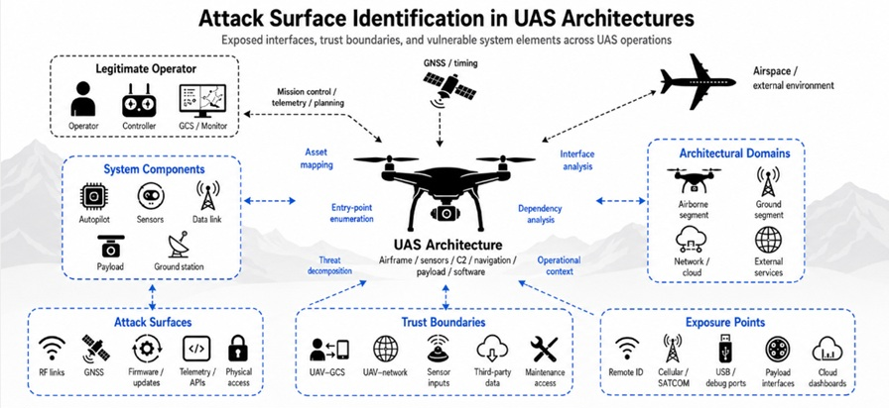
CHAPTER 3 / SUPPLEMENTARY MATERIAL
Attack surfaces and trust boundaries
Figure S3.2. Attack surfaces are exposed interfaces. Trust boundaries mark changes
in authority or trust assumptions. Inventory both before selecting test cases.
Conceptual relationships, not a demonstrated attack sequence. Teaching notes expand the assessment questions.
03
Notes:
A trust boundary represents a change in trust or authority, not merely a physical separation or RF coverage boundary. Enumerate data flows, identities, keys, privileges, maintenance paths, and third-party dependencies. A broadcast interface such as Remote ID is not automatically a control channel or a vulnerability. Question: which interface allows data to cross from a payload processor into the flight-control domain?
Operational context: VLOS depends on continuous unaided visual contact, not a universal distance. BVLOS does not specify a communication technology. EVLOS is legacy terminology in these illustrations. EASA SORA 2.5 uses BVLOS with an airspace observer. Source: https://www.easa.europa.eu/sites/default/files/dfu/explanatory_note_to_ed_decision_2025-018-r.pdf (accessed 3 November 2026). Original lower operation-mode strip omitted from display. Original illustration retained from material_ch3.pptx.

Slide 4
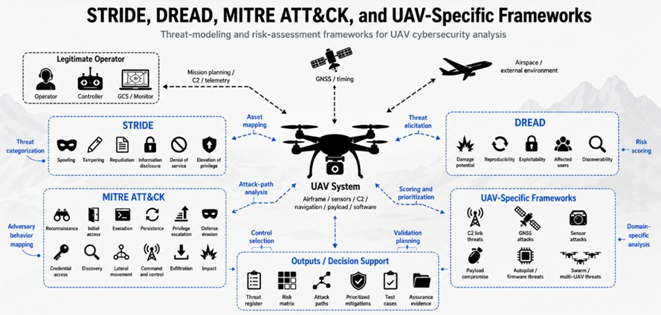
CHAPTER 3 / SUPPLEMENTARY MATERIAL
Threat-analysis methods and assessment outputs
Figure S3.3. STRIDE supports threat categorization. DREAD supports relative scoring.
ATT&CK describes adversary behavior. Each requires adaptation to the UAS architecture.
Conceptual relationships, not a demonstrated attack sequence. Teaching notes expand the assessment questions.
04
Notes:
The original illustration combines different methods. They are complementary, not interchangeable certification schemes. STRIDE expands to Spoofing, Tampering, Repudiation, Information disclosure, Denial of service, and Elevation of privilege. DREAD expands to Damage potential, Reproducibility, Exploitability, Affected users, and Discoverability. Define scoring criteria before scoring. ATT&CK mappings require an applicable platform and evidence. Do not imply a specific official UAS ATT&CK matrix or a single universal UAV framework. Sources: https://learn.microsoft.com/en-us/windows-hardware/drivers/driversecurity/threat-modeling-for-drivers ; https://attack.mitre.org/resources/faq/
Operational context: VLOS depends on continuous unaided visual contact, not a universal distance. BVLOS does not specify a communication technology. EVLOS is legacy terminology in these illustrations. EASA SORA 2.5 uses BVLOS with an airspace observer. Source: https://www.easa.europa.eu/sites/default/files/dfu/explanatory_note_to_ed_decision_2025-018-r.pdf (accessed 3 November 2026). Original lower operation-mode strip omitted from display. Original illustration retained from material_ch3.pptx.

Slide 5
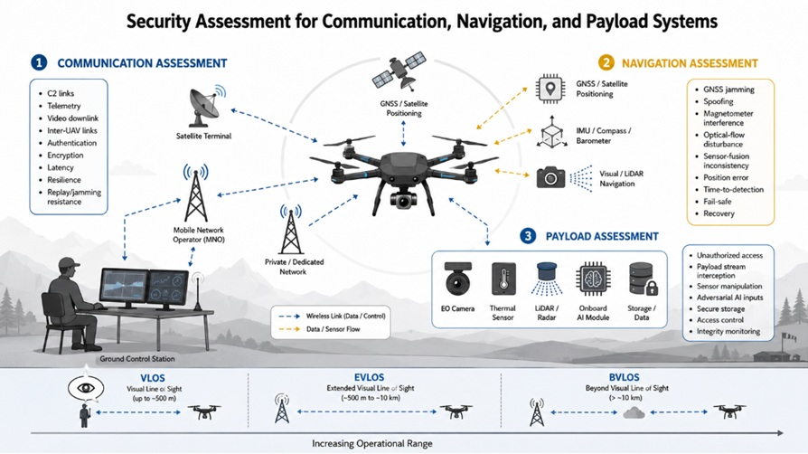
CHAPTER 3 / SUPPLEMENTARY MATERIAL
Communication, navigation, and payload assessment
Figure S3.4. Subsystem tests should measure mission effects and recovery behavior.
Dependencies can allow a failure in one subsystem to affect another.
Conceptual relationships, not a demonstrated attack sequence. Teaching notes expand the assessment questions.
05
Notes:
The image is a conceptual assessment overview. Check command authentication and message freshness, navigation consistency and fallback, payload access boundaries, and shared computing dependencies. Encryption does not prevent RF jamming. Sensor disagreement alone does not prove malicious deception. The source figure assigns fixed distance bands to VLOS, EVLOS, and BVLOS; those bands are omitted because they are not universal definitions. Question: can payload processing overload delay the navigation estimator or control loop?
Operational context: VLOS depends on continuous unaided visual contact, not a universal distance. BVLOS does not specify a communication technology. EVLOS is legacy terminology in these illustrations. EASA SORA 2.5 uses BVLOS with an airspace observer. Source: https://www.easa.europa.eu/sites/default/files/dfu/explanatory_note_to_ed_decision_2025-018-r.pdf (accessed 3 November 2026). Original lower operation-mode strip omitted from display. Original illustration retained from material_ch3.pptx.

Slide 6
CHAPTER 3 / SUPPLEMENTARY MATERIAL
Method selection and limits
The assessment question determines the method and the evidence it needs.
Method | Useful output | Limit to record
STRIDE | Threat categories applied to interfaces and data flows | Does not establish likelihood or demonstrate exploitability
DREAD | Relative prioritization using explicit scoring criteria | Subjective scores need rationale and uncertainty, not false precision
MITRE ATT&CK | Behavior descriptions and supported technique mappings | Platform coverage may leave gaps for RF and physical UAS effects
UAS-specific assessment | Mission consequences, dependencies, and testable control requirements | Document the chosen method and its validation evidence
A category, a priority score, and a successful test answer different questions.
06
Notes:
Sources: Microsoft STRIDE and DREAD overview, https://learn.microsoft.com/en-us/windows-hardware/drivers/driversecurity/threat-modeling-for-drivers ; MITRE ATT&CK FAQ, https://attack.mitre.org/resources/faq/ ; NIST SP 800-30 Rev. 1, https://csrc.nist.gov/pubs/sp/800/30/r1/final . Accessed 3 November 2026. DREAD is presented because it appears in the chapter source, not as a mandatory or current universal standard. Preserve separate likelihood and impact judgments, assumptions, and confidence. Adapting a framework to UAS requires explicit mappings and documented omissions. Discussion: why could two assessors assign different priorities to the same exposed interface?

Slide 7
CHAPTER 3 / SUPPLEMENTARY MATERIAL
Worked example: cooperative UWB positioning
Scope and assets
Target estimate, anchor coordinates, range records, update timing, and navigation commands.
Trust boundaries
Anchor-to-target messages, reference-position entry, dashboard access, and estimator-to-controller output.
Threat hypothesis
An incorrect or stale anchor update enters the estimator and distorts the reference geometry.
Candidate controls
Authenticated updates, freshness checks, coordinate validation, and an explicit safe pause during relocation.
Assumptions: test access is authorized, anchor references are externally established, and height constraints are known.
07
Notes:
Worked example is an author-created teaching scenario. It does not assert that the supplied prototype implements or lacks any particular security control. Two ranges alone do not uniquely determine an unrestricted 3D position. The assessment must state additional constraints, independently known anchor coordinates, altitude information, motion priors, or additional observations. Authentication can establish message origin and integrity but cannot establish that an authenticated coordinate is physically correct. DWM3000 radio capabilities do not establish end-to-end application security. Suggested workflow: draw the actual data flows, identify who can update each reference, list stale-data cases, and review how the estimator and controller handle invalid geometry.

Slide 8
CHAPTER 3 / SUPPLEMENTARY MATERIAL
Evidence and acceptance criteria
Define measurable criteria before testing. Set the thresholds below for the chosen mission.
Assessment case | Evidence to collect | Example acceptance rule
Stale anchor update | Timestamp, sequence, accepted state, and estimator input trace | Reject data older than T_max or enter a defined degraded mode
Incorrect coordinate update | Submitted reference, validation result, reference revision, and operator log | Reject updates outside the configured operating envelope
Anchor-link interruption | Valid-range count, outage duration, mode transitions, and recovery time | Declare degraded localization within T_detect and apply fallback
Positioning performance | Independent ground truth, error series, validity flags, and geometry | 95th-percentile error ≤ E_max within a declared operating domain
Course parameters: T_max = data-age limit, T_detect = detection deadline, E_max = permitted position error.
08
Notes:
These are proposed assessment cases and acceptance templates, not empirical measurements. Select all limits before the experiment and justify them using mission needs, estimator update rate, vehicle dynamics, and required safety margin. If the project uses 0.30 m as a desired accuracy target, it may set E_max to 0.30 m for a declared error statistic and operating domain, but that choice does not demonstrate achieved accuracy. Record outages and unavailable estimates separately to avoid reporting error only for successful samples. Keep application security checks distinct from RF-ranging accuracy. Independently verify anchor reference coordinates and ground-truth synchronization.

Slide 9
CHAPTER 3 / SUPPLEMENTARY MATERIAL
Practical exercise: threat register and review
Objective: produce a traceable assessment for one communication, navigation, or payload interface.
1. System definition
Identify the mission, architecture, protected assets, and assumptions.
2. Threat register
For each interface, state the threat, precondition, consequence, and current control.
3. Priority and confidence
Explain likelihood and impact separately. Record evidence gaps and uncertainty.
4. Validation and decision
Define a test, acceptance criterion, owner, and residual-risk review.
Deliverable: one annotated architecture, a threat register, and a short evidence-based review.
09
Notes:
Suggested register columns: ID, asset/interface, trust boundary, threat statement, precondition, mission consequence, existing control, likelihood rationale, impact rationale, confidence, proposed action, validation evidence, owner, and residual risk. Use qualitative scales with explicit anchors or another documented method. Reassess after controls are tested rather than assuming a proposed control eliminates risk. Review prompts: Which evidence would falsify your threat hypothesis? What benign failure could produce the same symptom? Who can accept the residual risk? Basis: NIST SP 800-30 Rev. 1, https://csrc.nist.gov/pubs/sp/800/30/r1/final .

Slide 10
CHAPTER 3 / SUPPLEMENTARY MATERIAL
References and terminology
Primary references support the method descriptions and operational-context notes.
Microsoft
Threat Modeling for Drivers. STRIDE categories and DREAD approach.
learn.microsoft.com/en-us/windows-hardware/drivers/driversecurity/threat-modeling-for-drivers
MITRE
ATT&CK FAQ. Tactics, techniques, and use of the knowledge base.
attack.mitre.org/resources/faq/
NIST
SP 800-30 Rev. 1, Guide for Conducting Risk Assessments (2012).
csrc.nist.gov/pubs/sp/800/30/r1/final
EASA
Explanatory Note to ED Decision 2025/018/R (2025).
SORA 2.5 terminology: BVLOS with airspace observer.
UAS: unmanned aircraft system GCS: ground control station C2: command and control
PNT: positioning, navigation, and timing UWB: ultra-wideband
10
Notes:
Full source URLs, accessed 3 November 2026:
ms: https://learn.microsoft.com/en-us/windows-hardware/drivers/driversecurity/threat-modeling-for-drivers
mitre: https://attack.mitre.org/resources/faq/
nist: https://csrc.nist.gov/pubs/sp/800/30/r1/final
easa: https://www.easa.europa.eu/sites/default/files/dfu/explanatory_note_to_ed_decision_2025-018-r.pdf
Source figures: supplied material_ch3.pptx. Added comparisons, example, and exercises are teaching material rather than reported experimental results. Original illustrations remain raster images. New headings, captions, tables, and teaching content are editable.

