Slide 1
CHAPTER 5 / SUPPLEMENTARY MATERIAL
Cyber–Physical Security and
Mission Assurance for
Unmanned Aerial Vehicles
Intelligence Gathering, Red Teaming,
and Adversarial Assessment of UAS
Companion figures, evidence interpretation, detection metrics,
and a collaborative assessment exercise
Learning goal: produce defensible findings from a scoped and repeatable security assessment.
Notes:
This supplement retains the five supplied Chapter 5 figures and adds five teaching slides. Learning objectives: scope an assessment, distinguish observations from inferences, explain red/blue/purple roles, calculate detection metrics, and report test evidence and limitations. Numerical examples are synthetic. None of these figures establishes that a particular incident or attack occurred. Source artwork: material_ch5.pptx. Retain source attribution and reuse permissions.

Slide 2
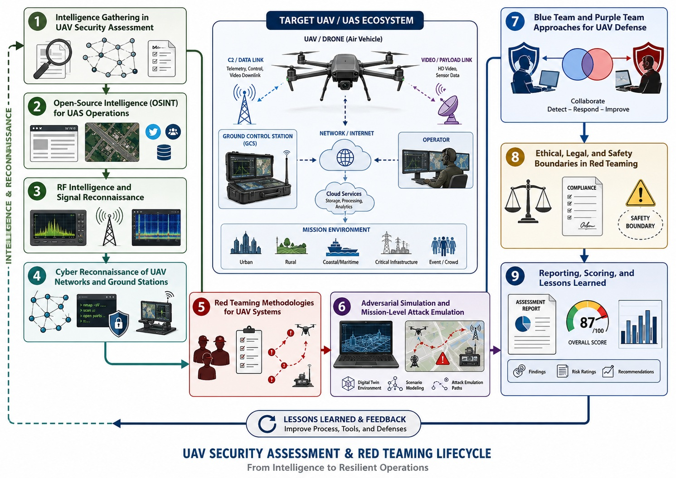
CHAPTER 5 / SUPPLEMENTARY MATERIAL
UAS security assessment lifecycle
Figure S5.1. Planning, collection, analysis, controlled testing, and reporting form an iterative
assessment. Findings should connect observations to mission consequences and corrective action.
Source illustration is conceptual. Teaching notes identify assumptions, terminology, and evidence limits.
02
Notes:
Assessment scope and rules of engagement precede technical testing. Define assets, permitted techniques, exclusions, contacts, data handling, stop conditions, and restoration. The source illustration shows an overall score as an example graphic; it is not a measured result or a universal security scale. Map reconnaissance observations to explicit hypotheses and then seek evidence that could confirm or refute them. Assessment completion requires documented limitations and retesting after changes. Source: https://csrc.nist.gov/pubs/sp/800/115/final
Original illustration retained from supplied material_ch5.pptx.

Slide 3
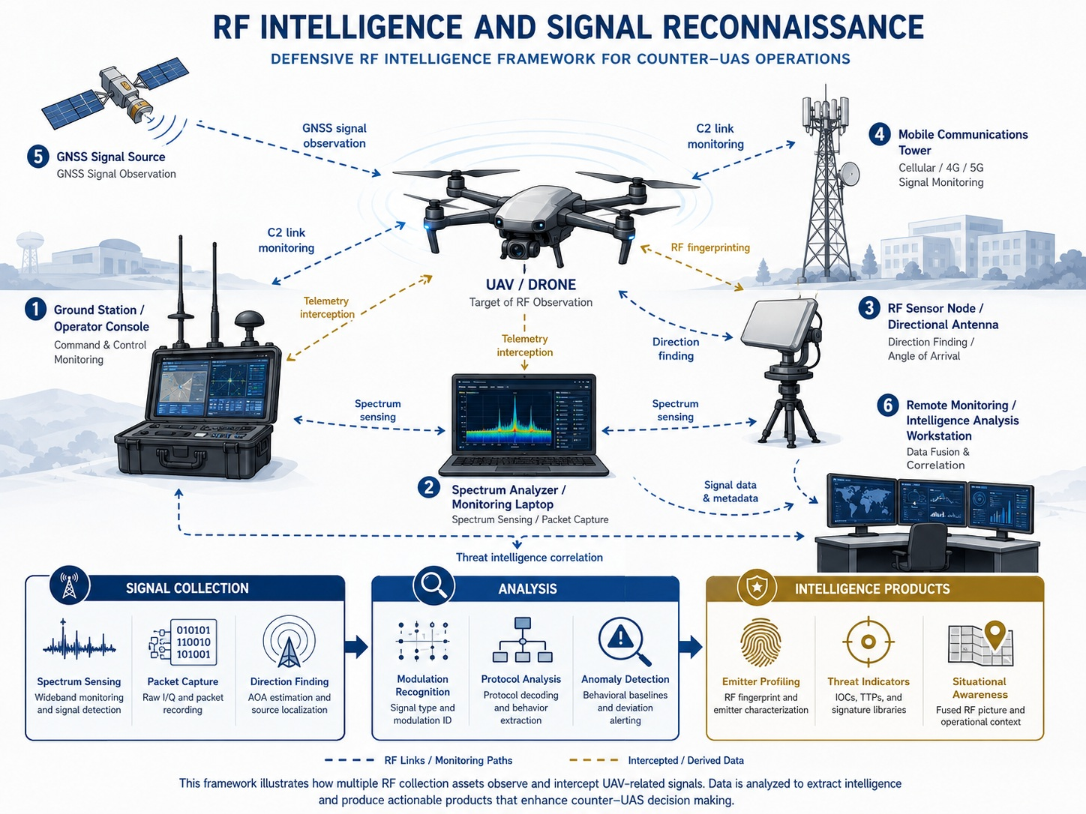
CHAPTER 5 / SUPPLEMENTARY MATERIAL
RF observations and intelligence products
Figure S5.2. Signal observations can support hypotheses about emitters and activity.
Identification, aircraft association, and attribution require corroborating evidence.
Source illustration is conceptual. Teaching notes identify assumptions, terminology, and evidence limits.
03
Notes:
RF observation does not itself establish operator identity, aircraft authorization, or hostile intent. A signal classification, RF fingerprint, or direction-finding estimate carries uncertainty and depends on the propagation environment, calibration, and receiver setup. Satellite GNSS broadcast reception alone does not locate a specific target receiver. Packet capture and content analysis depend on authorized access and applicable data-handling constraints. Correlate approved RF observations with aircraft tracks, test logs, configuration records, and timing information. Discussion: which alternative emitters could produce a similar spectrum?
Original illustration retained from supplied material_ch5.pptx.

Slide 4
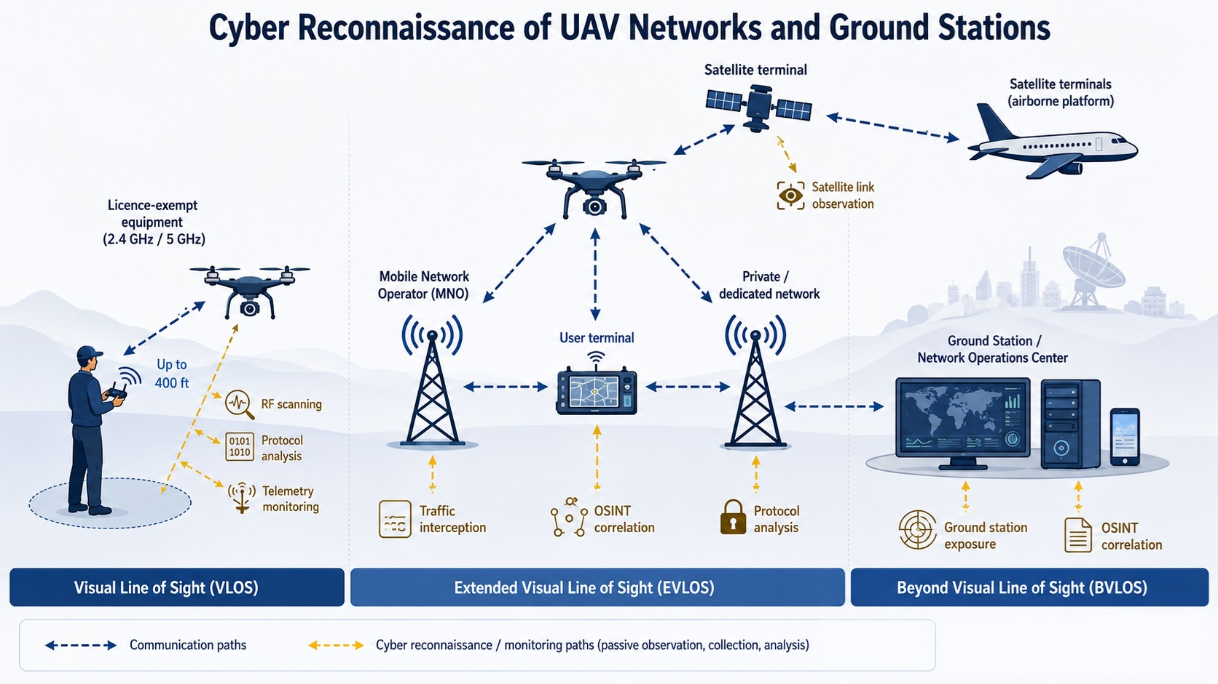
CHAPTER 5 / SUPPLEMENTARY MATERIAL
Network observations and operating context
Figure S5.3. Network topology and monitoring access determine the available evidence.
VLOS/BVLOS describe visual-contact conditions independently of the transport technology.
Source illustration is conceptual. Teaching notes identify assumptions, terminology, and evidence limits.
04
Notes:
The source figure associates an altitude and particular communication technologies with VLOS, EVLOS, and BVLOS. Treat those assignments as illustrative, not definitions or universal boundaries. VLOS depends on continuous unaided visual contact. Cellular and satellite links are not necessary definitions of BVLOS. EVLOS is legacy terminology in this source illustration; EASA SORA 2.5 uses BVLOS with airspace observer. Distinguish public information from authorized internal logs and from active testing. The presence of a service or network address does not itself establish a vulnerability. Sources: https://www.easa.europa.eu/en/document-library/easy-access-rules/easy-access-rules-unmanned-aircraft-systems ; https://csrc.nist.gov/pubs/sp/800/115/final
Original illustration retained from supplied material_ch5.pptx.

Slide 5
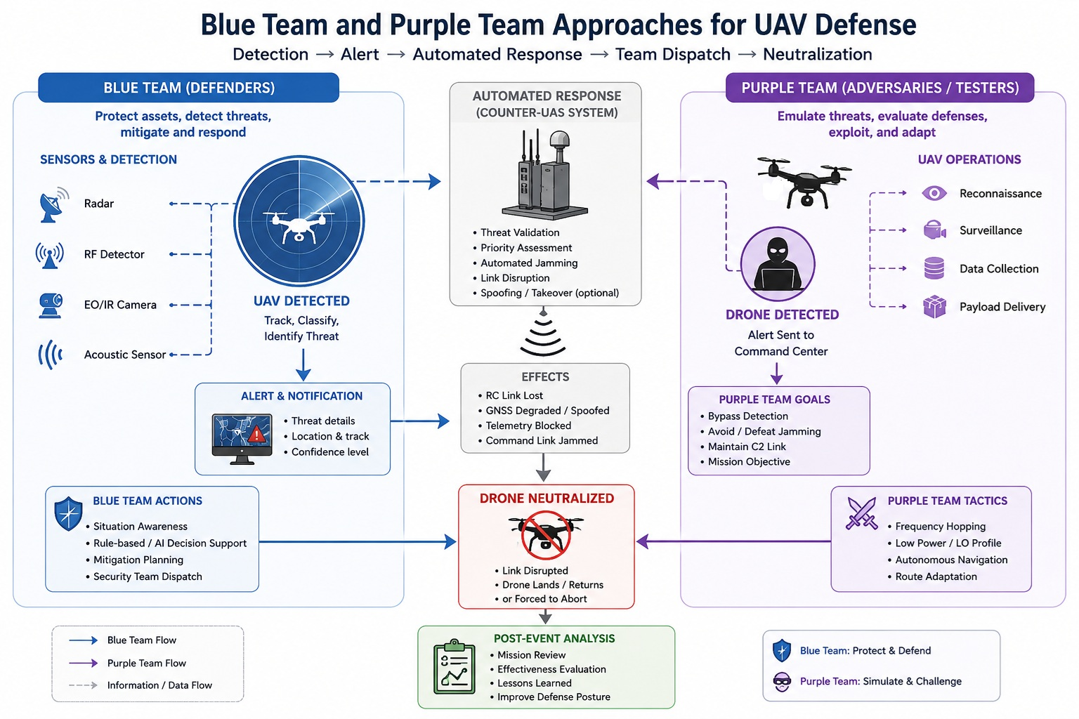
CHAPTER 5 / SUPPLEMENTARY MATERIAL
Blue-team defense and purple-team collaboration
Figure S5.4. Purple teaming combines testers and defenders to validate detection and response.
Keep threat detection, authorization, and operational intervention as separate decisions.
Source illustration is conceptual. Teaching notes identify assumptions, terminology, and evidence limits.
05
Notes:
The source illustration labels the purple side as adversaries/testers. More precisely, red teams or assessors emulate adversarial behavior, blue teams defend, and purple teaming is their collaborative validation approach. Purple teaming does not have to be a separate permanent team. The automatic neutralization sequence in the source is a conceptual scenario, not a general recommended workflow or evidence of authority to intervene. Detection alone does not establish hostile intent or authorize interference. Treat active counter-UAS response as a distinct operational decision requiring the applicable authority and mission controls. This supplement focuses on assessment and evidence, not real-world interdiction. Sources: https://csrc.nist.gov/pubs/sp/800/115/final ; https://csrc.nist.gov/pubs/sp/800/61/r3/final
Original illustration retained from supplied material_ch5.pptx.

Slide 6
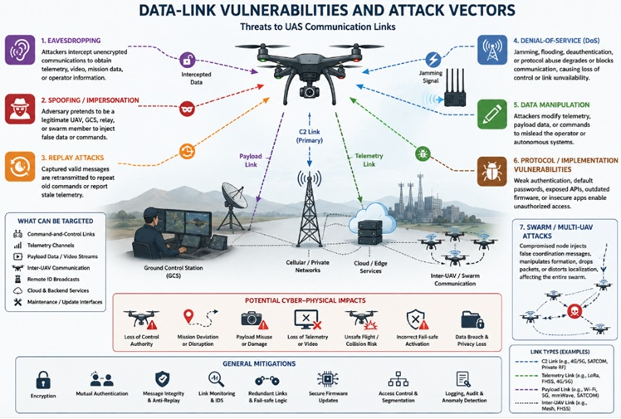
CHAPTER 5 / SUPPLEMENTARY MATERIAL
Data-link exposure and assessment hypotheses
Figure S5.5. Candidate threat paths guide test selection. Each finding needs evidence
of the relevant preconditions, affected interface, and observed mission effect.
Source illustration is conceptual. Teaching notes identify assumptions, terminology, and evidence limits.
06
Notes:
The figure depicts hypothetical vulnerabilities and threat mechanisms, not a confirmed exploit chain. Separate passive exposure, message manipulation, replay, service disruption, and compromised endpoint behavior. Source examples such as Remote ID do not imply that all listed interfaces support control of the aircraft. A link outage may have benign causes. Select observable acceptance criteria and collect a comparable baseline before testing. Authentication and encryption address different properties from timely delivery and resistance to RF interference. Cross-reference the service requirements in Chapter 4.
Original illustration retained from supplied material_ch5.pptx.

Slide 7
CHAPTER 5 / SUPPLEMENTARY MATERIAL
Assessment scope and team responsibilities
A test plan assigns ownership and defines which actions and evidence belong to the assessment.
Role / responsibility | Contribution | Record to retain
Assessment owner | Defines objectives, scope, contacts, exclusions, and stop conditions | Approved test plan and change / restoration record
Red team / assessors | Execute scoped test scenarios and document actual test actions | Scenario IDs, timestamps, preconditions, and observed effects
Blue team / defenders | Monitor, investigate, and apply the agreed response process | Alerts, investigation records, response actions, and limitations
Purple-team collaboration | Jointly replay evidence and refine detections, controls, and procedures | Evidence comparison, gaps, corrective actions, and retest results
Success means a useful, reproducible finding and a validated improvement, rather than a score alone.
07
Notes:
Teaching synthesis of assessment planning and collaborative validation. The same person may hold multiple roles in a small lab, but responsibilities and decision ownership should remain explicit. This role table is not an organizational standard. Document permitted systems, test accounts, traffic boundaries, data retention, emergency contacts, and conditions for stopping the exercise. Keep observed test results separate from assumptions about real adversaries. Sources: NIST SP 800-115, https://csrc.nist.gov/pubs/sp/800/115/final ; MITRE adversary emulation plans, https://attack.mitre.org/resources/adversary-emulation-plans/ .

Slide 8
CHAPTER 5 / SUPPLEMENTARY MATERIAL
Observations, inferences, and decisions
Report what the evidence supports and state the uncertainty that affects interpretation.
Evidence / claim | Supported interpretation | Additional evidence needed
Unusual RF energy | A change in the monitored spectrum or received power | Calibration, baseline, timing, and alternative-source checks
Repeated protocol pattern | Traffic has observable structure consistent with a candidate class | Validated classifier performance and independent aircraft association
Link outage or track deviation | A communication or navigation performance anomaly occurred | Synchronized system logs and a defensible causal explanation
Claim of hostile intent or operator identity | A hypothesis requiring evidence beyond the signal anomaly | Corroborated attribution, context, and the appropriate review process
A defensible assessment preserves competing explanations and records confidence explicitly.
08
Notes:
Author-created evidence interpretation exercise. An observation can be reliable while a causal or attribution inference remains uncertain. Suggested record fields: sensor and version, calibration, acquisition settings, location/time reference, original data identifier, processing version, observation, alternative explanation, confidence rationale, and reviewer. Spectrum or protocol similarity is not conclusive platform identification. Distinguish confidence in a sensor observation from confidence in a specific causal explanation. Basis for testing evidence and reporting: https://csrc.nist.gov/pubs/sp/800/115/final ; incident analysis and response context: https://csrc.nist.gov/pubs/sp/800/61/r3/final .

Slide 9
CHAPTER 5 / SUPPLEMENTARY MATERIAL
Worked example: detection performance
Synthetic dataset: 100 fixed observation windows, including 20 simulated threat events and 80 benign windows.
Ground-truth label | Alert | No alert
Simulated threat event | 16 true positives (TP) | 4 false negatives (FN)
Benign window | 4 false positives (FP) | 76 true negatives (TN)
Precision = TP / (TP + FP) = 16 / 20 = 80%
Recall = TP / (TP + FN) = 16 / 20 = 80%
False-positive rate = FP / (FP + TN) = 4 / 80 = 5%
These values describe the synthetic test set. Operational performance depends on event prevalence and conditions.
09
Notes:
Author-created numerical teaching example. Every fixed window receives one ground-truth class and one binary alert decision. Threat windows: TP 16 + FN 4 = 20. Benign windows: FP 4 + TN 76 = 80. Total windows = 100. Precision = 16/(16+4) = 0.80. Recall = 16/(16+4) = 0.80. False-positive rate = 4/(4+76) = 0.05. False discovery proportion = FP/(TP+FP) = 20%, which is distinct from the 5% false-positive rate. No experimental measurements are asserted. Define matching windows, duplicate-alert handling, event duration, and labeling uncertainty before testing. Precision depends on prevalence. For timing metrics, state whether missed detections are excluded or censored and report misses separately. Exercise: with 10% threat prevalence and unchanged recall and false-positive rate, expected alert precision is 0.08/(0.08+0.045) = 64%. This is an expectation from assumed rates, not a measured outcome.

Slide 10
CHAPTER 5 / SUPPLEMENTARY MATERIAL
Practical exercise: collaborative detection validation
Use a recorded dataset or a controlled simulator with known event labels and a repeatable baseline.
1. Scope and baseline
Choose one observable failure or threat hypothesis. Define the data, controls, and stop conditions.
2. Controlled scenarios
Compare benign variation with a simulated anomaly such as a stale update or a link outage.
3. Joint evidence review
Match scenario times to alerts, system state, and mission effects. Identify misses and false alarms.
4. Improvement and retest
Change one detection or control, repeat the scenarios, and document benefits and remaining gaps.
Deliverable: a scoped test plan, labeled event log, detection metrics, and a retest report.
10
Notes:
Suggested lab setup: simulation or recorded telemetry with synthetic packet loss, stale application messages, or out-of-envelope sensor values. This exercise does not require real-world interception, exploitation, or RF interference. Record test IDs, scenario version, timestamps, ground-truth event label, alert label, estimator/controller mode, operator actions, and outcome. For a DWM3000 extension, compare normal moving-anchor updates with deliberately stale application records in the simulator. Verify that an alert corresponds to the stated hypothesis rather than ordinary range noise or anchor-geometry changes. Retest on held-out scenarios where feasible to reduce overfitting. Discuss alert quality, operator workload, deadline behavior, and unresolved evidence gaps. Sources: https://csrc.nist.gov/pubs/sp/800/115/final ; https://attack.mitre.org/resources/adversary-emulation-plans/ .

Slide 11
CHAPTER 5 / SUPPLEMENTARY MATERIAL
References and terminology
Primary references support assessment planning, adversary emulation, and response analysis.
NIST SP 800-115
Technical Guide to Information Security Testing and Assessment (2008).
csrc.nist.gov/pubs/sp/800/115/final
MITRE ATT&CK
Adversary Emulation Plans. Behavior-based assessment examples.
attack.mitre.org/resources/adversary-emulation-plans/
NIST SP 800-61r3
Incident Response Recommendations and Considerations for
Cybersecurity Risk Management (2025). csrc.nist.gov/pubs/sp/800/61/r3/final
EASA
Easy Access Rules for Unmanned Aircraft Systems, June 2026.
Operational terminology and visual-contact definitions.
OSINT: open-source intelligence RF: radio frequency UAS: unmanned aircraft system
TP / FP: true / false positives FN / TN: false / true negatives
11
Notes:
Full references, accessed 3 November 2026:
test: https://csrc.nist.gov/pubs/sp/800/115/final
emulation: https://attack.mitre.org/resources/adversary-emulation-plans/
response: https://csrc.nist.gov/pubs/sp/800/61/r3/final
uas: https://www.easa.europa.eu/en/document-library/easy-access-rules/easy-access-rules-unmanned-aircraft-systems
NIST SP 800-61 Rev. 3 full title: Incident Response Recommendations and Considerations for Cybersecurity Risk Management: A CSF 2.0 Community Profile. These sources are general guidance and do not establish authority to conduct active counter-UAS intervention. Original illustrations: supplied material_ch5.pptx. Synthetic metric examples and teaching exercises are newly added and do not represent measured prototype performance. Source diagrams remain raster images, while added text and tables are editable.

