Slide 1
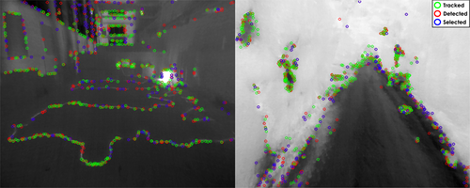
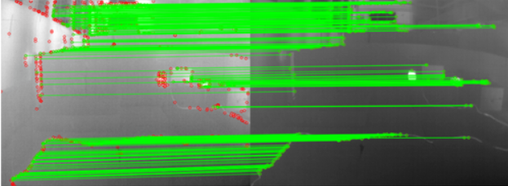
Visual–Inertial Odometry when GPS is unavailable
Camera + IMU → position, velocity, attitude, trajectory
Situation | Use VIO? | Reason
Indoor navigation | Yes | GPS is unavailable indoors
Tunnels, mines, caves | Yes | No satellite signal
Urban canyons | Yes | GPS multipath and blockage
Forests / dense vegetation | Yes | GPS may be weak or noisy
Search-and-rescue environments | Yes | Works without external infrastructure
Drone obstacle avoidance | Yes | Provides local motion and attitude
Short-to-medium missions | Yes | Drift is manageable

Slide 2
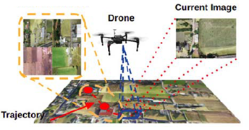
Geo-location when you need global or map-based position when GPS is unavailable
Situation | Use Geo-location? | Reason
Returning to a known base station | Yes | Needs global reference
Mapping a disaster zone | Yes | Needs position on a map
Indoor warehouse navigation | Yes | Can use known map or markers
Multi-drone coordination | Yes | Drones need shared coordinates
Long missions | Yes | Corrects VIO drift
Repeated inspection route | Yes | Can localize against previous map
Search-and-rescue target reporting | Yes | Need victim/object location in map frame

