Slide 1

Team No - 11
Title - IPL Score Prediction with Deep Learning
This project aims to predict IPL innings scores using deep learning. We leverage early match data to forecast outcomes, enhancing strategic insights and real-time analysis. Our goal is to achieve high accuracy with minimal error.
Irshad Ahmad S 1BG23CS051
Ruchit Pahadia 1BG23CS124

Slide 2
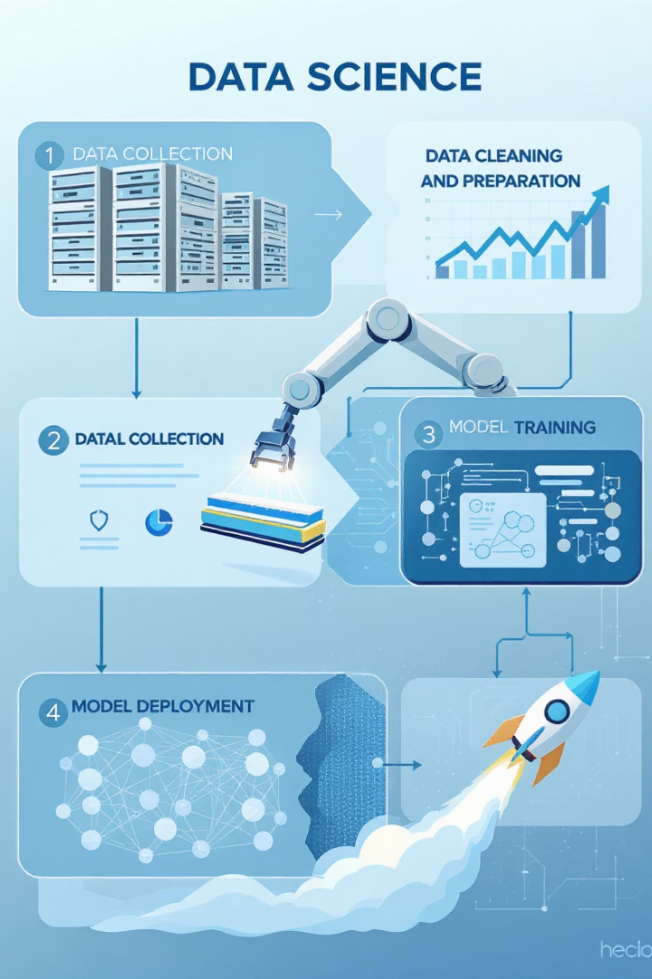





Methodology and Workflow
Data Source
IPL ball-by-ball data from 2008–2023.
EDA & Preprocessing
Explored data distribution, encoded categorical features, and scaled numerical data.
Model Building
Keras Sequential model with Dense layers (128 → 64 → 32), ReLU, Adam optimizer, MSE loss.
Training Setup
80/20 train-test split, 100 epochs, monitored with validation loss plots.

Slide 3

Key Assumptions
Early Influence
First 5-6 overs significantly influence final score.
Statistical Roles
Teams and venues have significant statistical impact.
Player/External Factors
Player skills and external factors (weather) are averaged out or excluded.
Aggregated Features
Simplified over-by-over data forms a static input.

Slide 4

Model Evaluation and Analysis
Evaluation Metrics
Mean Squared Error (MSE)
R² score (variance explanation)
Results
Most innings within <10 runs error.
Strong alignment with actual scores.
Analysis
Performed well on average innings.
Slight underperformance on outlier scores.
Good generalization within input scope.

Slide 5


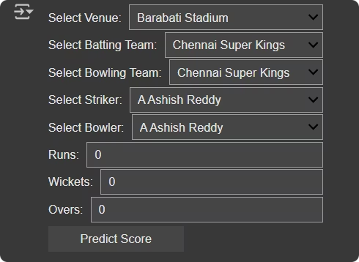



Project Summary and Outcomes
Deep Learning Success
Built an accurate neural network for IPL score prediction.
Full ML Lifecycle
Covered EDA, preprocessing, modeling, and evaluation comprehensively.
Early Feature Power
Demonstrated the predictive power of early match features.
Goal Achieved
Met primary objective with low MSE and close predictions.

Slide 6








Future Improvements and Extensions
Temporal Modeling
Player Stats
Integrate RNNs/LSTMs for ball-wise progression.
Incorporate player form and strike rates.
Real-time API
External Context
Develop a live prediction dashboard.
Add pitch condition, toss result, and weather data.

Slide 7




Reflections and Learning Outcomes
Data Preparation
Learned to prepare real-world sports data.
Hands-on Experience
Gained skills in encoding, NN design, and evaluation.
Feature Importance
Realized key role of feature selection and data cleaning.
Domain Knowledge
Understood its importance in sports ML.

Slide 8


