Slide 1

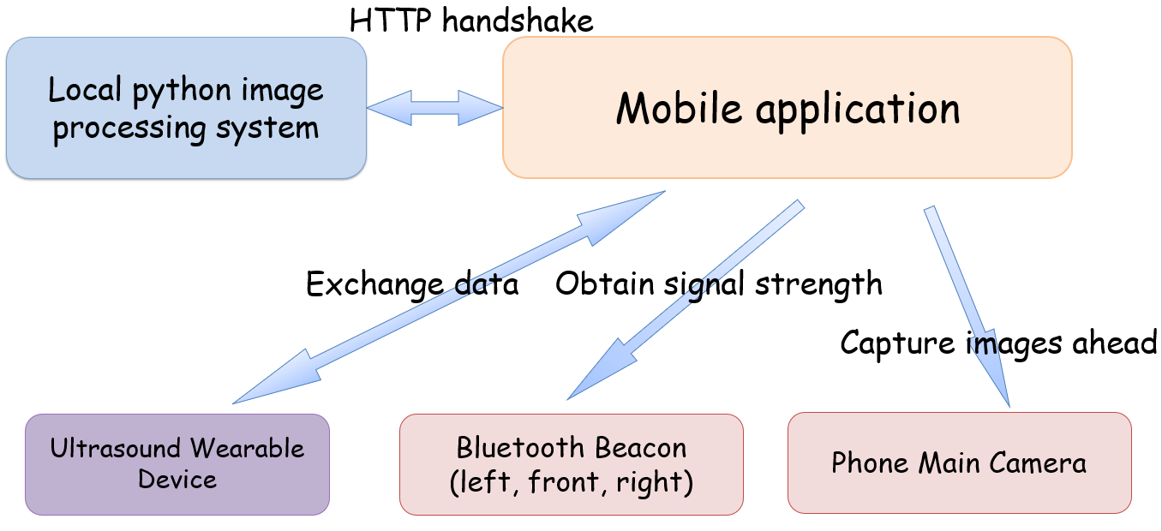
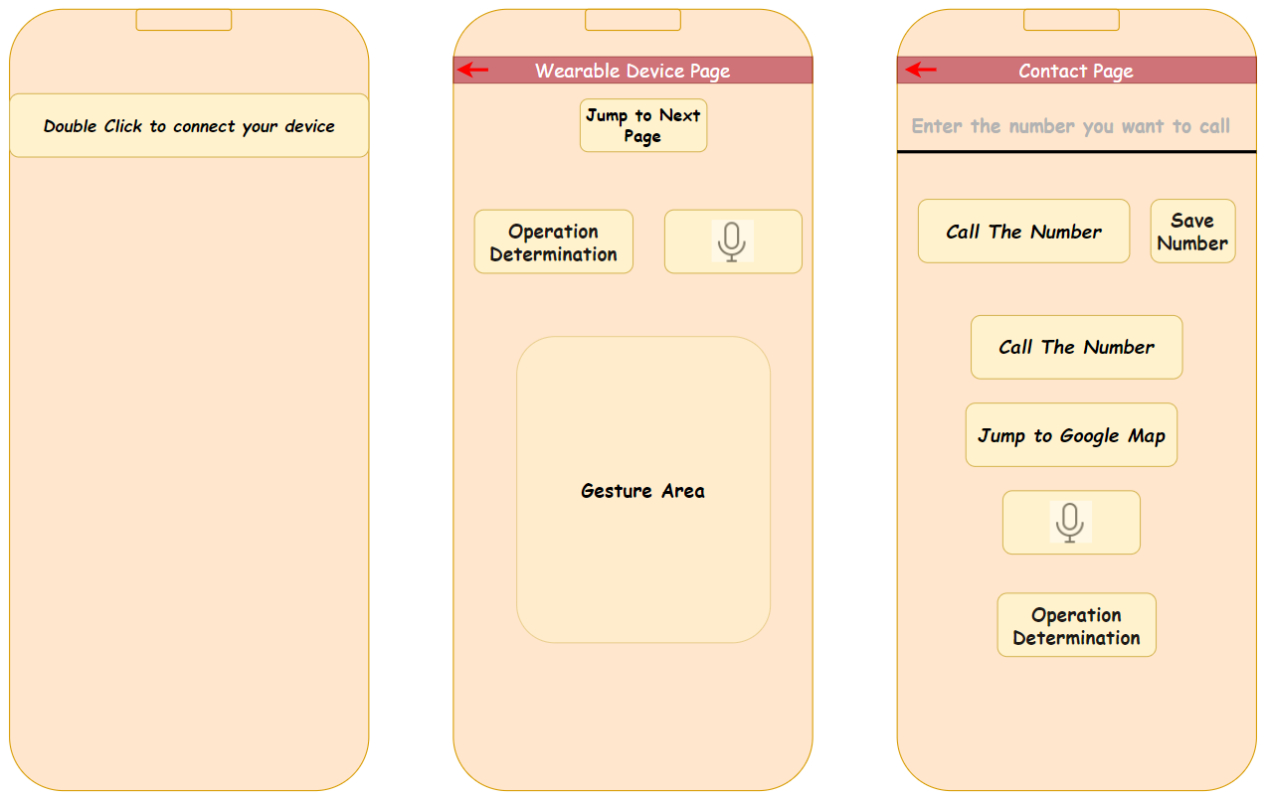
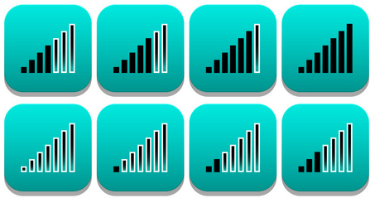
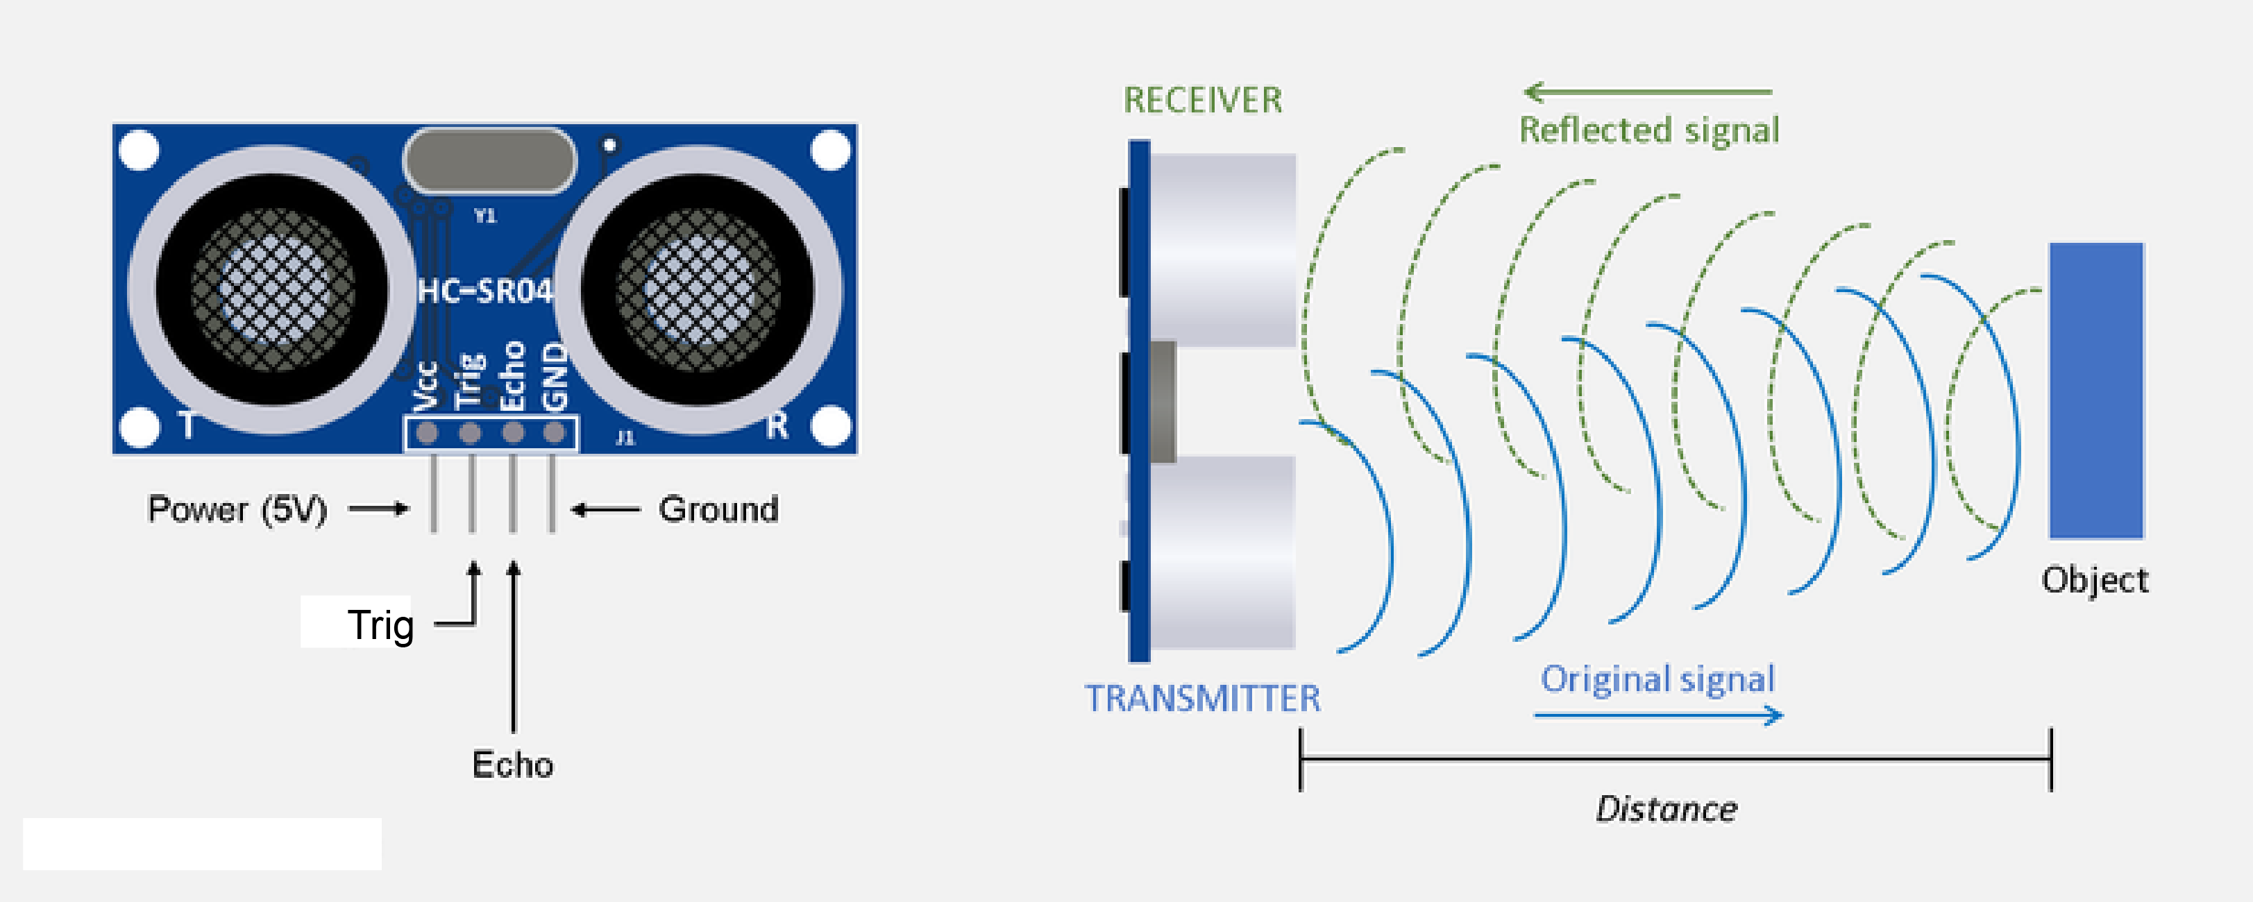
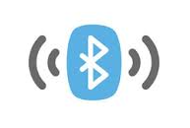
Student Name: Shuai Ran
Student ID : 2633609R
Email : 2633606R@student.gla.ac.uk
Supervisors : Marion Hersh
Msc computer system Engineering
Last 10 metres travel aid for blind people
Blind Navigation Assistance System Based on Bluetooth, Ultrasound and Obstacle detect System
Introduction
GPS can guide blind people to arrive at a destination within about 10 meters, but it cannot directly tell users where the entrance is. The purpose of our design is to help users find the entrance in the last 10 meters.
Introduction to the principle
Introduction to the functions
How to provide directional guidance
By detecting the signal strength of Bluetooth beacons to calculate the distance between the user and the beacon and using this distance to provide directional guidance.
How to measure the distance between the user and obstacles
The ultrasonic sensor sends high-frequency sound waves above the audible range of human ears. The signals propagate to the object surface and reflect. The receiver of the ultrasonic sensor receives the reflected signals. By calculating the round-trip time of the reflected signals, the distance can be derived.
How wearable devices exchange information with mobile apps
The mobile phone connects via Bluetooth to the wearable device to exchange information.
Considering that blind people turn on accessibility mode when using mobile phones, our mobile application is developed based on accessibility mode. Our app supports gesture input, voice input and output, as well as haptic feedback. Each key will vibrate when pressed to alert the user.
Page 1
This page's voice guidance on the phone will tell you how to connect the device.
Page 2
Successfully entering this page indicates the device is successfully connected.
This page updates the user's location every 8 seconds to help the user find their way around.
The obstacle alarm distance can be set by voice. You can ask by voice how far away obstacles are ahead.
The above tasks can also be accomplished through gesture controls.
The above operations can all be done by voice commands.
Page 3
Dial and save emergency contact numbers. Once saved, you can directly dial them next time.
Directly open Google Maps navigation.
The above operations can all be done by voice commands.
Page 1
Page 2
Page 3
Conclusion
Currently this blind navigation system can guide blind people to find the entrance within the last ten meters.
However, due to the propagation characteristics of Bluetooth signals, the system may make wrong judgments when there are obstructions blocking the signals.
University of Glasgow, charity number SC004401

Slide 2

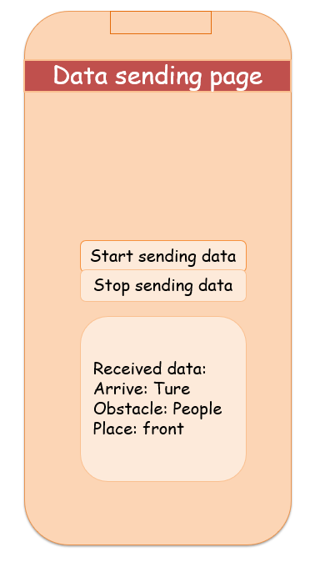
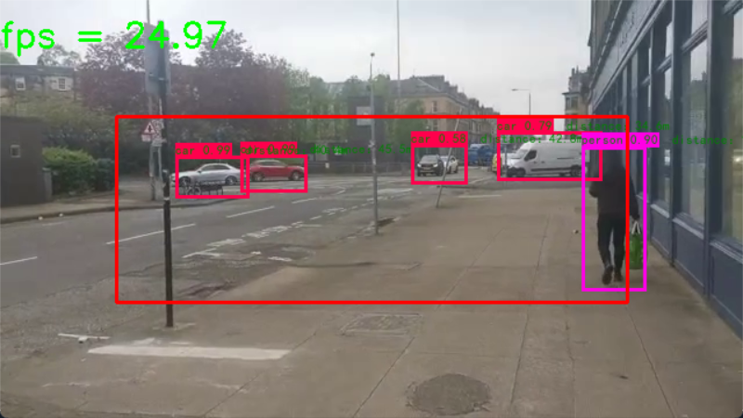
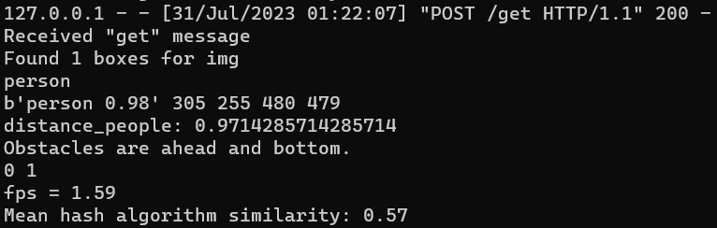
Last 10 metres travel aid for blind people
lind Navigation Assistance System Based on Bluetooth, Ultrasound and Obstacle detect System
Introduction
GPS can guide blind people to arrive at a destination within about 10 meters, but it cannot directly tell users where the entrance is. The purpose of our design is to help users find the entrance in the last 10 meters.
How to detect different obstacle
Use computer vision techniques. Obstacle prediction based on the trained computer vision model. The prediction results are analyzed within the Obstacle detect system(The following will refer to this simply as “the system”).
How to train the computer vision related model
Based on python3.8.17, using TensorFlow2.6.0 and yolov4 as neural network framework model architecture and object detection algorithm. We use VOC dataset of 9963 photos. Cuda 11.2 and cudnn based on NVIDIA graphics card for hardware acceleration.
How to measure the distance between the user and obstacles
Use pixel size-based distance measurement.
Obstacle Distance (D) = (Real Object Height * Focal Length) / Pixel Height
The actual object height takes the average value of the region, the system calculates the pixel height, and the python code obtained camera focal length, so the system can obtain a rough obstacle distance.
How to provide obstacle avoidance advice
Use OpenCV-python to mark a box. If an obstacle is cannot be displayed fully and enters the box or distance less than 1 meter, the system will warn and send it to the mobile app. The mobile app will output a warning to remind the user.
How system exchange information with mobile apps
The mobile app connects the system via local HTTP handshake(http://127.0.0.1:5000) Mobile app loops to request the system, and the system will reply with identification information and obstacle warning.
(The images captured by the upper and lower are different!)
How to detect the destination
The picture of the end point is stored in advance. In the system, the image captured by the camera is continuously compared using the mean hash algorithm similarity. If it is greater than the threshold, it is considered to have reached the destination.
How to train the model
Enter two-part boundaries feat1 and backbone feaat2.
A 1x1 convolutional layer with 256 filters is first applied to the feature map `feat2` obtained from the Darknet backbone.
Next a 3x3 convolutional layer of 512 filters is applied to feat2.
Another 1x1 convolutional layer is applied and produces the final output of the second scale (`P5_output`).
Then use a 1x1 convolutional layer with 128 filters followed by a 2x2 up sampling operation to achieve up sampling and enhance features.
Fusing information from the second scale (“feat2”) with the lower scale (“feat1”) yields P4.
A 3x3 convolutional layer with 256 filters is applied to the concatenated feature map P4.
Another 1x1 convolutional layer is applied to `P4_output` to produce the final output of the first scale (`P4_output`).
The outputs are "P5_output" and "P4_output", denoting predictions for object detection at two different scales. The anchor boxes used for each scale are determined by "anchors_mask", and the number of classes detected is specified by "num_classes".
Introduction to the Functions
Page 4
Enter this page, if you press the start sending button, the mobile app will send an image recognition request every 1 second (because of the limitation of the hardware capability of the mobile phone, the maximum FPS number tested is 1.39) and get the recognition information and alarm information.
If you press stop sending, the mobile app stops sending requests, and the system enters a waiting state.
Page4:
System request and respond page
University of Glasgow, charity number SC004401

Slide 3
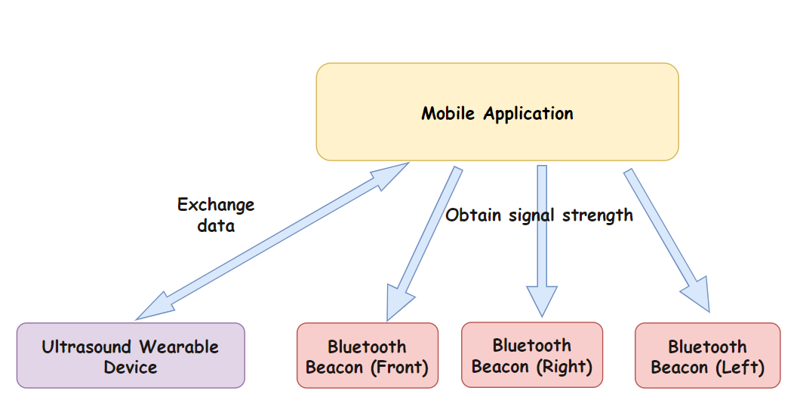
A1 poster Title – 58pt arial bold
Subhead – 32pt arial bold
paragraph – 24pt arial
HTTP handshake
Column 1
Local python image processing system
Mobile application
Column 2
Exchange data
Obtain signal strength
Capture images ahead
Ultrasound Wearable Device
Bluetooth Beacon
(left, front, right)
Phone Main Camera
University of Glasgow, charity number SC004401

Slide 4
HTTP handshake
Local python image processing system
Mobile application
Exchange data
Obtain signal strength
Capture images ahead
Ultrasound Wearable Device
Bluetooth Beacon
(left, front, right)
Phone Main Camera

Slide 5

Data sending page
Start sending data
Stop sending data
Received data:
Arrive: Ture
Obstacle: People
Place: front

