Slide 1
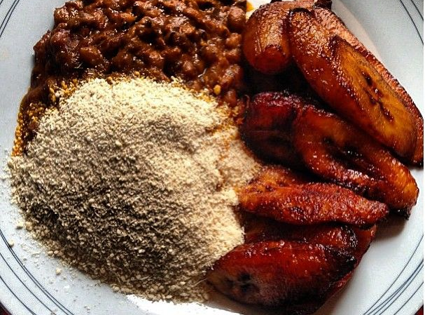

Online Gob3
“we care for your well beans”
Be a Seller
Buy Beans
NB:
Gob3 is a Ghanaian dialect for cook beans and fried plantain with gari
Powered by :
Group 3

Slide 2

Gob3
You’ve choosen to be a Gob3 seller
Please fill the form below to register
First Name
Last Name
Phone Number
Place of Sell
Enter Email Address
Create Username
Create Password
Register
Already a member ?
Login in here
Powered by :
Group 3

Slide 3

Online Gob3
R
“we care for your well beans”
Enter Username
Enter Password
Forgot password ?
Remember me
Sign in
Don’t have an account ?
Sign up !
Powered by :
Group 3

Slide 4

Gob3
Forgot Password
Enter Username
Reset Password
Powered by :
Group 3

Slide 5
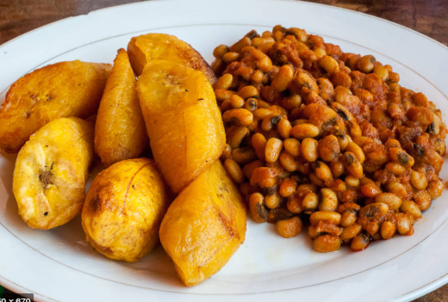
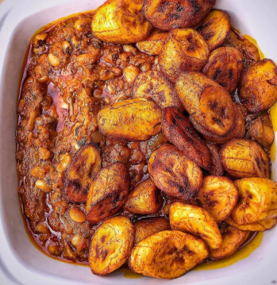
Gob3
Login
Sell Gob3
Buy Gob3
Sign Out
Powered by :
Group 3

Slide 6
Gob3
You’ve successfully signed up
You’re now a member of beans (Gob3) sellers in Ghana.
Click on the link below to sign in .
Login
Powered by :
Group 3

Slide 7


Gob3
Donzy
#G241
View Sellers
ACHIMOTA SELLERS
EAST LEGON SELLERS
Orders in a queue:
12
Orders in a queue:
3
Order Gob3
New Order Status :
New Order Status :
LAPAZ AREA
POKUASE SELLERS
Orders in a queue:
1
Orders in a queue:
5
New Order Status :
New Order Status :
Available
Not available

Slide 8
Order Gob3
Gob3
Donzy
#G241
View Sellers
Order Gob3

Slide 9
Gob3
Donzy
#G241
Sign Out
View Sellers
Order Gob3

