Slide 1
WMI
🎺 The skeleton key to basically everything 🎺

Slide 2
What is wmi?
Windows Management Instrumentation
Microsoft’s take on the standard
What standard?
Web Based Enterprise Management Consortium
Is it CIM?
Notes:
You know what they say about standards…
Amusingly there is still a tool in windows which references this ancient heritage,
Windows Server 2012 and Windows 8 saw Microsoft make some changes to WMI by aligning it with CIMv2 and moving to WS-MAN for remote connections. Because WS-MAN is a HTTP-based protocol, it is more firewall friendly than DCOM. Although it’s worth noting that the updated WMI stack can be accessed using DCOM for backwards compatibility.
PowerShell Core doesn’t even have them!

Slide 3
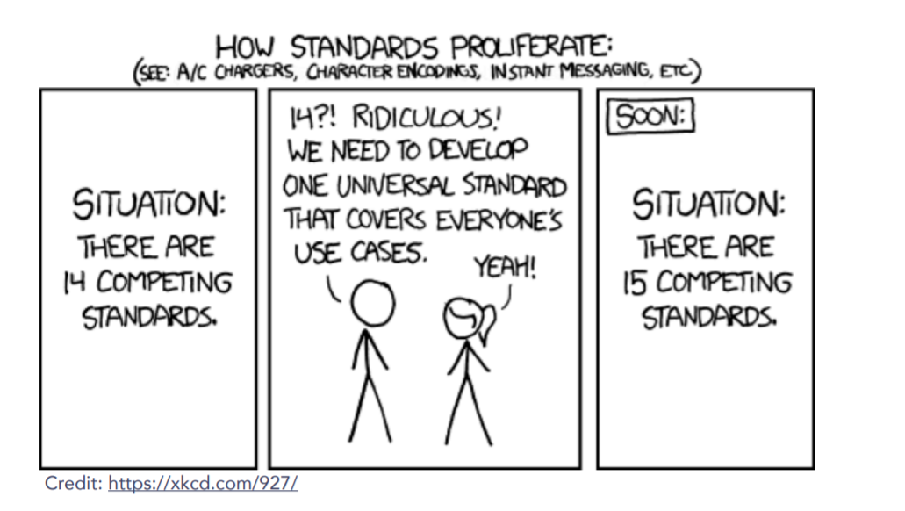
The great thing about standards is…
There are so many to choose from!

Slide 4
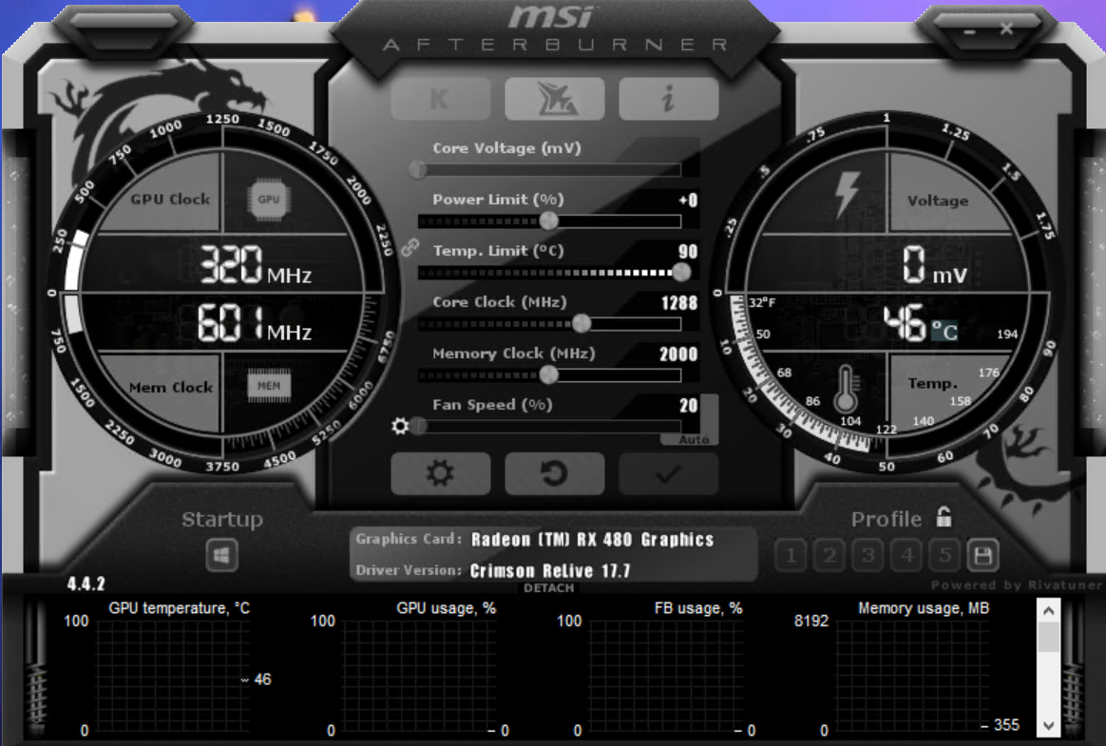

Why bother with wmi?
It’s everywhere…
…..in Windows
If it’s not in the registry…guess where it lives in Windows?
Database vs API
Solves this common life scenario…
Notes:
This is deep in windows, it’s been part of the OS since Windows 95, and kind of cutely, you can still find hundreds of articles walking you through installing it from way back when it was an optional feature on Windows NT 4.0 lol
Imagine you’ve been a totally boss at work and have built your own comepletly pimped out and not ostentatious gaming laptop.
To play Minecraft on.
Now because the pc embarrasses your wife, you have to hide it out of the way, and its time to update your bios and drivers…but your forget what mobo version you have.
You COULD>..crawl under the desk and look at it ☹ lame
Or you could open the eyeball frying terrible ‘GAMING’ app to find the settings…or you could dig into wmi for it (lets act like device manager doesn’t exist, too much clicking!)

Slide 5
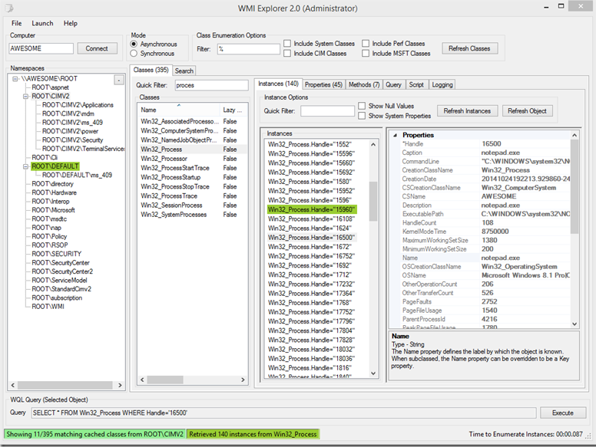
Tools to use with wmi
WMIC – keeping it old school
PowerShell
Search for classes w/ Get-CimClass!
WBEMTest
WMI Explorer
Notes:
We can use WMIC
Wmic service list | more
>wmic os LIST BRIEF
List information on currently running processes with WMIC –
wmic process get caption,executablepath,commandline
List user accounts with WMIC - wmic useraccount get /ALL
PowerShell. Great because has search function built in!
WBEMtest ‘Open istance’ WIn32_BaseBoard’
WBEMtest – Query “select * from win32_baseboard’
List patches installed on the local workstation with WMIC –
wmic qfe get description,installedOn /format:csv
Humble beginnings. In The Monad manifesto revisted talk, Snover told a story of the development of powershell and wmic. Shortlink at the end!
List information on currently running processes with WMIC –
wmic process get caption,executablepath,commandline
List user accounts with WMIC - wmic useraccount get /ALL
WBEMtest ‘Open istance’ WIn32_BaseBoard’
WBEMtest – Query “select * from win32_baseboard’

Slide 6
WMI Organization
Hierarchy -> items are hierarchichally organized
5 bonus points if you can pronounce this word.
Organized into Namespaces
Notes:
What an exciting slide title
Namespaces are basically folders where interesting wmi stuff lives

Slide 7
What lives where
Root\cimv2
Default namespace
Most basic windows settings
Win32_ComputerSystem – Basic OS Info
Win32_LogicalDisk – Drive by letter
Win32_DiskDrive – physical disk info
Win32_BaseBoard
Win32_VideoController
Notes:
What an exciting slide title
Namespaces are basically folders where interesting wmi stuff lives

Slide 8
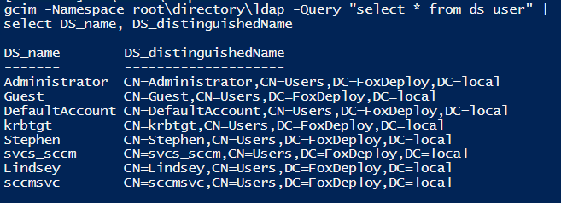
What lives where, electric boogaloo
Root\Directory\ldap
Perform Native AD Queries!
Root\ccm
SMS_Client – Reinstall CM Client, request policy, evaluatepolicy
TriggerAppInstalls
CImv2\Security
Encrypt/Decrypt Volumes
Notes:
What an exciting slide title
Namespaces are basically folders where interesting wmi stuff lives

Slide 9
Resources / Links
Comprehensive guide to WMI – LogicMonitor http://bit.ly/wmiguide
There’s something about WMI – SANS DFIR http://bit.ly/wmi4evil
PowerShell History – Snover http://bit.ly/poshhistory

