Slide 1


Raindrops keep falling on my head
don’t
Regina
1reginacheong@gmail.com

Slide 2
Agenda
Background
Data Source
Tools
Findings
Conclusion

Slide 3
Background
When should I bring an umbrella to fetch my kid at Newton?
How much transport allowance should I budget for grab rides for my kid?

Slide 4


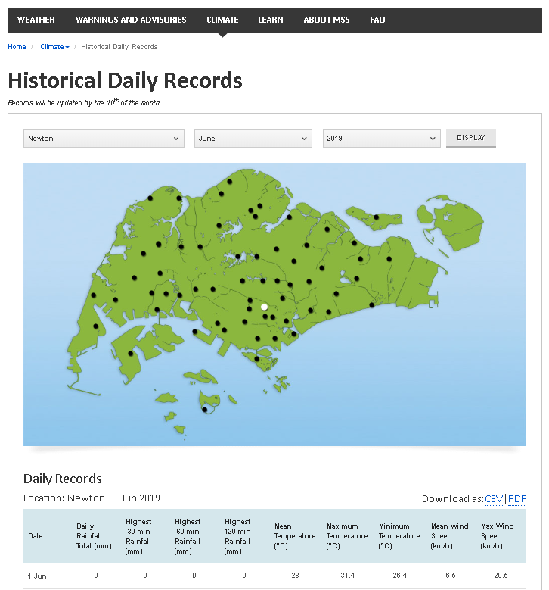


Data Source
Tools
Newton – 2014 to 2019
Web scrapping
Beautifulsoup4
Selenium
EDA and Data Cleaning
Numpy
Pandas
Model Building and Selection
Scikit
Scipy.stats
Statsmodel
Seaborn and Matplotlib
From 3600 data rows -> 1800 rows

Slide 5
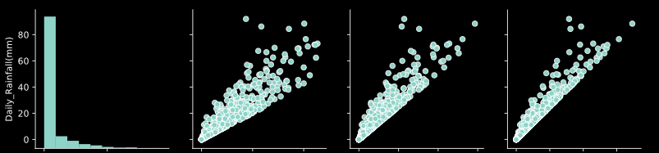
Findings – Remove “noisy” parameters
parameters
Date
Daily Rainfall Total (mm)
Highest 30-min Rainfall (mm)
Highest 60-min Rainfall (mm)
Highest 120-min Rainfall (mm)
Mean Temperature (°C)
Maximum Temperature (°C)
Minimum Temperature (°C)
Mean Wind Speed (km/h)
Max Wind Speed (km/h)

Slide 6
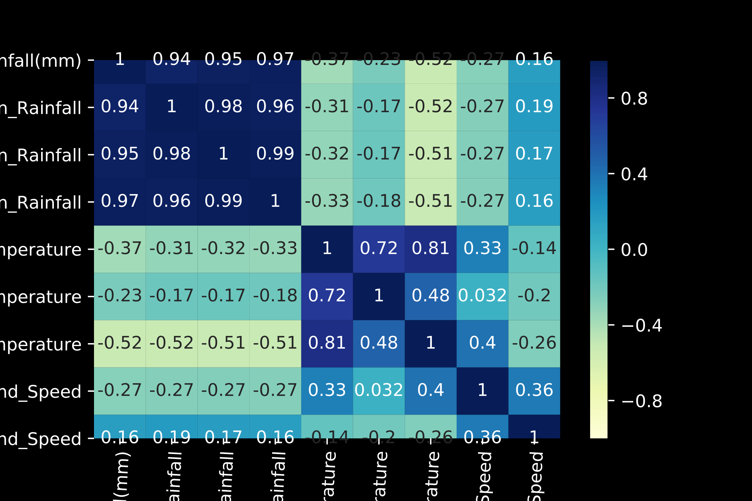
Findings
parameters
Collinearity
Date
Daily Rainfall Total (mm)
Highest 30-min Rainfall (mm)
Highest 60-min Rainfall (mm)
Highest 120-min Rainfall (mm)
Mean Temperature (°C)
Maximum Temperature (°C)
Minimum Temperature (°C)
Mean Wind Speed (km/h)
Max Wind Speed (km/h)

Slide 7
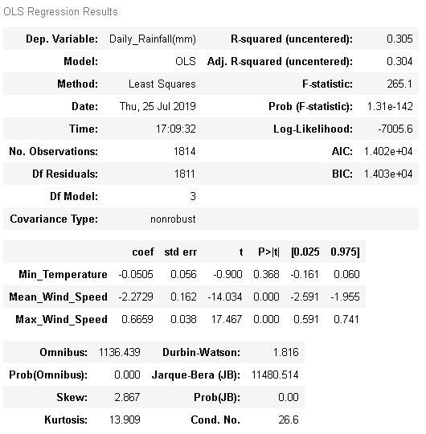
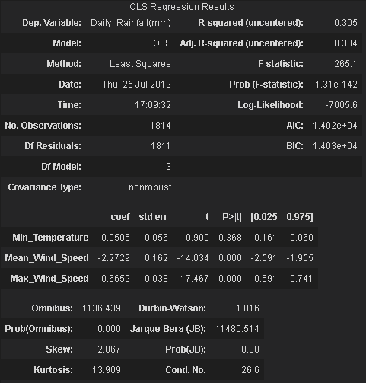
Findings – Model 1
parameters
Date
Daily Rainfall Total (mm)
Highest 30-min Rainfall (mm)
Highest 60-min Rainfall (mm)
Highest 120-min Rainfall (mm)
Mean Temperature (°C)
Maximum Temperature (°C)
Minimum Temperature (°C)
Mean Wind Speed (km/h)
Max Wind Speed (km/h)

Slide 8

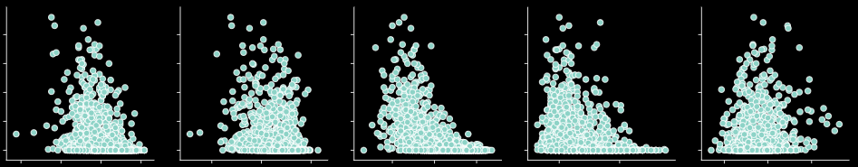
Findings – Collinearity

Slide 9
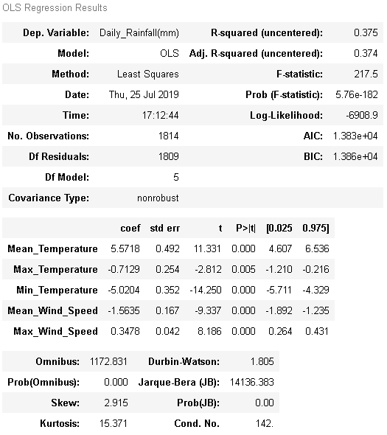
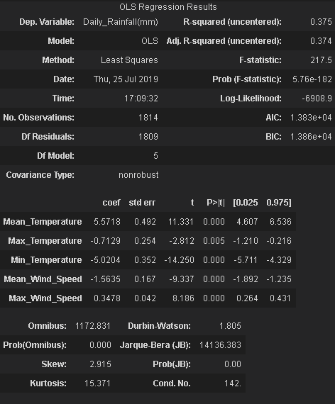
Findings – Model 2
PARAMETERS
Date
Daily Rainfall Total (mm)
Highest 30-min Rainfall (mm)
Highest 60-min Rainfall (mm)
Highest 120-min Rainfall (mm)
Mean Temperature (°C)
Maximum Temperature (°C)
Minimum Temperature (°C)
Mean Wind Speed (km/h)
Max Wind Speed (km/h)

Slide 10
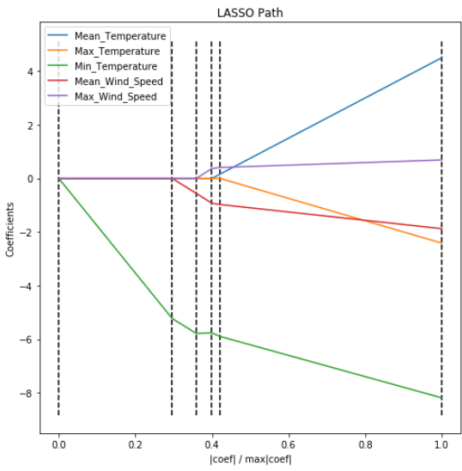
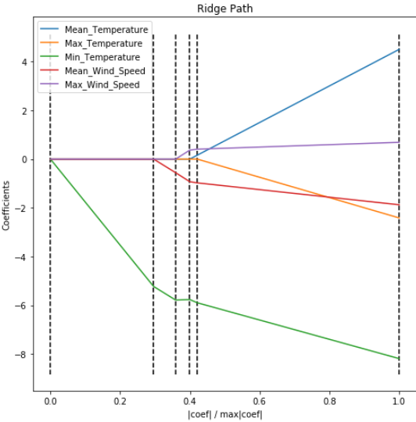
Findings – LASSO vs Ridge Models
LASSO
RIDGE

Slide 11
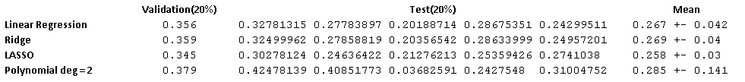
Findings – Model Selection
Approach: TRAINING (60%) vs Validation (20%) vs TEST (20%)
Select Model: Linear Regression

Slide 12
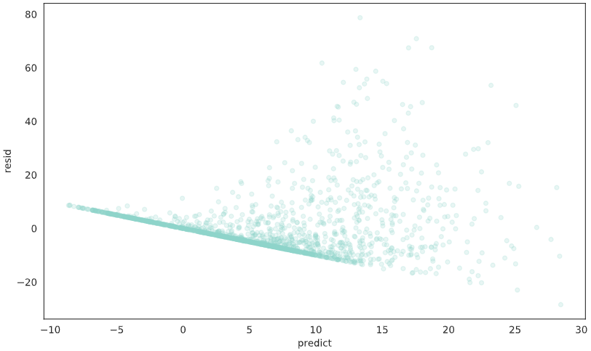
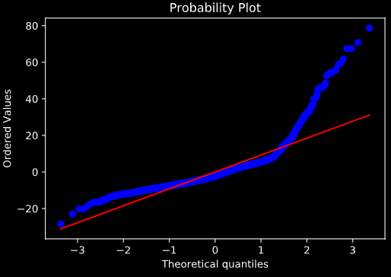
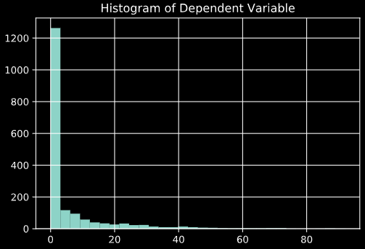
Findings – Linear Regression Model Evaluation
Evaluation: The raw Model cant predict extreme target values

Slide 13
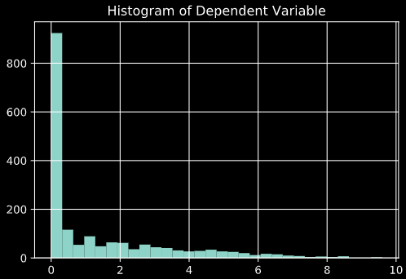
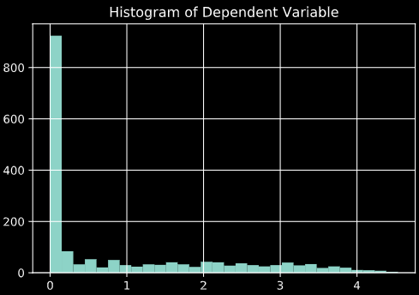
Findings – Model Evaluation
Square root of y
Log y

Slide 14
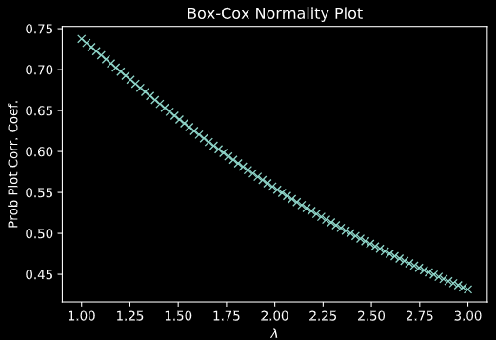
Conclusion
Historical Temperature and Wind Speed alone are good parameters to predict Rainfall at Newton.
Probable reasons:
Cloud movements/weather in surrounding areas.
There is a seasonal/time dimension that is not accounted.
not

Slide 15
Thank you
Regina

Slide 16
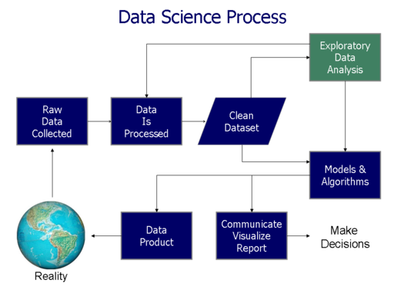
Data Model Process

