Slide 1
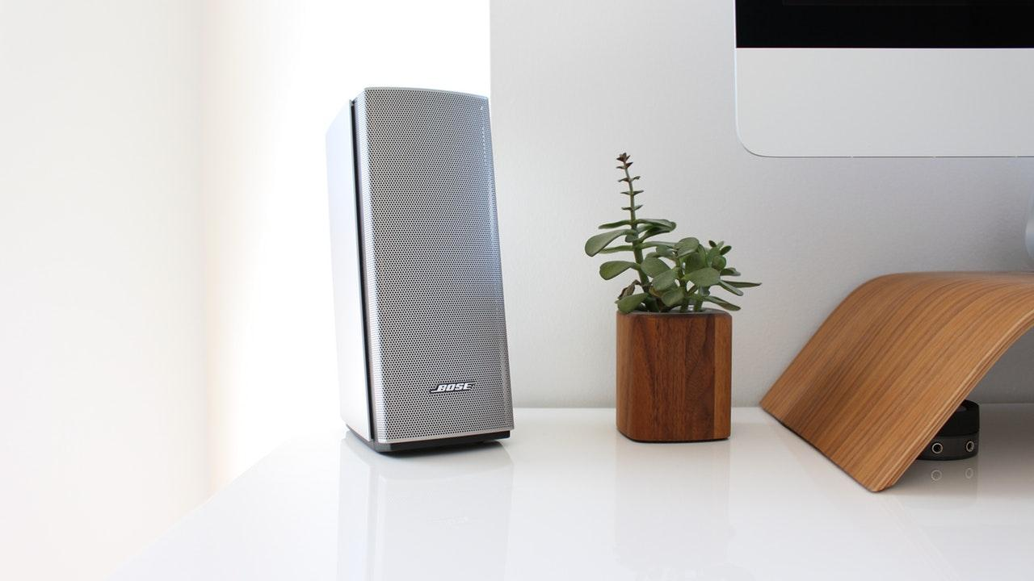
miSPICKy
Regina Cheong
27 Sep 2019

Slide 2
mi-SPICKy
SPICK and span

Slide 3





All adjectives are subjective.
What is messy?
-- Regina Cheong

Slide 4

Multi-class Image classifier
Clean / Tidy room
Messy room
Bad excuse

Slide 5
Process
Models Building
Front end Application
Web-scraping
Dataset Preparation
Model Testing

Slide 6
Web-Scraping
Clean Room
clean bedroom, tidy room, hotel room, clean and neat, declutter
Messy Room
clutter, mess, disorganized room
Bad Excuse
kids’ handwritten note, love letters, handwritten notes
etc..

Slide 7
Web-Scraping
Clean Room
clean bedroom, tidy room, hotel room, clean and neat, declutter
Messy Room
clutter, mess, disorganized room
Bad Excuse
kids’ handwritten note, love letters, handwritten notes
etc..

Slide 8
Web-Scraping
Clean Room
clean bedroom, tidy room, hotel room, clean and neat, declutter
Messy Room
clutter, mess, disorganized room
Bad Excuse
kids’ handwritten note, love letters, handwritten notes
etc..

Slide 9
Dataset Preparation
Models Building
Front end Application
Web-scraping
Dataset Preparation
Model Testing

Slide 10
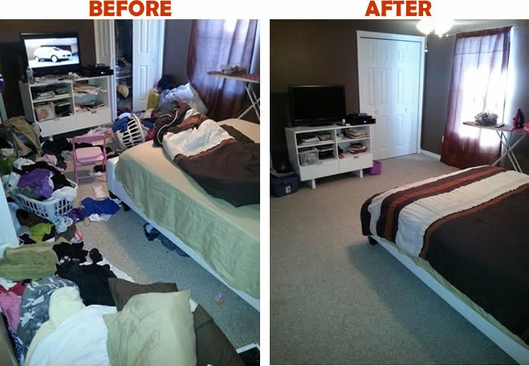
Dataset Preparation

Slide 11


Dataset Preparation

Slide 12
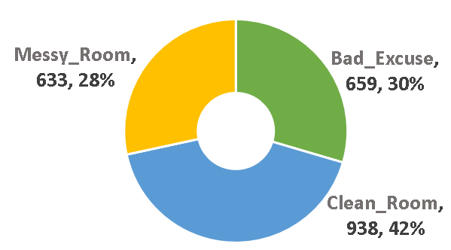
Dataset Preparation

Slide 13


Models Building
Models Building
Front end Application
Web-scraping
Dataset Preparation
Model Testing

Slide 14
Models Building
K-Nearest Neighbors
Gaussian Naive Bayes
Logistic Regression
Support Vector Classifier
Decision Tree
Multi-Layer Perception
Random Forest
XGBoost
Convolutional Neural Network
0.77

Slide 15
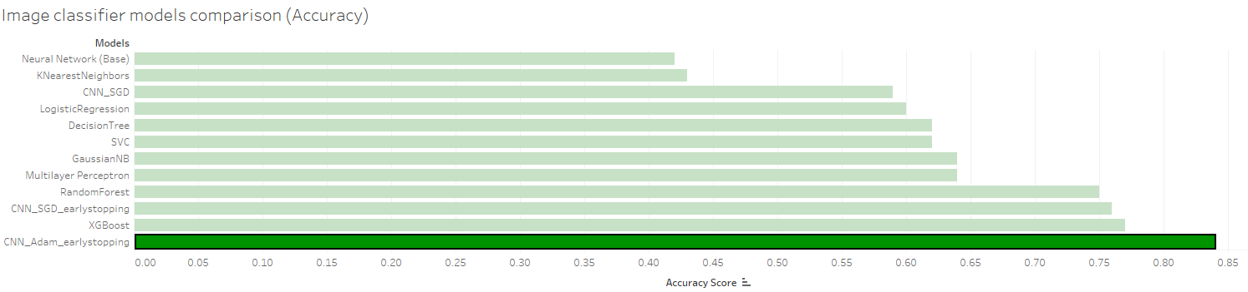
Models Building
CNN_Adam_earlystopping: 0.84

Slide 16
Model Testing
Models Building
Front end Application
Web-scraping
Dataset Preparation
Model Testing

Slide 17


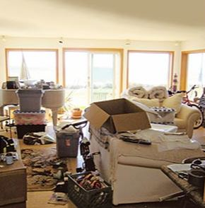
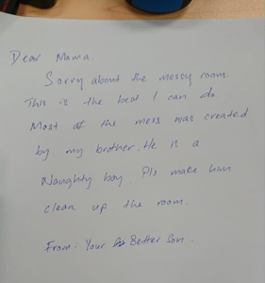
Model Testing
02
Clean Room
03
Messy Room
01
Bad Excuse
100.00%

Slide 18
Model Testing
65.75%
02
Clean Room
03
Messy Room
01
Bad Excuse

Slide 19
Model Testing
02
Clean Room
03
Messy Room
84.28%
01
Bad Excuse

Slide 20

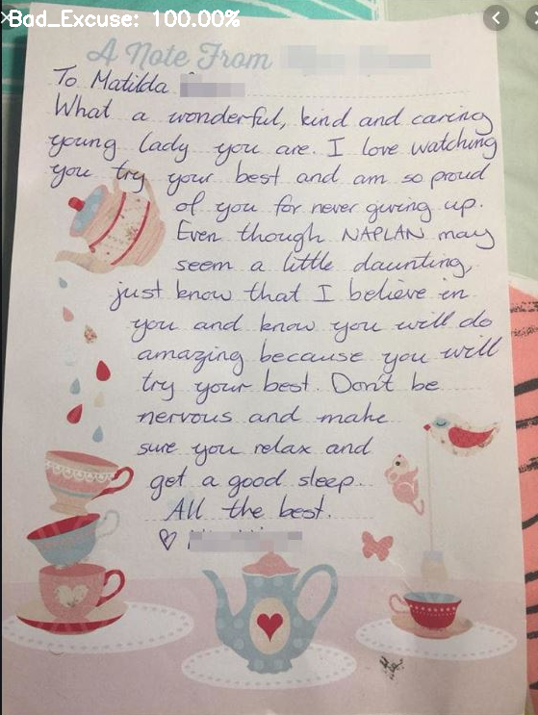
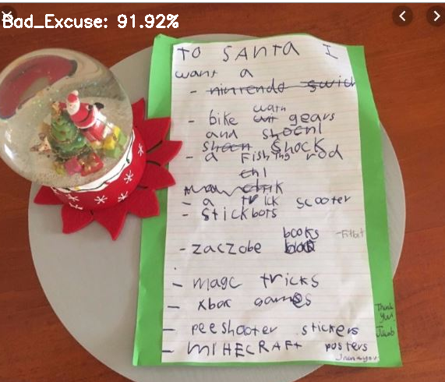
Model Testing
Meet Our Team
91.92%
Bad Excuse
Bad Excuse
100.00%

Slide 21
Front end Application
Models Building
Front end Application
Web-scraping
Dataset Preparation
Model Testing

Slide 22

Front-end Application
miSPICKy

Slide 24
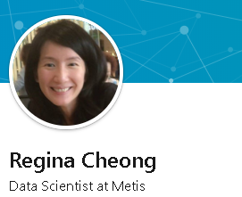





Connect with me
 | https://www.linkedin.com/in/regina-cheong
 | https://github.com/1Regina
 | https://public.tableau.com/profile/regina7068#!/
 | 1reginacheong@gmail.com
 | 98766330

Slide 25

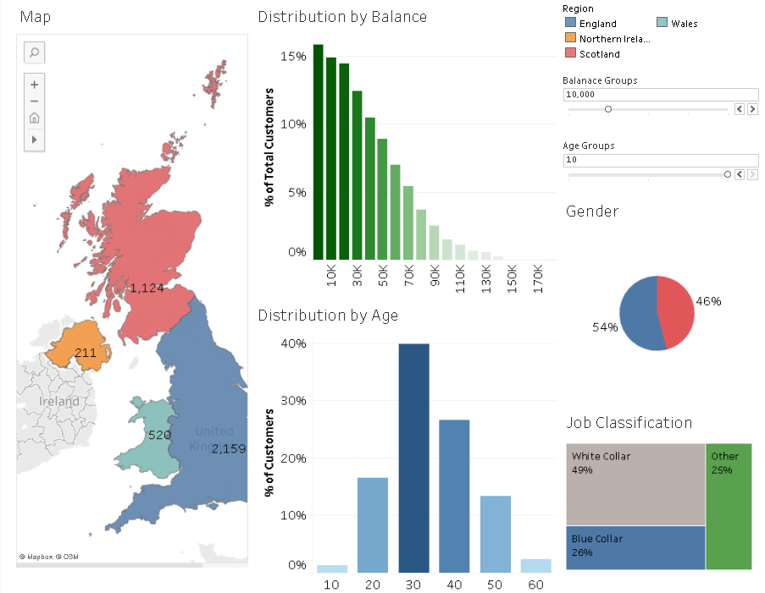
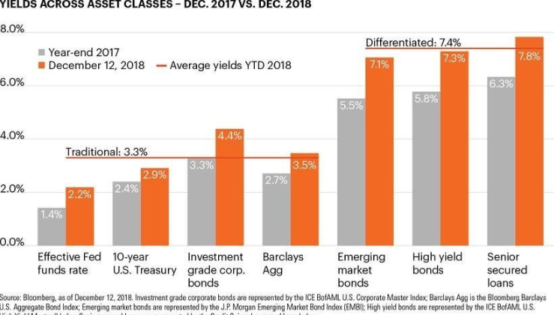

Image Classifier
Thank You
Machine learning and deep learning algorithms
Insights with Tableau
NLP Topic modelling & similarity scoring
Machine learning for investment decision
Regression models
Interactive dashboard on customer segmentation analysis
JD topics & resume matcher
Machine learning models to predict loan default
Regression models to predict rainfall

Slide 26
Front end Demo
miSPICKy
Show and explain your web, app or software projects using these gadget templates.

