Slide 1
Probabilistic attacks against compressed encrypted protocols
Dimitrios Karakostas | Dionysis Zindros | Aristeidis Pagourtzis
Creative Commons 4.0 Attribution

Slide 2
Theoretical background (gzip)
gzip: The most used encryption software in the Internet.
Implements the DEFLATE algorithm:
DEFLATE(m) = Huffman(LZ77(m))

Slide 3
Theoretical background (LZ77)
LZ77: Lossless data compression algorithm, published in 1977 by A. Lempel and J. Ziv.
Method:
Find repeated portions of data.
Replace them with references as [length, offset].
Minimum length = 3.
Maximum offset = 32Kb.

Slide 4
Theoretical background (LZ77)
LZ77 example
Hello, world! I love you.
Hello, world! I hate you.
Hello, world! Hello world! Hello world!
Hello, world! I love you.
(26, 16) hate (21, 5)
(26, 14) (14, 28)

Slide 5
Theoretical background (Huffman)
Huffman coding: Lossless data compression algorithm, proposed by D. Huffman in 1952.
Method:
Analyze the frequency of each letter in the text.
Replace common letters with short codes.
Replace rare letters with long codes.
Code alphabet should be prefix free.

Slide 6
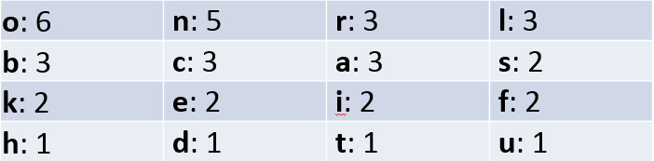
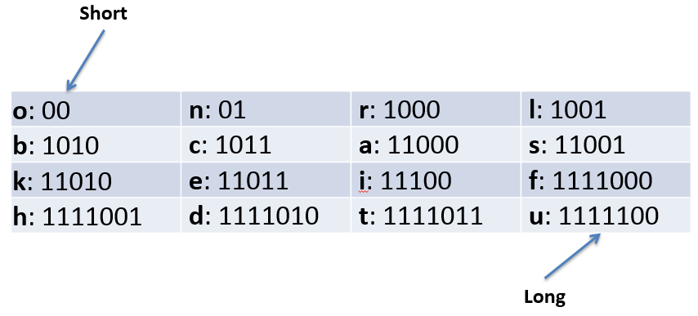
Theoretical background (Huffman)
Huffman example
Frequency analysis:
Code alphabet:

Slide 7
Theoretical background (Same-origin policy)
Same-origin policy: scripts in one page are allowed to access data in a second page if both have the same origin.
Origin: protocol, host and port of a URL.
Documents retrieved from distinct origins are isolated from each other.
i.e. a document retrieved from http://example.com/target.html is disallowed to access the DOM of a document retrieved from https://head.example.com/target.html.

Slide 8
Theoretical background (Same-origin policy)
Attacks on same-origin policy:
Cross-site scripting (XSS): vulnerability that allows an attacker to inject a client-side script into web pages viewed by other users.
Cross-site request forgery (CSRF): exploit that allows the attacker to issue unauthorized requests to a website, on behalf of a user the website trusts.

Slide 9
Theoretical background (TLS)
Transport Layer Security (TLS): protocol that provides security over the internet.
Prevents eavesdropping, tampering or message forgery.
TLS handshake allows the negotiation of a symmetric key via asymmetric cryptography, provided by certificates created by trusted authorities.

Slide 10
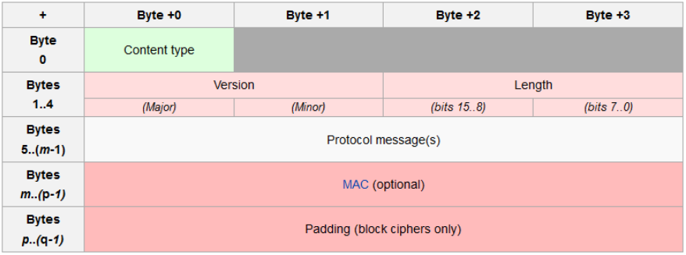
Theoretical background (TLS)
TLS record structure

Slide 11

Theoretical background (MitM)
Man-in-the-Middle: one of the most common attack vectors on modern communications.
Common MitM techniques:
ARP Spoofing: the attacker sends ARP messages, so that its MAC address is associated with the target endpoint’s IP address.
DNS Poisoning: the attacker introduces data into a DNS resolver’s cache, to return incorrect address for the chosen endpoint.

Slide 12
IND-PCPA (PCPA game)
Traditionally, cryptographers have used games for security analysis
IND-CPA, IND-CCA{1,2}
We introduce a new security game:
Indistinguishability under partially chosen plaintext attack (IND-PCPA)

Slide 13
IND-PCPA (PCPA game)
The challenger generates a pair P_{k}, S_{k} and publishes P_{k} to the adversary.
The adversary may perform a polynomially bounded number of encryptions or other operations.
Eventually, the adversary submits two distinct chosen plaintexts M₀, M₁ to the challenger.
The challenger selects a bit b∈{0,1} uniformly at random.
The adversary can then submit any number of selected plaintexts R_{i} , i ∈ N, |R| ≥ 0, and the challenger sends the ciphertext C_{i} = E(P_{k}, M_{b}||R_{i}) back to the adversary.
The adversary is free to perform any number of additional computations or encryptions, before finally guessing the value of b.

Slide 14
IND-PCPA (PCPA game)
A cryptosystem is indistinguishable under partially chosen plaintext attack, if every probabilistic polynomial time adversary has only a negligible advantage on finding b over random guessing.

Slide 15
IND-PCPA
IND-PCPA vs IND-CPA:
The adversary submits the empty string as chosen plaintext.
The challenger then sends back:
C = E(P_{k}, M_{b}||””) = E(P_{k}, M_{b})
which is the challenger response of the IND-CPA game.
Intuitively, if the adversary can beat the game of IND-PCPA, he also has the ability to beat IND-CPA.

Slide 16
IND-PCPA
PCPA scenario on compression-before-encryption protocol:
A system creates:
c = Encrypt(Compress(m))
where c is the ciphertext of the compressed m.
The attacker issues a PCPA creating:
m = n₁||secret||n₂||reflection||n₃
where n₁,n₂,n₃ are random nonces.
If the chosen reflection is the same as the secret, a pattern emerges and the compression is better, possibly resulting in smaller ciphertext, compared to the one of a wrong reflection.

Slide 17
IND-PCPA (PCPA exploits)
CRIME:
[Rizzo, Duong ‘12]
CRIME attacked TLS header compression in HTTPS.
TLS header compression is now disabled.
CRIME is no longer possible.
CRIME set the foundation for compression/encryption attacks.

Slide 18
IND-PCPA (PCPA exploits)
BREACH:
[Prado, Harris, Gluck ‘13]
BREACH was based on CRIME.
BREACH attacks HTTPS response.
Original BREACH attack had specific assumptions:
Against stream ciphers.
No noise in response.
Secret has known prefix, bootstrapping is trivial.

Slide 19
Attack model (Assumptions)
The attacker has gained control of the victim’s network and can view the victim’s encrypted traffic, which can be accomplished by MitM.
The attack script issues requests toward the chosen endpoint from the victim’s browser, i.e. via XSS.
Each request contains a chosen stream of data, which is reflected in the response body, along with the secret.
Compression is applied on both the secret and the reflection.

Slide 20
Attack model
MitM implementation:
We add a rule in the hosts file of the lab machine, in order for all traffic toward an endpoint to be redirected to the localhost.
We implemented a Python MitM proxy, that opens TCP sockets on both the lab machine and the endpoint and forwards traffic on both ends, while parsing the header and (encrypted) body TLS record.
We also implemented a defragmentation mechanism, in order to parse records that span over multiple TCP packets.

Slide 21
Attack model
BREACH script implementation:
The user inputs a known prefix for the secret, needed to bootstrap the attack, and the alphabet that the characters of the secret belong.
An attack vector is created, with each item corresponding to a fragment of the alphabet, where the sum of the fragment makes up the whole alphabet.
A request is issued for each item of the vector every 4 seconds, resuming from the beginning when the end of the vector is reached.
The requests are made in the form of <img> tags, injected in the HTML body of a controlled website.

Slide 22
Attack model
Attack persistence:
We propose a command-and-control mechanism that allows the execution of the attack without the need of a contaminated website, that the victim would visit.
The victim needs to browse the HTTP web.
The attacker that controls the victim’s traffic would inject the attack script in the response from a regular HTTP website.

Slide 23
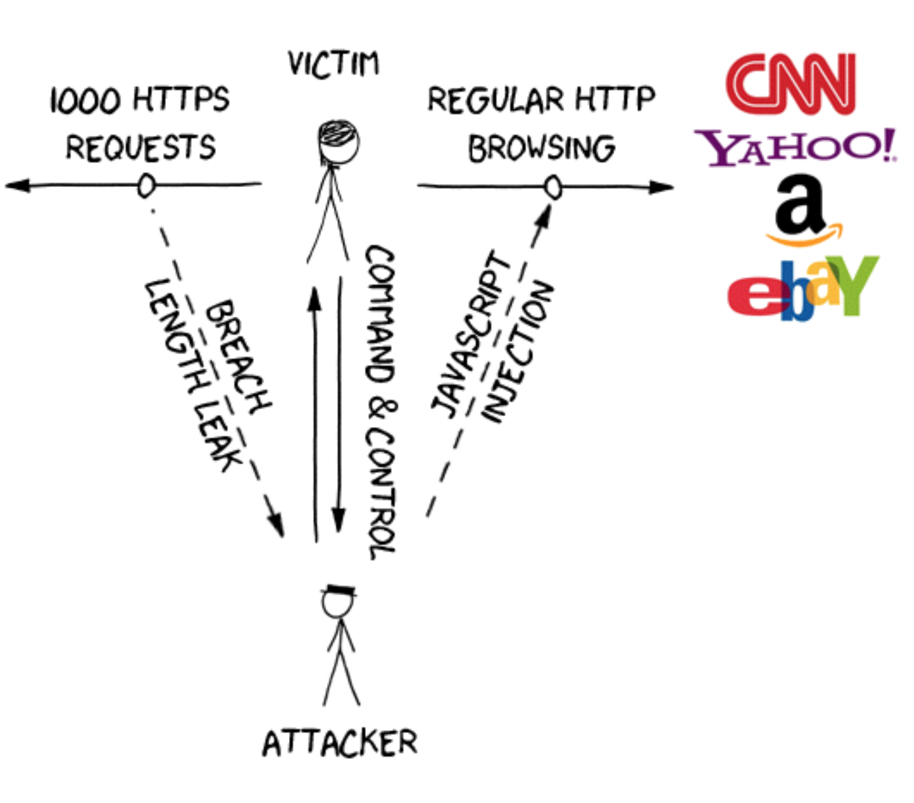

Attack model

Slide 24
Attack model
Vulnerable endpoints:
Facebook Chat messages
Gmail Authentication token
Gmail private emails

Slide 25
Attack model (Facebook Chat messages)
Facebook Chat messages:
Facebook provides a lightweight mobile version, Facebook Touch.
It also allows a search functionality via URL, in the form:
https://touch.facebook.com/messages?q=<search_string>
The search string is reflected in the body of the response.
Also, regardless of the search results, the last message of the 5 most recent conversations is also included in the body.

Slide 26
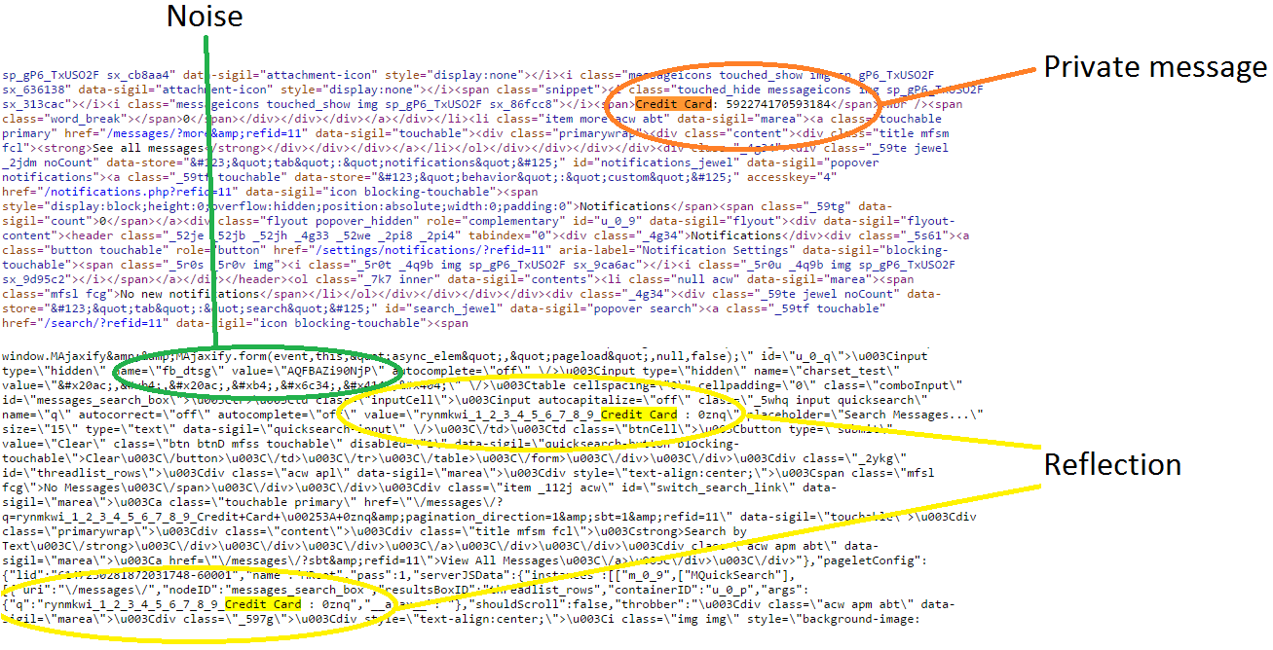
Attack model (Facebook Chat messages)

Slide 27
Attack model (Gmail Authentication token)
Gmail Authentication token:
Gmail provides a plain HTML version for faster browsing, which enables a search functionality as:
https://mail.google.com/mail/u/0/x/?s=q&q=<search_string>
Each request should contain a valid, random-generated string between the 0 and x parameter of the URL.
If no string is included, a redirection to a URL that contains such a string is applied, returning an empty result page, stating the action as incomplete.
However, the HTML body contains both the search string and the authentication token for the account.
Different tokens of different accounts demonstrate a fixed prefix: “AF6bup”.

Slide 28
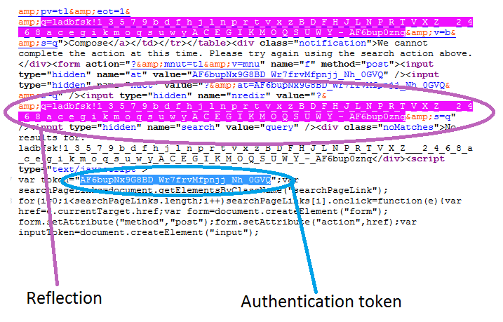
Attack model (Gmail Authentication token)

Slide 29
Attack model (Gmail private emails)
Gmail private emails:
The attacker issues a search request through a URL like:
https://mail.google.com/mail/u/0#search/<search_string>
The response body does not include the search string, however, it contains both the Subject and a fragment of the body of the latest inbox mails.
The attacker could send multiple mails to the victim, that would be included in the response, along with other private mails.

Slide 30
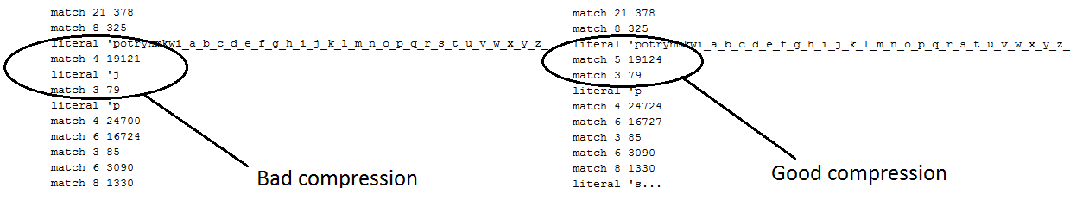
Attack model
Validation of secret-reflection compression:
We use mitmproxy¹, to extract the compressed body of a response that was obtained with the attack.
We use infgen², to disassemble the compressed body to the LZ77 compression of the initial data stream.

Slide 31
Statistical methods (Block ciphers)
Original attacks assumed stream ciphers. e.g. original BREACH assumed RC4.
[Prado, Neal, Gluck] suggested block ciphers are vulnerable, but did not provide practical attack details.
In this work, we perform practical attacks against popular block ciphers:
We attack AES_128 used in Facebook, Gmail, Twitter, Wikipedia, YouTube, Amazon etc.
We have found that the AES implementation in the NSS library displays certain patterns.

Slide 32
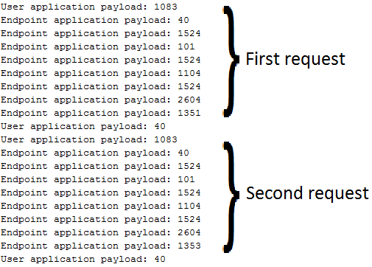
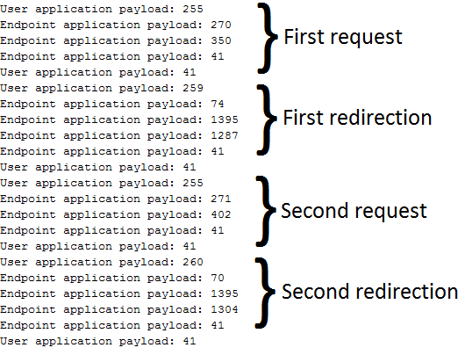
Statistical methods (Block ciphers)
Facebook flow Gmail flow

Slide 33
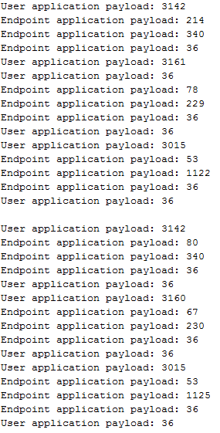
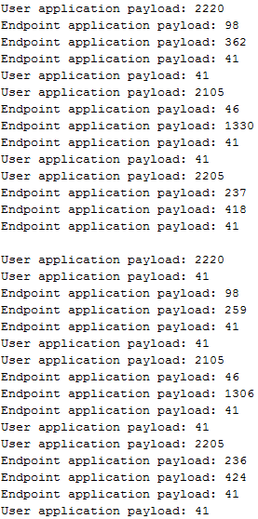
Statistical methods (Block ciphers)
Old browser flow Newer browser flow

Slide 34
Statistical methods (Block ciphers)
We issue a large amount of requests for each item of the attack vector.
We calculate the mean response length for each item.
The correct guess should converge to smaller mean response length, compared to the others.

Slide 35
Statistical methods (Huffman fixed-point)
Huffman tables may be tampered, when different requests are issued.
We describe a methodology to bypass this Huffman-induced noise:
An alphabet pool is created, containing every item in the alphabet of the secret.
In each request, the part of the alphabet that is not being tested is appended in the beginning.
Each request presents same letter frequency, although the text is rearranged.

Slide 36
Statistical methods (Huffman fixed-point)
?q=rynmkwi_1_2_3_4_5_6_7_8_9_Credit Card: 0znq
?q=rynmkwi_0_2_3_4_5_6_7_8_9_Credit Card: 1znq
?q=rynmkwi_0_1_3_4_5_6_7_8_9_Credit Card: 2znq
?q=rynmkwi_0_1_2_4_5_6_7_8_9_Credit Card: 3znq
?q=rynmkwi_0_1_2_3_5_6_7_8_9_Credit Card: 4znq
?q=rynmkwi_0_1_2_3_4_6_7_8_9_Credit Card: 5znq
?q=rynmkwi_0_1_2_3_4_5_7_8_9_Credit Card: 6znq
?q=rynmkwi_0_1_2_3_4_5_6_8_9_Credit Card: 7znq
?q=rynmkwi_0_1_2_3_4_5_6_7_9_Credit Card: 8znq
?q=rynmkwi_0_1_2_3_4_5_6_7_8_Credit Card: 9znq

Slide 37
Statistical methods (Hill-climbing parallelization)
The alphabet partitioning follows a divide-and-conquer scheme.
Example:
The attack vector on digits could be as follows:
[“0 2 4 6 8”, “1 3 5 7 9”]
The correct digit will be compressed with the secret, so the vector item that contains it will present better behavior.
Each stage of the attack outputs a chosen half of the tested alphabet fragment, until the chosen half contains only one digit, which is the correct one.
This method could reduce the time of the attack from O(|S|) to O(log|S|).

Slide 38
Statistical methods (Cross-domain parallelization)
Most websites use subdomains for specific applications, such as mobile versions.
Cookies from the parent domain are available to the subdomains.
If the subdomains handle similar data, containing the chosen secret, the attack could be issued against them.
The parallelization could effectively increase the attack efficiency up to Nx, where N is the number of different subdomains.

Slide 39
Statistical methods (Point-system meta-predictor)
Experiments revealed that the correct guess does not always result in minimum mean response length.
However, the correct item is more probable to be among the best ones over time, compared to the others, that may demonstrate only a spike in performance for a certain period.
For that reason we introduce a point-system that evaluates the performance of each item compared to the others.
1: 20 | 2: 16
3: 12 | 4: 10
5: 8 | 6: 6
7: 4 | 8: 3
9: 2 | 10: 1

Slide 40
Experimental results (Facebook Chat messages)
We created a lab account, that has no friends, no user activity of any kind, except for a self-sent private message, containing the secret.
We choose a prefix to bootstrap the attack, while the alphabet consists of lowercase and uppercase letters.
We issue the attack using the serial method of requests, performing 4000 iterations, with a 4 second interval between requests.
Total time
4000*52*4 = 832000 seconds = 9 days

Slide 41
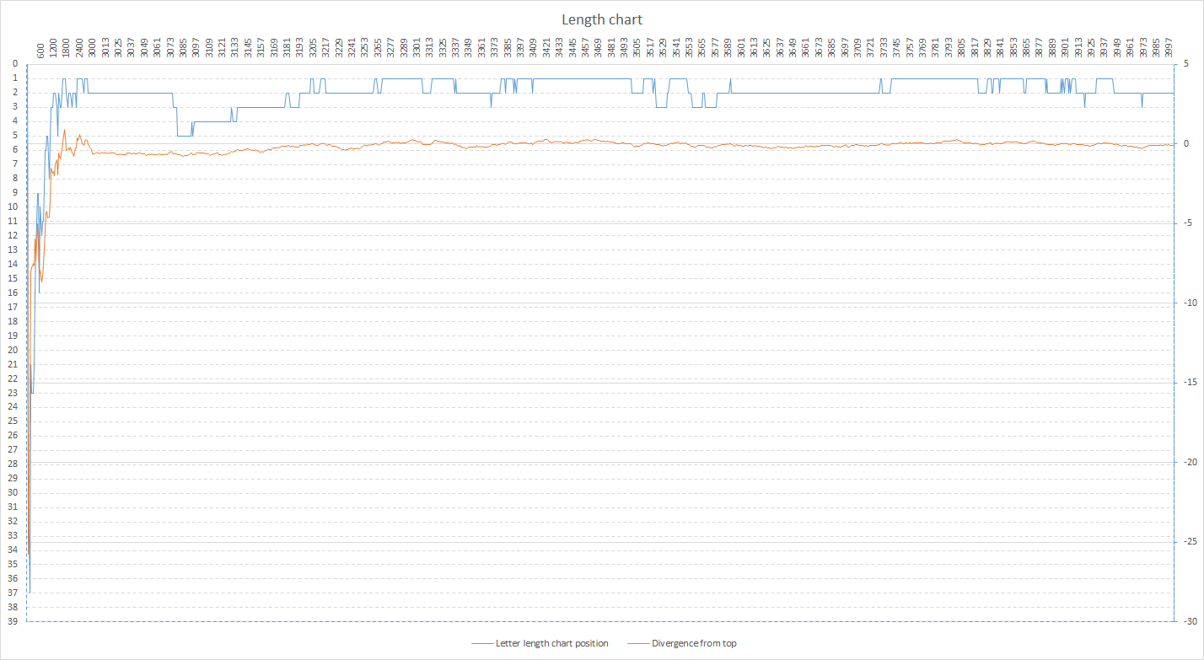
Experimental results (Facebook Chat messages)

Slide 42
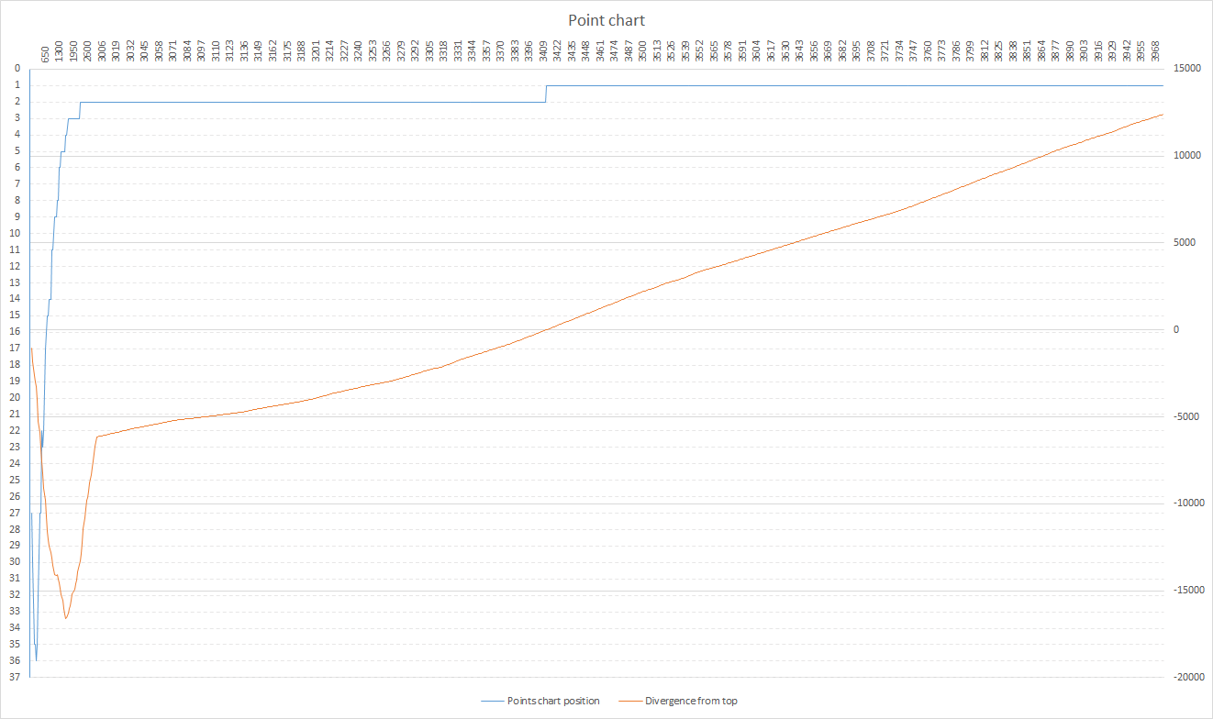
Experimental results (Facebook Chat messages)

Slide 43
Experimental results (Gmail Authentication token)
We use the hill-climbing parallelized attack method to steal the auth token of a regular Gmail account.
The alphabet consists of lowercase, uppercase, digits and dashes, so the stages of the attack are log(64) = 6.
We repeat each stage of the attack, until one of the two halves is chosen 4 times, so at most 7 attempts are made for each stage of the parallelization.
Total time
4000*7*6*4 = 672000 seconds = 7 days

Slide 44
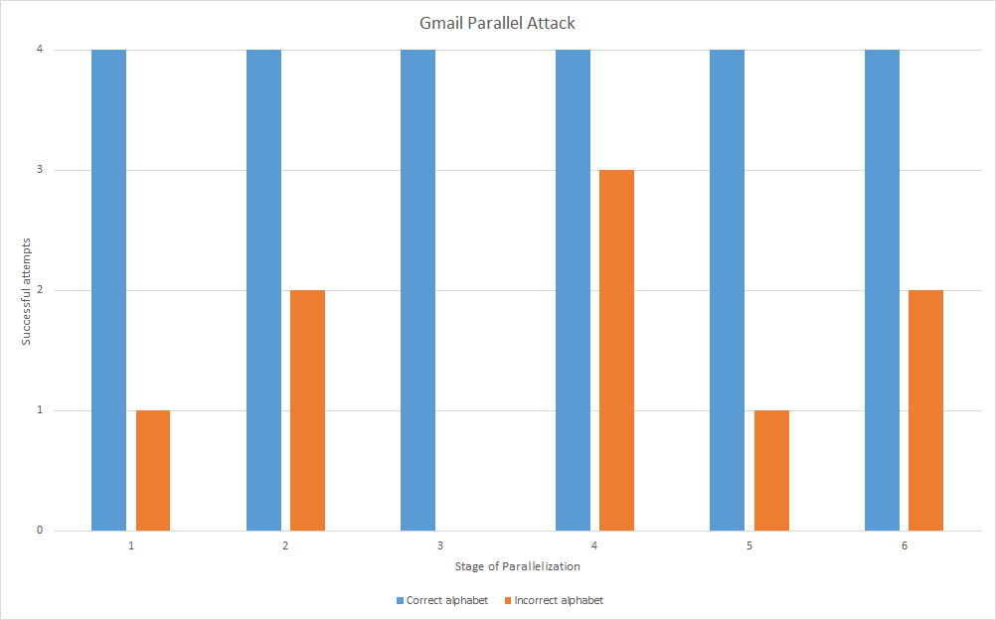
Experimental results (Gmail Authentication token)

Slide 45
Mitigation techniques
[Prado etc.] proposed several mitigation techniques:
Length hiding. In this work, we were able to defeat this mitigation measure through noise by-passing.
Separating secrets from user input. In this work, we were able to defeat this mitigation measure through alternative secrets: Secrets and user input are sometimes one and the same, e.g. private messages.
Masking secrets. This mitigation mechanism is still feasible. But we showed that many more secrets than CSRF tokens must be masked.
Rate limiting and monitoring. This mitigation mechanism is still feasible.
CSRF protection. In this work, we showed that this is not adequate mitigation, as secrets other than CSRF can be stolen.
Disabling compression. While this solves the problem, it is not a practical solution.

Slide 46
Novel mitigation techniques (Compressibility annotation)
We propose that web servers and web application servers cooperate to indicate which portions must not be compressed.
Web application server returns annotated response:
Annotation indicates where secrets are located.
Annotation indicates where reflection is located.
Annotation uses some special format.
Must be implemented separately in every web framework, e.g. Django, Ruby on Rails.
Web server interprets annotated web application server response and changes compression behavior.
Annotated reflections and secrets always sent as literals
Must be implemented separately in web servers, e.g. mod_breach for Apache, Nginx etc.

Slide 47
Novel mitigation techniques (SOS headers)
[Schema, Toukharian ‘13] propose SOS headers as an extension to CSP.
A policy applies to each cookie, specifying whether it should be included in a request.
Policies applied: any, self, isolate
Pre-flight requests are made to check for exceptions.
If trusted websites use HSTS policy and cookies are not included in other cases, the response would not contain the secret.
Complete mitigation of the attack.

Slide 48
Conclusion
Our contributions:
Definition of IND-PCPA
Attack optimization:
Parallelization
Point-system prediction
Attack persistence
Alternative secrets
Experimental results on major systems
Future work:
Mathematical proof for IND-PCPA properties
HTTP injection persistency mechanism
Integration of MitM attacks
Implementation of proxy on TCP level
Implementation of novel mitigation techniques

Slide 49
Thank you! Questions?

