Slide 1
Performance of multiple individual haplotype assembly algorithms
Shuying Sun & Sherwin Massoudian
Department of Mathematics, Texas State University, San Marcos, TX

Slide 2
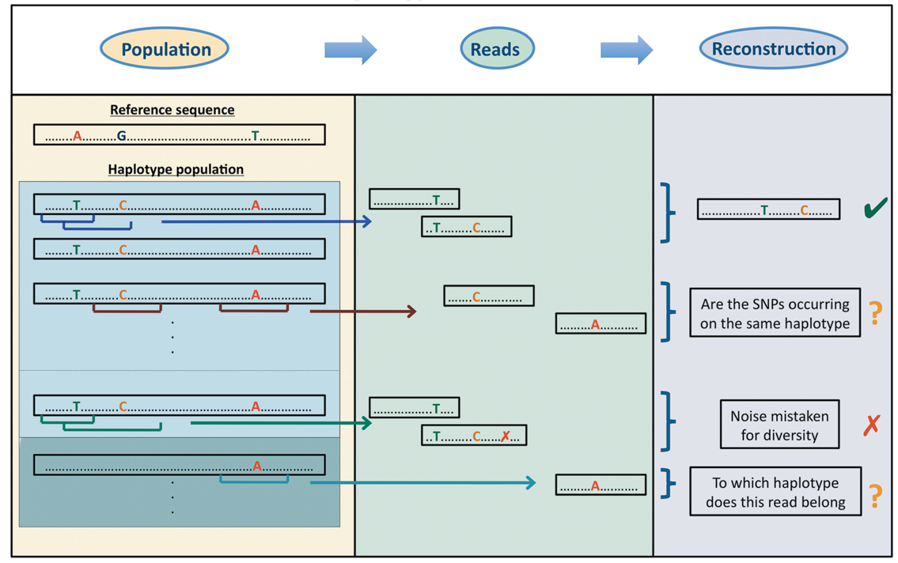
Haplotype assembly
Haplotype Reconstruction
Humans are diploid organisms, having pairs of chromosomes, inheriting one from each parent.
SNP: Single Nucleotide Polymorphism
Haplotype is a set of DNA variants (e.g., SNP) inherited together from one parent (or one chromosome)
Figure 1 of Schirmer 2014: https://www.ncbi.nlm.nih.gov/pubmed/23257116

Slide 3
Importance
It is challenging to conduct haplotype assembly because DNA sequencing datasets are often very large and have complex genetic and technological features.
Haplotype assembly can be used for inheritance analysis, evolutionary selection, study of gene function, medication intervention, ect.
There are about 50 leading Haplotype Assembly Software Packages spanning from 2008 to 2019.
Our main interest is to review the key features used within each algorithm and for comparative purposes.
We’ll show some preliminary comparison results.

Slide 4
Software Packages and Data Sets
MIHA: Multiple Individual Haplotype Assembly
DBM, 2013: A Bayesian Markov model for Phasing and Population Structure Analysis on NGS Data.
HapSeq2, 2013: A HMM based method for both genotype calling and haplotype phasing.
Whatshap, 2015: A read-based phasing or haplotype assembly software that is especially suitable for long reads.
Datasets
5 samples: 826, 827, 832, 847, 850:
Illumina Genome Analyzer IIx [GA2x] paired-end sequencing.
5 samples are unrelated colon cancer patients, designated cancer 1 to 5 in the paper from the link below: https://www.ncbi.nlm.nih.gov/pubmed/22878650

Slide 5
Software: BWA
Input: FASTA reads
Output: SAM format
Software: Samtools 1.9
Input: SAM format
Output: BAM format
Software: Bcftools 1.9
Input: BAM format
Output: VCF file with SNPs
Software: WhatsHap
Input: VCF file with SNPs
Output: VCF file with haplotype
Software: grep, awk, sed
Input: VCF file with SNPs
Output: sample.snps
Software: grep, awk, sed
Input: SNP file and VCF file
Output: sample.counts
Software: DBM &HapSeq2
Input: SNP file and counts file
Output: sample.g

Slide 6
MIHA Running Time

Slide 7
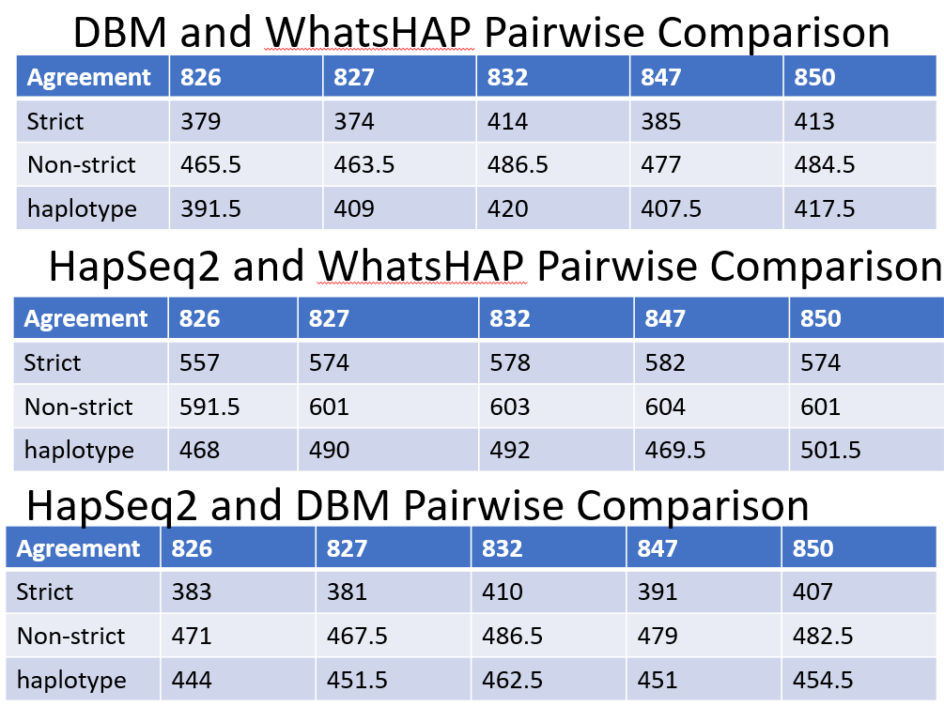
628 total positions - phased >= 20 coverage
Script: PhasingWhatshapHapseqDBM.2020.July.1.txt
WhatsHap and HapSeq2 agree with each other more based on both block and SNV comparisons.

Slide 8
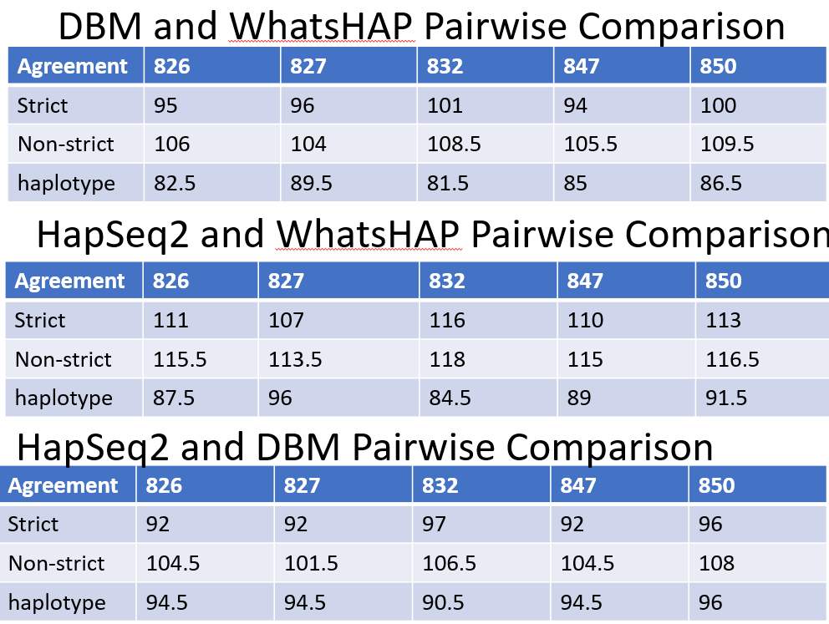
120 total positions on >= 3 samples
Script: Pick3PhasingWhatshapHapseqDBM.2020.July.10.txt
WhatsHap and HapSeq2 agree with each other more based on both block and SNV comparisons.

Slide 9
MIHA Comparison: DBM & Hapseq2
Samples | 826 | 827 | 832 | 847 | 850
Genotype Agreement (Strict) | 49 | 48 | 60 | 45 | 62
Allele agreement (non-strict) | 83.5 | 81.5 | 88.5 | 78 | 87.5
Haplotype agreement | 76.5 | 71.5 | 75.5 | 70.5 | 76.5
120 SNVs are with ≥ 2X coverage and are present in ≥3 of the 5 samples.
DBM and Hapseq2 are run to obtain the haplotypes of these 120 SNVs
In the above table, each cell is the count out of the total 120 SNVs

Slide 10
Conclusion & Discussion
It is vital to compare currently available algorithms.
The 3 MIHA algorithms have a low agreement rate.
One challenge of the comparison analysis is to find suitable real datasets with known haplotypes.
It is also challenging to compare a large number of algorithms.
With some preliminary comparison results, we aim to provide new perspectives on haplotype assembly, which will be helpful for developing more accurate and efficient algorithms.

Slide 11
References
Adams, M. D., Veigl, M. L., Wang, Z., Molyneux, N., Sun, S., Guda, K., Yu, X., Markowitz, S. D., & Willis, J. (2012). Global mutational profiling of formalin-fixed human colon cancers from a pathology archive. Modern pathology : an official journal of the United States and Canadian Academy of Pathology, Inc, 25(12), 1599–1608. https://doi.org/10.1038/modpathol.2012.121
Bonizzoni, P., Dondi, R., Klau, G. W., Pirola, Y., Pisanti, N., & Zaccaria, S. (2016). On the Minimum Error Correction Problem for Haplotype Assembly in Diploid and Polyploid Genomes. Journal of computational biology : a journal of computational molecular cell biology, 23(9), 718–736. https://doi.org/10.1089/cmb.2015.0220
Li, H., & Durbin, R. (2009). Fast and accurate short read alignment with Burrows-Wheeler transform. Bioinformatics (Oxford, England), 25(14), 1754–1760. https://doi.org/10.1093/bioinformatics/btp324
Li H. (2011). A statistical framework for SNP calling, mutation discovery, association mapping and population genetical parameter estimation from sequencing data. Bioinformatics (Oxford, England), 27(21), 2987–2993. https://doi.org/10.1093/bioinformatics/btr509
Patterson, M., Marschall, T., Pisanti, N., Van Iersel, L., Stougie, L., Klau, G. W., & Schönhuth, A. (2015). WhatsHap: weighted haplotype assembly for future-generation sequencing reads. Journal of Computational Biology, 22(6), 498-509.
Zhang, K., & Zhi, D. (2013). Joint haplotype phasing and genotype calling of multiple individuals using haplotype informative reads. Bioinformatics (Oxford, England), 29(19), 2427–2434. https://doi.org/10.1093/bioinformatics/btt418
Zhang Y. (2013). A dynamic Bayesian Markov model for phasing and characterizing haplotypes in next-generation sequencing. Bioinformatics (Oxford, England), 29(7), 878–885. https://doi.org/10.1093/bioinformatics/btt065
Contact Information: Dr. Sun ssun@txstate.edu

