Slide 1
DSI Project 3: Web Scraping and Natural Language Processing

Slide 2
Goals of the project
We are asked access reddit to scrape posts from two subreddits using the reddit API.
Using Natural Language Processing routines, build a model that reads a post and then predicts from which subreddit it originated.

Slide 3
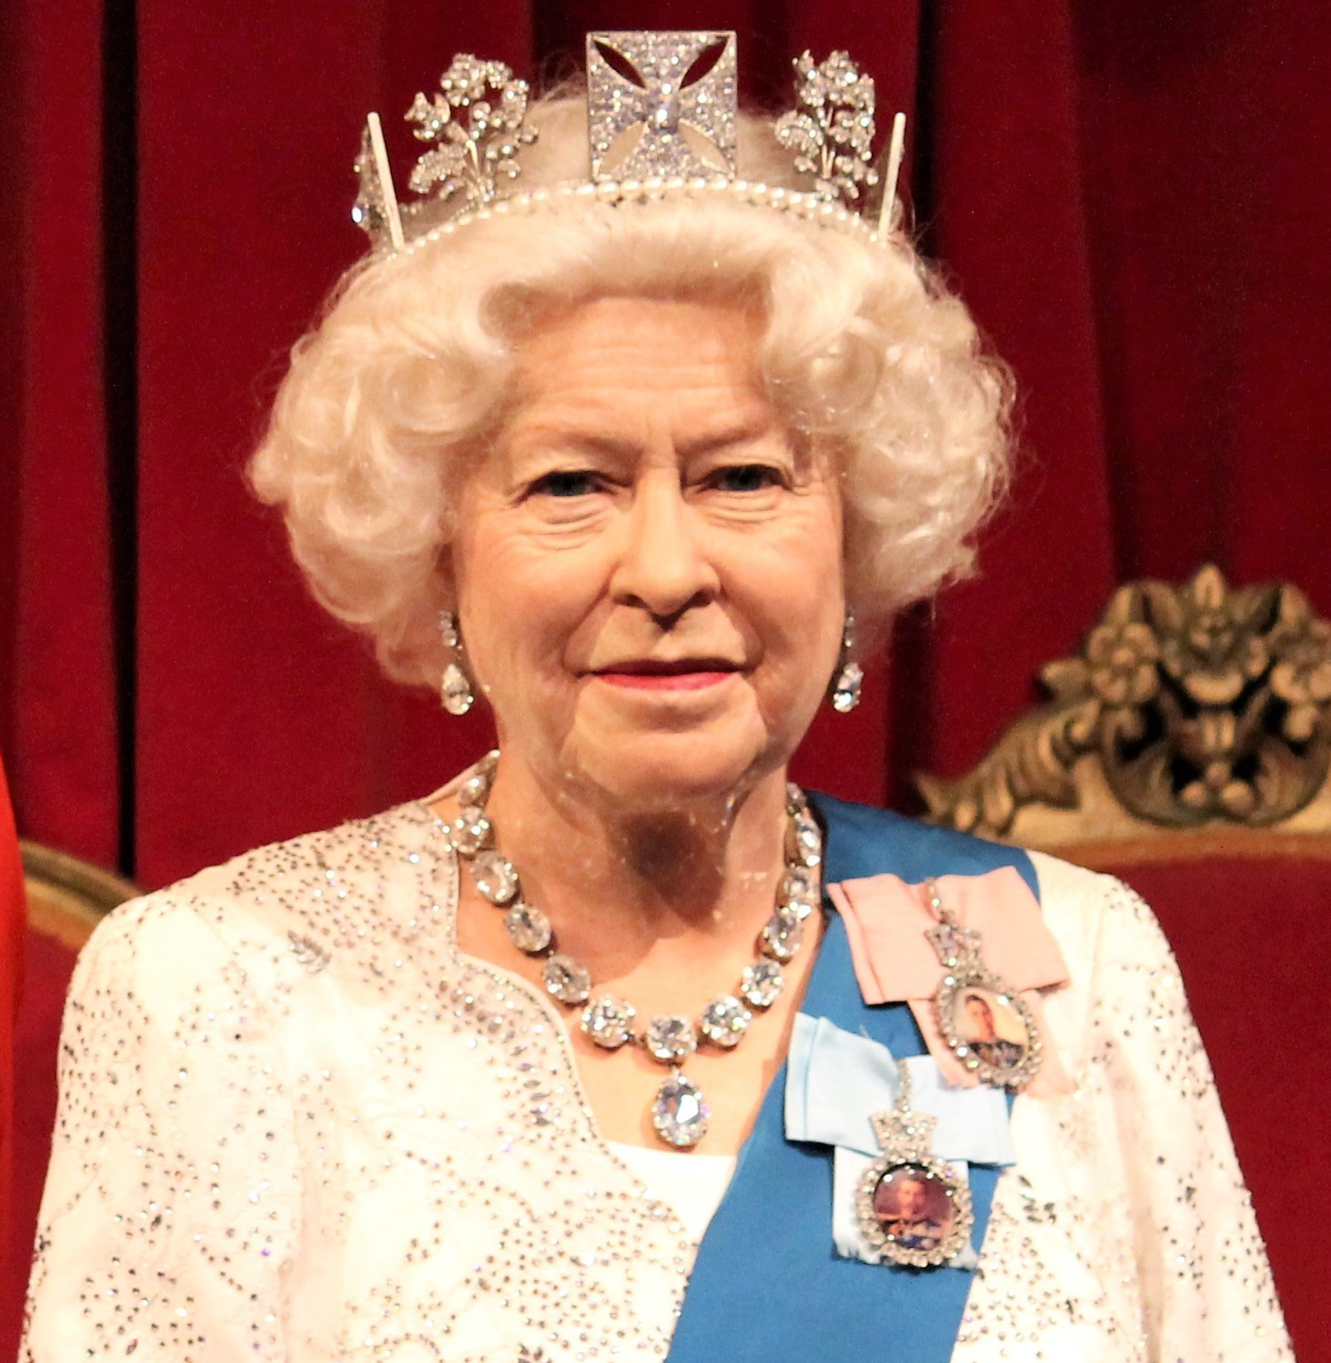
Which subreddit owns the word ‘Queen’?
← Queen? →
r/monarchist
r/rupauldragrace
Photos obtained through subscription from ShutterStock.com

Slide 4
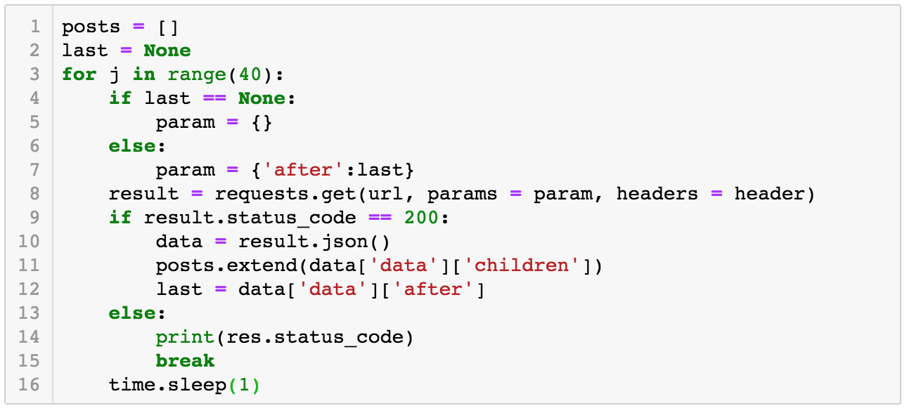
Data sources – scraping code

Slide 5
Limitations on data / availability
The reddit API limits access to the most recent 1,000 posts.
I used the routine multiple times over two weeks to increase the amount of data I gathered
The resulting combined data sets had multiple entries with the same data, so I had to eliminate duplicates using the “.drop_duplicates” method on dataframes.
I also had to reset the indices of the combined data using the “.reset_index” method.

Slide 6
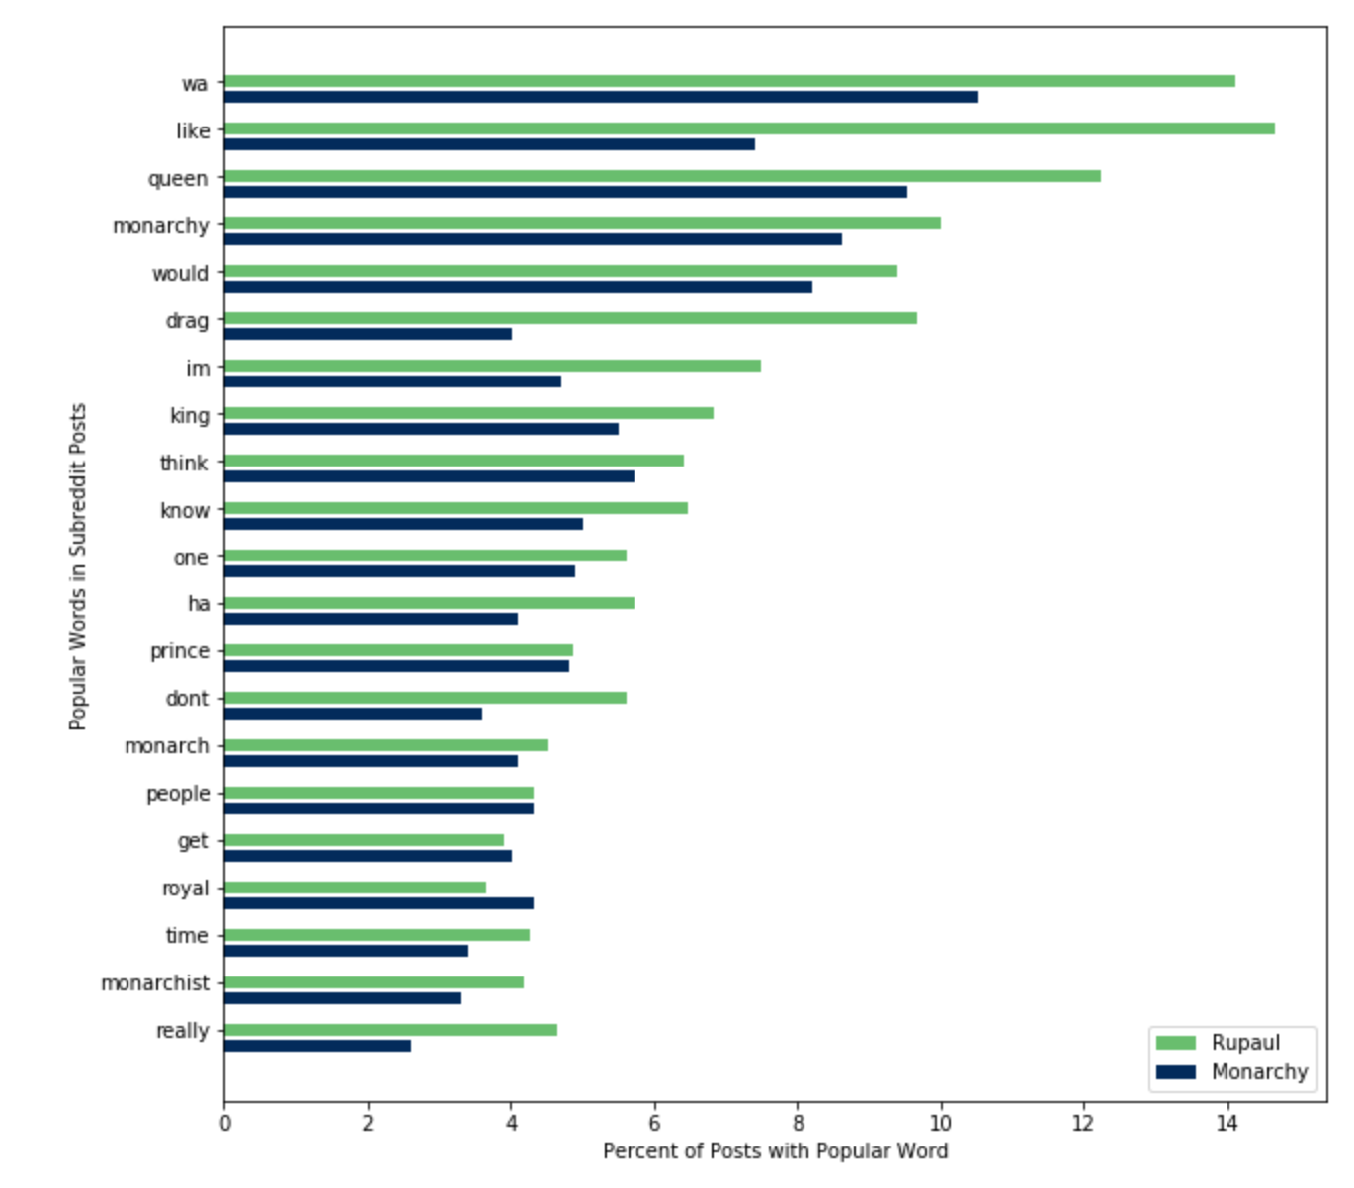
EDA – word frequency
Because I had more posts from one subreddit, I converted word count to the ratio of word count to total posts for that subreddit.

Slide 7
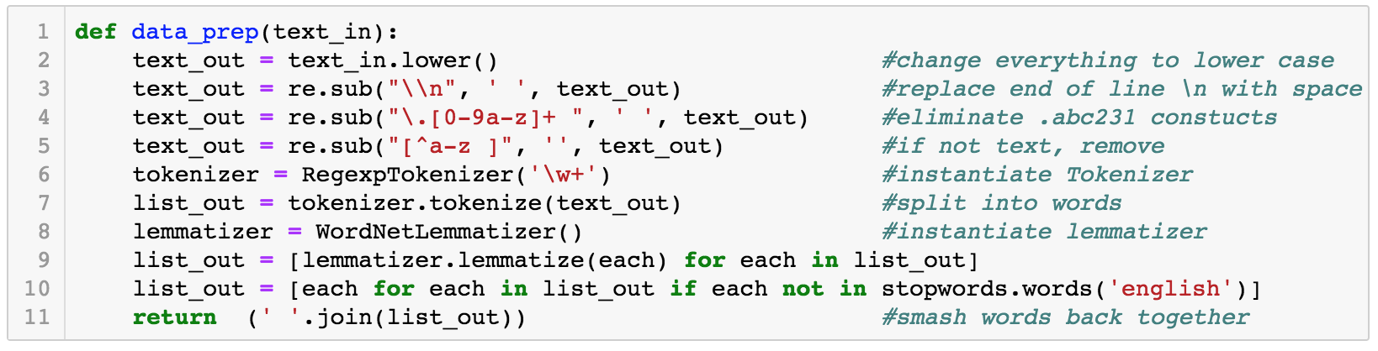
EDA – Data Prep for NLP
I used a variation on the manual data prep routine that was included in one of the NLP labs. It was easier to make sure I understood what was going on with the data. Also, it only needed to be run once on the data rather than each time a model was run.

Slide 8
Models - Overview
I used many classification models to attempt the best fit on the training data and the best predicative power on the test data set.
The model combination that worked best was a Naïve Bayes Multinomial model with a Count Vectorizer.
Final attempts at using sentiment analysis, word count per post, and average length of word per post did not improve results.
Additional data after inital1,000 posts improved model

Slide 9
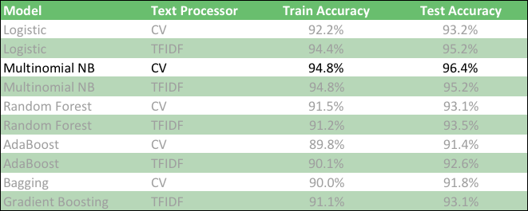
Models – results of fitting and hyper-parameter tuning

Slide 10
Modeling – final observations
Hyper-parameter tuning resulted in 2% - 3% gain in model fit. Ngrams had biggest impact on best model.
Sentiment analysis, word count, and average word length all decreased fit of the best model.
Model assessment was based on accuracy since there was no difference to my uses between Type I and Type II errors
Many of the models had a bias toward Type II errors but NB was almost equal between Type I & II.

Slide 11
Model use
I scrapped a third subreddit, a discussion on the Netflix series The Crown.
Before hyper-parameter tuning, the 60% of the posts were more similar to the Rupaul subreddit.
After final tuning, they were only 55% similar.

Slide 12
Which subreddit does the model predict for the following phrases?
← Queen? →
r/monarchist
r/rupauldragrace

Slide 13
Which subreddit does the model predict for the following phrases?
← Queen? →
r/monarchist
r/rupauldragrace

Slide 14
Which subreddit does the model predict for the following phrases?
← William? →
r/monarchist
r/rupauldragrace

Slide 15
Which subreddit does the model predict for the following phrases?
← William? →
r/monarchist
r/rupauldragrace

Slide 16
Which subreddit does the model predict for the following phrases?
← Willam? →
r/monarchist
r/rupauldragrace

Slide 17
Which subreddit does the model predict for the following phrases?
← Willam? →
r/monarchist
r/rupauldragrace

Slide 18
Which subreddit does the model predict for the following phrases?
← Jujube? →
r/monarchist
r/rupauldragrace

Slide 19
Which subreddit does the model predict for the following phrases?
← Jujube? →
r/monarchist
r/rupauldragrace

Slide 20
Which subreddit does the model predict for the following phrases?
← Jubilee? →
r/monarchist
r/rupauldragrace

Slide 21
Which subreddit does the model predict for the following phrases?
← Jubilee? →
r/monarchist
r/rupauldragrace

Slide 22
Questions / Discussion
Thank you for your attention

