Slide 1
FINAL PROJECT PRESENTATION
GROUP-4 :
Sai Sharath Ponugubati (11507563)
Sravani Vangala (11412414)
Shreshta Poojala (11443949)
Mounica Satraboina (11445213)
Kazi Siddiquee (11390694)
Under the guidance of Ms. Huyen Nguyen and Mr. Haihua Chen

Slide 2
Sentimental Analysis on Rulemaking Comments

Slide 3
What is Sentimental Analysis?
The process of computationally identifying writer’s attitude from the opinions expressed in the form of text towards a particular topic
Types of sentimental analysis:
Fine-Grained
Aspect-Based
Emotion Detection
Intent Analysis

Slide 4
Data Collection
Our project is based on sentiment analysis on rulemaking comments.
For this we are using the official Federal website of United States where the official regulations regarding all rules are updated and are available for public to review and comment their opinions and thoughts.
The link for official website is: https://www.regulations.gov/

Slide 5
Data Collection – Continuation
As there are very wide range of topics in the regulations data, to concentrate on rich data quality, we chose to extract data related to a single topic. That topic is Tobacco Products.
To access the data for web scraping, API authentication is required.

Slide 6
Data Collection – Continuation
Single Layer
Front End web scrapping
This is most common and simple web scrapping way. By this we get all the data currently visible/available on current URL page of the Web. It might miss in depth details like reference links etc.
Multi Layer
Deep Web scrapping
Multi layer web scrapping method is more deep and slower method of scrapping in which we can access reference data usually not present on front page. The website can be 2-layer, 3-layer or more. So, more the layer the more will cost time.
API
3rd Party Web scrapping
This is 3rd party access to any website with very fast and efficient results. Usually big and regulated website have their APIs. For example with “tweeter” API we can get tweets and other tweeter related data.
Our Strategy
We selected API method of web scrapping
The website assign to us was regulation.org which has it’s own API. We selected API method because it’s fast and more efficient.

Slide 7
Python Scrapping
We used Python as scrapping tool and used some python
Libraries to request the content and parse it, by following way:
Use request library to request API against a URL
With this we have content regarding that URL in html format.
Use Beautiful Soup to parse the content got from the API
And then find out the data we are interested in.
Use Json library to convert html data into fine dictionary format
To filter out our data.
Extract all the interested data from dictionary and then store
It into pandas DataFrame.

Slide 8
Data Collection - Continuation
For every rulemaking regulation we have extracted the following attributes:
Docket_Id : the unique identification alpha-numerical code for each regulation which can be used to extract details of that particular regulation.
Comment_Id : the unique identification alpha-numerical code for each comment posted to the respective regulation.
Comment : the posted individual public comments of that respective docket/regulation.
The docket_id and comment_id are both unique from all the data.

Slide 9
Rulemaking Regulations Scraped
FDA-2010-D-0277- Compliance with Regulations Restricting the Sale and Distribution of Cigarettes and Smokeless Tobacco To Protect Children and Adolescents; Availability
FDA-2010-N-0136- Implementation of the Family Smoking Prevention and Tobacco Control Act Request for Comments
FDA-2010-N-0568 – Required Warnings for Cigarette Packages & Advertisements
FDA-2011-N-0493 – Regulations Restricting the Sale and Distribution of Cigarettes and Smokeless Tobacco to Protect Children and Adolescents
FDA-2012-N-0977 – Standards for Pipe Tobacco and Roll-Your-Own Tobacco
FDA-2013-N-0227 – Tobacco Product Manufacturing Practice; Establishment of a Public Docket
FDA-2013-N-0521 – Menthol in Cigarettes, Tobacco Products; Request for Comments
FDA-2015-N-2002 – Clarification of When Products Made or Derived From Tobacco Are Regulated as Drugs, Devices, or Combination Products
FDA-2019-N-2854 - Premarket Tobacco Product Applications and Recordkeeping Requirements

Slide 10
After removal of unneccesary data
FDA-2010-N-0136- 95
FDA-2010-N-0568 – 402
FDA-2011-N-0493 – 30
FDA-2012-N-0977 – 32
FDA-2013-N-0227 – 42
FDA-2013-N-0521 – 140
FDA-2015-N-2002 – 123
FDA-2019-N-2854 – 339
FDA-2010-D-0277- 21

Slide 11
What is Aspect-Based SA?
Text classification technique which categorizes data by aspect and identifying sentiment of each aspect.
What is aspect?
A distinct feature in a comment or text data(in our context)
Types of Aspects:
Implicit Aspects
Explicit Aspects

Slide 12
1
Implicit Aspects
Human-aware sentiment which is not an obvious word but conveys the inner meaning that can be found in the comment.
Example: Cigars, little cigars, and pipe tobacco can hook young people on tobacco products, all of which are detrimental to health.
Aspects: Youth, Health Hazard.
2
Explicit Aspects
An obvious informative sentiment word in the comment that implies the overall comment.
Example: Keep tobacco products away from children and teens!
Aspects: Children , teens

Slide 13
Criteria for identifying aspects
Common words such as Tobacco, cigarettes and Nicotine cannot be used as aspects.
No Nouns and pronouns can be aspects.
Determiners such as ‘a’, ‘an’, ‘the’, ‘for’, ‘few’, ‘more’ should not be included as aspect terms.
Nominal phrases explicity mentioning aspects should be annotated.
Example: I support efforts in protecting children and adolescents from the availability of the sale and distribution of cigarettes.
Here the aspect term should be “sale and distribution” rather than “sale” and “distribution”.
All the occurrences of an aspect term in a sentence must be annotated.

Slide 14
Aspect Polarity
Every aspect in a particular comment should be assigned a polarity based on the sentiment expressed by that comment.
Polarity of the aspect can be identified as:
Positive
Negative
Neutral

Slide 15
Data Annotation
Technique used for adding labels to raw data, to enable the machine learning models to understand human opinions.
Types of annotation we performed on our data:
Sentiment-based annotation
Positive
Negative
Neutral
Aspect- based annotation
Explicit aspects
The data is annotated by 3 individual annotators from our group on sentiment-based annotation based on the comment writer’s attitude towards the rulemaking comment.
Aspect-based annotation is done by two annotators together.

Slide 16
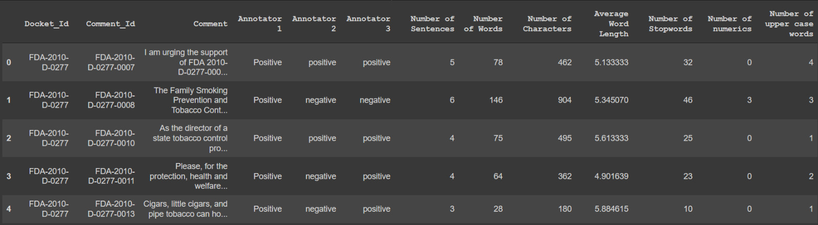
Exploratory Data Analysis (EDA)
Performed EDA to find the number of sentences, number of words, number of characters, average word length, number of stopwords, number of numerics, number of upper case words from each comment.

Slide 17
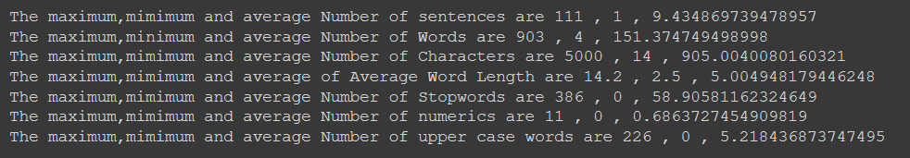
Exploratory Data Analysis: Continued
The maximum, minimum and average of all the data analytics metrics we extracted for each comment, are calculated for the whole data.

Slide 18
Exploratory Data Analysis: Continued
Upon checking the Kappa score, which tells us about the inter-relatability between the annotators, we found the following results:
Kappa value between Annotator 1 and Annotator 2 is 0.86
Kappa value between Annotator 2 and Annotator 3 is 0.71
Kappa value between Annotator 1 and Annotator 3 is 0.85
On the scale of Kappa value range, a kappa value between 0.6-0.8 shows that the annotators have substantial agreement. Also, a kappa value greater than 0.8 shows that there is almost perfect agreement between the annotators. Hence, we see that the annotation data is good enough to be worked on.

Slide 19
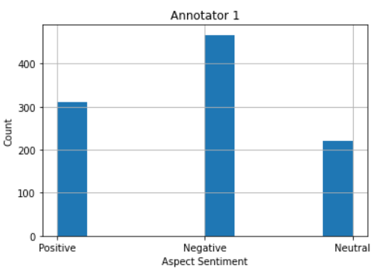
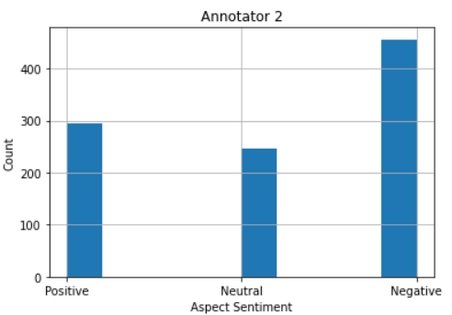
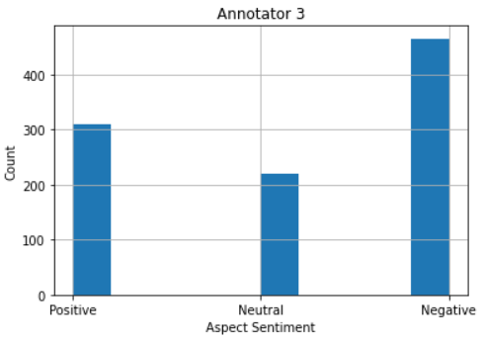
Exploratory Data Analysis: Continued
Understanding the skewness of the data helps us to train the models accordingly to rectify this undersampling/oversampling of the data. When our data was checked for skewness, we found the following pattern:

Slide 20
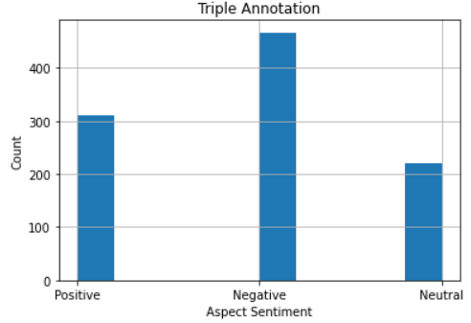
Upon inspecting these graphs, we found that our data is heavily skewed to the negative sentiment side.

Slide 21
Data Pre-Processing
Data Preprocessing is a technique used to enhance the performance of data by transforming the raw data which has noise, missing attribute values, duplicate data etc., into understandable data.
Data preprocessing may have an impact on how the results of the final data processing are understood.
The quality of data can increase the performance of the models and the evaluation metrics values.
Data preprocessing techniques we used in this project are removing punctuations and stopwords, tokenization, lemmatization, stemming, etc.

Slide 22
Sentiment-Based Annotation Result
Annotating the data for three times based on sentiment analysis in three different perspectives.
Annotation1 Annotation2 Annotation3 Result
Positive Positive Negative Positive
Negative Negative Positive Negative
Positive Negative Neutral Neutral
Positive Positive Positive Positive
Negative Negative Negative Negative
Netural Neutral Neutral Neutral

Slide 23
Pre-Processed Data
Regular expressions such as ^,$,\,{,},[,],(,),.,*,+,?,| are used for the advantage of matching with the strings.
These are used to verify the structure, extract substring from structured string, search, replace rearrange the string, splitting the string.
Example: emojis((?::|;|=)(?:-)?(?:\)|\(|D|P)), stopwords punctuations.

Slide 24
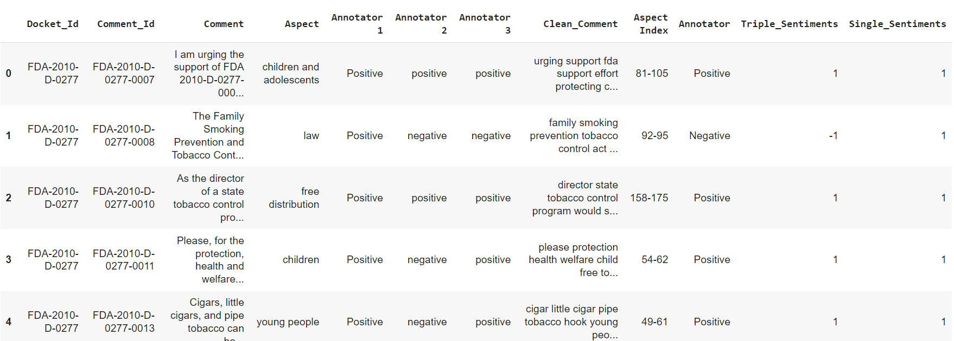
Dataframe after annotation of the aspect and cleaning the comments

Slide 25
Types of Machine Learning Models
Different types of Machine learning models:
Classification Models
Regression Models
Clustering
Dimensionality Reduction
Deep Learning etc.

Slide 26
Model building
Constructed 5 traditional classification machine learning models for two iterations individually i.e., single-annotator input and best of 3-annotator input. The machines were trained on aspect and aspect sentiments in order to identify the sentiment of new aspects
The 5 models constructed were:
Naïve-Bayes pipeline
SVM
Decision Trees
Random Forest
Logistic Regression

Slide 27
Criterion for training models
Train-Test split of the data was decided to be 70:30.
TF-IDF vectorizer was used to vectorise the aspect text.
Stratified 10-fold cross-validation was used to get a more realistic performance evaluation of the models.

Slide 28
Metrics considered:
Precision
Recall
F1-score
Accuracy
Confusion matrix

Slide 29
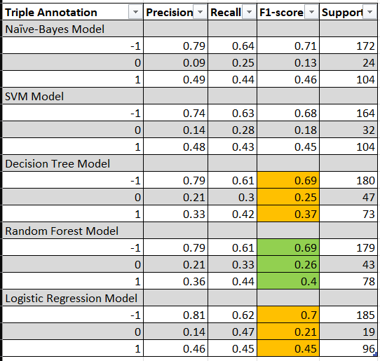
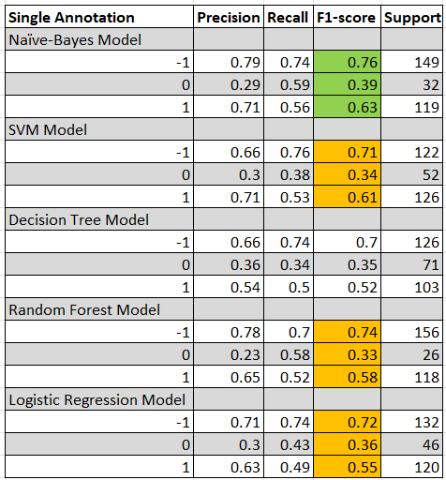

Slide 30
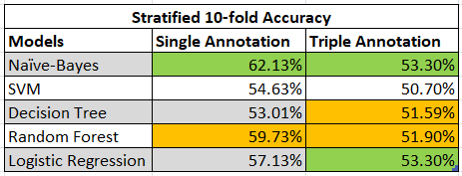

Slide 31
Github Link: https://github.com/Sharath-11507563/Aspect-based-sentimental-analysis-on-Rulemaking-comments
Contributions:
Sai Sharath Ponugubati- EDA and Model building
Sravani Vangala – Aspect identification and sentiment annotation
Shreshta Poojala – Aspect identification and sentiment annotation
Mounica Satraboina - Aspect identification and sentiment annotation
Kazi Siddiquee – Data Collection

Slide 32
THANK YOU

