Slide 1
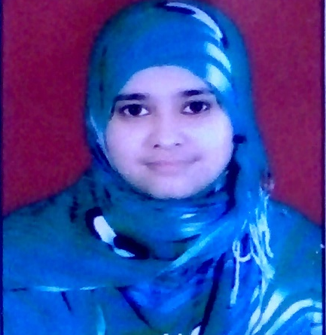

Shahzadi Begum Shaikh Rafique
Bachelor of Technology.
Computer Science And Engineering: (2018-2021)
Certifications: RHCSA and Some Certifications done from coursera
Analyst/Software Engineer
Mumbai
SHAHZADI-BEGUM.SHAIKH@CAPGEMINI.COM
+91 9623468994
A4
Skills
C# | C#Basics,OOPS,Generics Collections,Array,Loops,LINQ
.NET | ADO.NET,ASP.NET with MVC5 and WEB API,Entity Framework
Database | Basic SQL Server
UI Tech | HTML 5 & CSS 3, JavaScript,Angular.
Tools | Git,Visual Studio,Visual Studio Code.
Add On skills | Python
Full Stack Developer :
Hands on experience on GitHub,SQL Server, C#,JavaScript Basics,HTML,CSS,TypeScript Baiscs,Angular.
Some basic experience in Linux, AWS, Word Press, C++ and in Python
Developing web pages using HTML5, CSS3,JavaScript,TypeScript,Angular
Understanding of Oops Concept
Completing the course on Azure Fundamentals.
Audio Book :
Using Python language created Audio Book’s backend part to convert pdf files into audio files.
Flight Booking System :
Completed case study on Online Flight Booking System which is a web based system where passenger can easily do Signup,Login, Searching Flight then Ticket booking after that one reference number is generated using that number can check the details of the passenger.
Created this system using Angular as frontend Webapi dot net core as backend and using SQL for store the details of the passenger.
https://github.com/Shahzadi-Shaikh
Video Link :

